Slide 1
Rules and Expert Systems

Slide 2
Rule Based Production Systems
A production system is a system that uses knowledge in the form of rules to provide diagnoses or advice on the basis of input data.
The system consists of a database of rules (knowledge base), a database of facts, and an inference engine which reasons about the facts using the rules.

Slide 3
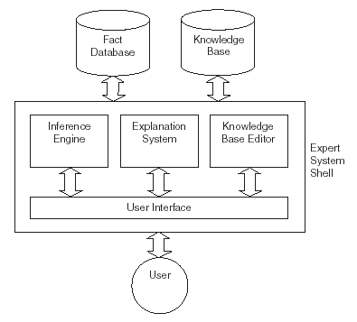
Expert Systems
An expert system uses expert knowledge derived from human experts to diagnose illnesses, provide recommendations and solve other problems.

Slide 4
Forward Chaining
Forward chaining is a reasoning model that works from a set of facts and rules towards a set of conclusions, diagnoses or recommendations.
When a fact matches the antecedent of a rule, the rule fires, and the conclusion of the rule is added to the database of facts.

Slide 5
Example (Forward Chaining)
Man(W) → Dislikes(Snoopy, W)
Close_to(Z,DormG) → Meets(Snoopy, Z)
T→Man(John)
{Z/John}
T→Close_to(John, DormG)
{W/John}
T→Dislikes(Snoopy, John)
(1)
(2)
T→Meets(Snoopy, John)
(3)
Dog(X) ^ Meets(X,Y)^Dislikes(X,Y) → Barks_at(X,Y)
T→Dog(Snoopy)
(4)
Meets(Snoopy,Y)^Dislikes(Snoopy,Y) → Barks_at(Snoopy,Y)
{Y/John}
(5)
Meets(Snoopy,John) → Barks_at(Snoopy,John)
?
Barks_at(Snoopy,John)→ False
T→Barks_at(Snoopy,John)

Slide 6
Backward Chaining
In cases where a particular conclusion is to be proved, backward chaining can be more appropriate.
Works back from a conclusion towards the original facts.
When a conclusion matches the conclusion of a rule in the database, the antecedents of the rule are compared with facts in the database.

Slide 7
Example (Backward Chaining)
Barks_at(Snoopy,John)→ False
Dog(X) ^ Meets(X,Y)^Dislikes(X,Y) → Barks_at(X,Y)
{X/Snoopy, Y/John}
Dog(Snoopy) ^ Meets(Snoopy,John)^Dislikes(Snoopy,John) → F
T → Dog(Snoopy)
Meets(Snoopy,John)^Dislikes(Snoopy,John) → False
Close_to(Z,DormG) → Meets(Snoopy, Z)
{Z/John}
Close_to(John,DormG)^Dislikes(Snoopy,John) → False
True → Close_to(John, DormG)
Dislikes(Snoopy,John) → False
Man(W) → Dislikes(Snoopy, W)
{W/John}
Man(John) → False
True → Man(John)
True → False

Slide 8
Conflict Resolution 牴觸的規則
Sometimes more than one rule will fire at once, and a conflict resolution strategy must be used to decide which conclusions to use.
One strategy is to give rules priorities and to use the conclusion that has the highest priority.
Other strategies include applying the rule with the (a) longest antecedent, or applying the rule that was (b) most recently added to the database.
(1) 天氣好,睡得好,工作不忙→ 去打球； vs.“吃飽飯→不打球”
(2) 男生,穿拖鞋,靠近女生宿舍→小花吠; vs.“吃飯中→不吠人”
Priority?

Slide 9
Meta Rules
The rules that determine the conflict resolution strategy are called meta rules.
Meta rules define knowledge about how the system will work.
For example, meta rules might define that (c) knowledge from Expert A is to be trusted more than knowledge from Expert B.
Meta rules are treated by the system like normal rules, but are given higher priority.

Slide 10
Knowledge Engineering
A knowledge engineer takes knowledge from experts and inputs it into the expert system. (擷取)
A knowledge engineer will usually choose which expert system shell to use. (實現)
The knowledge engineer is also responsible for entering meta-rules. (整合)
Expert System (Rule Based Production System)
只是後來所謂「知識工程」的一個小部份

