Slide 1
Fuzzy Reasoning

Slide 2
Expert System (Forward Chaining Case)
Recall:
Forward chaining is a reasoning model that works from a set of facts and rules towards a set of conclusions, diagnoses or recommendations.
When a fact matches the antecedent of a rule, the rule fires, and the conclusion of the rule is added to the database of facts.

Slide 3
Example (Forward Chaining)
Recall:
Man(W) → Dislikes(Snoopy, W)
Close_to(Z,DormG) → Meets(Snoopy, Z)
Man(John)
{Z/John}
Close_to(John, DormG)
{W/John}
Dislikes(Snoopy, John)
Meets(Snoopy, John)
Dog(X) ^ Meets(X,Y)^Dislikes(X,Y) → Barks_at(X,Y)
Dog(Snoopy)
Meets(Snoopy,Y)^Dislikes(Snoopy,Y) → Barks_at(Snoopy,Y)
{Y/John}
Meets(Snoopy,John) → Barks_at(Snoopy,John)
Barks_at(Snoopy,John)

Slide 4
Conflict Resolution 牴觸的規則
Recall:
Sometimes more than one rule will fire at once, and a conflict resolution strategy must be used to decide which conclusions to use.
One strategy is to give rules priorities and to use the conclusion that has the highest priority.
Other strategies include applying the rule with the (a) longest antecedent, or applying the rule that was (b) most recently added to the database.
(1) 天氣好,睡得好,工作不忙→ 去打球； vs.“吃飽飯→不打球”
(2) 男生,穿拖鞋,靠近女生宿舍→小花吠; vs.“吃飯中→不吠人”
Priority?

Slide 5
Meta Rules
Recall:
The rules that determine the conflict resolution strategy are called meta rules.
Meta rules define knowledge about how the system will work.
For example, meta rules might define that (c) knowledge from Expert A is to be trusted more than knowledge from Expert B.
Meta rules are treated by the system like normal rules, but are given higher priority.

Slide 6
Contents
讀書幾個小時、手上工作幾件、
氣溫幾度、距離幾公尺、etc…
Fuzzy Sets
  Membership Functions
Fuzzy Set Operation
  e.g. A ∩ B (single-domain)
Linguistic Variables
  Linguistic Hedges (副詞修飾)
Fuzzy Logic Operation
  e.g. P ^ Q (inter-domain variables)
Fuzzy Inference System
  Fuzzification, Defuzzification
希臘文明始於邏輯與集合：
以事件是否屬於某個集合
來表示命題之真假
e.g. 愛玩 ∩ 用功
IF (天氣溫暖) AND (工作不忙)
THEN (去打球)
Case 2: Close_to..
(1) Fire Strength of Rules
(2) Conflict / Redundant

Slide 7
Fuzzy Sets
A crisp set is a set for which each value either is or is not contained in the set.
For a fuzzy set, every value has a membership value, and so is a member to some extent.
The membership value defines the extent to which a variable is a member of a fuzzy set.
The membership value is from 0 (not at all a member of the set) to 1.

Slide 8
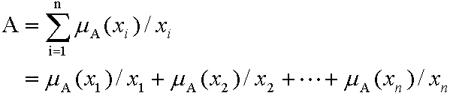


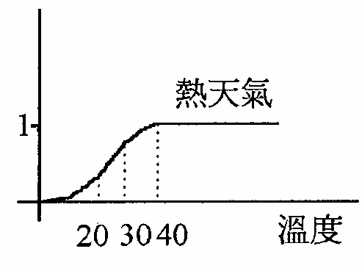
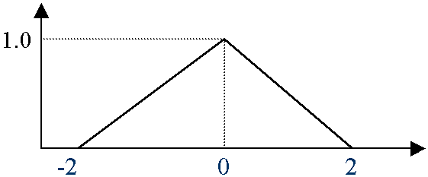
Discrete vs. Continuous Sets
Discrete Fuzzy Set
  “工作忙(正整數．件數)”,
  “中醫所謂燥熱食物(列舉)”
  “ 男生?” {0.9/John, 0.99/Bob, 0.01/Angle…}
Continuous Fuzzy Set
  “天氣熱”,
  “穩定性好”
  “車速快”,
事件的量測值是 x 則屬於 A 集合的程度為μ_{A}(x)
Note: 只是借用積分符號, 沒有dx記號

Slide 9
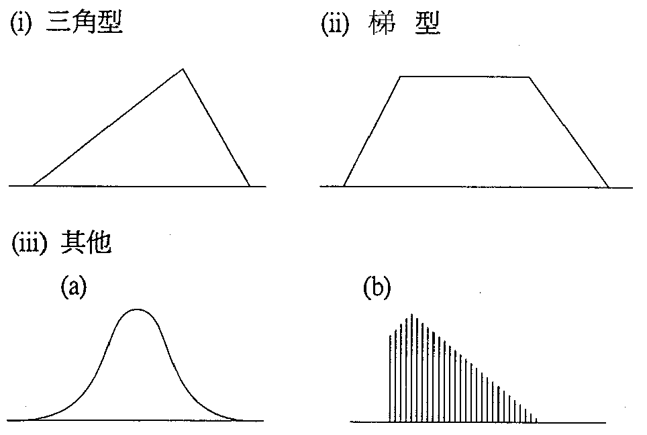
隸屬函數(Member Function)的常見型式：
Figure by 中研院資訊所許鈞南老師

Slide 10
Crisp Set Operators
Not A – the complement of A, which contains the elements which are not contained in A.
A ∩ B – the intersection of A and B, which contains those elements which are contained in both A and B.
A ∪ B – the union of A and B which contains all the elements of A and all the elements of B.
Fuzzy sets use the same operators, but the operators have different meanings.

Slide 11
Fuzzy Set Operators
Fuzzy set operators can be defined by their membership functions
  μ_{¬A}(x) = 1 - μ_{A}(x)
  μ_{A ∩ B} (x) = MIN (μ_{A} (x), μ_{B} (x))
  μ_{A ∪ B} (x) = MAX (μ_{A} (x), μ_{B} (x))
We can also define containment (subset operator):
  B ⊂ A iff ∀x (μ_{B} (x) ≤ μ_{A} (x))

Slide 12
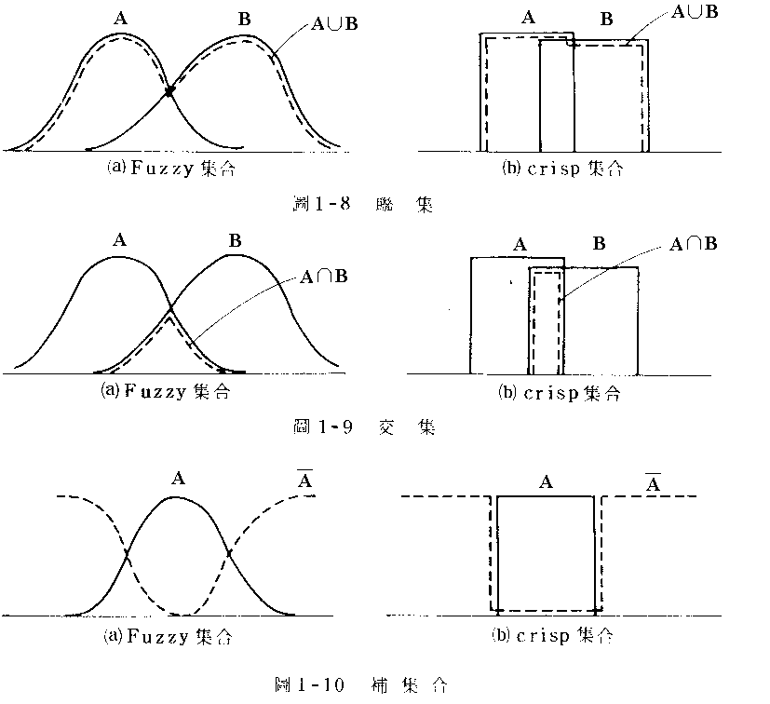
會玩的同學,每天唸書 2~4小時
會唸書的同學,每天唸書3~6小時
Crisp set: 不能多也不能少
Example: 每天用功時間
  A: 會玩，B:會唸書
這三者最基本常用的運算公式為“標準運算”：
  交集 (Intersection)
  (A∩B)(x) = min(A(x), B(x))
  聯集 (Union)
  (A∪B)(x) = max(A(x), B(x))
  補集 (Complement)
  Ā(x) = 1 - A(x)
Figure by 中研院資訊所許鈞南老師

Slide 13
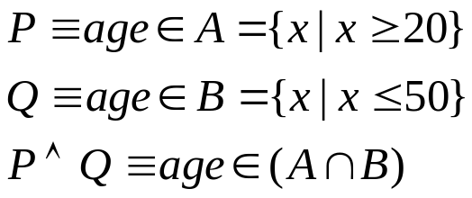
Contents
邀保對象:
Fuzzy Sets
  Membership Functions
Fuzzy Set Operation
  e.g. A ∩ B (within the same domain)
Linguistic Variables
  Linguistic Hedges
Fuzzy Logic Operation
  e.g. P ^ Q (distinct-domain variables)
Fuzzy Inference System
  Fuzzification, Defuzzification
成年人
年輕人
IF (天氣溫暖) AND (工作不忙)
THEN (去打球)

Slide 14
Linguistic Variables
Variables used in fuzzy systems to express qualities such as height,
  which can take values such as
  “tall”, “short” or “very tall”.
These values define subsets of the universe of discourse. (對談的元素)

Slide 15
Linguistic Hedges
A hedge is a qualifier
  such as “very”, “quite”, “somewhat” or “extremely”
  applied to create a new fuzzy set
  Mathematic functions are usually used
Examples:
  μ_{not_A} (x) = 1-(μ_{A} (x))
  μ_{very_A} (x) = (μ_{A} (x))²
  μ_{more_or_less_A} (x) = (μ_{A} (x))^{0.5}

Slide 16


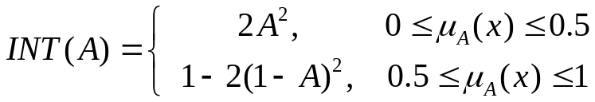
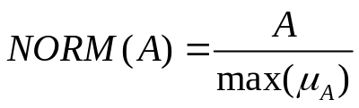
Concentration:
Dilation:
Contrast
intensification:
Normalization:
very A = CON(A)
more or less A = DIL(A)
slightly A = NORM (A and not (very A))
sort of A = NORM (not CON²(A) and DIL(A))
pretty A = NORM (INT(A) and not INT(CON(A))
rather A = NORM(INT(A))

Slide 17
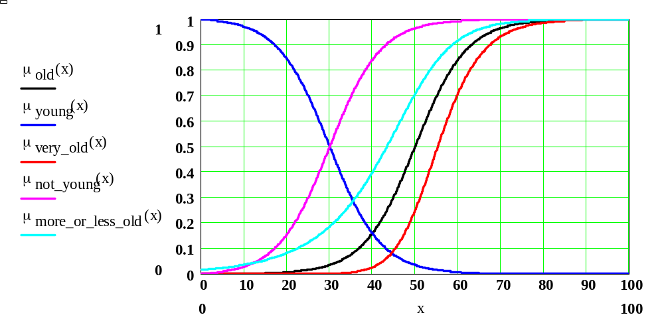
Example (Old)
X=55

Slide 18
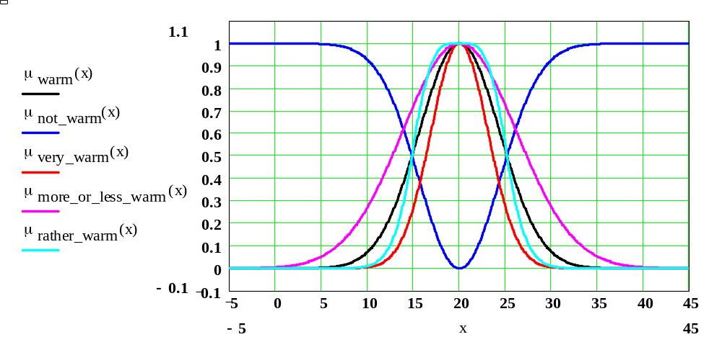
Example (Warm)

Slide 19
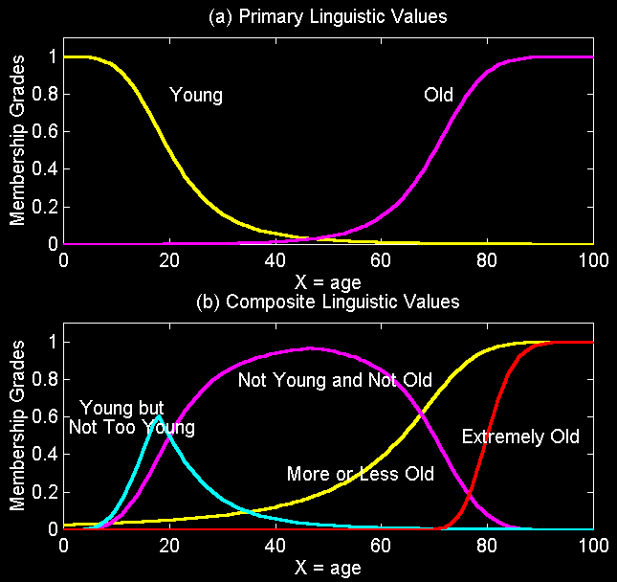
Membership Functions
Figure by 清大資工系張智星老師

Slide 20
Contents
邀保對象:
Fuzzy Sets
  Membership Functions
Fuzzy Set Operation
  e.g. A ∩ B (within the same domain)
Linguistic Variables
  Linguistic Hedges
Fuzzy Logic Operation
  e.g. P ^ Q (inter-domain variables)
Fuzzy Inference System
  Fuzzification, Defuzzification
成年人
年輕人
IF (天氣溫暖) AND (工作不忙)
THEN (去打球)
Case 2: Close_to..
(1) Fire Strength of Rules
(2) Conflict / Redundant

Slide 21
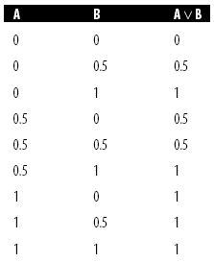
Fuzzy Logic
Fuzzy Rule
  IF x is A AND y is B, THEN z is C
Fire Strength
  A V B ≡ MAX (μ_{A}(x), μ_{B}(y))
  A Λ B ≡ MIN (μ_{A}(x), μ_{B}(y))
  ¬A ≡ 1 – μ_{A}(x)

Slide 22
Fuzzy Inference System
Multiple Rules
  May be Conflict or Redundant
Example: Rulebase with 2 rules
  R1: IF x is A₁ AND y is B₁ THEN z is C₁
  R1: IF x is A₂ AND y is B₂ THEN z is C₂
and
B₁
B₂
B_{j}
A₁
C₁
A₂
C₂
C_{k}
A_{i}

Slide 23
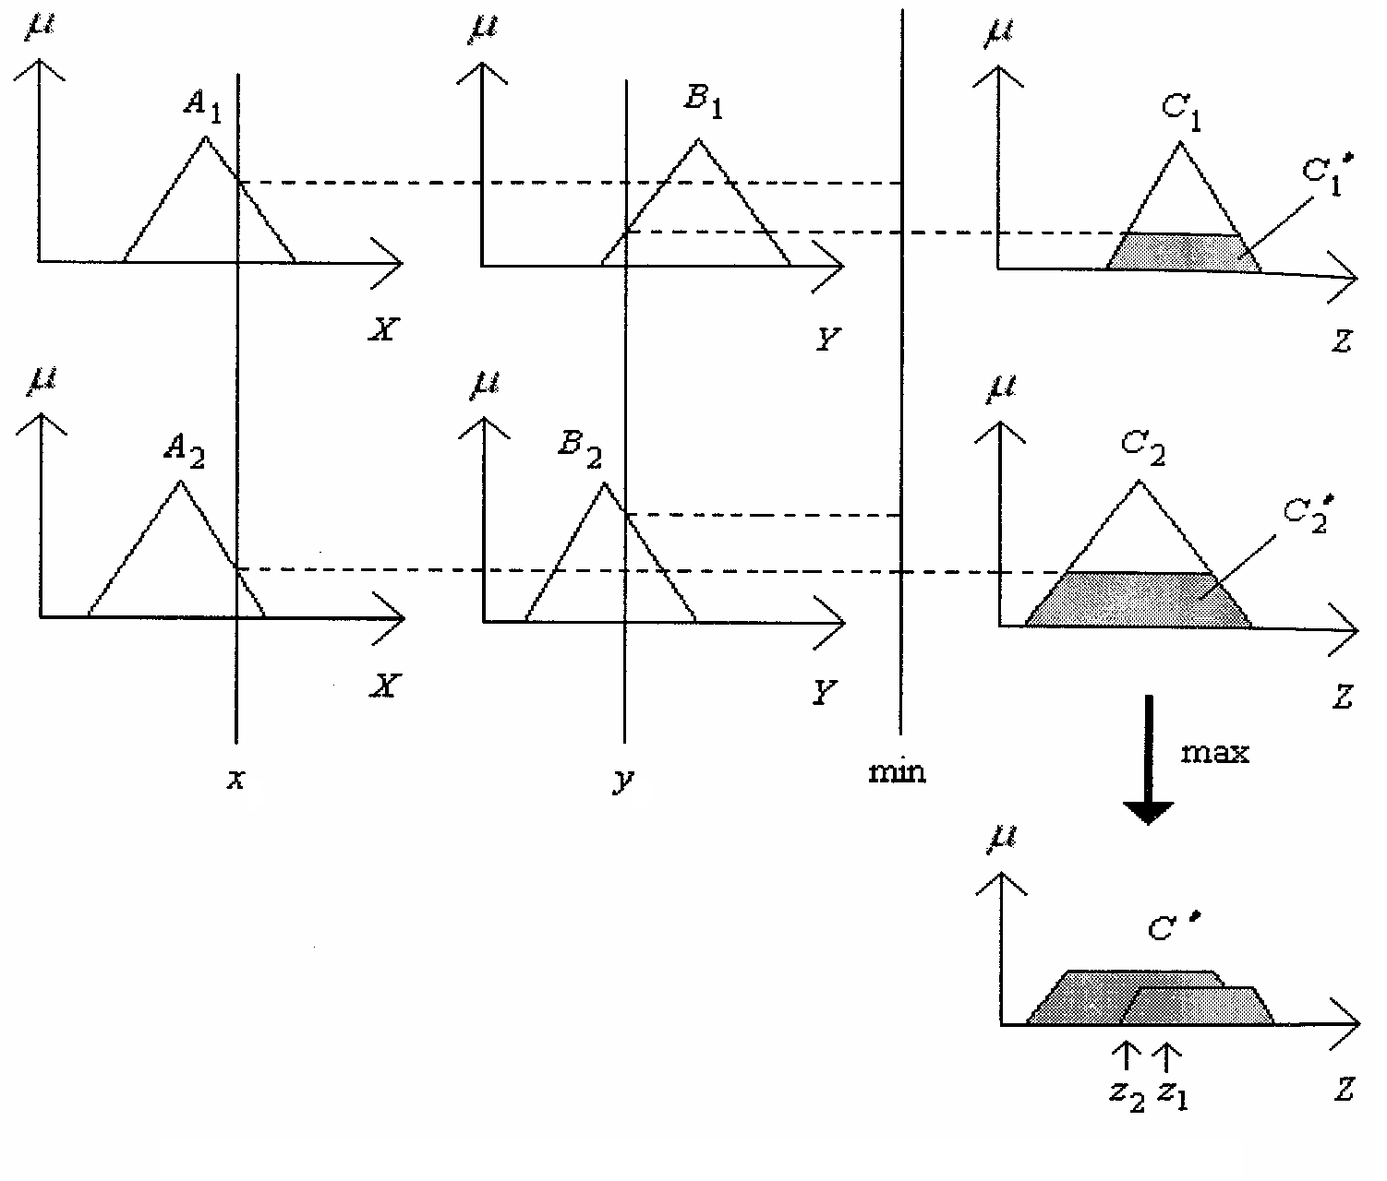
Defuzzification
 | B₁ | B₂
A₁ | C₁
A₂ |  | C₂
音量高(NH) &
溫度暖(NH)
工作模式II
音量中(M) &
溫度涼(NC)
睡眠模式I
Output z = “centriod of aera”
壓縮機運轉
重心法只是其中一種解模糊的方法

Slide 24
Example of Driving a Car
#rules: 2 *2 = 4
and | 車速慢 | 車速快
車距近 | 保持 | 減速
車距遠 | 加速 | 保持

Slide 25
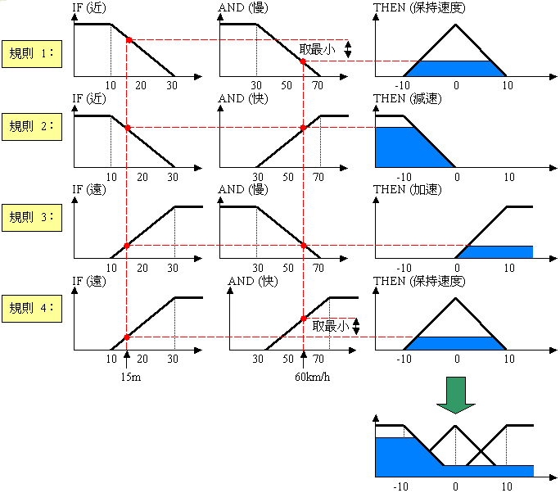
加速度
加速度為-6
Figure by 中研院資訊所許鈞南老師

Slide 26
More Complex Rules
Antecedents: (interval, velocity)
X1 = Very Close(VC), C, M, F, VF (Far)
X2 = Very Low (VL), L, A, H, VH (High)
Consequence: (acceleration)
Y = NL, NM, NS, ZE, PS, PM, PL

Slide 27
Example (Rulebase)
X2 X1 | VL | L | A | H | VH
VC | ZE | NS | NS | NM | NL
C | PS | ZE | NS | NS | NM
M | PS | PS | ZE | NS | NS
F | PM | PS | PS | ZE | NS
VF | PL | PM | PS | PS | ZE

Slide 28
Fuzzy Logic Membership
µ
NL
NR
NM
NS
ZE
PS
PM
PR
PL
-1.0
-0.8
-0.6
-0.4
-0.2
0
0.2
0.4
0.6
0.8
1.0
A, B
µ
NL
NR
NM
NS
ZE
PS
PM
PR
PL
-0.1
-0.08
-0.06
-0.04
-0.02
0
0.02
0.04
0.06
0.08
0.1
C

Slide 29
Fuzzy Expert Systems
Creating fuzzy rules
  choosing suitable linguistic variables
  expert’s knowledge, using the linguistic variables
Applying fuzzy inference
  Resolve - Uncertainty (membership function)
  Resolve - Conflict among rules (file strength)
  In many ways this is more appropriate than standard expert systems since expert knowledge is not usually black and white but has elements of grey.

Slide 30
break

Slide 31
Contents
Conclusion
Fuzzy Sets
  Membership Functions
Fuzzy Set Operation
  e.g. A ∩ B (within one domain)
Linguistic Variables
  Linguistic Hedges
Fuzzy Logic Operation
  e.g. P ^ Q (inter-domain variables)
Fuzzy Inference System
  Fuzzification, Defuzzification
希臘文明始於邏輯與集合：
以事件是否屬於某個集合
來表示命題之真假
IF (天氣溫暖) AND (工作不忙)
THEN (去打球)
Case 2: Close_to..
(1) Fire Strength of Rules
(2) Conflict / Redundant

Slide 32
Fuzzy Inference
  R1: IF x is A1 AND y is B1 THEN z is C1
  R1: IF x is A2 AND y is B2 THEN z is C2
Output z = “centriod of aera”

Slide 33
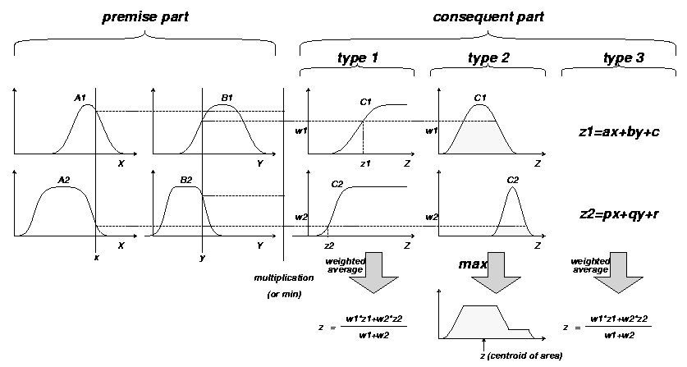
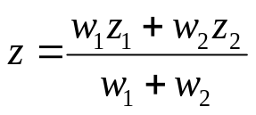
Commonly Used Fuzzy IF-THEN Rules and Fuzzy Reasoning Mechanisms
Type1: Tsukamoto
Type2: Mamdani
Type3: Sugeno
“Multiplication”
-or- “Min”

Slide 34
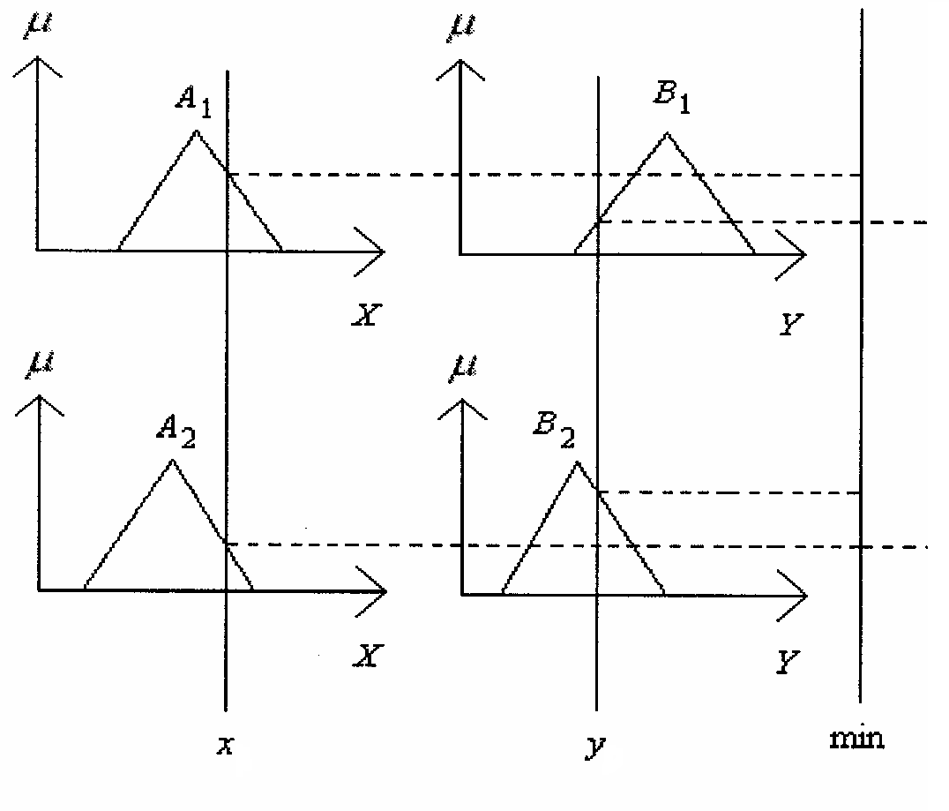


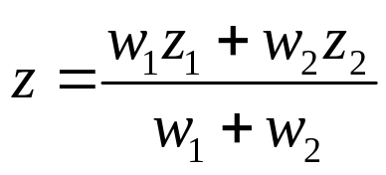
Takagi-Sugeno (Type 3) Method
  R1: IF x is A1 AND y is B1 THEN z is C1
  R1: IF x is A2 AND y is B2 THEN z is C2
符合條件一之
線性決策公式
w₁
w₂

