Slide 1
Inference and Resolution for Problem Solving
定理的自動證明
決策支援、專家系統
msn(對話) 機器人

Slide 2
Contents
What is Logic?
Normal Forms
  Converting to CNF
  Clauses
The Resolution Rule
  Proof by Refutation
  Resolution Refutation
Predicate Calculus
  Unification
  Skolemization
  Normal Forms in Predicate Calculus
The Resolution Algorithm
  Examples
wff: natural language to symbols
CNF: input for resolution algorithm
與數位邏輯電路課程差異 = resolution algorithm

Slide 3
What is Logic?
Reasoning about the validity of arguments.
An argument is valid if its conclusions follow logically from its premises – even if the argument doesn’t actually reflect the real world:
  All lemons are blue
  Mary is a lemon
  Therefore, Mary is blue.

Slide 4
Translating between English and Logic
Facts and rules need to be translated into logical notation.
A sentence in logic notation is called a well-formed formula (wff).
For example:
  It is Raining and it is Thursday:
  R Λ T
  R means “It is Raining”, T means “it is Thursday”.

Slide 5
Translating between English and Logic
More complex sentences need predicates. E.g.:
  It is raining in New York:
  R(N)
  Could also be written N(R), or even just R.
It is important to select the correct level of detail for the concepts you want to reason about.

Slide 6
Logical Operators
And Λ
Or V
Not ¬
Implies → (if… then…)
Iff ↔ (if and only if)

Slide 7
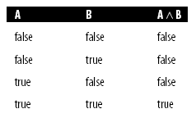
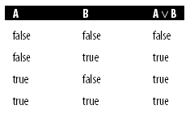
Truth Tables
Tables that show truth values for all possible inputs to a logical operator.
For example:
A truth table shows the semantics of a logical operator.

Slide 8
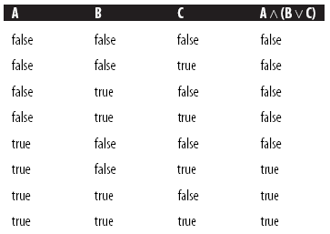
Complex Truth Tables
A Λ (B v C) ≡ (A Λ B) v (A Λ C) ??
We can produce truth tables for complex logical expressions, which show the overall value of the expression for all possible combinations of variables:
真值表可以證明邏輯式的相等關係
因而可以進行邏輯式的轉換

Slide 9
Some Useful Equivalences
A v A ≡ A
A Λ A ≡ A
A Λ (B Λ C) ≡ (A Λ B) Λ C
A v (B v C) ≡ (A v B) v C
A Λ (B v C) ≡ (A Λ B) v (A Λ C)
A Λ (A v B) ≡ A
A v (A Λ B) ≡ A
A Λ true ≡ A A Λ false ≡ false
A v true ≡ true A v false ≡ A
用真值表推算太麻煩(雖然通用)
在證明等式之後可用等式連續推導

Slide 10
Equivalence Works
(A Λ B) V (A Λ C) …... DNF (Disjunctive Normal Form)
≡ ¬¬ (A Λ B) V (A Λ C) … double negative law
≡ ¬[(¬A V ¬B) Λ (¬A V ¬C)]
≡ … distributive law and De Morgan's laws…
≡ A Λ ( B V C ) …... CNF (Conjunctive Norma Form)
一個推導的例子
(以真值表驗證, 參見次頁)
(2) 在 rulebase 之內
輸入上面式子等於輸入上面式子
(手動/ 自動 皆可, 看系統功能)

Slide 11
Equivalence Works (真值表驗證)
(A Λ B) V (A Λ C) ≡ A Λ ( B V C )
A | B | C | (A Λ B) V (A Λ C) | A Λ ( B V C )
T | T | T | (T) T (T) | (T) T (T)
T | T | F | T | T
T | F | T | T | T
T | F | F | F | F
F | T | T | F | F
F | T | F | F | F
F | F | T | F | F
F | F | F | F | F

Slide 12
Equivalence Works (不可誤用)
Qu: 事件為T才進行推理不是嗎?
i.e. 真值表的 F 部份為什麼要考慮?
i.e. 完全相等才能在規則庫中新增或代換?
三個相同
的問題
P ≠ (P V Q )
不可只看 P ≡ T 的部分
就認為可以在規則庫中任意新增或代換
其值亦為 T 的 rule (例如 P VQ 也是T)
規則庫中彼此之間都是以 Λ 關係共存，
一旦規則有變( 例如新增 ¬ P) :
P Λ (P V Q ) Λ ¬ P
P Λ [(P Λ ¬ P) V (¬ P Λ Q )]
P Λ (¬ P Λ Q )]
Q ….. 可能會多出莫名其妙的事件出來
P | Q | P V Q
T | T | T
T | F | T
F | T | T
F | F | F
P VQ
( P V Q )

Slide 13
Rulebase Works
P Λ (P → Q) ……... implies
≡ P Λ (¬ P V Q) …... CNF
≡ (P Λ ¬ P ) V (P Λ Q )
≡ P Λ Q …... 規則彼此為 Λ
此例是 rulebase 工作原理
(稱為 resolution, 細節後述)
分段輸入 P 與 (P → Q) 兩條規則
運作結果是新增一條規則 Q
而且繼續連鎖反應
或以真值表證明
P | Q | P → Q | P Λ (P → Q) | P Λ Q
T | T | T | T | T
T | F | F | F | F
F | T | T | F | F
F | F | T | F | F

Slide 14
break

Slide 15
Contents
What is Logic?
Normal Forms
  Converting to CNF
  Clauses
The Resolution Rule
  Proof by Refutation
  Resolution Refutation
Predicate Calculus
  Unification
  Skolemization
  Normal Forms in Predicate Calculus
The Resolution Algorithm
  Examples

Slide 16
Normal Forms
A wff is in Conjunctive Normal Form (CNF) if it is a conjunction of disjunctions:
  A₁ Λ A₂ Λ A₃ Λ … Λ A_{n}
  where each clause, A_{i,} is of the form:
  B₁ v B₂ v B₃ v … v B_{n}
  The B’s are literals.
  E.g.: A Λ (B V C) Λ (¬A V ¬B V ¬C V D)
“Implies Form” is frequently used in recent research
  A→B ≡ (¬A v B)
  A V B ≡ (¬ A → B ) Λ (¬ B → A ) … 等式都寫進來或需要再轉換
  P ≡ T → P ; ¬ P ≡ P → F … 單一事件時的表示法
Implies form 可經由 CNF 再轉化而來

Slide 17
Converting to CNF
Any wff can be converted to CNF by using the following equivalences:
(1) A ↔ B ≡ (A → B) Λ (B → A)
(2) A → B ≡ (¬A v B)
(3) ¬(A Λ B) ≡ (¬A v ¬B)
(4) ¬(A v B) ≡ ¬A Λ ¬B
(5) ¬¬A ≡ A
(6) A v (B Λ C) ≡ (A v B) Λ (A v C)
https://en.wikipedia.org/wiki/Conjunctive_normal_form
Importantly, this can be converted into an algorithm – this will be useful when when we come to automating resolution.

Slide 18
Clauses
Having converted a wff to CNF, it is usual to write it as a set of clauses.
E.g.:
  (A → B) → C
In CNF is:
  (A V C) Λ (¬B V C) write {(A, C), (¬B, C)}
In “Implies” form, we write
  { (¬A → C), (¬C → A), (B → C)}
e.g. 善有善報造就文明社會
CNF 變成規則庫中的 clause
規則庫中的 clauses 彼此都是 Λ
如果 CNF 中有 Λ (如左例)
一條 CNF 可以被拆成多條 clauses
Implies form 可經由 CNF 再轉化而來

Slide 19
The Resolution Rule (CNF)
The resolution rule is written as follows:
A v B ¬ B v C
A v C
This tells us that if we have two clauses that have a literal and its negation, we can combine them by removing that literal.
E.g.: if we have {(A, C), (¬A, D)}
We would apply resolution to get {C, D}
規則庫寫作 Clause form
好處是可做破解(Resolution)

Slide 20
The Resolution Rule (Implies form)
The resolution rule is written as follows:
¬A → B B → C
¬A → C
Implies form
  (左側之間^) → (右側留一項事件)
  所有事件可以輪流出現在右側, 因此轉換出的規則不止一條
  全部可轉換出的規則皆列入規則庫，或在需要時才轉換
  單一事項的轉換式為： A ≡ T→A; ¬A ≡ A→F
  同側異號相消，異側同號相消，相消使兩規則合併
  左側消淨給 T (無條件), 右側消淨給 F (無結果)

Slide 21
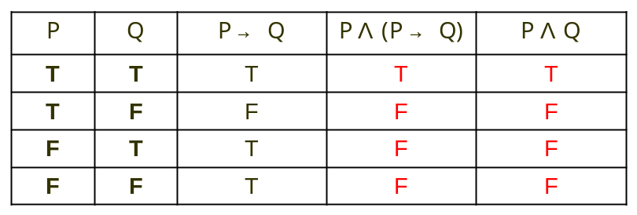
Rulebase Works
Review
P Λ (P → Q) ……... implies
≡ P Λ (¬ P V Q) …... CNF
≡ (P Λ ¬ P ) V (P Λ Q )
≡ P Λ Q …... 規則彼此為 Λ
此例亦是 rulebase 工作原理
(稱為 resolution, 細節後述)
分段輸入 P 與 (P → Q) 兩條規則
運作結果是新增一條規則 Q
而且繼續連鎖反應
Qu: (三個相同的問題)
事件為T才進行推理不是嗎?
真值表的 F 部份為什麼要考慮?
只有完全相等才能在規則庫中代換?

Slide 22
Rulebase Works (cont.)
Review
Qu: 事件為T才進行推理不是嗎?
i.e. 真值表的 F 部份為什麼要考慮?
i.e. 只有完全相等才能在規則庫中代換?
P | Q | P V Q
T | T | T
T | F | T
F | T | T
F | F | F
不可只看 P ≡ T 的部分
就認為可以在規則庫中任意新增
其值為 T 的 rule (例如 P VQ 也是T)
一旦規則有變( 例如新增 ¬ P) :
P Λ (P V Q ) Λ ¬ P
P Λ [(P Λ ¬ P) V (¬ P Λ Q )]
P Λ (¬ P Λ Q )]
Q ….. 會多出莫名其妙的事件出來

Slide 23
Resolution of Inference (1)
Proof
(A V B)Λ (¬ B V C)
≡ [(A V B) Λ ¬ B] V [(A V B) Λ C]
≡ (A Λ ¬ B) V (A Λ C) V (B Λ C)
≡ …轉換CNF
≡ (A V B)Λ (¬ B V C) Λ (A V C)
或以真值表證明
A | B | C | (A V B) Λ (¬ B V C) | (A V B) Λ (¬ B V C) Λ (A V C)
T | T | T | T | T
T | F | T | T | T
T | F | F | T | T
F | T | T | T (其餘為F) | T (其餘為F)

Slide 24
Resolution of Inference (2)
Proof
(A → B) Λ (B → C) ≡ (A → B) Λ (B → C) Λ (A → C)
A | B | C | (A → B) Λ (B → C) | (A → B) Λ (B → C) Λ (A → C)
T | T | T | (T) T (T) | (T) T (T) (T)
T | T | F | T | T
T | F | T | T | T
T | F | F | F | F
F | T | T | F | F
F | T | F | F | F
F | F | T | F | F
F | F | F | F | F

Slide 25
Proof by Refutation
If we want to prove that a logical argument is valid, we negate its conclusion, convert it to clause form, and then try to derive falsum using resolution.
If we derive falsum, then our clauses were inconsistent, meaning the original argument was valid, since we negated its conclusion.
加入 (¬EXP) 或 (EXP → false) 導致規則庫不成立
即可得證 EXP ≡ True
矛盾證法：(EXP → false) ^ RB ╞ ⊥ 或 {(¬EXP) ^ RB} ╞ ⊥

Slide 26
Resolution Refutation (CNF)
Given {(¬A, B), (¬A, ¬B, C), A}, Prove C holds? ….Think {C, ¬C} ?
Let us resolve: {(¬A, B), (¬A, ¬B, C), A, ¬C}
We begin by resolving the first clause with the second clause, thus eliminating B and ¬B:
  {¬A, (¬A, C), A, ¬ C}
  {C, ¬C}
Now we can resolve both remaining literals, which gives falsum:
  ⊥
If we reach falsum, we have proved that our initial set of clauses were inconsistent.
This is written:
  {(¬A, B), (¬A, ¬B, C), A, ¬C} ╞ ⊥

Slide 27
Resolution Refutation (Implies)
Given {(A→B), (A ^ B →C), (T→ A) }, Prove C holds?
Let us resolve: {(A→B), (A ^ B →C), (T→ A), (C→ F)}
We begin by resolving the first clause with the second clause, thus eliminating B notions:
  { (A→C), (T→A), (C→F)}
  { T → C, C→ F}
Now we can resolve both remaining literals, which gives falsum:
  T → F
If we reach falsum, we have proved that our initial set of clauses were inconsistent.
This is written:
  {(A→B), (A ^ B →C), (T→A), (C→F)} ╞ T→ F

Slide 28
Refutation Proofs in Tree Form
P, P→Q Should Q be true?
Forward Chaining + Refutation
P
¬P VQ
¬Q
True→P
P→Q
Q→False
Q
True→Q
⊥
True→False
CNF Implies →
Refutation + Backward Chaining
¬Q
¬P VQ
P
Q→False
P→Q
True→P
¬P
P→False
⊥
True→False

Slide 29
Refutation Proofs (CNF)
S, P, ¬R, (S^P→Q V R) Should Q be true?
S^P→Q V R
¬SV¬PVRVQ … CNF 使用,相對單純
¬ Q
¬S V ¬P V RVQ
¬S V ¬P V R
S
¬P V R
P
R
¬ R
⊥

Slide 30
Refutation Proofs (Advanced Example)
S, P, ¬R, (S^P→Q V R)
Should Q be true?
S^P→Q V R
(S^P^¬Q → R)
(S^P^¬R → Q)
(S^P^¬Q → R)
^(S^P^¬R → Q) … Implies 需要時取一條用
  同側異號相消，
  異側同號相消，
  相消兩規則合併
Q → F
S^P^¬Q → R
Q → F
S^P^¬R → Q
OR
S^P→ R
T→S
S^P^¬R → F
T→S
P→R
T→P
P^¬R → F
T→P
T→R
R→F
¬R → F
R→F
T→ F
T→ F

Slide 31
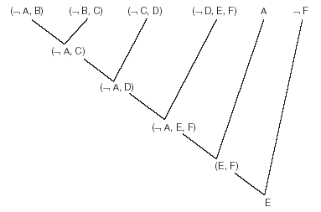
Refutation (Other than Proofs)
It is often sensible to represent a refutation proof in tree form:
In this case, the
proof has failed, as we
are left with E instead of falsum.
A→B
B→C
C→D
D→(E V F)
A
F ?
想要求證 F 成立嗎？
結論是
要再加上 ¬E 才成立
(1) 依目前規則做無目標性的推演/預演/預告 .. inference
(2) 試求某個結論成立或不成立
若不成立能否知道所缺條件?
… reasoning

Slide 32
Contents
What is Logic?
Normal Forms
  Converting to CNF
  Clauses
The Resolution Rule
  Proof by Refutation
  Resolution Refutation
Predicate Calculus
  Unification
  Skolemization
  Normal Forms in Predicate Calculus
The Resolution Algorithm
  Examples

Slide 33
Predicate Calculus (述語推算)
Predicate Calculus extends the syntax of propositional calculus with predicates and quantifiers:
  P(X) – P is a predicate.
First Order Predicate Calculus (FOPC) allows predicates to apply to objects or terms, but not functions or predicates.

Slide 34
Quantifiers ∀ and ∃
∀ - For all:
  ∀xP(x) is read “For all x’es, P (x) is true”.
∃ - There Exists:
  ∃x P(x) is read “there exists an x such that P(x) is true”.
Relationship between the quantifiers:
  ∃x P(x) ≡ ¬(∀x)¬P(x)
  “If There exists an x for which P holds, then it is not true that for all x P does not hold”.
∃x Like(x, War) ≡ ¬(∀x) ¬Like(x, War)

Slide 35
Unification
對於 (∀x) … 我們略去，因為規則庫都是通則
其中變數 x 須在 Resolution 過程之中進行代換。
To resolve clauses we often need to make substitutions. For example:
{(P(w,x)), (¬P(a,b))}
To resolve, we need to substitute a for w, and b for x, giving:
{(P(a,b)), (¬P(a,b))}
We write the unifier we used above as:
  {a/w, b/x}
Now these resolve to give falsum. (可完全消去)
e.g. 全城居民都相親相愛

Slide 36
Skolemization
那對於 (∃x) … 我們要如何處理？
Before resolution can be applied, ∃ must be removed, using skolemization.
Variables that are existentially quantified are replaced by a constant:
∃(x) P(x) e.g. ∃(y) GoodMan(y)
is converted to:
P(c) e.g. GoodMan(c)
c must not already exist in the expression.
存在某人去刺殺暴君，被刺殺則死亡 { ∃(x) kill(x, Caesar), ∀(y,z) kill(y,z) → die(z) }
Qu: 暴君死亡了嗎？
Ans: 死了(依代換過程,是那個 “刺殺暴君的人”殺的）{ kill(killer(Caesar), Caesar), …}

Slide 37
Skolem functions
If the existentially quantified variable is within the scope of a universally quantified variable, it must be replaced by a skolem function, which is a function of the universally quantified variable.
Sounds complicated, but is actually simple:
(∀x)(∃y)(P(x,y))
Is Skolemized to give:
(∀x)(P(x,f(x)) e.g. (∀x)(Love(x,lover(x))
After skolemization, ∀ is dropped, and the expression converted to clauses in the usual manner.
(∀x) … 略去，規則庫預設都是通則
(∃y) … 如上頁以 Skolem function 取代
Skolem function 視為特殊的 “常數”，
只可代換別人，不可被別人代換，並不違背 FOPC

Slide 38
Normal Forms in Predicate Calculus
A FOPC expression can be put in prenex normal form by converting it to CNF, with the quantifiers moved to the front.
For example, the wff:
(∀x)(A(x) → B(x)) → (∃y)(A(y) Λ B(y))
Converts to prenex normal form as:
  (∃x)(∃y)(((A(x) v A(y)) Λ (¬B(x) v A(y)) Λ (A(x) v B(y)) Λ (¬B(x) v B(y))))
如果世上每個樂觀的人都長壽
則必存在某個樂觀且長壽的人

Slide 39
The Resolution Algorithm
1 First, negate the conclusion and add it to the list of assumptions.
2 Now convert the assumptions into Prenex Normal Form
3 Next, skolemize the resulting expression
4 Now convert the expression into a set of clauses
5 Now resolve the clauses using suitable unifiers.
This algorithm means we can write programs that automatically prove theorems using resolution.
此外，要注意“不同來源”的規則(rule)之間，要使用或置換成不同的變數名稱
因為置換是把規則庫中的同一變數都置換，下面例子是“相同來源”的規則:
(∀x) Dog(x) → Cute(x) ^ Loyal(x) ➔ {(¬Dog(x), Cute(x)), (¬Dog(x), Loyal(x))}

Slide 40
Example (CNF)
在本社區中
P(w)→Q(w) 每個早起者都晨跑
Q(y)→S(y) 每個晨跑者都健康
P(x) V R(x) 每人都早起或快樂
R(z)→S(z) 每個快樂者都健康
S(A)? 某 A 健康嗎?
求 ¬S(A) 是錯的
¬P(w) V Q(w)
¬Q(y) V S(y)
{w/y}
¬P(w) V S(w)
P(x) V R(x)
{w/x}
S(x) V R(x)
¬R(z) V S(z)
{z/x}
S(x)
¬S(A)
{x/A}
⊥
本例如把¬S(A) 提至最前面更可顯得出 Backward chaining 的威力
目前看到的推導方式則是混合順推&逆推的過程

Slide 41
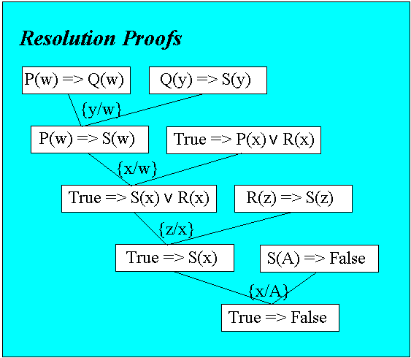
Example (Implies form)
在本社區中
P(w)→Q(w) 每個早起者都晨跑
Q(y)→S(y) 每個晨跑者都健康
P(x) V R(x) 每人都早起或快樂
R(z)→S(z) 每個快樂者都健康
S(A)? 某 A 健康嗎?
求 S(A)→False 是錯的
本例如把 S(A) → False 提至最前面更可顯得出 Backward chaining 的威力
目前看到的推導方式則是混合順推&逆推的過程

Slide 42
Example (CNF vs. Implies form)
¬P(w) V Q(w)
¬Q(y) V S(y)
{w/y}
¬P(w) V S(w)
P(x) V R(x)
{w/x}
S(x) V R(x)
¬R(z) V S(z)
{z/x}
S(x)
¬S(A)
{x/A}
⊥
求 S(A)→False 是錯的
亦即求 ¬S(A) 是錯的

Slide 43
Example (Skolem function)
每個人都存在有媽媽
human(x) → mother(M(x), x)
∀(x) ∃(y) human(x) → mother(y, x)
每個人都愛他的媽媽
human(w)Λmother(y, w) →love(w,y)
∀(w,y) human(w) ^ mother(y,w)→..
John 是一個人
human(John)
John 有沒有他所愛的人？
love(John,z)
→ 求 ¬ love(John,z) 是錯的
¬love(John,z)
¬human(w) V ¬mother(y,w) V love(w,y)
{John/w, z/y}
¬human(John) V ¬mother(z,John)
¬human(x) V mother(M(x),x)
{John/x, z/M(x)=M(John)}
¬human(John)
human(John)
⊥
Ans: 原式成立, 而且 z= M(John)

Slide 44
Deduction over FOPC --- forward-chaining
Forward chaining:
Dog(X) ^ Meets(X,Y)^Dislikes(X,Y) → Barks_at(X,Y)
Close_to(Z, DormG) → Meets(Snoopy, Z)
Man(W) → Dislikes(Snoopy, W)
Man(John), Dog(Snoopy), Close_to(John,DormG)
{John/W}
Dog(X) ^ Meets(X,Y)^Dislikes(X,Y) → Barks_at(X,Y)
Close_to(Z, DormG) → Meets(Snoopy, Z)
Dislikes(Snoopy, John)
Dog(Snoopy), Close_to(John,DormG)
??
Barks_at(Snoopy,John)

Slide 45
Deduction over FOPC --- Resolution
Backward chaining:
Barks_at(Snoopy,John)→ False
Dog(X) ^ Meets(X,Y)^Dislikes(X,Y) → Barks_at(X,Y)
{X/Snoopy, Y/John}
Dog(Snoopy) ^ Meets(Snoopy,John)^Dislikes(Snoopy,John) → F
T → Dog(Snoopy)
Meets(Snoopy,John)^Dislikes(Snoopy,John) → False
Close_to(Z,DormG) → Meets(Snoopy, Z)
{Z/John}
Close_to(John,DormG)^Dislikes(Snoopy,John) → False
True → Close_to(John, DormG)
Dislikes(Snoopy,John) → False
Man(W) → Dislikes(Snoopy,W)
{W/John}
Man(John) → False
True → Man(John)
此為 “Implies” Normal Form
了解此法可以銜接 “Expert System”
True → False

