Slide 1
Chapter 3
Graphics and Image Data Representations
3.1 Graphics/Image Data Types
3.2 Popular File Formats
3.3 Further Exploration

Slide 2
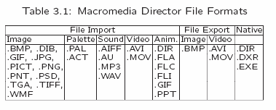
Multimedia Data Types
File Extension Details, http://filext.com/index.php

Slide 3
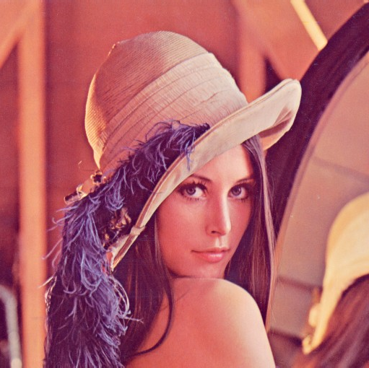
Express Our Respects to
Lena (Lenna), Ms. Nov., Playboy Mag., 1972

Slide 4
1-bit Images
1-bit monochrome image
  Also referred to as binary image.
  Satisfactory for FAX documents containing simple graphics
Single bit (0 or 1 on/off) for each pixel
  640 x 480 monochrome image requires
  307200 (bits)/8 = 38400 (bytes)
  = 38.4 Kbytes storage

Slide 5
8-bit Gray-level Images
Each pixel
  has a gray-value between 0 and 255.
Bitmap:
  The two-dimensional array of pixel values
Image resolution (w x h)
  higher resolution, better quality
  640 x 480 Gray-level image requires
  307200 (bytes)
  = 307.2 Kbytes storage

Slide 6

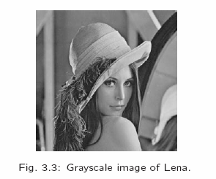
Binary and Gray-level Images
38.4 Kbytes
307.2 Kbytes

Slide 7
Color Image Data
The most common data types –
24-bit and 8-bit color.
Compression technique
  Compression techniques can be classified into either lossless or lossy.

Slide 8
24-bit Color Images
Color 24-bit image
  each pixel is represented by three bytes, usually representing RGB.
True Color
  3 million colors at least
  24-bit image supports 256 x 256 x 256 = 16,777,216 possible colors.
Storage Penalty:
  A 640 x 480 24-bit color image would require 921.6 kB of storage without any compression.

Slide 9
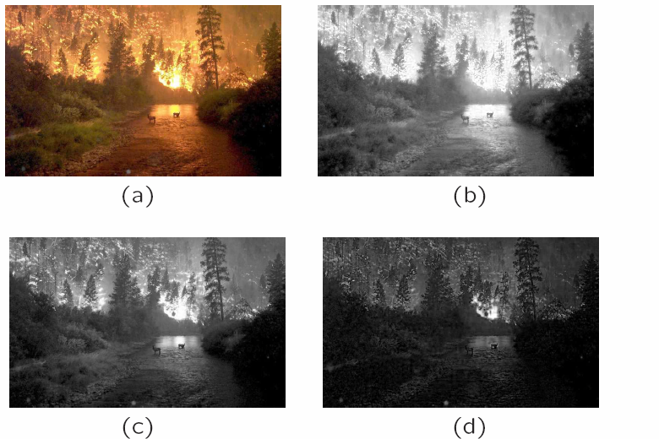
Fig 3.5 High resolution color and separate R,G,B color channel
Images (a) Example of 24-bit image “forestfire.bmp”
(b,c,d) R, G, B color channels for this image

Slide 10
8-bit Color Images
256 Colors
  Many systems can make use of 8 bits of color information (so-called “256 colors") in producing a screen image.
lookup table (Palette)
  The image stores not color, but instead just a set of index bytes,
  Map into a table with 3-byte (24-bit) values that specify the color for a pixel
  So does the 16-bit format (高彩))

Slide 11
Great Savings in Space
Great savings in space for 8-bit images, over 24-bit ones: (without any compression applied)
640 x 480 8-bit color image only requires 300 KB of storage
compared to 921.6 KB for a color image.

Slide 12
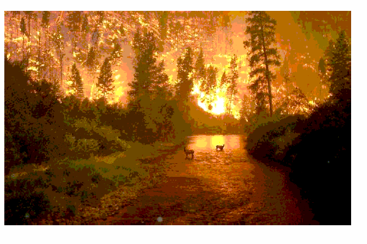
Fig 3.7 Examples of 8-bit color image

Slide 13
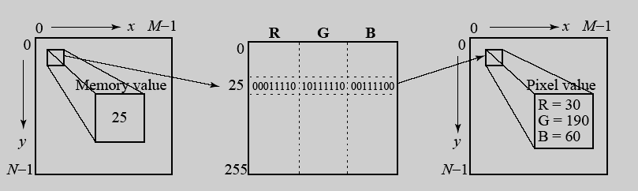
Color Look-up Tables (LUT, Palette)
The idea used in 8-bit color images is to store only the index, or code value, for each pixel. Then, e.g., if a pixel stores the value 25, the meaning is to go to row 25 in a color look-up table (LUT).

Slide 14
How to devise a color look-up table
Making 8-bit look-up color out of 24-bit color
  The most straightforward way is
  Dividing the RGB cube into
  Equal slices in each dimension.
  (a) The centers of each of the resulting cubes would serve as the entries in the color LUT, while simply scaling the RGB ranges 0..255 into the appropriate ranges would generate the 8-bit codes.

Slide 15
Method using Equal Slices
  (b) Since humans are more sensitive to R and G than to B, we could shrink the R range and G range 0..255 into the 3-bit range 0..7 and shrink the B range down to the 2-bit range 0..3, thus making up a total of 8 bits.
  (c) To shrink R and G, we could simply divide the R or G byte value by (256/8)=32 and then truncate. Then each pixel in the image gets replaced by its 8-bit index and the color LUT serves to generate 24-bit color.

Slide 16
Improvement
Disadvantage of simple scheme:
  Edge artifacts appear in image
  Slight change in RGB results in shifting to a new code, an edge appear
Improve: median-cut algorithm
  more bits → more discrimination power
  colors are much more clustered

Slide 17
Fig 3.7 Examples of 8-bit color image

Slide 18
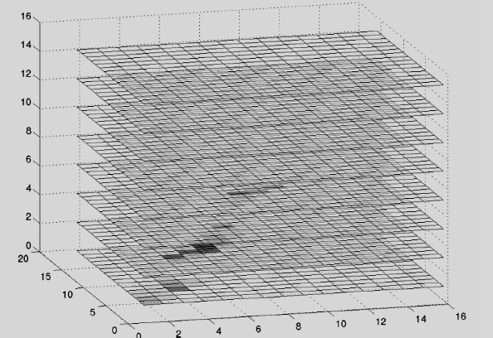
3D histogram of the RGB values of the pixels in ”forestfire.bmp'.

Slide 19
Median-cut algorithm (1):
A simple alternate solution for color reduction problem
(a) The idea is to sort the R byte values and find their median;
  e.g. 100x100 = 10,000 → value [5000] = 62
  values smaller than the median are labeled with “0" and values larger than the median are labeled with a “1" bit.
(b) For the second bit (colors G ) of the index:
  Just for the “0" Red bit pixels, (bottom-left in Fig. 3.11),
  ➔ label this G-bit as “0" or “1" according as their G value is less than or greater than the median of the G values of these pixels.
(c) Continuing over R, G, B for 8 bits gives a color LUT 8-bit index
中文版這一段 p.75 翻得很差(錯?離譜?)
請參考英文版 p.69

Slide 20
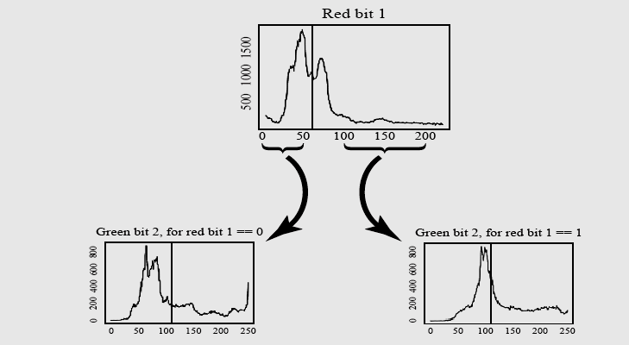

Slide 21
(R, G, B) regions
(R1 median)
B3 在垂直於
投影平面的四條
長方磚上各別
攔腰砍斷
1st: 1 切
2nd: 2 切
3rd: 4 切
4th: 8 切
G
G2 median”s”,
Built upon R1 cut
R
(R1)(G2)(B3)(R4)(G5)(B6)(R7)(G8)
做完這八次的切割之後，立方體上有 256塊大小不等
的長方磚(color cube)，同一塊內的色號(color code/ index)
都一樣，可取其中心點顏色作為 24-bit 代表色。

Slide 22
Median-cut algorithm (2):
More Accurate Approach
(1) Find the smallest box that contains all the colors in the image
(2) Sort the enclosed colors along the longest dimension of the box
(3) Split the box into two regions at the median of the sorted list
Repeat the above process in steps (2) (3) until the original color space has been divided into, say, 256 regions
此一版本不侷限於 (R1)(G2)(B3)(R4)(G5)(B6)(R7)(G8) 之
切斷順序，也不限定 R, G 比 B 多切幾刀；只要那段比較長
就先把它切斷。切過255次之後(每次都選切最長邊，每次都
是獨立選擇 cube)，同樣可得 256 塊大小不等的 cubes.

Slide 23
Median cut algorithm (accurate) (2)
For every box, call the mean of R, G, B in that box the representative (center) color for the box
Based on Euclidean distance between a pixel RGB value and the box centers, assign every pixel to one of the representative colors. Replace the pixel by the code in the lookup table that index representative colors.

Slide 24
Chapter 3
Outline:
3.1 Graphics/Image Data Types
3.2 Popular File Formats
3.3 Further Exploration

Slide 25
3.2 Popular File Formats
8-bit GIF :
  one of the most important format
  historical connection to the WWW and HTML
  1st image type recognized by net browsers.
JPEG:
  currently the most important common file format.
PNG, TIFF, EXIF, FLC(FLI), PS, PDF, Windows WMF, BMP, MAC PAINT/PICT, X windows PPM

Slide 26
GIF (Graphics Interchange Format)
Initially for transmitting graphical images over phone lines via modems
Use Lempel-Ziv-Welch compression – use line grouping of pixels effectively
GIF standard supports interlacing --
  4-pass display process
  quick sketch, progressive mode

Slide 27

GIF87a v.s. GIF 89a
GIF actually comes in two flavors:
  1. GIF87a: The original specification.
  2. GIF89a: The later version. Supports simple animation via a Graphics Control Extension block in the data,
  -- provides simple control over delay time,
  a transparency index,
  -- Corel Draw allows access to and editing
  of GIF images

Slide 28
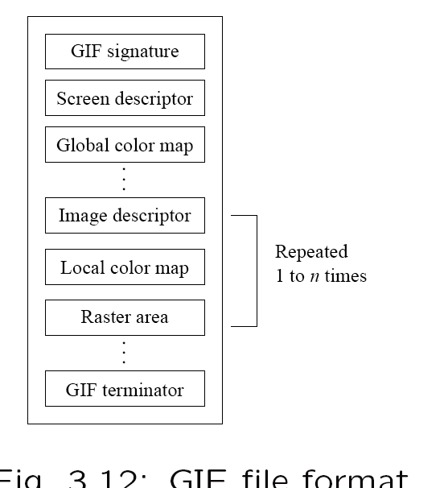

GIF87a
6 Bytes
Future Extension (GIF89a)
Fig 3.12 GIF file format

Slide 29

Multiple Images in a File
GIF 87 can contain more than one image definition
Each image can contain its own color lookup table -- a local color map
A global color map can be defined for all images

Slide 30
GIF Screen Descriptor
Screen Descriptor comprises a set of attributes that belong to every image in the file. According to the GIF87 standard, it is defined as in (next page)
Color resolution, cr (3-bit): meant to operate on a variety of low end hardware, web enabled wristwatch, cell phone
“pixel” (3-bit): number of bits per pixel in the image as stored in file.
“cr” usually equals “pixel”, it need not

Slide 31
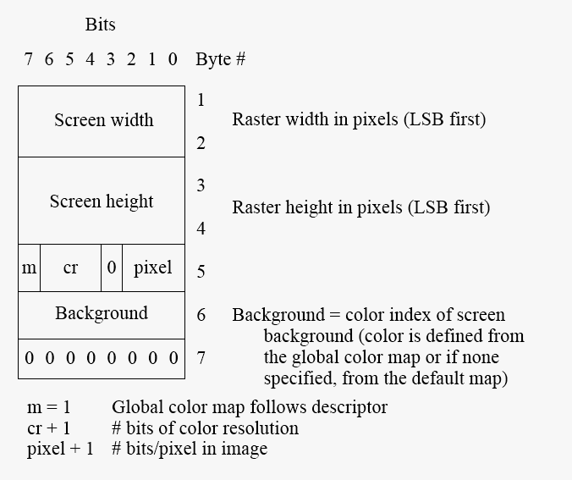
Least Significant Byte
GIF screen descriptor

Slide 32
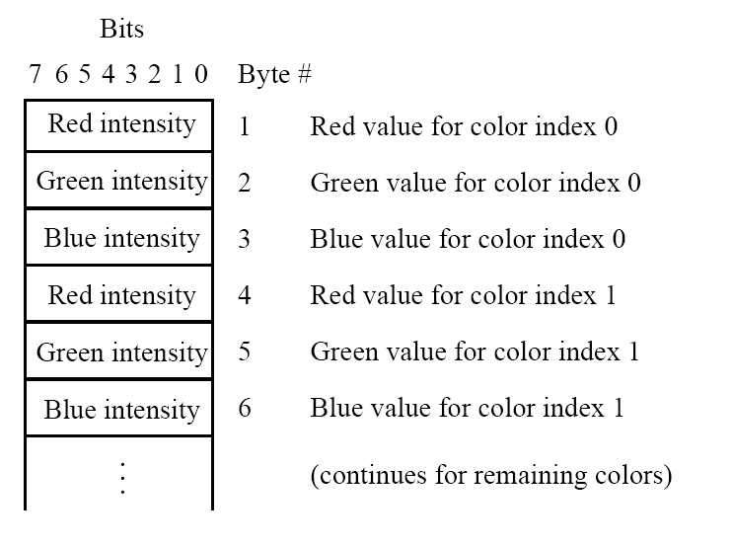
# (Entry) = 2^{(pixel+1)}
GIF color map

Slide 33
GIF87a
6 Bytes
Future Extension (GIF89a)

Slide 34
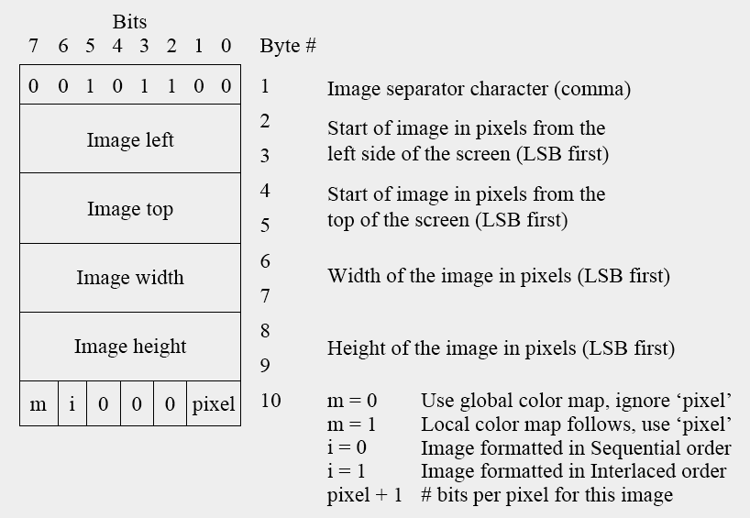
Fig 3.15 GIF image descriptor

Slide 35
GIF87a
Recall: Fig 3.12 GIF file format

Slide 36
7.5 Dictionary-based Coding
LZW uses fixed-length codewords to represent variable-length strings of symbols/characters
LZW encoder and decoder build up the same dictionary dynamically while receiving the data.
LZW places longer and longer repeated entries into a dictionary, and then emits the code for an element, rather than the string itself, if the element has already been placed in the dictionary.
Applications include "UNIX Compress", "GIF image format", "Modem V.42 protocol"

Slide 37
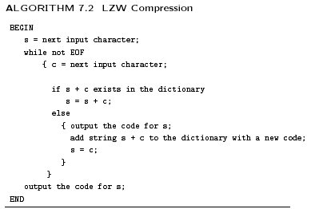
Dictionary-based Coding
(Lempel-Ziv_Welch)
GIF:
#Symbol = #color index
字典長度 4096
字串逐一加長
直到字典所無
Output: 曾經字典有的
Add Wd: 新的字串
然後，
由剛才出包的 c 再出發

Slide 38
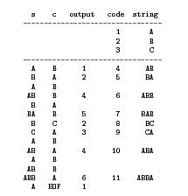
字串逐一加長 直到字典所無
Output: 曾經字典有的
Add Wd: 新的字串
然後，由剛才出包的 c 再出發
Example 7.2 LZW compression for string “ABABBABCABABBA"
Let's start with a very simple dictionary (also referred to as a “string table"), initially containing only 3 characters, with codes as follows:
中文版 p.196 本表有誤，少列 row[5] B A

Slide 39
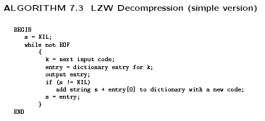

Slide 40
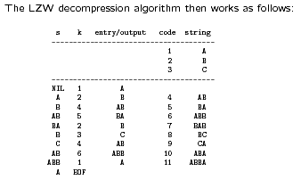
The LZW decompression algorithm works as follows
A B AB BA B C AB ABB A
Example 7.3: LZW decompression for string “ABABBABCABABBA".
Input codes to the decoder are
1 2 4 5 2 3 4 6 1.
The initial string table is identical to what is used by the encoder.
s
s+entry[0]
或直接由 entry/output 欄來抓 S_{i}+S_{i+1}[0]

Slide 41
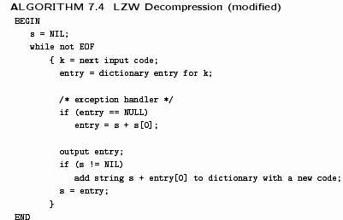
In Case Encoder is ahead of decoder
(中文版 p.198更正)
當解碼端找不到字碼的 entry 時，必是因編碼端
把剛產生的code 馬上沿用來產生另一個新的code, 依據此理，可直接抓 S_{i}+S_{i}[0] 自身來作為新的 entry & code.
A B AB BA B C AB ABB ABBA X

Slide 42
Bits per Record
GIF:
#Symbol = #color index
字典長度 4096
字串永遠算不完，
所以經常會超過長度，
超長之後沿用舊碼即可，
編解碼端皆不再出新碼。
Huffman Coding:
  variable length
Run Length Coding:
  b(symbol)+b(length)
LZW:
  number of entries
  12 bits for 4096 (GIF), 11 bits for 2048 (V.42)
Arithmetic Coding:
  N/A

Slide 43
GIF87a
Recall: Fig 3.12 GIF file format

Slide 44
Recall: Fig 3.15 GIF image descriptor

Slide 45
Interlace Bit
If the “interlace” bit is set in the local image Descriptor , then the rows of the image are displayed in a four-pass sequence (Fig 3.16)
Allow quick sketch to appear when a web browser displays image, followed by more detailed fill-ins
Progressive mode in JPEG
Actual raster data LZW compressed

Slide 46
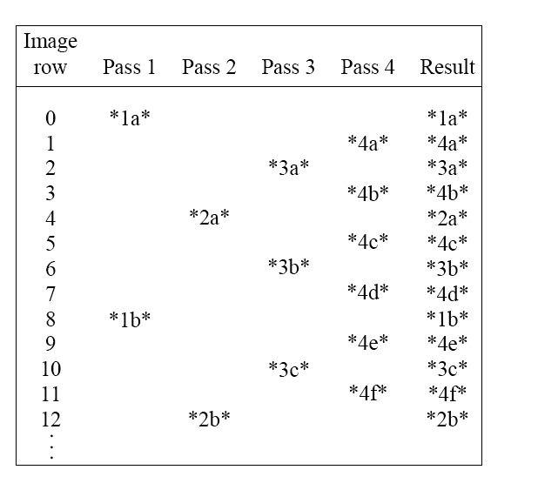
中文版 p.80 表格對齊發生錯誤
Fig 3.16 GIF 4-pass interlace display row order

Slide 47
Interlace Strategy
1st
2nd
3rd
4th
1st
2nd
3rd
4th
8 n
8 n + 4
8 n + 2
8 n + 6
8 n + 1
8 n + 3
8 n + 5
8 n + 7
N
2
0/1
2
2
倒數第 1 pass

Slide 48
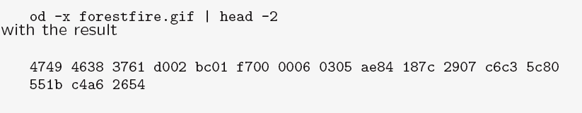
To decipher the remainder of the file header (after “GIF87a"), we use hexadecimal
(02d0)h = 720
Hexadecimal dump

Slide 49
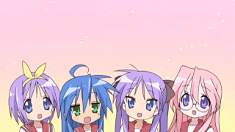
Break

Slide 50
Chapter 3
Outline:
3.1 Graphics/Image Data Types
3.2 Popular File Formats
3.3 Further Exploration

Slide 51
JPEG
The most important current standard
  for image compression.
The human vision system
  has some specific limitations and
  JPEG takes advantage of these to
  achieve high rates of compression.
JPEG allows the user to set
  a desired level of quality, or
  compression ratio (input divided by output).

Slide 52
Example
As an example, Fig. 3.17 shows our forestfire. image, with a quality factor Q=10%. This image is a mere 1.5% of the original size.
In comparison, a JPEG image with Q=75% yields an image size 5.6% of the original,
a GIF version of this image compresses down to 23.0% of uncompressed image size.

Slide 53
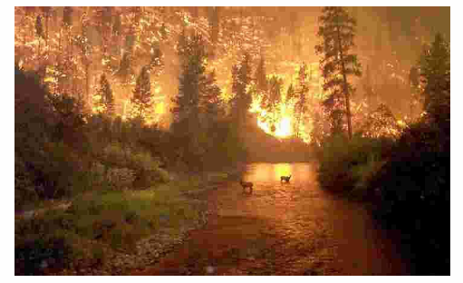
Fig 3.17 JPEG image with low quality specified by user
Q= 10%, size/original size = 1.5%, comp ratio= 66.77

