Slide 1
Chapter 6
Basics of Digital Audio
取樣定理
頻域轉換 for 定理證明、濾波處理
濾波器使用測試
格式 & 傳輸儲存方法
6.1 Digitization of Sound
6.2 MIDI: Musical Instrument Digital Interface
6.3 Quantization and Transmission of Audio
6.4 Further Exploration

Slide 2
Issues (modified outline)
數位化
格式
1.取樣
2.量化
5.記錄
6.傳輸
F.T.
4.濾波
3.合成
辨識
偵測
處理

Slide 3
What is Sound
A wave phenomenon like light
Molecules of air being compressed and expanded under the action of some physical device
  pressure wave
  continuous values (before digitized)
  reflection (反射)
  refraction (折射)
  diffraction (繞射)

Slide 4
Interesting Titbits
Typical Sampling Rates = 8k / 48k Hz
  Human voice → up to 4K Hz.
  Human ear can hear → 20 ~ 20K Hz.
  Nyquist Sampling Rate (later)
Musicology/ Octave/ Harmonics:
  note “A” (La) within middle C is 440 Hz.
  Octave above is another A note doubling the frequency, i.e., 880 Hz.
  any series of musical tones whose frequencies are integral multiples of the frequency of a fundamental tone.

Slide 5
Issues
數位化
格式
1.取樣
2.量化
5.記錄
6.傳輸
F.T.
4.濾波
3.合成
辨識
偵測
處理

Slide 6
Orthogonality (正交性)
W₁
W₂
W
F
W₅
W
W₃
G
θ
W₄
x= v₀ cos(θ) t – W/m t²
兩個分量其內積(1-by-1相乘相加)為零
無法再分解出投影在對方成分上的係數值
y= v₀ sin(θ) t – g t²
可用來投影、觀察、或數個物件進行加總、求平衡…

Slide 7
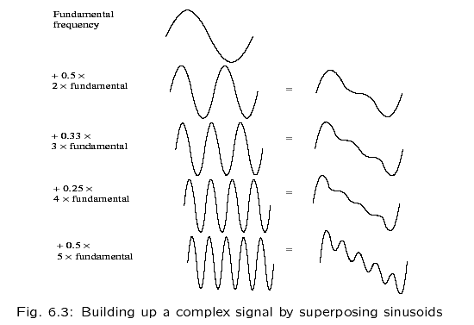
Signal Decomposition
Signals can be decomposed into a sum of sinusoids

Slide 8
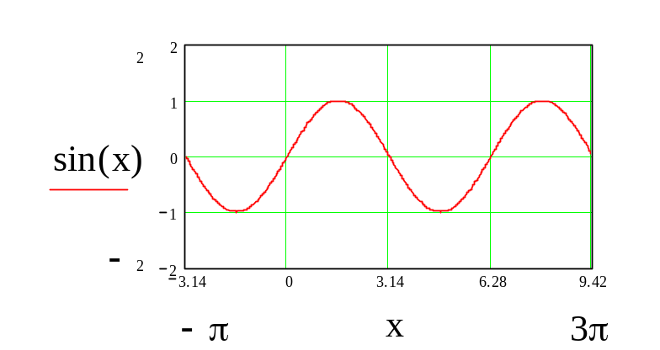
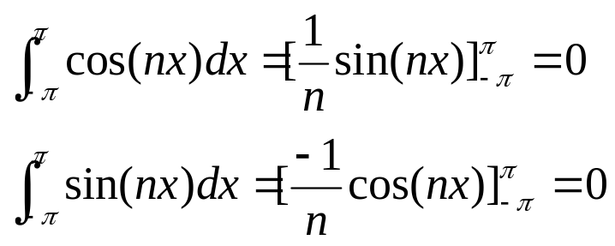
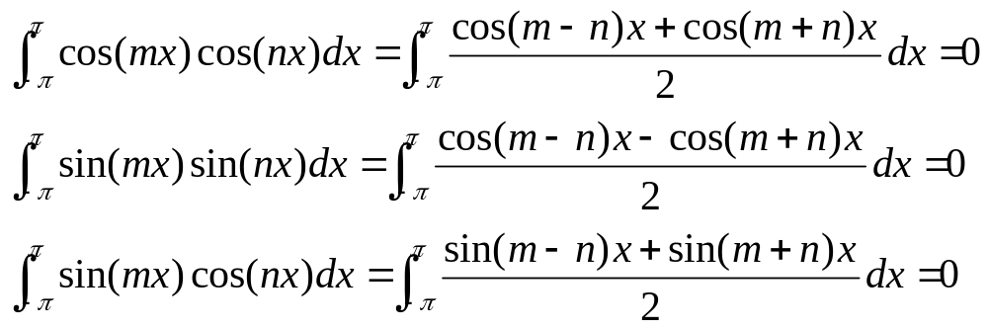

Orthogonality of Trigonometric Funcs.
三角函數的正交性

Slide 9
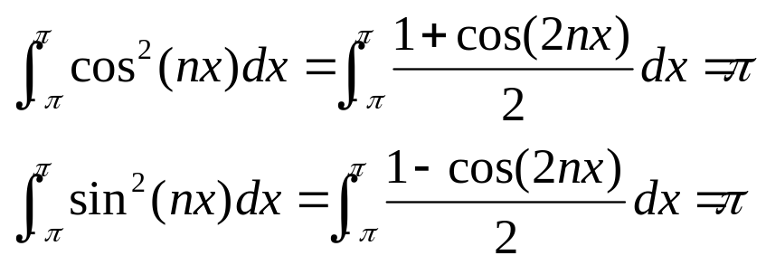
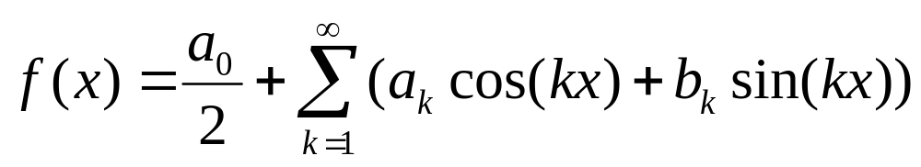
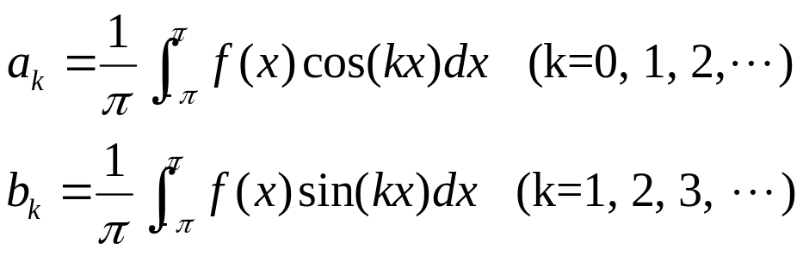
Euler-Fourier Formula
[Proof: a_{k}]
兩邊同時乘 cos(kx)
再逐項積分[-π,π]
意義: 依頻訊號強度

Slide 10
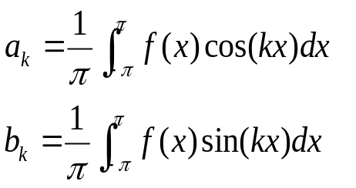
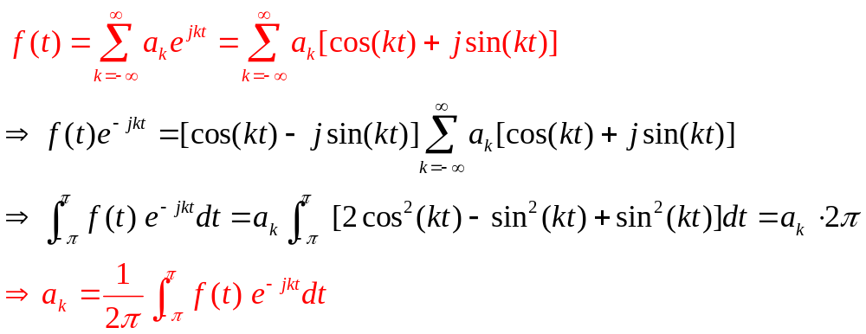

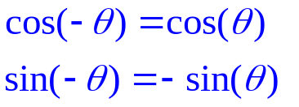
Fourier Series (複數型式的數列)
展開加項k, 去掉相乘之時域積分值為0 的項目
此處a_{k} 是個複數參數(具雙部)

Slide 11
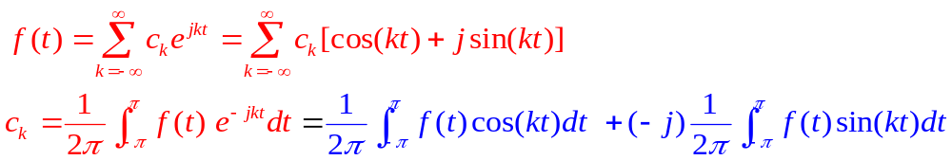
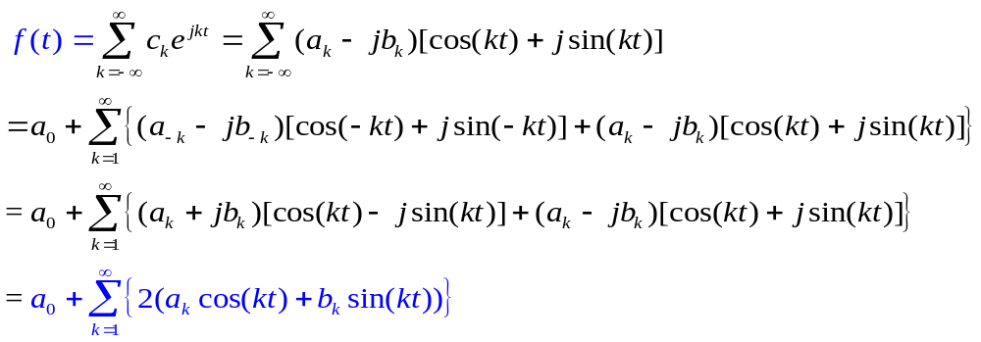
a_{k}
b_{k} (不含負號與虛數 j)
結論：兩組轉換式相同

Slide 12
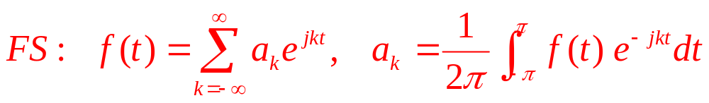
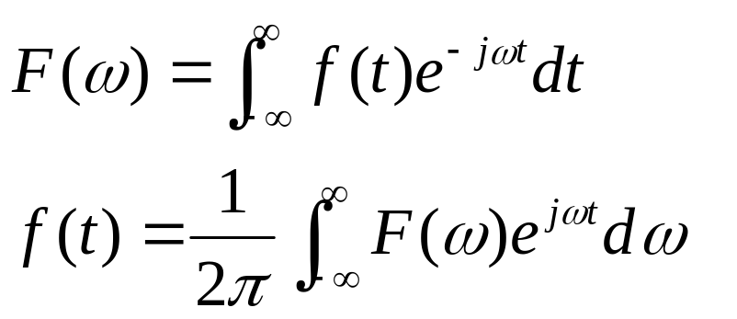
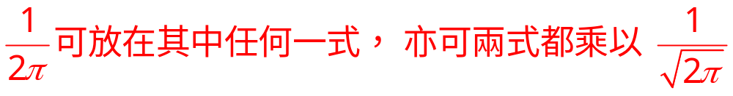
Fourier Transform (Rad)
把係數抽出來，不必
執著於等式的展開，
可以正/逆轉換即可。

Slide 13

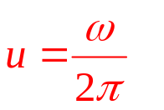
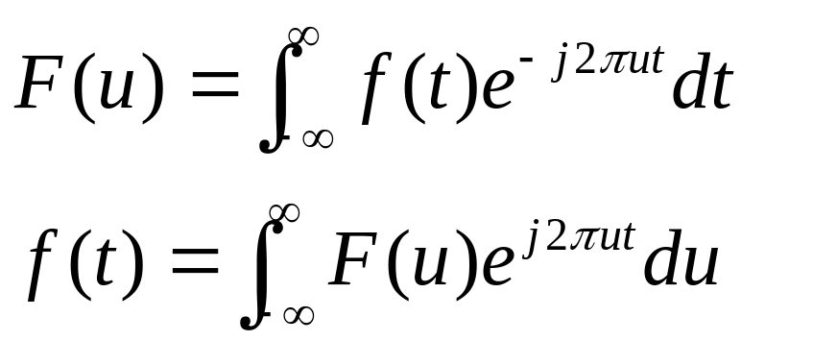
Fourier Transform (Hz)
w: 每秒相角轉幾弧度？
u: 每秒振動幾次(轉幾圈)？

Slide 14
Basic Properties
Time Domain |  | Frequency Domain
f(t) |  | F(u)
g(t) + h(t) |  | G(u) + H(u)
g(t) × h(t) |  | G(u) × H(u)
g(t) × h(t) |  | G(u) × H(u)
δ (t – T ) |  | δ (u - 1/T)
可見”帶通濾波”在”時域(time domain)”有多難處理
Demo

Slide 15
Issues
數位化
格式
1.取樣
2.量化
5.記錄
6.傳輸
F.T.
4.濾波
3.合成
辨識
偵測
處理

Slide 16
Issues for Digital Audio Data
What is the sampling rate?
How finely is the data to be quantized, and is quantization uniform?
How is audio data formatted?
(file format)

Slide 17
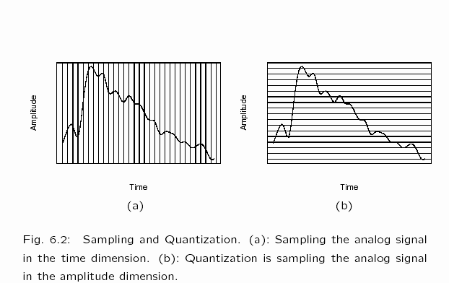
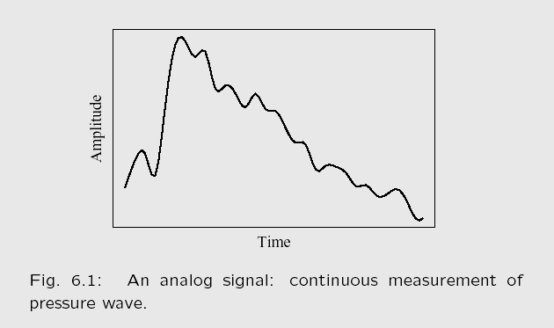
Digitization
Sampling
Quantization

Slide 18
Nyquist Theorem (1924)
Harry Nyquist (1889-1976)
If a signal is band-limited,
  i.e., there is a lower limit f1 and an upper limit f2 of frequency components in the signal
Sampling rate should be at least 2(f2 – f1).
Usually, f1 is “0”.

Slide 19
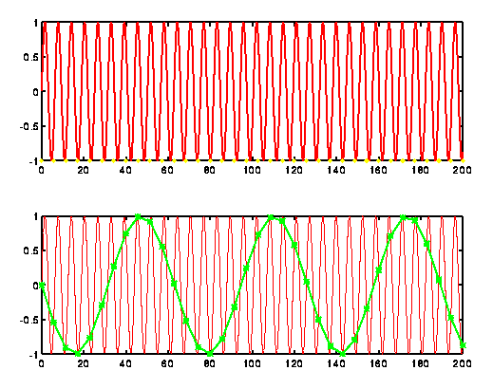
Time Domain Observation

Slide 20
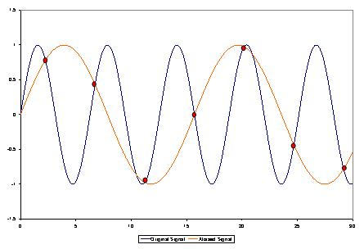
Alias Frequency
Sampling at 1.5 times per cycle produces an alias perceived frequency

Slide 21
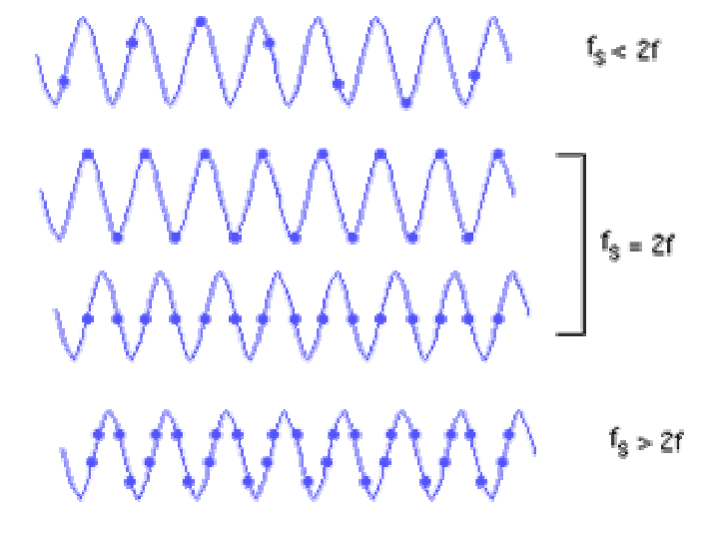
Nyquist Rate

Slide 22
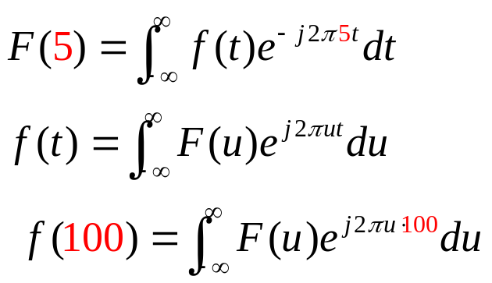

Fourier Transform (example)

Slide 23
Fourier Transform (Hz)
recall
w: 每秒相角轉幾弧度？
u: 每秒振動幾次(轉幾圈)？

Slide 24
Basic Properties
recall
Time Domain |  | Frequency Domain
f(t) |  | F(u)
g(t) + h(t) |  | G(u) + H(u)
g(t) × h(t) |  | G(u) × H(u)
g(t) × h(t) |  | G(u) × H(u)
δ (t – T ) |  | δ (u - 1/T)
可見”帶通濾波”在”時域(time domain)”有多難處理
Demo

Slide 25
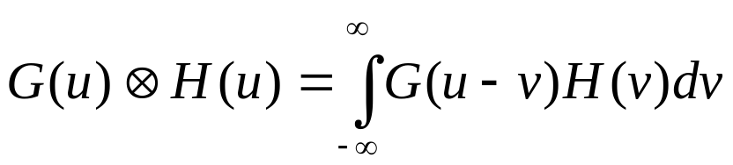
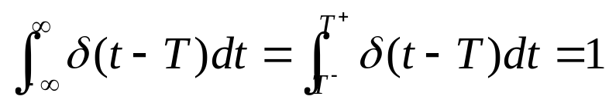
Basic Properties (Cont.)
Time Domain |  | Frequency Domain
g(t) × h(t) |  | G(u) × H(u)
δ (t – T ) |  | δ (u - 1/T)
Convolution
中譯: 疊代 or 旋積
Impulse Function
中譯：沖激函數

Slide 26
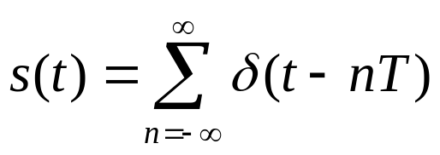
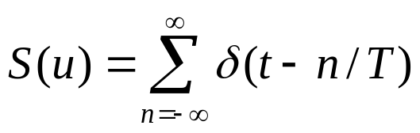
Sampling Rate
Time Domain |  | Frequency Domain
g(t) + h(t) |  | G(u) + H(u)
δ (t – T ) |  | δ (u - 1/T)
T
1/T

Slide 27
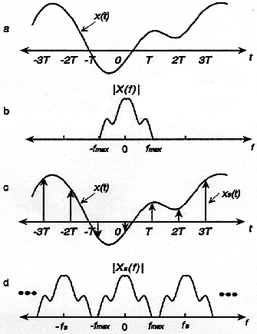
Fourier Spectrum
f(t)
f(t)
|F(u)|
| F(u) |
u_{max}
f(t)
f_{s}(t)
f_{s}(t) = f(t)．s(t)
Qu: what about T→0 ?
|F_{s}(u)|
1/T
Fs(u) = F(u) × S(u)
u_{max}
u_{sampling}

Slide 28
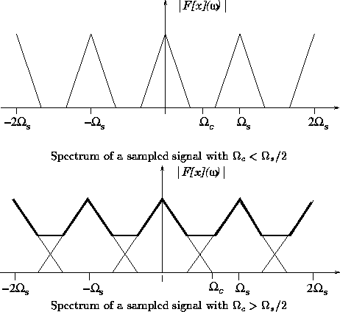
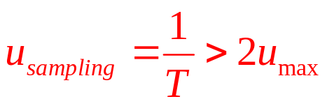
Nyquist Theorem (freq. Domain)
-1/T
0
u_{max}
1/T
2/T
=u_{sampling}
取樣頻率不到二倍
頻譜間格就不夠寬
-1/T
0
1/T
2/T
u_{max}
=u_{sampling}

Slide 29
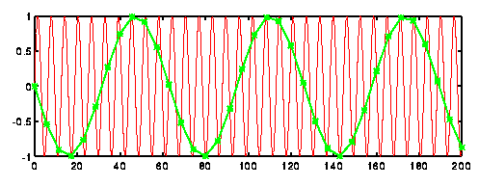
Nyquist Theorem (freq. Domain)
原本是兩個紅色peaks, 但取樣
複製出綠色peaks
而被誤解
如果是一段頻域如三角形所示，因複製干擾，則會產生Aliasing(串音)
-1/T
0
u_{max}
1/T
2/T
-1/T
0
1/T
2/T
u_{max}
=u_{sampling}

Slide 30
Issues
數位化
格式
1.取樣
2.量化
5.記錄
6.傳輸
F.T.
4.濾波
3.合成
辨識
鑑定
處理

Slide 31
Issues for Digital Audio Data
What is the sampling rate?
How finely is the data to be quantized, and is quantization uniform?
How is audio data formatted?
(file format)

Slide 32
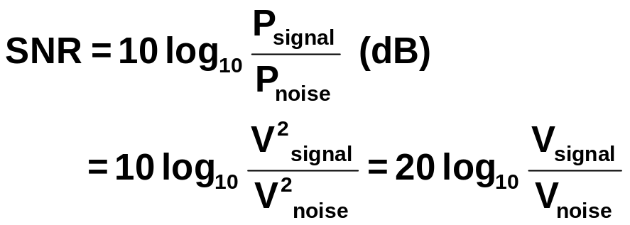
Signal to Noise Ratio (SNR)
A measure of the quality of the signal.
In units of dB (decibel), 10dB= 1 bel
Base-10 logarithms of the Ratio of
  (the power of the correct signal) and
  (the power of the noise)
Note: P=V²/R
The higher the better

Slide 33
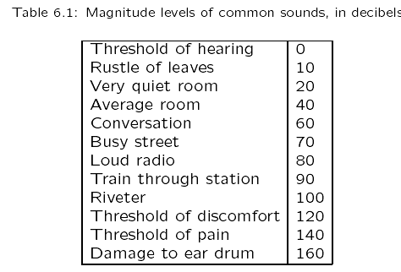
dB Applied to Common Sounds
A ratio to the quietest sound
  The quietest sound capable of hearing
  i.e. the just audible sound with frequency 1KHz
  Def. 10⁻⁵ N/m²
The lower the better

Slide 34
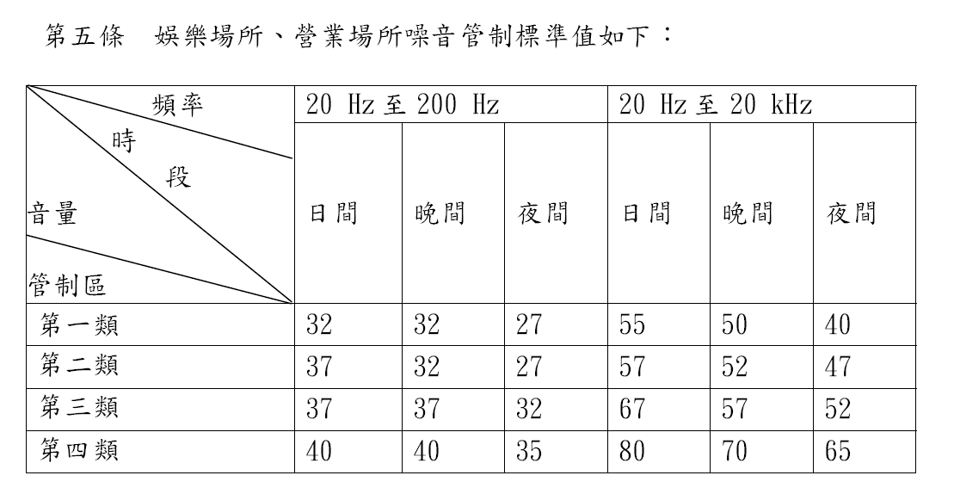
環保署噪音管制標準(1020065143號修正)

Slide 35
微軟消音室「-20.3分貝」 全球最安靜
2015-10-18 世界日報
美國華盛頓州瑞蒙市微軟總部87號大樓
獲認2015年金氏世界紀錄 -- 負20.3分貝
接近地球上可能達到的最安靜極限負23分貝
  空氣分子彼此碰撞製造的噪音強度
訓練太空人適應太空的「安靜環境」
  讓人產生幻覺和失去方向感，甚至站不穩
  安靜到讓人受不了，熬最久的人只停留了45分鐘
  聽到自己的心跳，甚至聽到肺部的聲音，以及肚子裡東西流動的聲音，自己變成了噪音來源

Slide 36
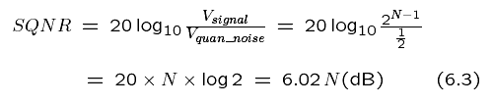
Signal to Quantization Noise Ratio
SQNR, Quantization noise = round-off error
Let quantization accuracy = N bits per sample
  The worst case SQNR = 6.02 N (dB)
  input signal is sinusoidal, the quantization error is statistically independent, SQNR = 6.02 N + 1.76 (dB)
SNR (SQNR) > 70
Can be acceptable
in general, i.e.,
We need N > 12

Slide 37
Linear and Non-linear Quantization
Linear format: samples are typically stored as uniformly quantized values.
Non-uniform quantization: set up more finely-spaced levels where humans hear with the most acuity.
  Weber's Law stated formally says that equally perceived differences have values proportional to absolute levels:
Δresponse ∞ ΔStimulus / Stimulus
(6.5)

Slide 38
Nonlinear Quantization
Transforming an analog signal
  from the raw s space
  into the theoretical r space, and then
uniformly quantizing the resulting values
  quantization of r
  giving finer resolution in s at the quiet end
Called μ-law encoding, (or u-law).
A very similar rule, called A-law
  used in telephony in Europe.

Slide 39
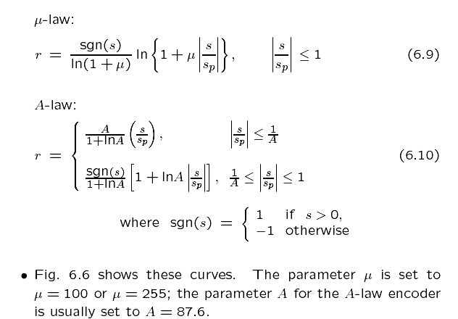
Equations of u-law and A-law
(6.9)
(6.10)

Slide 40
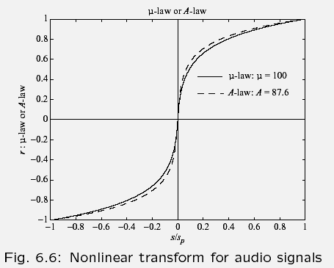
Nonlinear Transform for audio signals
Fig 6.6
r
s
音量較低的訊號
在量化過程中
被 “放大” 檢視

Slide 41
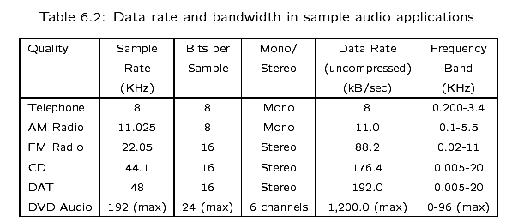
Data rate and bandwidth in sample audio applications
Table 6.2
Bytes
1/8
[1,2,6]
x
1/2 , “>=”

Slide 42
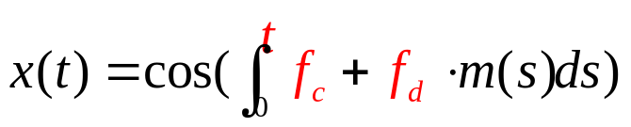

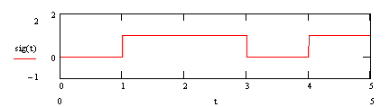
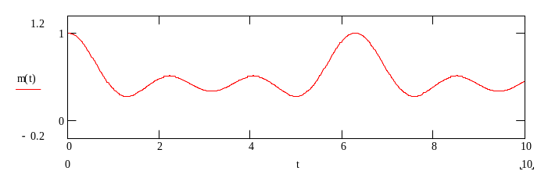
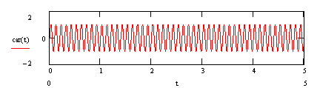
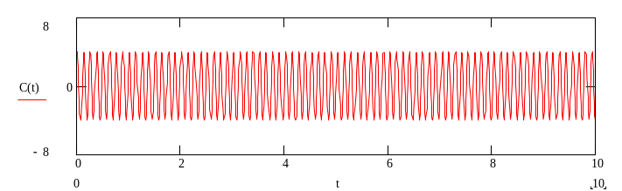
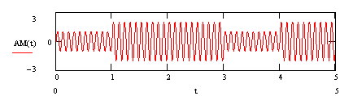
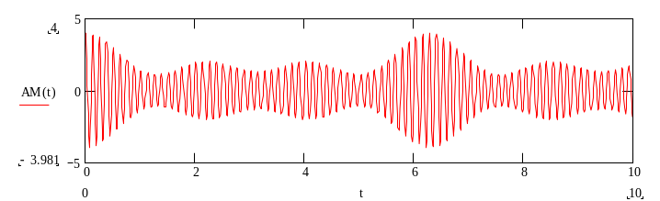
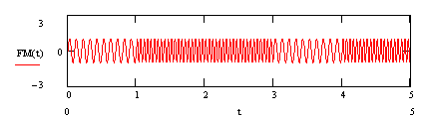
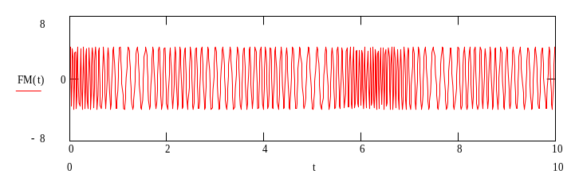
AM vs FM

Slide 43
Issues
數位化
格式
1.取樣
2.量化
5.記錄
6.傳輸
F.T.
4.濾波
3.合成
辨識
鑑定
處理

Slide 44
Synthetic Sounds
1. FM (Frequency Modulation):
  one approach to generating sound:
x(t) = A(t) cos[ M(t) ]
2. Wave table or wave sound
  A more accurate way of generating sounds from digital signals.

Slide 45
Issues
數位化
格式
1.取樣
2.量化
5.記錄
6.傳輸
F.T.
4.濾波
3.合成
辨識
鑑定
處理

Slide 46
Digital Filter
DEMO
Homework?
DFT/DCT (see DFTDCT.ppt)

Slide 47
Issues
數位化
格式
1.取樣
2.量化
5.記錄
6.傳輸
F.T.
4.濾波
3.合成
辨識
鑑定
處理

Slide 48
WAV File Format
‘RIFF’ | 4 bytes | RIFF file identification (Resource Interchange File Format)
<length> | 4 bytes | Length field (afterwards)
‘WAVE’ | 4 bytes | WAVE chunk identification
‘fmt’ | 4 bytes | Format sub-chunk identification
flength | 4 bytes | Length of format sub-chunk (afterwards)
format | 2 bytes | Format specifier (Linear-quantization PCM = 1)
Chans | 2 bytes | Number of channels
sampsRate | 4 bytes | Sampling rate in Hz
Bpsec | 4 bytes | Bytes per second = sampsRate x Bpsample
Bpsample | 2 bytes | Bytes per sample = chans x bpchan/8
bpchan | 2 bytes | bits per channel
‘data’ | 4 bytes | Data sub-chunk identificatoin
dlength | 4 bytes | Length of data sub-chunk (afterwards)
Values | dlength | Digital Audio Data
 | … | Other possible data chunk in the tail

Slide 49
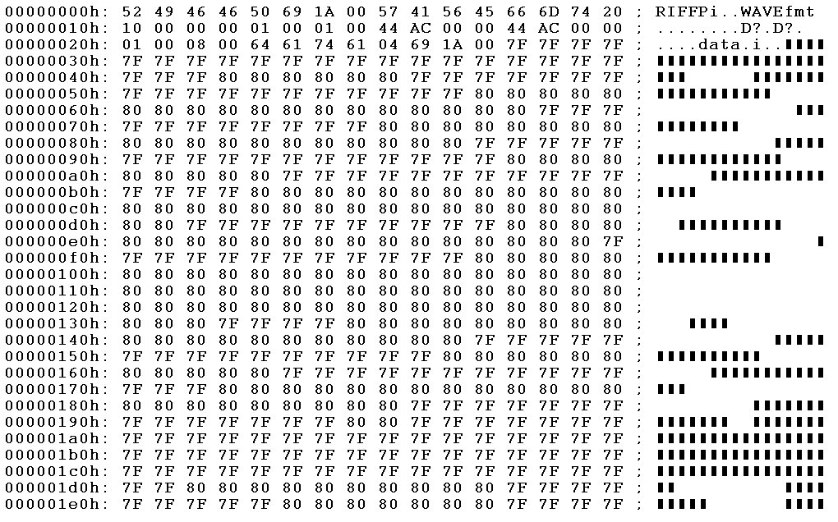
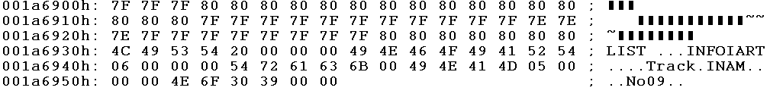
Binary Code (Sec1.wav)
Dlength=(001A6904)h=
1730820 =1730904 -44 -40
<length>=(001A6950)h=
1730896 = 1730904 -8
flength=(00 00 00 10)h=16
format = (00 01)h = 1 … PCM
chans = (00 01)h = 1
sampsRate = (00 00 AC 44)h = 44100
Bpsec = (00 00 AC 44)h = 44100
Bpsample = (00 01)h = 1
bpchan = (00 08)h = 8
檔頭到dlength 欄位結束
共44 bytes, 檔尾40 bytes

Slide 50
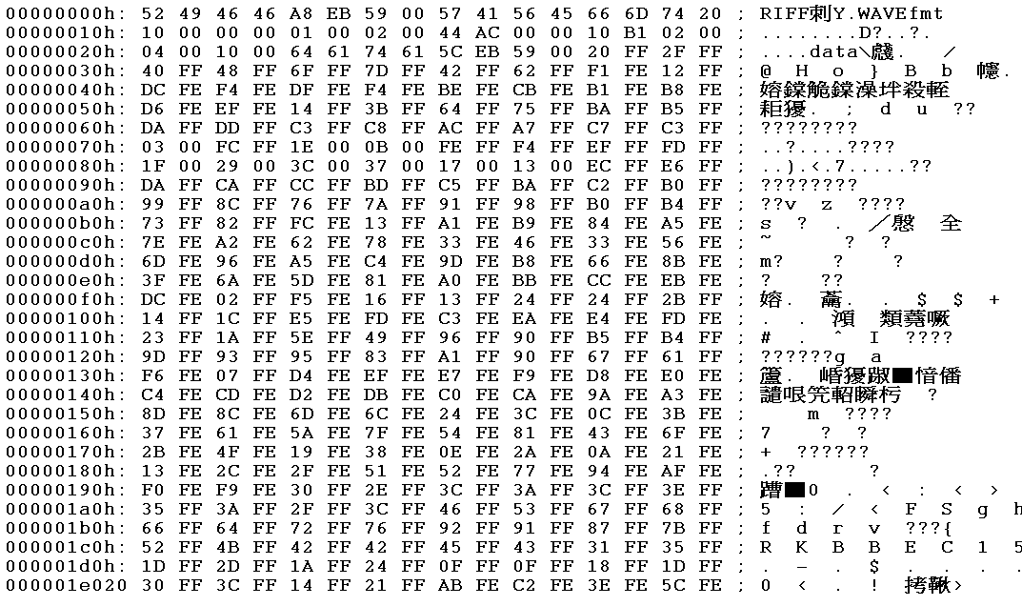

Binary Code (Sec2.wav)
<length>=(0059EBA8)h=
5893032 = 5893040 -8
Dlength=(0059EB5C)h=
5892956 =5893040 -44 -40
flength=(00 00 00 10)h=16
format = (00 01)h = 1 … PCM
chans = (00 02)h = 2
sampsRate = (00 00 AC 44)h = 44100
Bpsec = (00 02 B1 10)h = 17640
Bpsample = (00 04)h = 4
bpchan = (00 10)h = 16
檔頭到dlength 欄位結束
共44 bytes, 檔尾40 bytes

Slide 51
(break)

Slide 52
Issues
數位化
格式
1.取樣
2.量化
5.記錄
6.傳輸
F.T.
4.濾波
3.合成
辨識
鑑定
處理

Slide 53
Coding of Audio
Pulse Code Modulation: PCM (脈碼調變)
  The basic coding method
  Producing quantized sampled output for audio
The differences version: DPCM (差值脈碼調變)
A crude but efficient variant (delta): DM.
The adaptive version: ADPCM.
Example:
WAV 是一種 PCM 編碼
Skype 採用 ADPCM, 32kbps

Slide 54

Pulse Code Modulation: PCM
Original analog signal &
corresponding PCM signals.
(b) Decoded staircase signal.
(c) Reconstructed signal after low-pass filtering.
Fig 6.13

Slide 55

PCM in Telephony System
  如果有所謂的壓縮 (Compression)
  其實是指 Nonlinear Quantization
  8-bit, 8 kHz → 64 kbps

Slide 56
Coding of Audio
Pulse Code Modulation: PCM (脈碼調變)
  The basic coding method
  Producing quantized sampled output for audio
The differences version: DPCM (差值脈碼調變)
A crude but efficient variant (delta): DM.
The adaptive version: ADPCM.
Example:
WAV 是一種 PCM 編碼
Skype 採用 ADPCM, 32kbps

Slide 57
Three-Stages Compression
Every compression scheme has three stages:
  (A) The input data is transformed to a new representation that is easier or more efficient to compress.
  (B) We may introduce loss of information. Quantization is the main lossy step → we use a limited number of reconstruction levels, fewer than in the original signal.
  (C) Coding. Assign a codeword (thus forming a binary bitstream) to each output level or symbol. This could be a fixed-length code, or a variable length code such as Human coding (Chap. 7).
DPCM
(next page)
e.g.
Hoffman
code

Slide 58

Example: DPCM codec module
B
C
A

Slide 59
Huffman Code (Lossless Compression)
Symbol | @ | # | $ | &
Frequency | 1/8 | 1/4 | 1/2 | 1/8
Original Encoding | 00 | 01 | 10 | 11
 | 2 bits | 2 bits | 2 bits | 2 bits
Huffman Encoding | 110 | 10 | 0 | 111
 | 3 bits | 2 bits | 1 bit | 3 bits
Expected length
  Original ⇒ 1/8×2 + 1/4×2 + 1/2×2 + 1/8×2 = 2 bits / symbol
  Huffman ⇒ 1/8×3 + 1/4×2 + 1/2×1 + 1/8×3 = 1.75 bits / symbol

Slide 60
Huffman Tree Construction 1
A
B
C
D
E
3
2
5
8
7

Slide 61
Huffman Tree Construction 2
A
B
C
D
E
3
2
5
8
7
5

Slide 62
Huffman Tree Construction 3
A
D
E
B
8
7
3
2
C
5
5
10

Slide 63
Huffman Tree Construction 4
D
E
A
B
8
7
3
2
C
5
15
5
10

Slide 64
Huffman Tree Construction 5
010001110101110001
=DEDBCAED
A
B
3
2
E = 00
D = 01
C = 10
B = 110
A = 111
C
D
E
1
0
5
8
7
5
1
0
1
0
10
15
Average Length:
3x3/25 +3x2/25 +2x5/25
+ 2x8/25 +2x7/27 = 2.2 (bits)
1
0
25

Slide 65

Differential Coding of Audio
Audio is often stored not in simple PCM
Instead in a form that exploits differences –
  which are generally smaller numbers,
  so offer the possibility of using fewer bits to store.
(6.12)
最簡單的預估公式

Slide 66

Histogram of
digital speech signal
Signal Values
v.s.
Signal Differences
Fig 6.15

Slide 67



Predictive Coding
f0=f1, e0=0

Slide 68
Problem in Predictive Coding
f0=f1, e0=0
?!

Slide 69
DPCM codec module
引入 Quantization
已不是 lossless
必須用重建的訊號預估
而不可用真實訊號
真實
預估
重建 (訊號)

Slide 70

DPCM Formulae
(6.16)
"^" hat (預估)
"~" tilde (重建)

Slide 71

Example (DPCM, formulae)
Let Quantization Steps Be
{ … -24, -8, 8, 24, 40, 56, …}

Slide 72


Example (DPCM, results)
(2)
(3)
(1)
130
Encoder: (1) (2) (3)
Decoder: (1) (3)

Slide 73

DM (Delta Modulation) Formulae
(6.21)

Slide 74


Example (DM, results)
~
k=4, f₁=f₁=10

Slide 75

ADPCM codec module

Slide 76
End of Chap #6

