Slide 1
Implementing Microcontrollers and Sensors to Determine Ride Path on Roller Coasters
Hannah Arnold
23010127

Slide 2
Introduction

Slide 3
Project Overview
Why is it interesting?
Implement microcontrollers, Sensors and a camera to gain information on riders
Applied project management through research methods and methodologies
Developed a deeper understanding for embedded programming

Slide 4
Project Stages
Research Domain
1
Design a prototype
2
Build a Prototype
3
Code design
Wiring design
Test plan
Test Prototype
4
Collect sensor data
Detect emotion
LED and motor represent states
Unit Testing
Test entire artefact
Explore current uses
Find rider data

Slide 5
Research

Slide 6
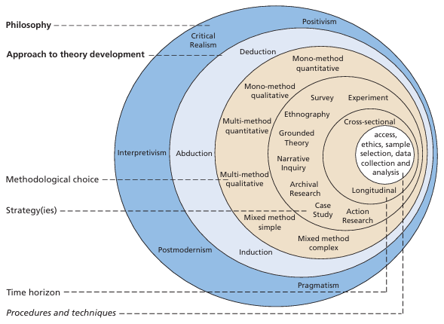
Research Methods
Research Onion
Positivism
Deductive
Mixed Method
Experimental and Case Study
Cross sectional
Secondary Research
Research Method
Scrum
Kanban
Iterative Waterfall

Slide 7
Problem Domain
Making roller coasters engaging to ride using interactivity but not virtual reality
Use eustress to interest riders instead of intense elements
How roller coasters affect rider’s, thus effecting sensor data

Slide 8
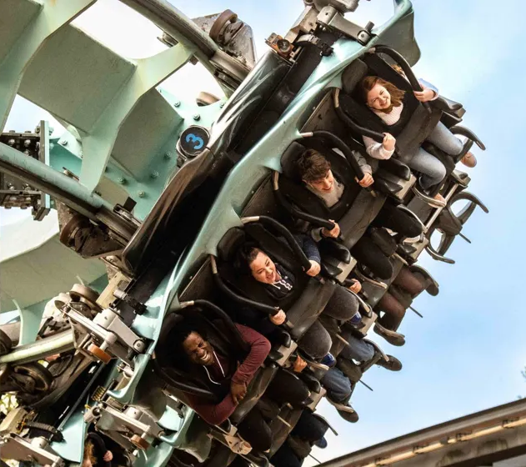
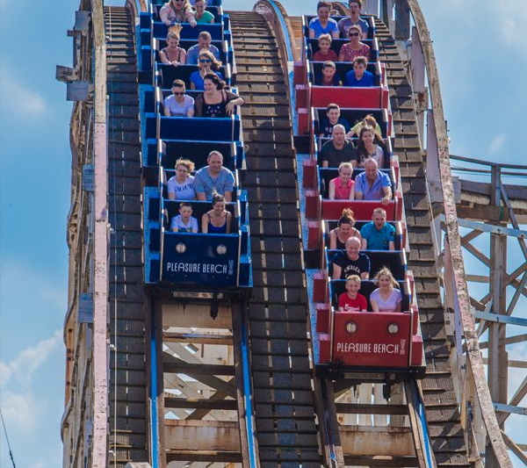
Current Industry Solutions
Examples of interactivity on rides
Virtual Reality (Coastiality, Galactica)
Sound Sensors (Adventure Drive)
Examples of dual track roller coasters
Grand National (One big looping track)
Racer (Kennywood)

Slide 9
Design

Slide 10
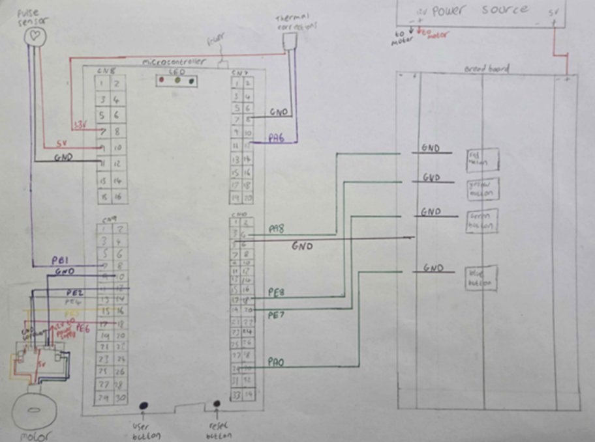
Physical Design
Software based program
LED light up with state
Motor move with state
Wiring diagram
Many different components

Slide 11
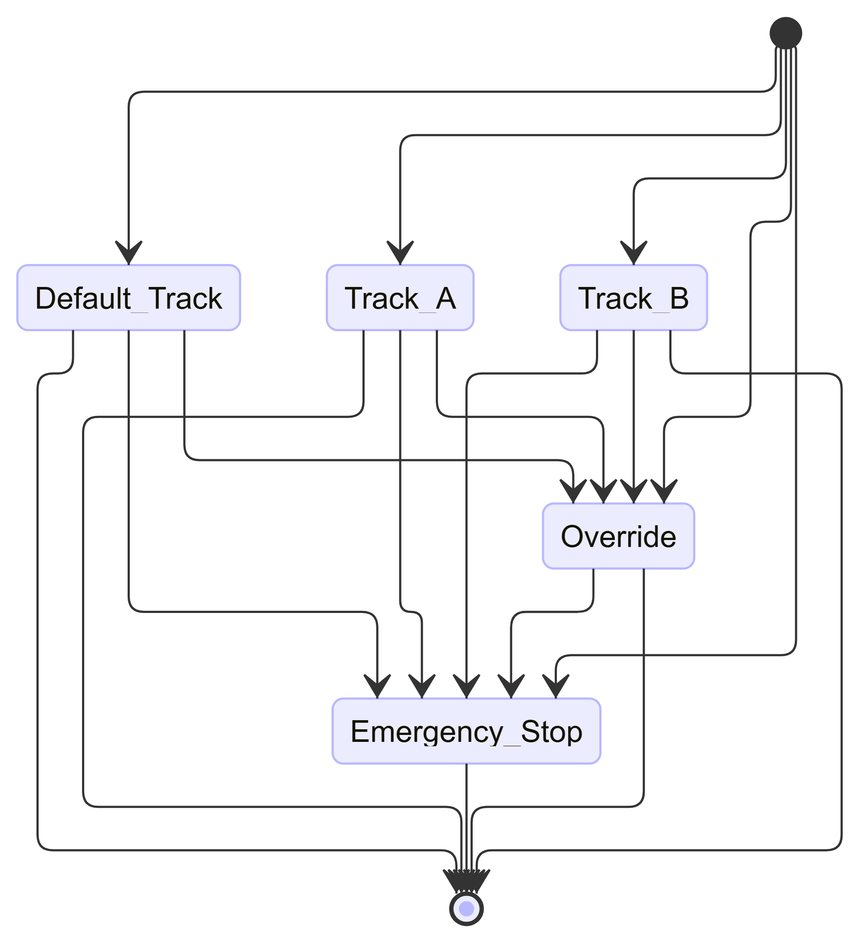
Software Design
Software
State Diagram
Flow chart
Algorithm
Deciding Logic
User Interface

Slide 12
Decision Making
ID | Thermal Sensor (Degrees Celsius) | Pulse Sensor (Beats Per Minute) | Result
1 | > 12 | > 89 | Excited
2 | < 12 | > 89 | Stressed
3 | > 12 | < 89 | Excited
4 | < 12 | < 89 | Bored
5 | > 12 | = 89 | Excited
6 | < 12 | = 89 | Stressed
7 | = 12 | = 89 | Bored
8 | = 12 | < 89 | Bored
9 | = 12 | > 89 | Stressed
Thermal and Pulse sensor compared to determine emotion
Emotion detection is also compared
Counts increase dependent on determined emotion

Slide 13
Implementation

Slide 14
Design Choices
Hardware
STM32 NUCLEO-H7A3ZI-Q
Stepper Motor
LM35 Temperature Sensor
Adafruit Pulse Sensor
Camera
Breadboard
Software
STMCubeIDE
C Programming language
LabView
G programming language

Slide 15
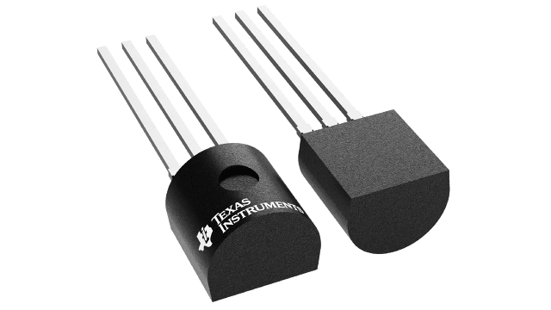
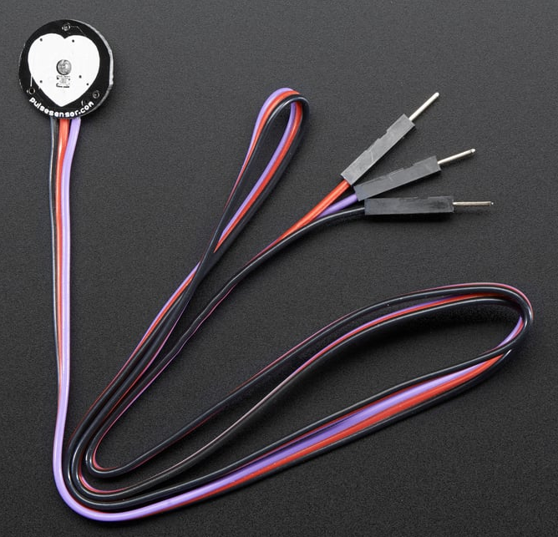
Sensor Data Collection
Thermal Data
Acquires data when user handles thermal sensor
Pulse Data
From buttons which pull from arrays
Was meant to use a pulse sensor

Slide 16
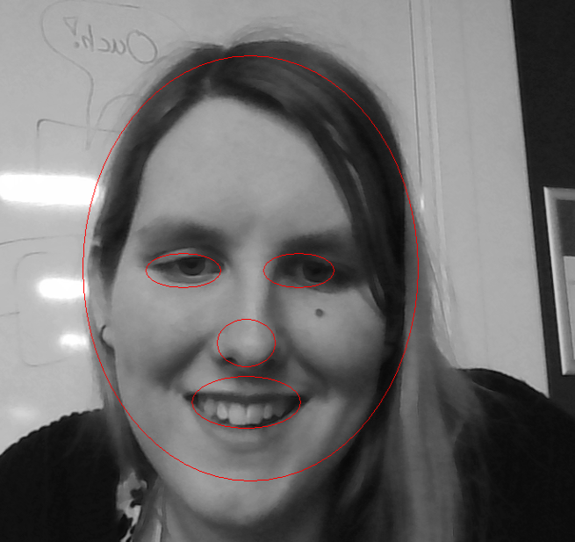
Emotion Detection
Takes snapshot of Users face
Detects for smile, frown or neutral emotion
Uses authors face as comparison for subject
Bias Data as a result
Heavily affected by external conditions

Slide 17
Testing and Results

Slide 18
Testing Strategy
Unit testing
Tested entire artefact
Quantitative

Slide 19
Results
Most Core functions work
Core functions that don’t work have been replaced with buttons
24 tests passed out of 28

Slide 20
Artefact Strengths
Temperature sensor acquires accurate data
Counts increase and determine track
LED’s correctly light up to represent state
Motor moves to represent switch track

Slide 21
Project Strengths
Engages rider by adding mystery
Anticipation as user directly affects choice
Encourages competitive nature (gamification)
Riders are less likely to get bored of re-riding

Slide 22
Limitations
Pulse Sensor didn’t acquire accurate data
I2C was unsuccessful
Emotion Detection Biased
Emotion Detection needs very precise conditions to work
No User Interface due to lack of I2C
Random State Will never be entered
Camera doesn’t track face, snapshot is needed

Slide 23
Changes
Due to environmental circumstances temperature sensor data was adjusted
Pulse sensor adjusted to buttons
I2C data updated using buttons instead of being transferred
User Interface no longer represents control panel

Slide 24
Ethics and Safety
Ethics
Images are deleted once program has stopped
Every new snapshot overrides the last so multiple images aren’t stored
Safety
Motor reaches 40 degrees while power supply is on
Ensure ground and power wires are wired correctly

Slide 25
Conclusion

Slide 26
Real World Implementation
Camera would be placed inside the seat in front
Pulse and Temperature sensor could be fit into a handle
3 Tracks would likely be difficult to implement
Couldn’t be implemented into existing systems

Slide 27
Future works
Accurate Timing methods for sensors
Varied data set
Track face instead of using snapshots
Transfer data between microcontrollers for more automation
Record people as they ride as well as a ride photo
Optional Survey to develop emotion data

Slide 28
What was learnt
Deeper knowledge of embedded programming practices
When to use specific tools
Understanding of how to build microcontroller systems
Stronger understanding of different components
Better understanding of time management
Better understanding of industry standards
How to take an advantage of resources

Slide 29
Thanks for Listening
Any Questions

Slide 30
Demonstration

Slide 31
References
Adadruit Industries (n.d.) Pulse Sensor Amped. Available at:https://www.adafruit.com/product/1093?srsltid=AfmBOorjT642vS6YmQhv8teXYAAdXPlvR_HjB-c79jlDL9Htnp2N7nDt [Accessed: 10 May 2026]
Alton towers (n.d.) Galactica. Available at: https://www.altontowers.com/explore/theme-park/rides-attractions/galactica/ [Accessed: 10 May 2026]
An, J., Payne, L., Liechty, T. & Iwasaki, Y., (2022). Understanding the experience of eustress among older adults with chronic conditions. Innovation in Aging, p489,
doi:10.1093/geroni/igac059.188. [Accessed: 10 May 2026].
Blackpool Pleasure Beach (2026) Grand National. Available at: https://www.blackpoolpleasurebeach.com/grand-national/ [Accessed: 10 May 2026]
Coasterpedia (n.d.) Adventure Drive. Available at: https://coasterpedia.net/wiki/Adventure_Drive [Accessed: 10 May 2026]
Europa Park (n.d.) Coastiality at Europa-Park. Available at: https://www.europapark.de/en/theme-park/info/media-entertainment/coastiality-europa-park [Accessed: 10 May 2026]
Fraser, C.J.,1994. Electrical and electronics principles. In: Mechanical Engineer’s Reference Book. 12th ed. Elsevier, Available at: https://www.sciencedirect.com/science/chapter/edited-volume/abs/pii/B9780750611954500063 [Accessed: 10 May 2026].

Slide 32
References
Kennywood (n.d.) Racer. Available at:
https://www.kennywood.com/discover-the-park/attractions/racer/ [Accessed: 10 May 2026]
Koivisto, J. and Hamari, J. (2019) ‘The rise of motivational information systems: A review of gamification research’, International Journal of Information Management, 45, pp. 191–210. doi:10.1016/j.ijinfomgt.2018.10.013. Available at: https://www.sciencedirect.com/science/article/pii/S0268401217305169 [Accessed: 10 May 2026]
National Instruments (n.d.) Develop graphical programming with LabVIEW. Available at: https://www.ni.com/en/shop/labview/develop-graphical-programming.html?srsltid=AfmBOoo3C-jekBaAOxkvRldgzU_x-HLvXxjO6W5r3tzhCswxtC1IzDAn [Accessed: 10 May 2026]
Pringle, S.D., Macfarlane, P.W. & Cobbe, S.M., 1989. Response of heart rate to a roller coaster ride. BMJ, 299(6715), p.1575. doi:10.1136/bmj.299.6715.1575. PMID: 2514919; PMCID: PMC1838817. [Accessed: 10 May 2026]
Rehkopf, M. (n.d.) What is a Kanban Board? Atlassian. Available at: https://www.atlassian.com/agile/kanban/boards [Accessed: 10 May 2026]
Sajak, A.A.B, (2021). Iterative Waterfall Model, ResearchGate. Available at: https://www.researchgate.net/figure/terative-Waterfall-Model_fig1_352087214 [Accessed: 10 May 2026].
Saunders, M., Lewis, P. & Thornhill, A. (2023) Research Methods for Business Students (9th edition.). Harlow: Pearson Education. [Accessed: 10 May 2026].
Schwaber, K. & Sutherland, J. (2020) The Scrum Guide. Available at: https://www.Scrumguides.org/Scrum-guide.html [Accessed: 10 May 2026].

Slide 33
References
STMElectronics (n.d.) NUCLEO-H7A3ZI-Q STM32 Nucleo-144 development board with STM32H7A3ZI MCU. Available at: https://www.st.com/en/evaluation-tools/nucleo-h7a3zi-q.html [Accessed: 10 May 2026]
Texas Instruments (n.d.) LM35CZ/NOPBAvailable at: https://www.ti.com/product/LM35/part-details/LM35CZ/NOPB [Accessed: 10 May 2026]
Vekoma Rides (n.d.) Understanding G-Forces. Available at: https://www.vekoma.com/public/files/understanding_g-forces_iaapa.pdf [Accessed: 10 May 2026].
Vinkers, C.H., Penning, R., Hellhammer, J., Verster, J.C., Klaessens, J.H.G.M., Olivier, B. & Kalkman, C.J., (2013). The effect of stress on core and peripheral body temperature in humans. Stress: The International Journal on the Biology of Stress, 16(5), pp.520–530. doi:10.3109/10253890.2013.807243. [Accessed: 10 May 2026]
Wolff, W., Özay-Otgonbayar, S., Danckert, J., Bieleke, M. and Martarelli, C.S. (2025) ‘Effort and boredom shape our experience of time’, Neuroscience & Biobehavioral Reviews. doi:10.1016/j.neubiorev.2025.103768. Avaialble at: https://www.sciencedirect.com/science/article/pii/S0149763425003768 [Accessed: 10 May 2026]

