Slide 1
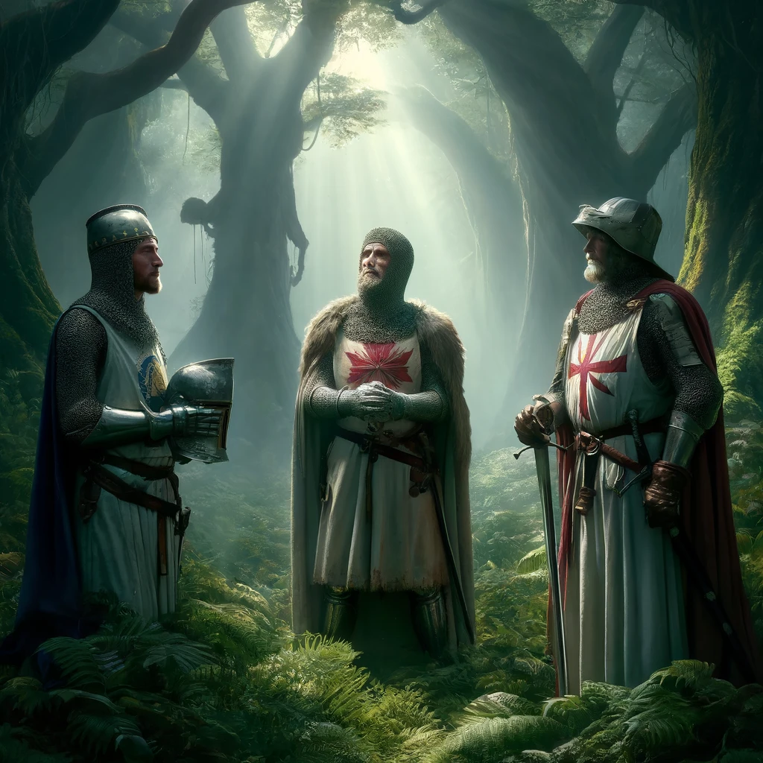
Quest for The Holy Grail
Contextual Layering:
1- Arthurian Legends takes places around 5th century after fall of the Roman administration
2- Arthurian Legends were composed inbetween the large timeframe of 8-15th centuries
3- Arthurian Legends were transformed to written format around mid 12th century
4- Arthurian Legends take place in the island of Britain with historical and mythical elements combined in the many tales and stories it has.
Slide Specific Question: Write an alternative ending to the story of the Holy Grail.
For the alternative ending to the quest for the Holy Grail, I’ve chosen a more mythical presence of the Holy Grail rather than a physical presentation where the quest for the Holy Grail is a trial of faith that the knights of the quest undergo during their hunt for the grail. In the end; the visual depiction is the perfect manifestation of their end of the journey where they realize that their quest was a test of their faith and test of their vows as a Knight and a moment of appreciation of each other on the end of their journey where they return to the roundtable being devoted knights to their faith in service to King Arthur.
Image generated using the prompt "Generate me an image depicting the quest for the Holy Grail with an alternative ending where Galahad, Percival and Bors come to realize that the holy grail is not real and the main focus of the quest is a trial of faith" by OpenAI, DALL-E, 2024 (https://labs.openai.com).
Berkem Elgül – 29363 – 27.04.2024

