Slide 1
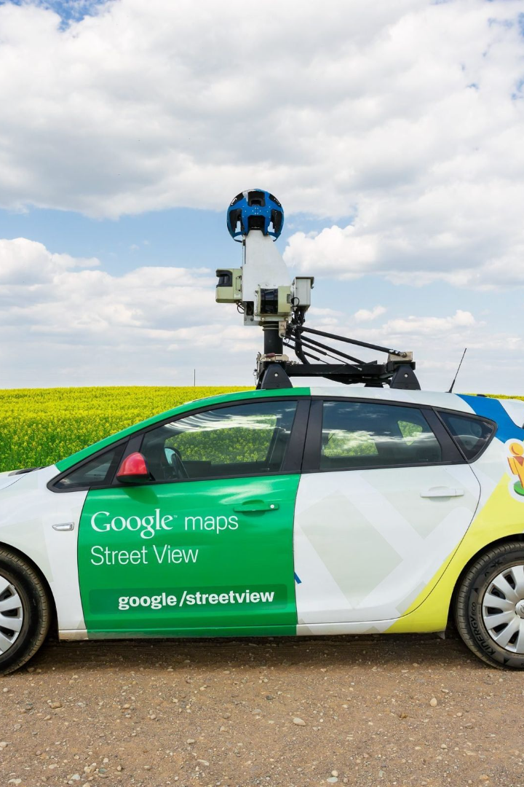
Gamifying Google Street View
Our website turns your Google Street View experience into a fun game. Use your navigation skills and knowledge of the world to guess your location.
It lies under the "Quality Education", "Sustainable Cities" and "Life on Land" goals of SDG.
TEAM 7

Slide 2

Computational Challenge from SDG Goals
1
The Problem
2
The Challenge
3
The Opportunity
Many people do not have enough financial resources to physically go to the historically relevant places far away from their homes and hence do not have sufficient knowledge about them.
To create an engaging game around street view locations while also collecting and analyzing data for sustainable city planning.
By gamifying Google Street View, we can get thousands of geographically diverse users to virtually visit cities and record data.

Slide 3
Existing Solutions and Their Limitations
App-Based Citizen Science
Uses the crowd for data collection. However, apps alone do not provide large or diverse enough datasets.
1
2
3
Professional Data Collection
Classic Gamification
Standard method for collecting data. It is expensive, time-consuming, and lacks geographical diversity.
Traditional game design can mask the goal for data collection and enforce competition rather than collaboration.

Slide 4
Our Proposed Solution
Street View Inspired Game
Innovative Data Collection
User Interaction & Incentive
Players will be randomly placed in Google Street View and given clues to guess their location.
Players will be asked to perform simple tasks that will help gather valuable data for urban planners.
The game will be designed to keep users engaged through interactive challenges and incentivized rewards.

Slide 5



Features
Interactive Gameplay
Data Collection for Sustainability
Incentivized Rewards
Our gameplay will engage users in a unique way they've never experienced before.
Offering rewards for performance and contributions will motivate players to stay engaged with the game more consistently.
Our game is designed to be a win-win for users and urban planners - everyone benefits!

Slide 6
Novelty and Innovation
Unconventional Gameplay
Collaborative Data Collection
Application and Impact
Our solution can be scaled to serve more cities in the pursuit of sustainable urban development through mass data collection.
We take a fresh approach to an otherwise mundane technology and add a new element of fun.
Our game fosters community involvement and input towards a common goal - Quality Education.

Slide 7
Evaluation Plan
Task Completion Speeds
We will measure the correlation between user task completion speeds and their accuracy ratings.
1
2
3
Navigational Accuracy
Data Significance
We will use our GPS API to track the player’s accuracy in identifying the street view location.
We will compare the accuracy of data collected through our game with the accuracy of existing professional data sets.

Slide 8
Researches
Anguelov, D., Dulong, C., Filip, D., & Frueh, C. (2010). Google Street View: Capturing the World at Street Level. https://www.researchgate.net/publication/220478096_Google_Street_View_Capturing_the_World_at_Street_Level

