Slide 1

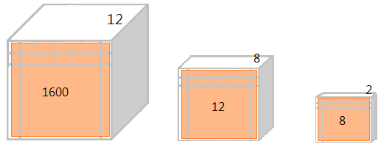
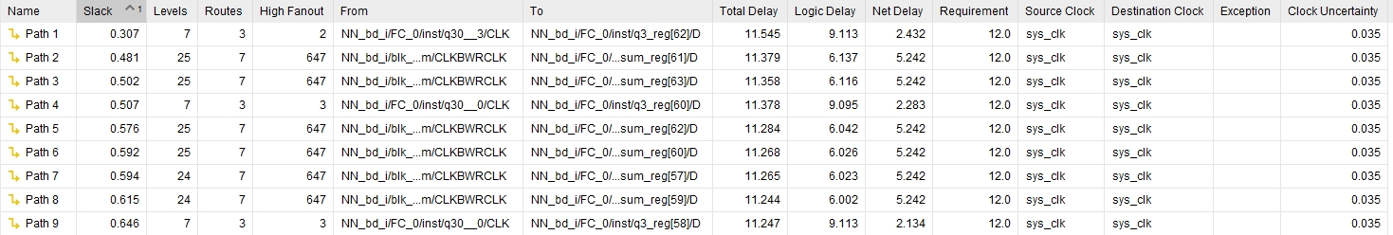
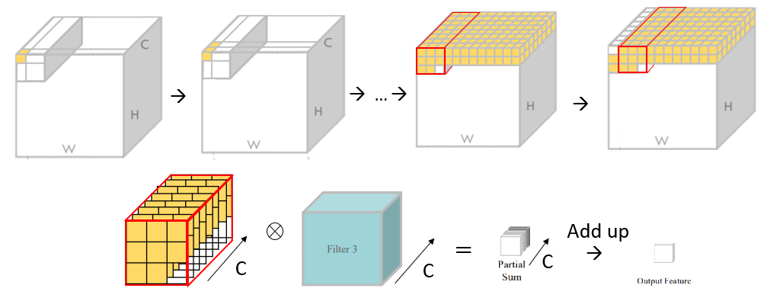
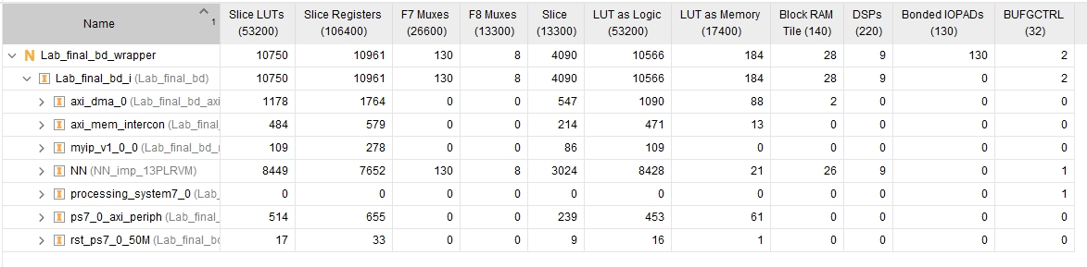
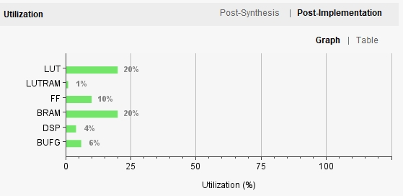
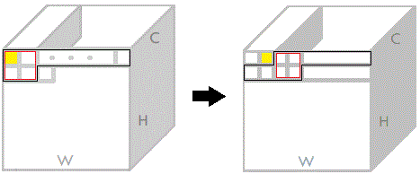
Convolution Neural Network Hardware Design
Embedded Deep Neural Network Processing | Group 5
M11202158 陳昱嘉 M11202122 鄭旭恆
Design concept and architecture
Convolution
In the convolutional layer, we fetch values channel by channel. The convolution calculation starts after fetching 2 * row + 2 values for each channel. With this, in subsequent readings, registers for different channels would sequentially fetch the essential data for convolution computation. This approach enables us to utilize only one register for accumulating partial sums, and the total clock cycles required to complete the convolution task will be close to the size of the input feature map. Additionally, after the convolution of a channel, the corresponding register can discard the first element, as it is not needed until a filter changes. This ensures that the register size for each channel remains at 2 * row + 3.
Static Timing Analysis
Total clock cycles =214592 clocks (max frequency: 41.68MHZ)
Hardware Utilization Rate
Max pooling & flatten
We used a queue to implement max pooling. When the queue reads (w+2) sizes and can start computing the max pooling result from the head and the tail of the queue until the end, this design not only saves register size but also accomplishes the mission as soon as possible.
After max pooling2, we formally write the results into RAM like form of the flatten phase, so we don’t need to do flatten stage individually.
Fully Connected
Conclusion
We implement a fully connected like a convolutional phase, with a key distinction being that the sliding window in the fully connected layer is equivalent to the flattened size. Moreover, in order to optimize register reuse and minimize the hardware area, we've integrated three layers of fully connected structures into a single unit. This design not only enhances efficiency but also results in a more expedited and efficient performance.
We make effort to combine some hardware architectures in one module and decrease model calculations within the fewest clock cycles possible. Reusing register in one module could reduce power consumption and decrease hardware utilization. However, this design needs more MUX to identify state in one module, so it causes more critical path delay and only operating in 41.6MHZ.

