Slide 1

Handwritten Digit
Recognition Using
Neural Network
A machine learning approach to
optical character recognition.
By Patel Ankshita Vinod

Slide 2



01 · THE CHALLENGE
Recognize digits 0 through 9
Handwriting is easy for people, hard for machines
Map handwritten marks to automatic digit predictions.
A human sees a digit as a shape; a model sees 784 measured intensities.
Handle visual variation
Writing style, stroke thickness, slant, and image noise alter the signal.
Connect to real workflows
Postal sorting, bank-check reading, and form processing rely on this capability.

Slide 3
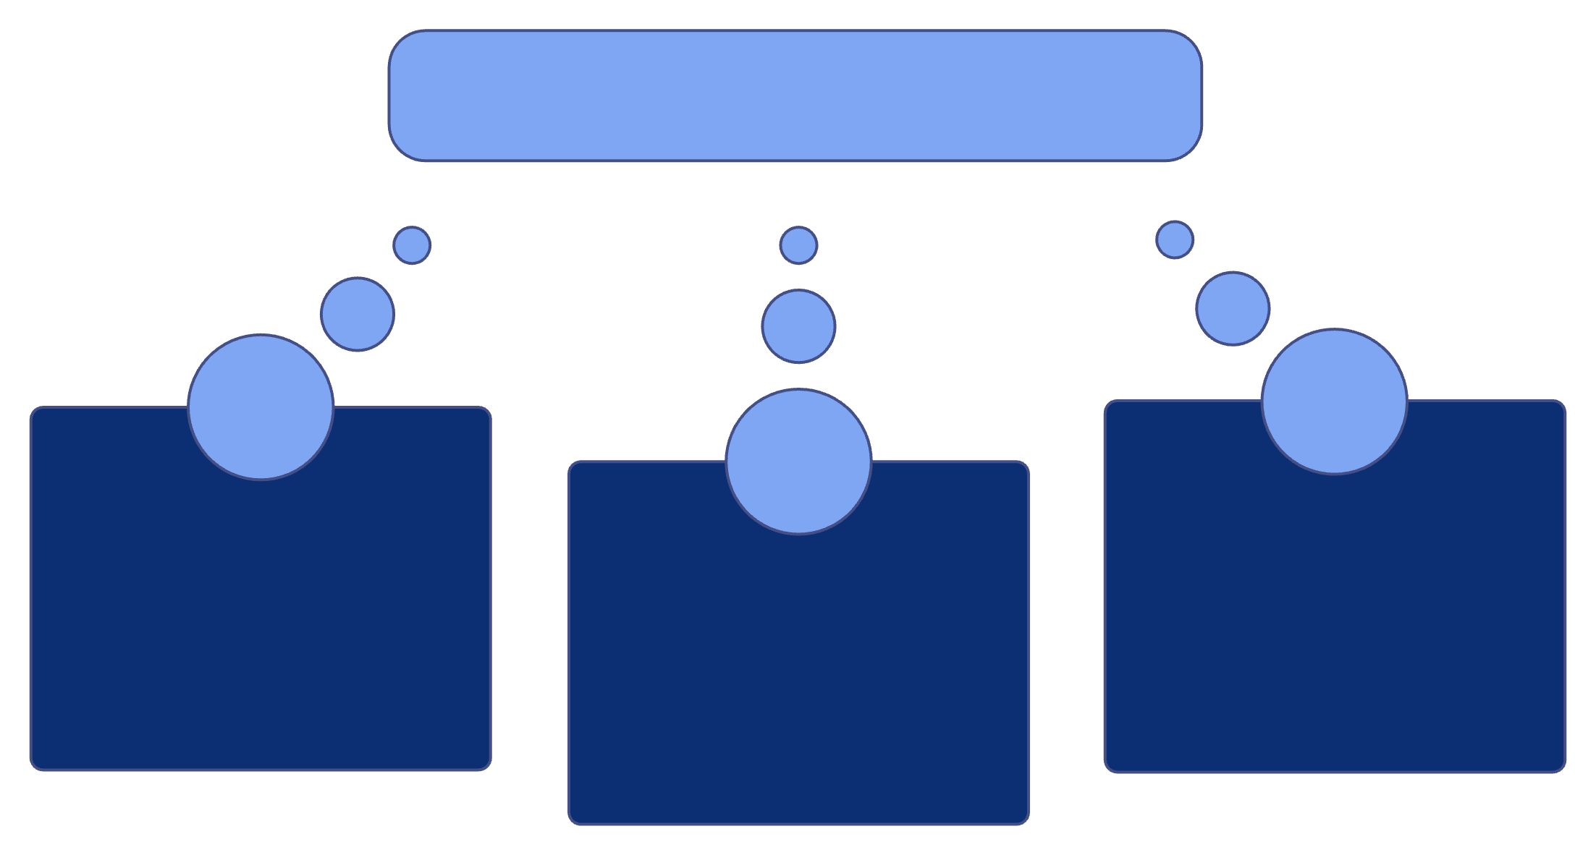



Digit Classification
02 · WHY IT MATTERS
Why digit recognition matters beyond the classroom
Searchable OCR Data
Image Understanding Reuse
Operational Workflows
Digit classification is a compact example of a much broader translation: visual marks become usable data.

Slide 4
03 · PROJECT FRAME
Build
Compare
The project turns pixels into reliable predictions
Grayscale digit inputs move through preprocessing, training, and inference.
Logistic Regression and SVM establish a performance floor beside CNNs.
Build the pipeline end to end, then evaluate the model from several angles.
Evaluate
Accuracy, precision, recall, and a confusion matrix expose model behavior.

Slide 5
04 · DATASET
MNIST gives the model 70,000 labeled examples
A compact, balanced benchmark with a clean train–test split.
Property | Value
Total images | 70,000
Training / test | 60,000 / 10,000
Image size | 28 × 28 × 1
Classes | 10 digits
Each example is labeled, grayscale, and assigned to one of the ten digit categories.

Slide 6
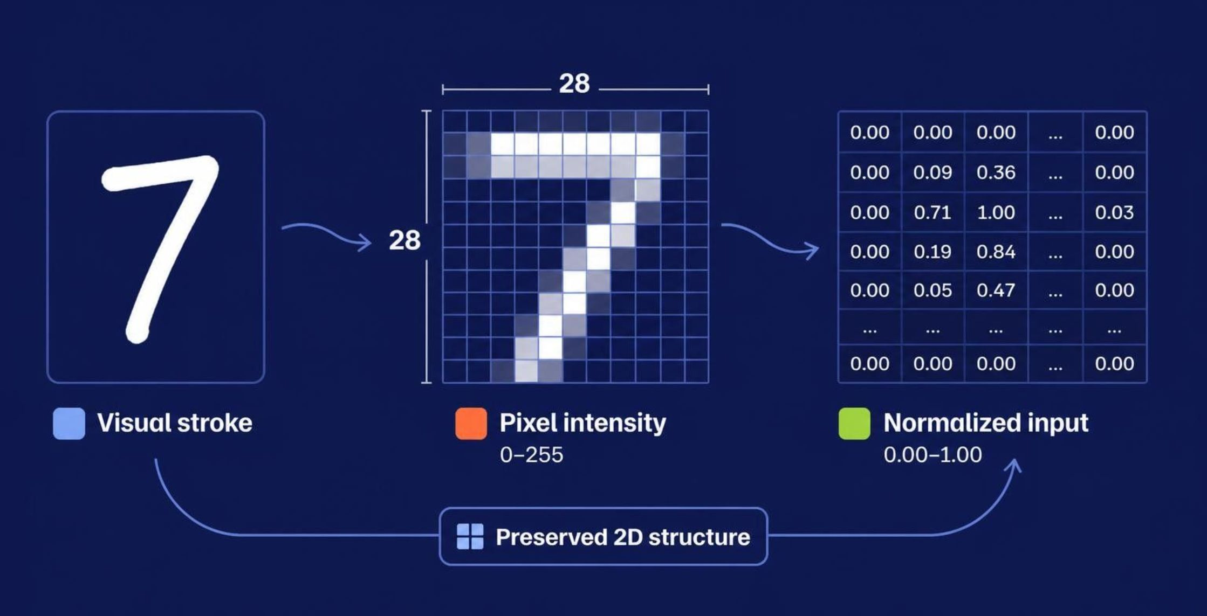
05 · REPRESENTATION
Each image is small, but every pixel carries signal
Intensity locates the stroke. Normalization stabilizes optimization. Reshaping preserves the 2D structure convolution can exploit.

Slide 7

06 · WORKFLOW
The pipeline moves from pixels to a tested model
Every stage makes the next decision more trustworthy.
Evaluate
Train
Test unseen data and watch for overfitting.
Explore
Compare baselines and CNNs through iterative training.
Preprocess
Inspect sample digits and class balance.
Normalize pixels and reshape image tensors.

Slide 8
07 · BASELINES
Baseline models create a useful performance floor
The baseline makes the CNN's value measurable rather than assumed.
Logistic Regression
SVM
CNN
Fast and interpretable. A direct reference point for the classification task.
Can separate classes effectively after suitable feature preparation.
Learns spatial image representations directly from pixels.
SPEED · HIGH
COMPLEXITY · MEDIUM
REPRESENTATION · LEARNED

Slide 9
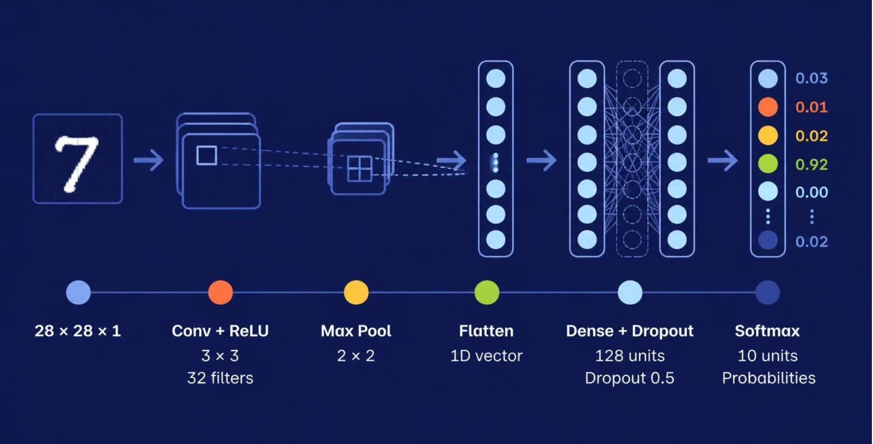
08 · ARCHITECTURE
A CNN learns shapes before it learns labels
Spatial features build upward into ten-class probabilities.

Slide 10





09 · OPTIMIZATION LOOP
Training improves the model one batch at a time
The model learns by measuring error, sending it backward, and updating its weights.
Feed labeled images
Predict the digit
Measure loss
Send a batch through the network.
Produce class probabilities from the input.
Compare the prediction with the true digit.
Backpropagate error
Update weights
Send the learning signal through the network.
Repeat across epochs while monitoring validation behavior.

Slide 11
10 · RESULTS OVERVIEW
Results need five measured views, not one number
Every value below is filled in from the experiment, not estimated here.
Accuracy
Precision
Recall
F1-score
Confusion matrix
Insert measured value
Insert measured value per class
Insert measured value per class
Insert measured value per class
Insert measured 10×10 counts

Slide 12
11 · MODEL COMPARISON
Each model trades speed for learned features
Criterion | Logistic Regression | SVM | CNN
Speed | Fastest to train | Moderate on large data | Slowest to train
Feature learning | None; uses raw pixels | Limited; kernel choice | Learns spatial features
Expected predictive strength | Solid baseline | Stronger baseline | Expected strongest
Actual test metrics | Placeholder: insert measured value | Placeholder: insert measured value | Placeholder: insert measured value

Slide 13
12 · ERROR ANALYSIS
Errors cluster around visually similar digits
The confusion matrix shows which class pairs the model mixes up.
Why it happens
How to read the matrix
Strokes that share a shape, such as loops and bars, blur together when written loosely.
Rows are true digits, columns are predictions. Off-diagonal cells mark class-specific weaknesses.
Commonly confused pairs are qualitative here; replace with the measured pairs from the confusion matrix.

Slide 14
13 · KEY FINDINGS
Four findings shape the next version
Preprocessing must match
CNNs learn spatial features
Training and test images need the same scaling and centering.
Convolutions read strokes and shapes directly from pixels.
Baselines set a floor
Accuracy is not enough
Simple models give a meaningful benchmark for the CNN.
Precision, recall, F1 and the confusion matrix reveal what accuracy hides.

Slide 15
14 · CONCLUSION
A CNN can read handwritten digits from pixels
The project takeaway is clear; the final numbers come from the experiment.
Next steps
Insert measured results for all five evaluation views
Inspect misclassified examples
Tune regularization and augmentation
Validate on less controlled handwriting

