Slide 1
ARTIFICAL INTELLIGENCE PROJECT
Cancer Classification and Prediction Using Neural Networks
Breast Cancer Wisconsin dataset
PRESENTED BY PATEL ANKSHITA VINOD

Slide 2



01 / MOTIVATION
Why automate tumor classification?
A model can make measurement-based analysis faster and more consistent while keeping clinical judgment in the loop.
Faster analysis
Consistent support
Clear output
Support faster analysis of tumor measurements.
Frame the model as a decision-support tool, not a replacement for clinical judgment.
Classify each case as benign or malignant.

Slide 3
02 / PROJECT SCOPE
Project objectives
01 / BUILD
02 / PREPARE
03 / EVALUATE
Predict
Prepare
Measure
Build an intelligent cancer prediction system.
Prepare healthcare data for machine learning.
Train a neural network and evaluate accuracy, precision, recall, F1 score, and confusion matrix.
A BINARY CLASSIFICATION TASK
FROM RAW MEASUREMENTS TO INPUTS
RESULTS MUST EXPLAIN ERRORS

Slide 4
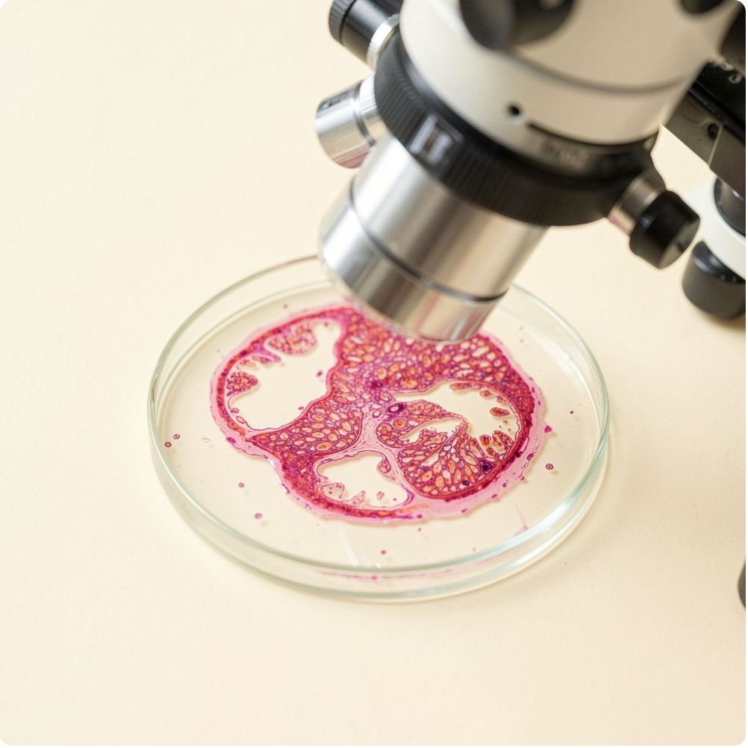
03 / DATASET
The dataset turns tumor shape into measurable signals
Each record converts observed tumor characteristics into numeric inputs that a model can compare.
569
30
RECORDS
NUMERIC TUMOR FEATURES
Feature groups include radius, texture, perimeter, area, smoothness, compactness, concavity, symmetry, and fractal dimension.
Each row also includes an identifier and diagnosis label.
THE MODEL RECEIVES MEASURABLE SIGNALS, NOT A VISUAL IMPRESSION.
B = BENIGN
M = MALIGNANT

Slide 5
04 / PREPROCESSING PIPELINE
From raw measurements to model-ready inputs
Five preparation steps make the dataset usable for supervised learning.
01
02
03
04
05
Load
Separate
Encode
Scale
Split
Load and inspect the dataset.
Separate features from the diagnosis target.
Encode the two classes numerically.
Scale features so large-valued measurements do not dominate.
Split data into training and validation/test sets.

Slide 6




05 / MODEL DESIGN
Neural network architecture
Numeric features flow through an input layer, fully connected hidden layers with nonlinear activation, and a binary output layer that returns the probability of malignancy.
INPUT
HIDDEN LAYERS
Standardized tumor measurements
Fully connected layers
OUTPUT
Probability
Model-ready numeric features enter the network.
Nonlinear activation learns feature interactions.
Benign vs malignant prediction.

Slide 7
06 / TRAINING CONTROL
Training strategy reduces overfitting
The training process watches validation behaviour, not only the score on examples it has already seen.
01 / MONITOR
02 / STOP
03 / RUN
Validation loss
Early stopping
51 epochs
Monitor validation loss during training.
Use early stopping with patience 10 and restore the best weights.
The supplied run trained for 51 epochs, with validation accuracy staying near the high-0.96 range by the end.
A CHECK BEYOND THE TRAINING SET
PATIENCE 10
BEST WEIGHTS RESTORED

Slide 8
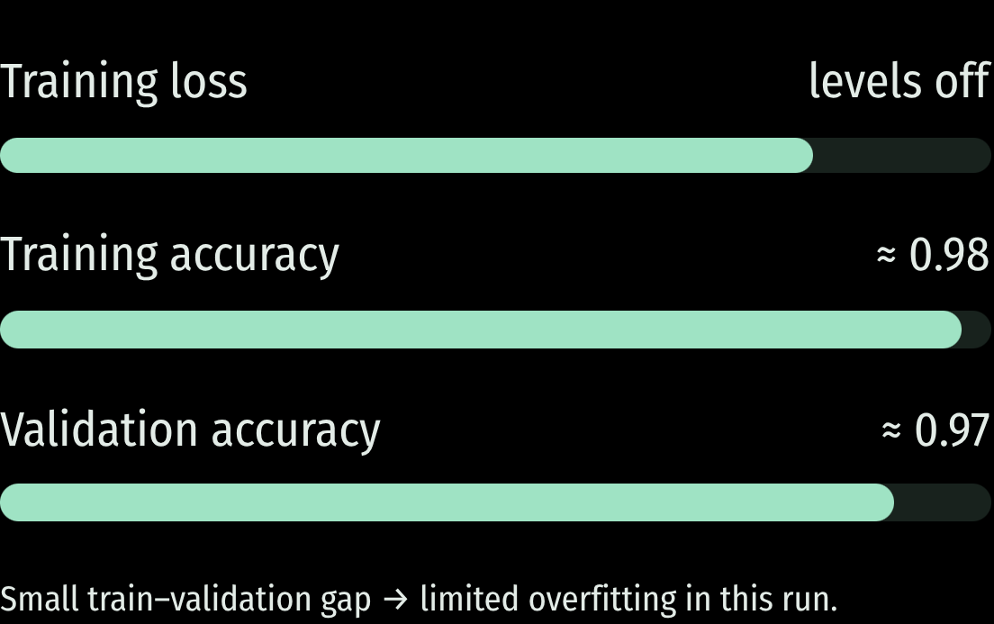
07 / TRAINING EVIDENCE
The model converges quickly and generalizes well
The supplied curves show a sharp early improvement, followed by a stable plateau.
LOSS
ACCURACY
Falls, then levels off
High and close
At roughly epoch 50, training accuracy is about 0.98 and validation accuracy about 0.97.
Training loss falls sharply in the first 10 epochs and then levels off.
EARLY LEARNING · STABLE FINISH
ESTIMATED FROM THE PLOTTED CURVES

Slide 9
08 / EVALUATION
Confusion matrix: most cases land on the diagonal
The diagonal contains correct predictions. Off-diagonal cells expose the errors that deserve attention.
PREDICTED CLASS
WHAT MATTERS
ACTUAL | BENIGN | MALIGNANT
Benign | 71 TRUE BENIGN | 1 FALSE MALIGNANT
Malignant | 2 FALSE BENIGN | 40 TRUE MALIGNANT
False negatives
Use the matrix to show which error matters most: a malignant case predicted benign is a false negative.
FALSE BENIGN = 2

Slide 10
09 / RESULTS WITH CONTEXT
Performance metrics translate errors into meaning
The supplied confusion matrix becomes four complementary views of this evaluation split.
ACCURACY
PRECISION
RECALL
F1 SCORE
97.4%
97.6%
95.2%
96.4%
111/114
40/(40+1)
40/(40+2)
Malignant class
MALIGNANT PREDICTIONS CORRECT
OVERALL CORRECT
MALIGNANT CASES FOUND
PRECISION–RECALL BALANCE
Metrics are calculated from the supplied confusion matrix; they describe this evaluation split, not universal clinical performance. This model is a decision-support tool, not a replacement for clinical judgment.

Slide 11
10 / BEYOND ACCURACY
Accuracy alone hides the costly errors
Precision and recall show how the model behaves on each class.
PRECISION
RECALL
WHY IT MATTERS
97.6%
95.2%
2 misses
40 of 41 malignant predictions were correct
40 of 42 malignant cases were found
False negatives delay treatment
PROTECTS PATIENTS FROM FALSE ALARMS
PROTECTS PATIENTS FROM MISSED CANCERS
RECALL IS WEIGHTED FIRST IN SCREENING
Notes:
Explain that accuracy can look strong while a few missed malignant cases still matter most.

Slide 12
11 / ERROR ANALYSIS
Benign and malignant errors carry different risks
The three errors in the confusion matrix point in different clinical directions.
FALSE NEGATIVES: 2
FALSE POSITIVES: 1
Missed malignancy
Unneeded follow-up
Malignant tumors predicted as benign delay diagnosis and treatment.
Benign tumors predicted as malignant trigger extra tests and anxiety.
HIGHEST PRIORITY TO REDUCE
LOWER COST, STILL REVIEWED BY CLINICIANS
Notes:
Walk through both error types and why the model is tuned to avoid false negatives.

Slide 13
12 / CLINICAL WORKFLOW
From measurement to clinician review in four steps
The model supports a decision; the clinician makes it.
STEP 1
STEP 2
STEP 3
STEP 4
Measure
Prepare
Predict
Review
Record cell nucleus measurements from the sample.
Scale and normalize the 30 features for the network.
The network returns a benign or malignant probability.
A clinician checks the result before any decision.
Notes:
Stress that the output is decision support and that clinician review closes the loop.

Slide 14
13 / LIMITATIONS
Limits, risks, and ethics shape safe use
A small, single-source dataset cannot certify performance for every patient.
Dataset bias
Explainability
Privacy
Human oversight
114 test cases may not reflect all patients, scanners, or populations.
Clinicians need to see which features drove each prediction.
Patient data must be protected and used under clear consent rules.
Every prediction needs qualified clinical review before action.
This classifier is a decision-support tool, not a replacement for clinical judgment.
Notes:
Cover bias, explainability, privacy, and oversight as conditions for any deployment.

Slide 15
14 / TAKEAWAYS AND NEXT STEPS
Accurate models still need careful, human-led deployment
The classifier is promising; the next work is validation, transparency, and oversight.
KEY TAKEAWAYS
NEXT STEPS
Accuracy of 97.4% on the test split
Recall guards against missed cancers
Clinicians remain the final decision makers
Validate on larger, multi-site datasets
Add explainability for each prediction
Pilot with clinicians under oversight
Notes:
Close by asking for support for a staged pilot with clinical review and monitoring.

