Slide 1

空白演示
Pig breeding intelligent hardware products
单击输入您的封面副标题
Qingdao Kechuang Xinda Technology Co., Ltd
2021.10.23

Slide 2
Pig product system
Super Brain for Pigsty: Climate Controller K16 Pro, K16, K9
Brain for Building Breeding: Climate Controller BC-M1, BC-S1
Alarms & Guards: S1、A1、A2、A3
IoT Modules: Wired gateway, Wireless gateway, XiaoKe-AI-Farm IoT Big Data Platform
Sensors : CO2 Sensor, Temperature Sensor, NH3 Sensor, Humidity Sensor, Static Pressure Sensor

Slide 3
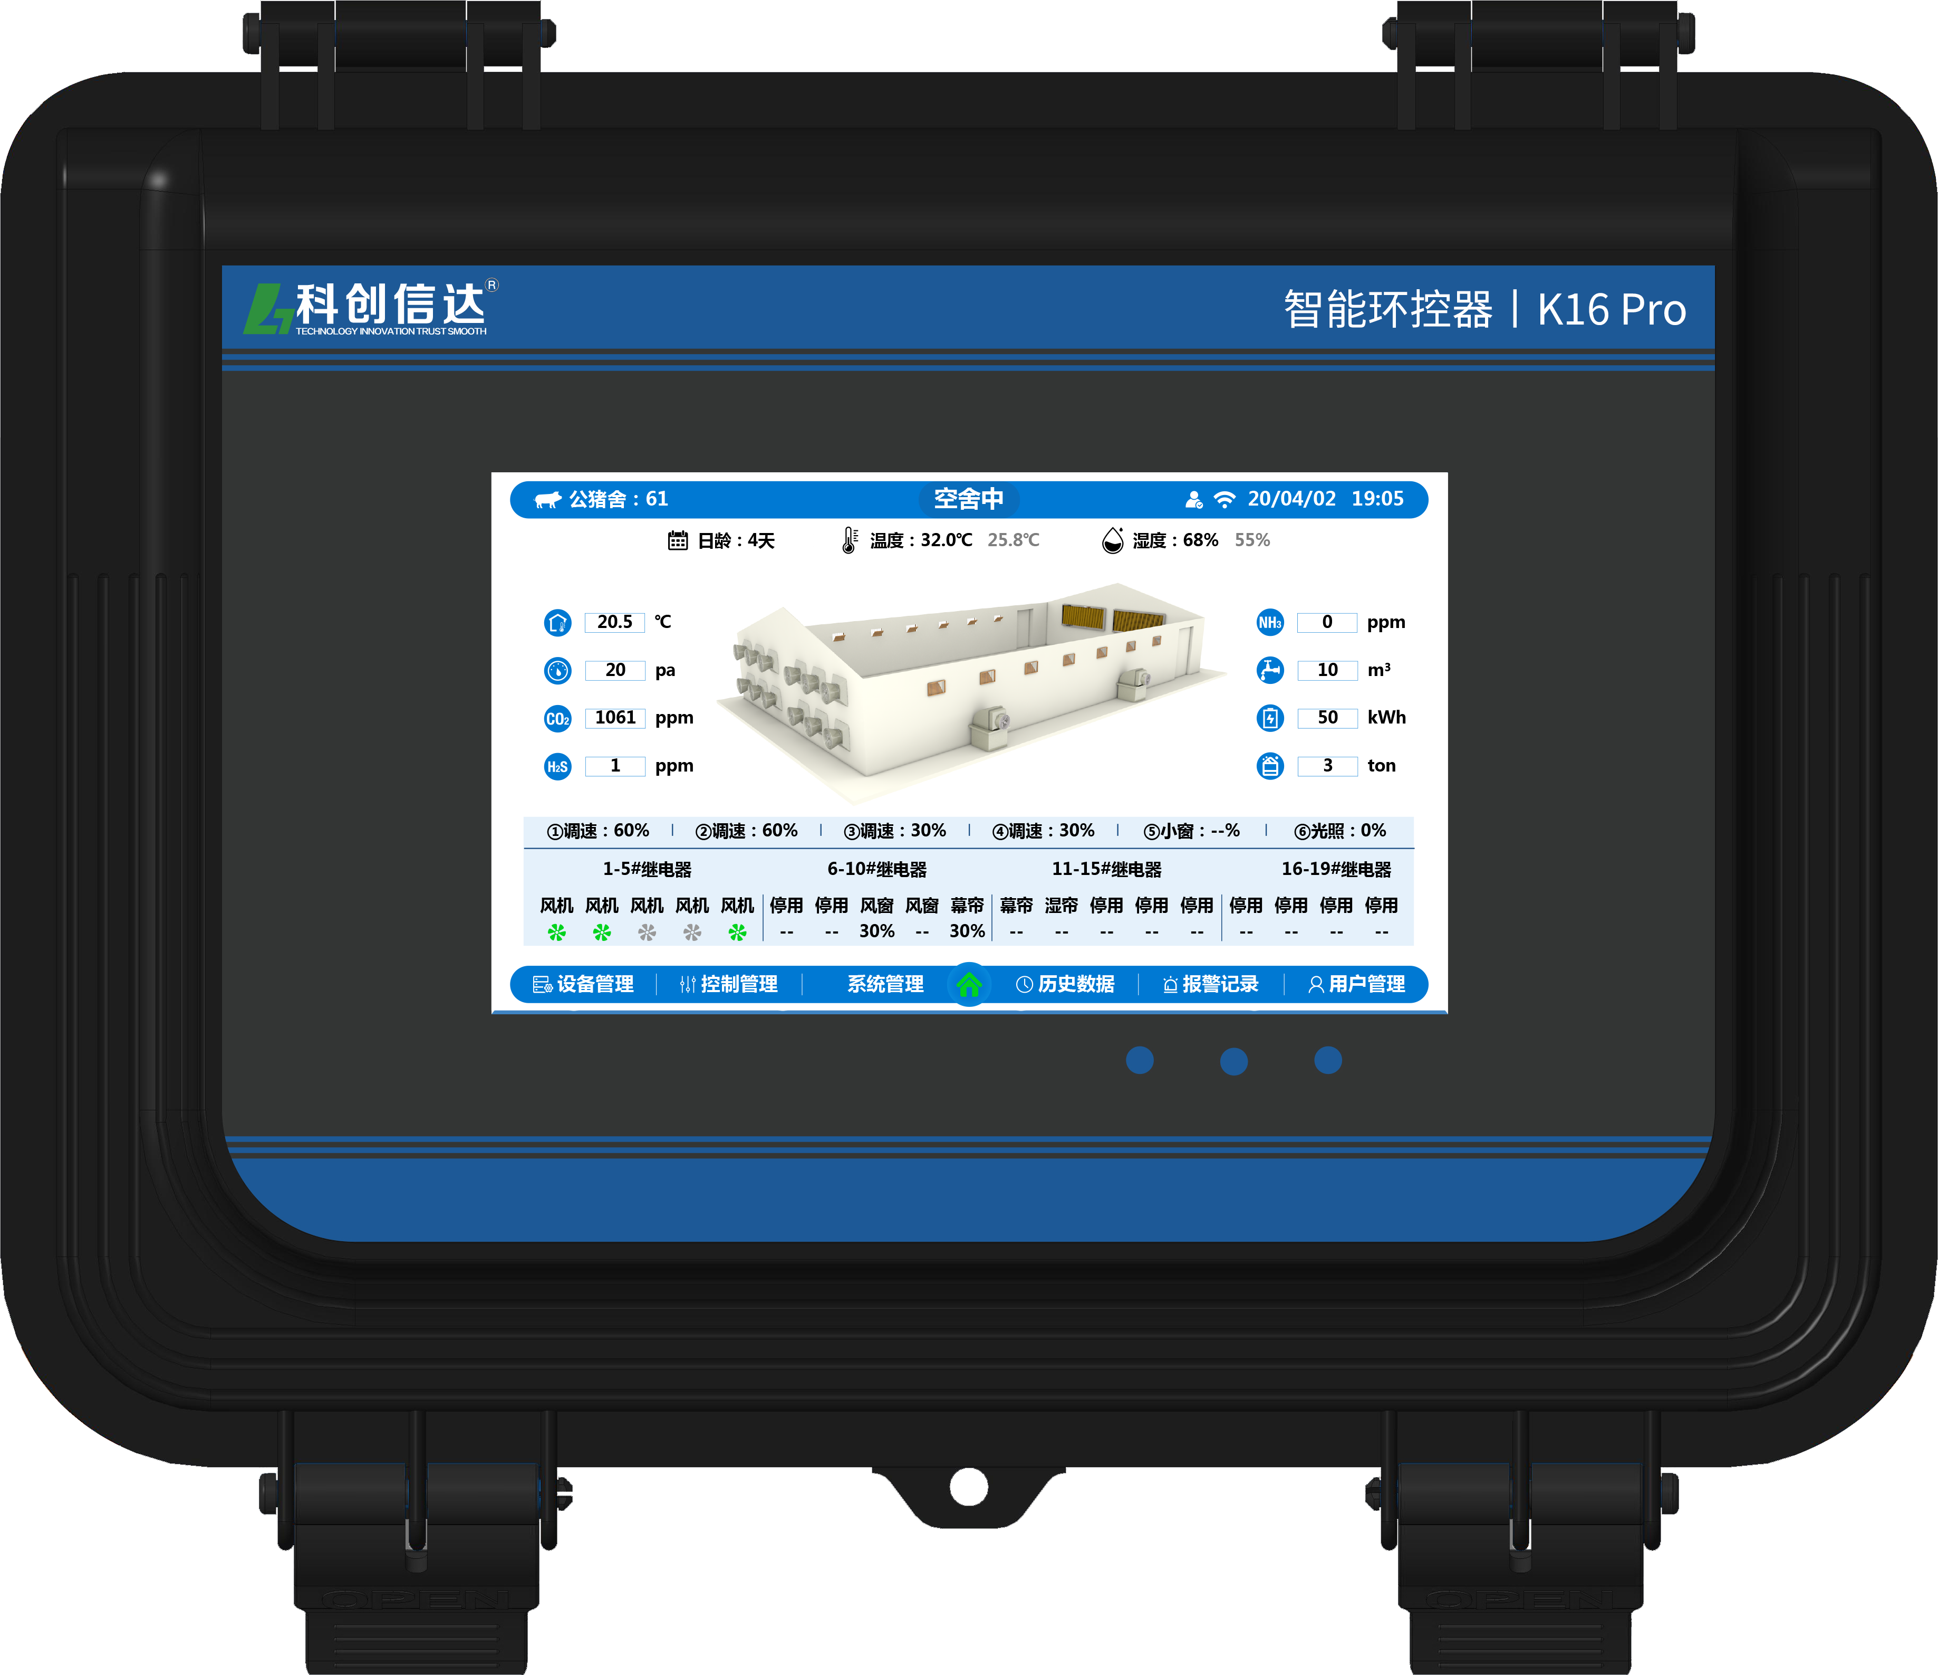





Intelligent environmental controller k16pro
Pig Super Brain
7-inch touch screen
Refined production data management
Multisensor fusion
Fine control
Cloud platform
Main technical parameters
Input voltage: AC85 ~ 305V, 50 / 60Hz;
Rated power: ＜ 15W;
Application range: 0 ~ 50 ℃ (32 ° f ~ 122 ° f), which is only suitable for installation in indoor locations without direct sunlight;
Overall dimension: 350 * 250 * 130mm;
Display accuracy: 0.1 ℃;

Slide 4
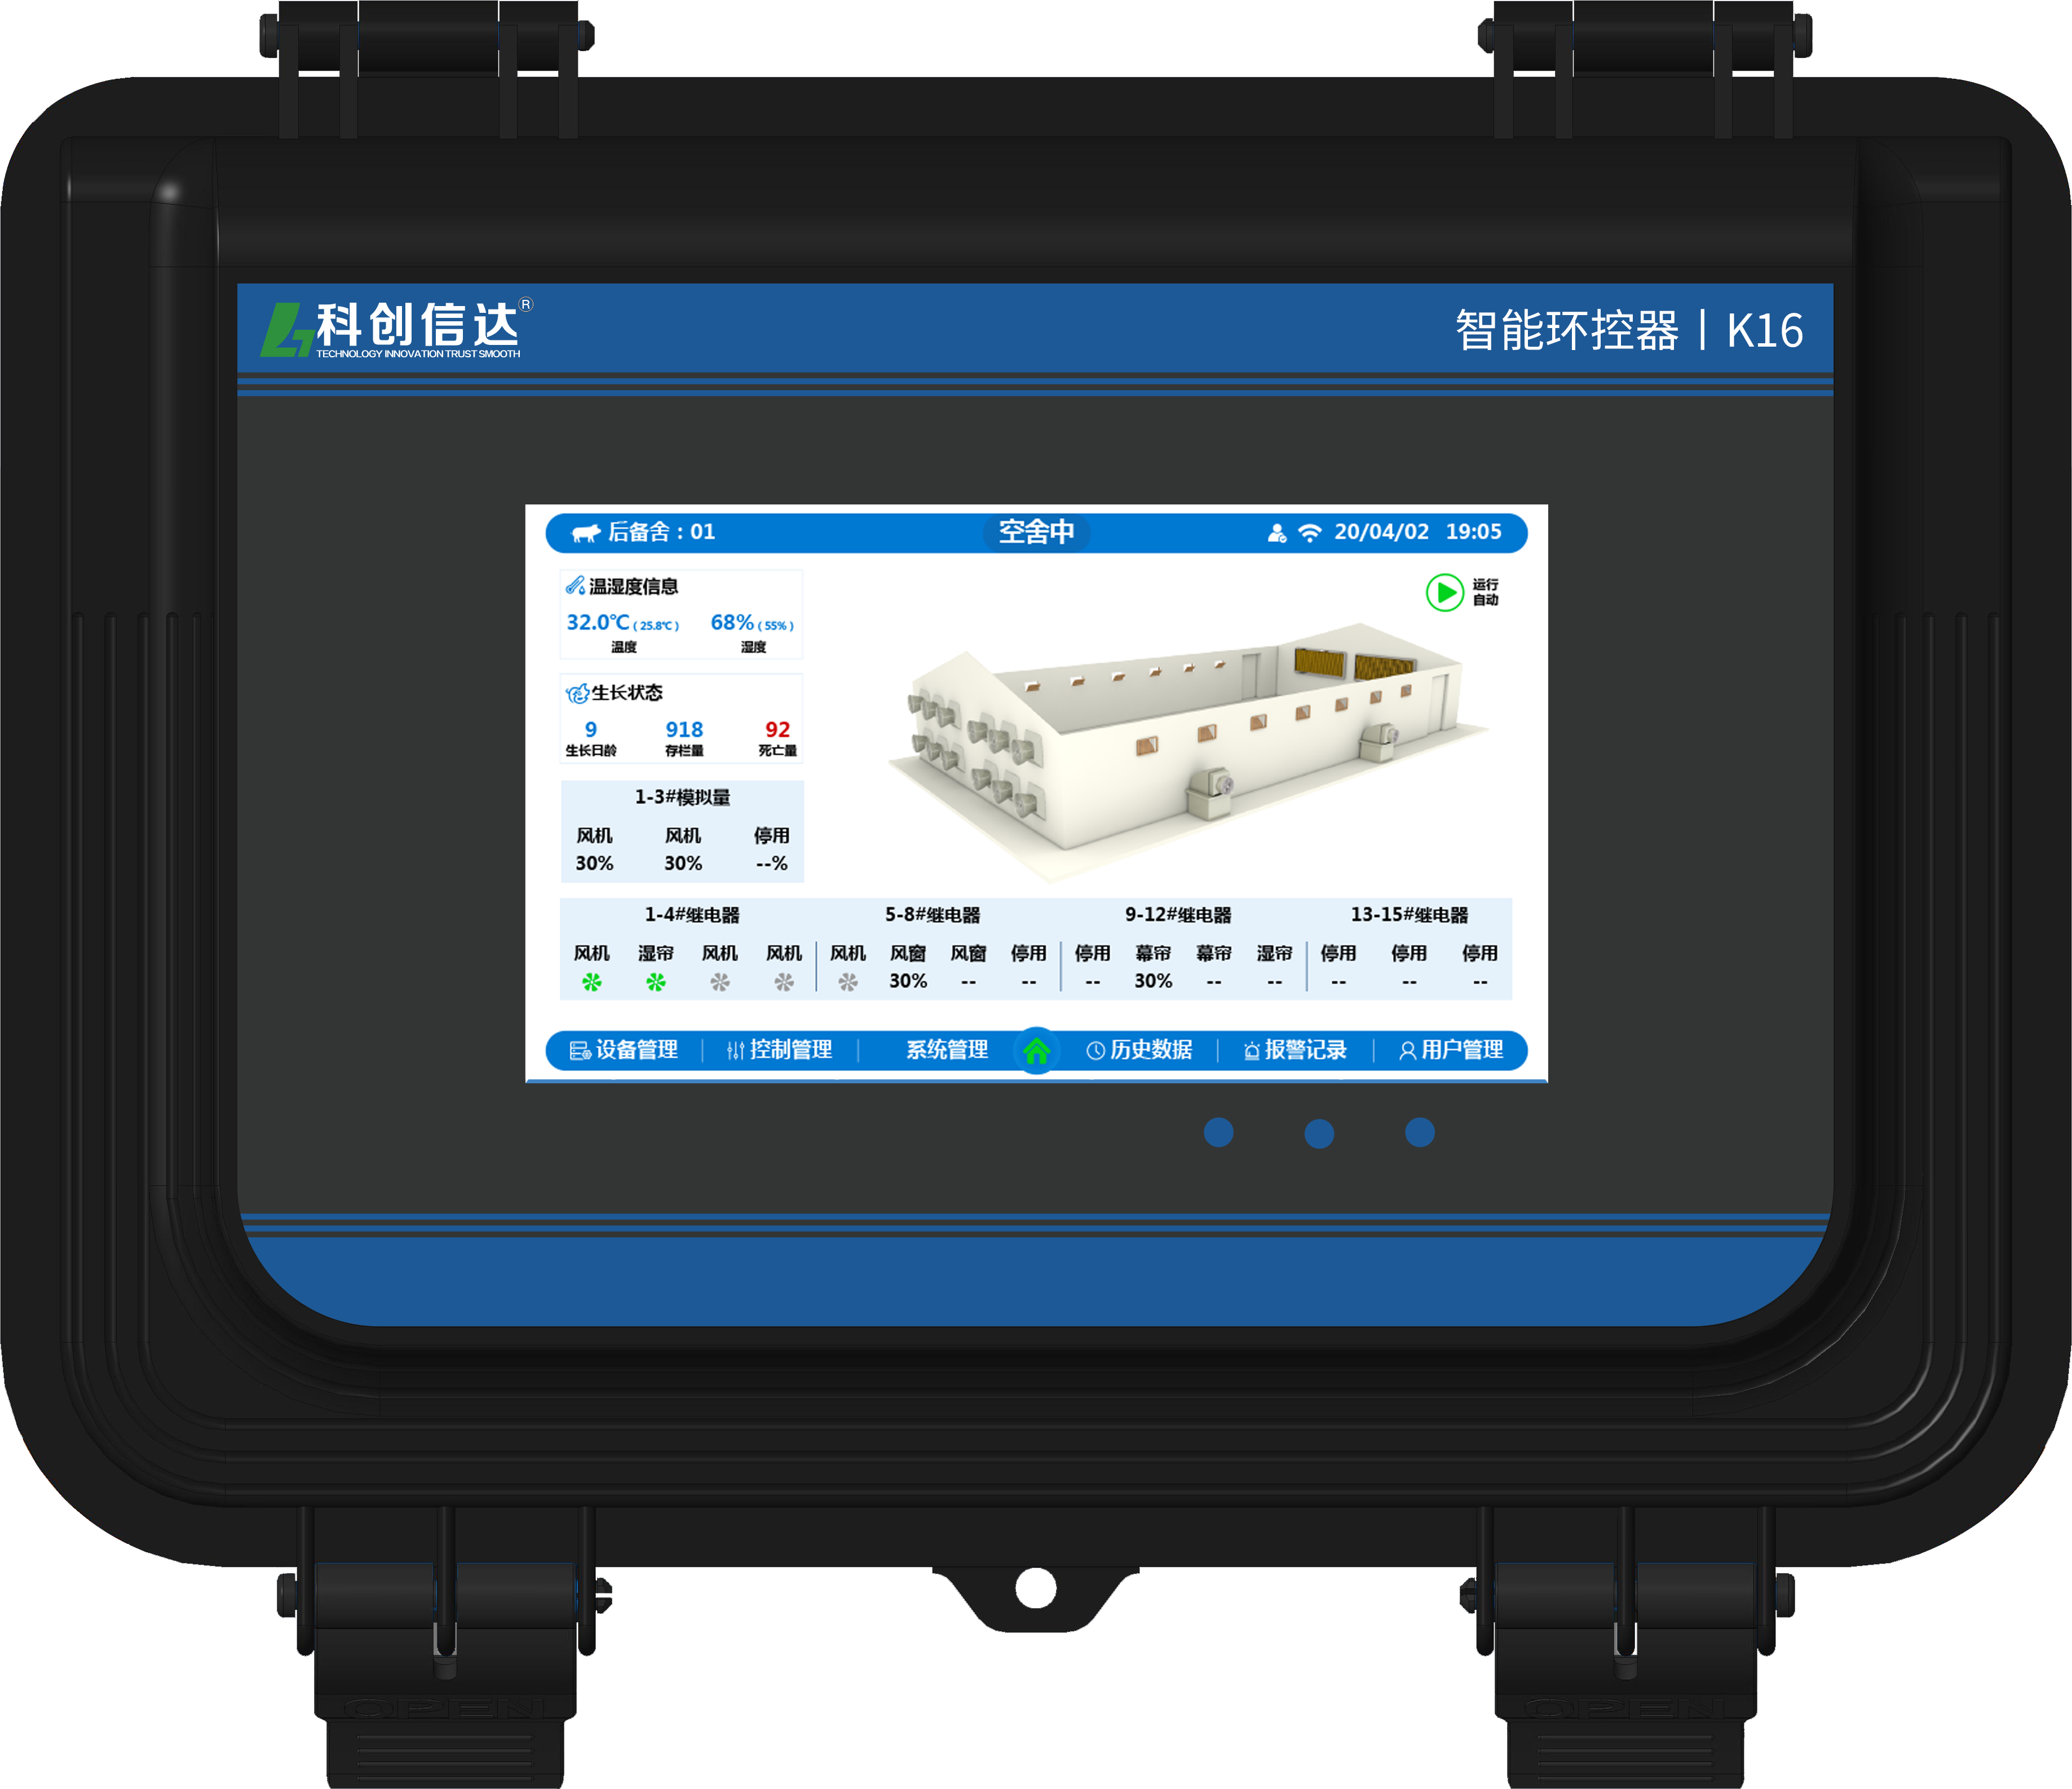
Intelligent environmental controller k16
Pig brain
7-inch touch screen
Multisensor fusion
Fine control
Cloud platform
Main technical parameters
Input voltage: ac85-305v, 50 / 60Hz;
Rated power: < 15W
Overall dimension: 350 * 250 * 130mm;
Display accuracy: 0.1C;

Slide 5
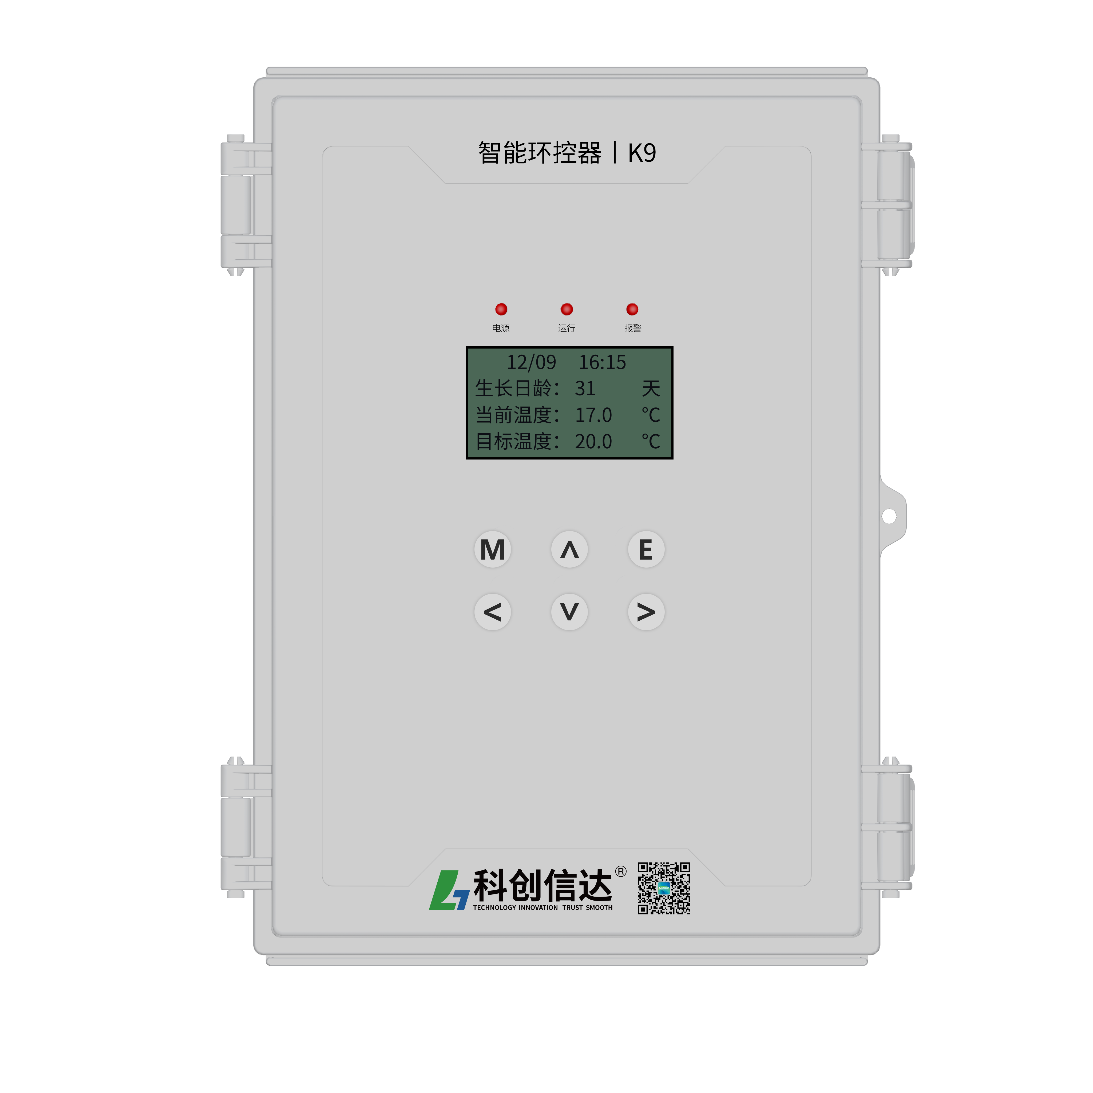


Intelligent environmental controller k9
Pig brain（Equipped with 3.6-inch LCD）
easy operation
Fully functional
Fine control
Cloud platform
Main technical parameters
Input voltage: AC85 ~ 305V, 50 / 60Hz
Rated power: < 10W;
Overall dimension: 250 * 350 * 130mm
Display accuracy: 01 ° C

Slide 6
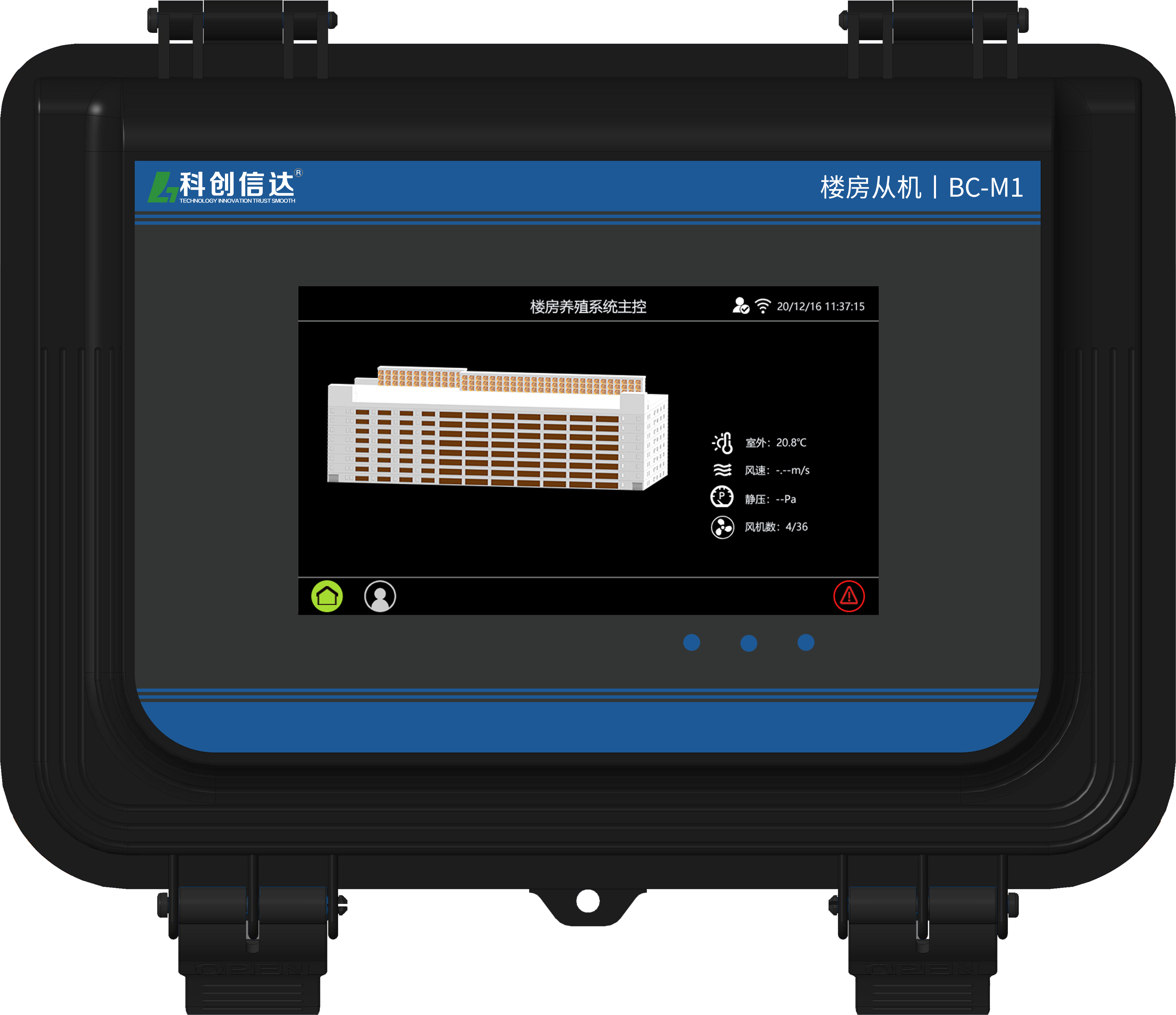


Intelligent environmental controller BC-M1
Building brain
7-inch touch screen
Flexible parameter setting
Modeless adaptive algorithm
Cloud platform
Main technical parameters
Input voltage: AC85 ~ 305V,50 / 60Hz
Rated power: < 15W
Overall dimension: 350 * 250 * 130mm
Display accuracy: 01 ° C

Slide 7
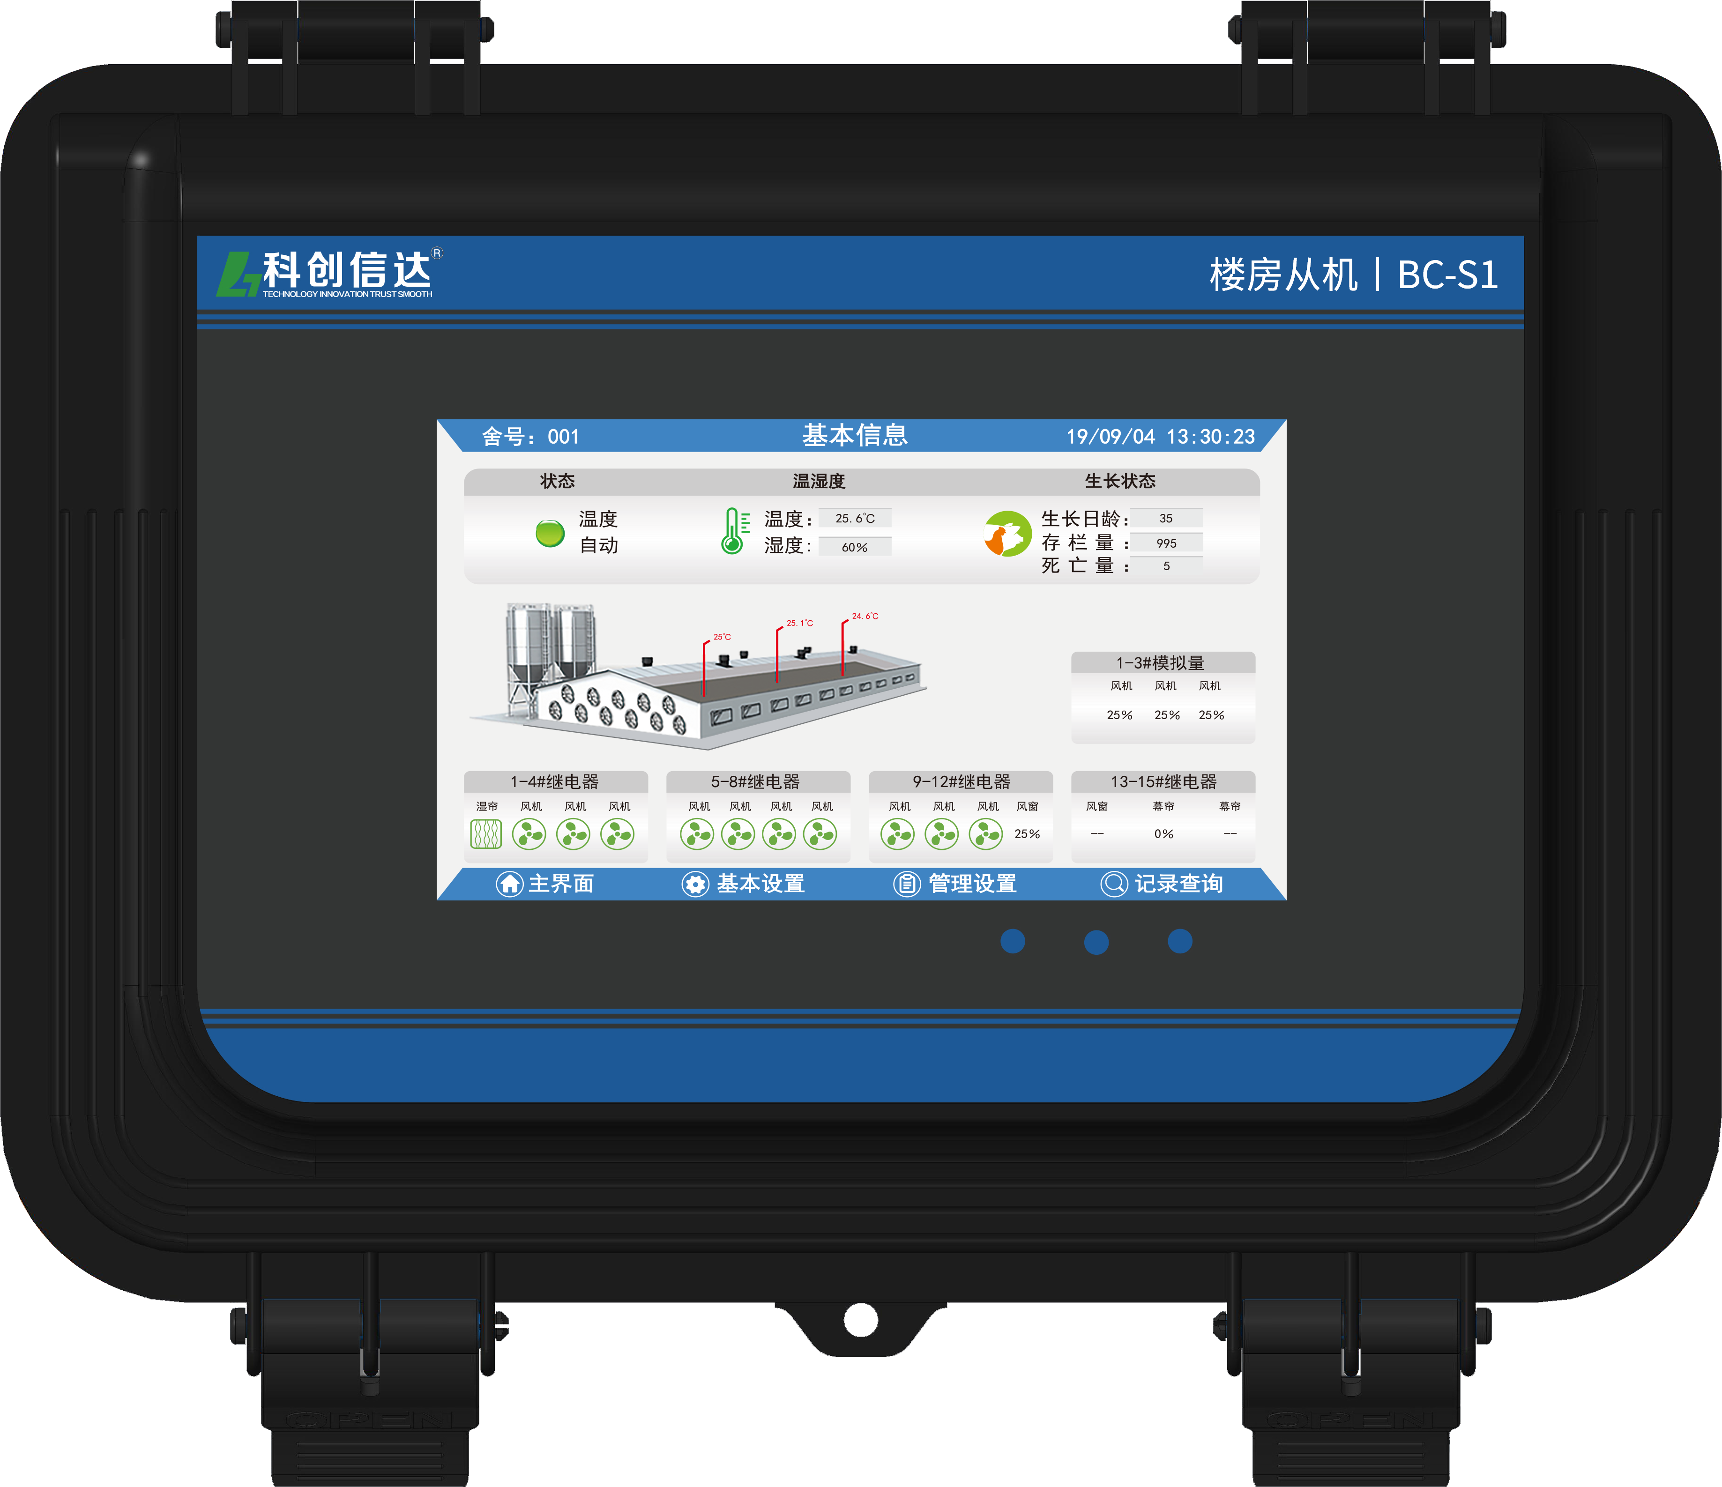
Intelligent environmental controller BC-S1
Building brain
7-inch touch screen
Multisensor combination
Fine control
Cloud platform
Main technical parameters
Input voltage: AC85 ~ 305V,50 / 60Hz
Rated power: < 15W
Overall dimension: 350 * 250 * 130mm
Display accuracy: 01 ° C

Slide 8
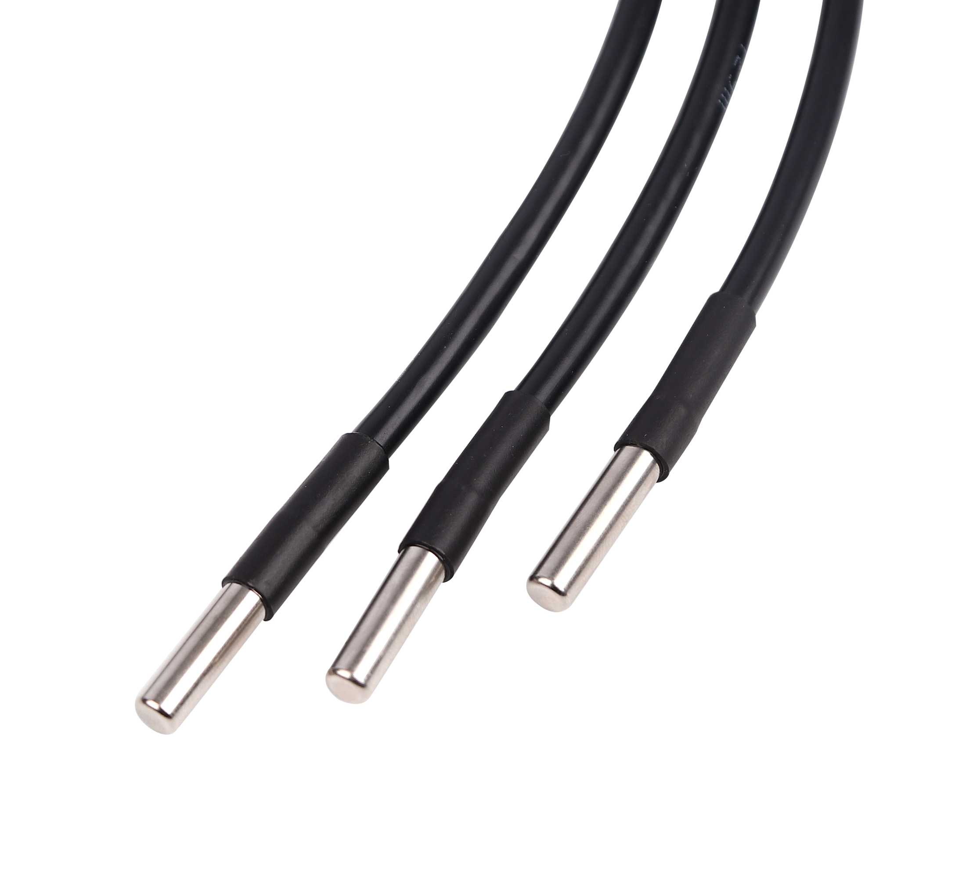
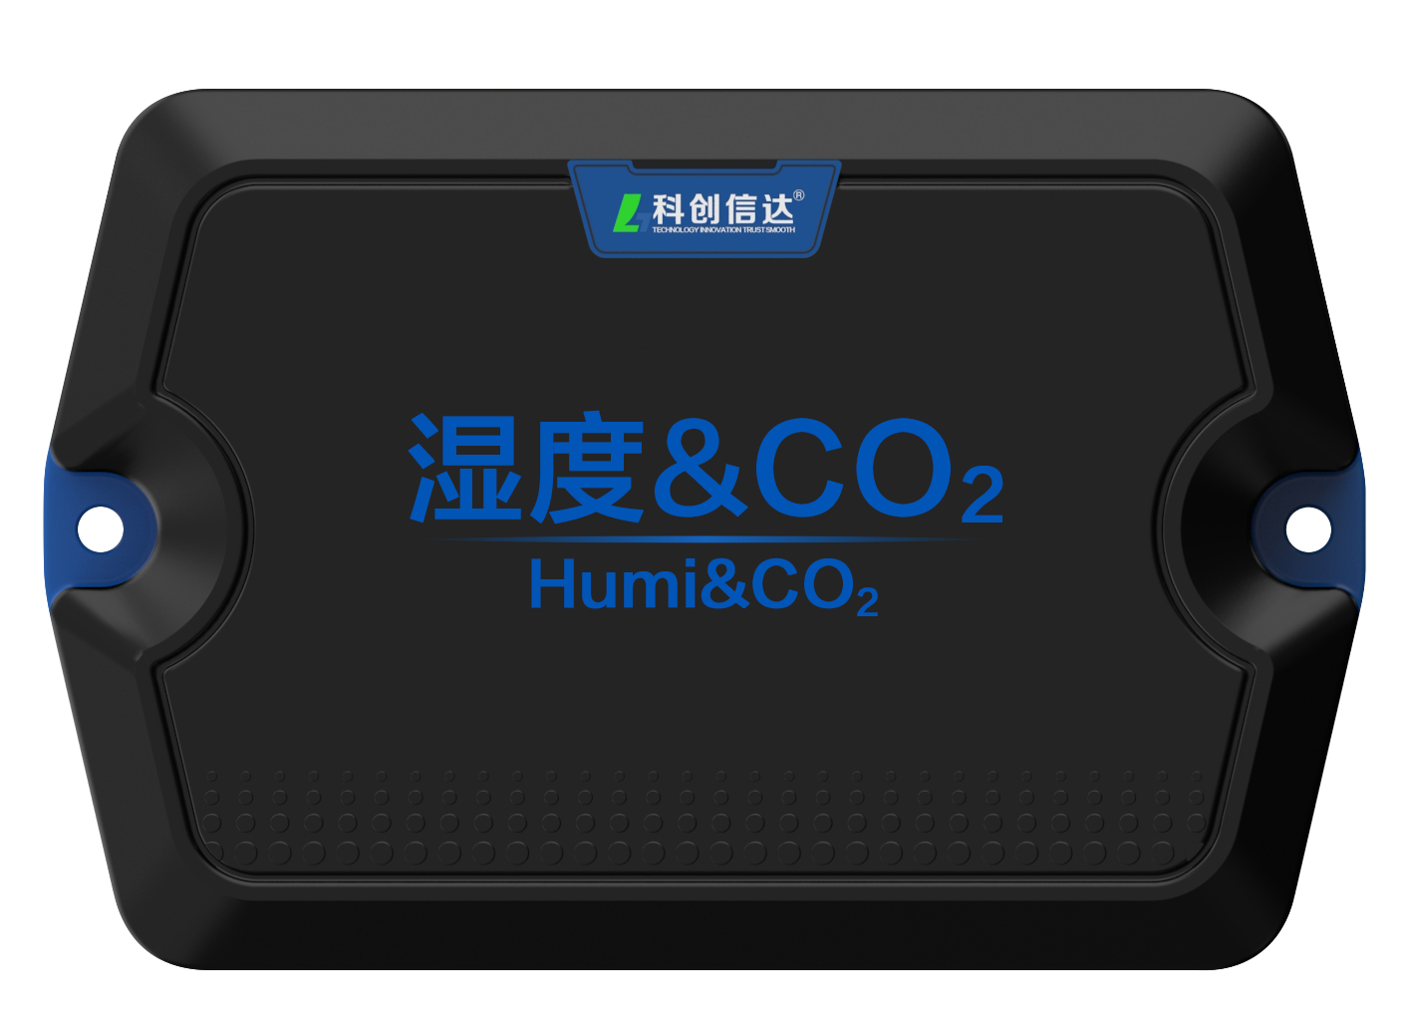
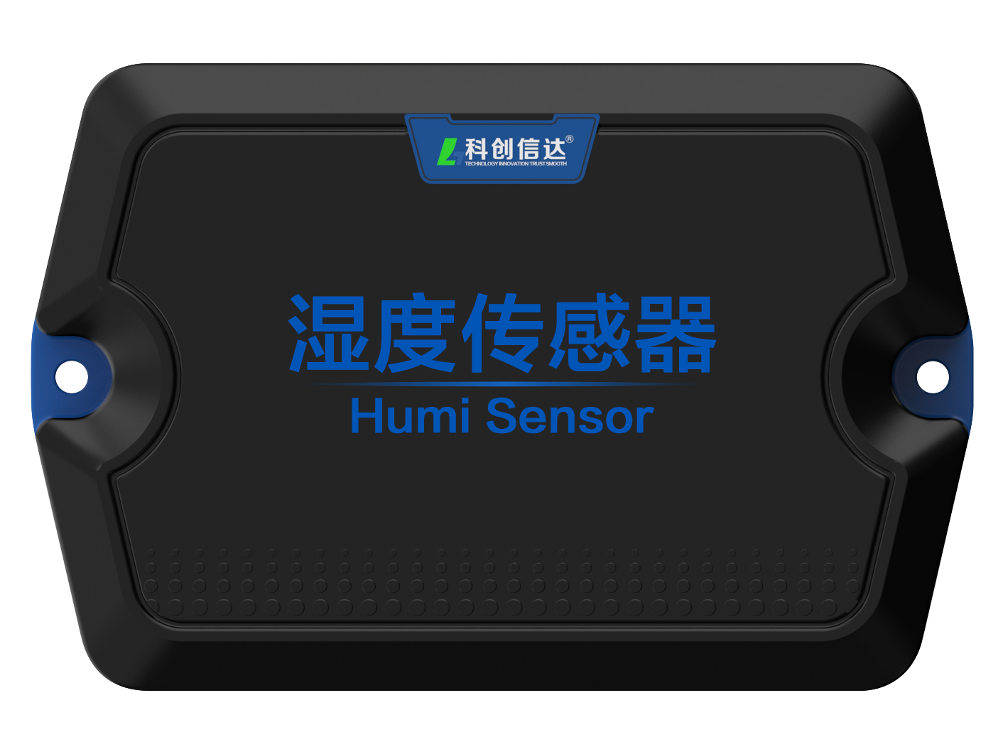
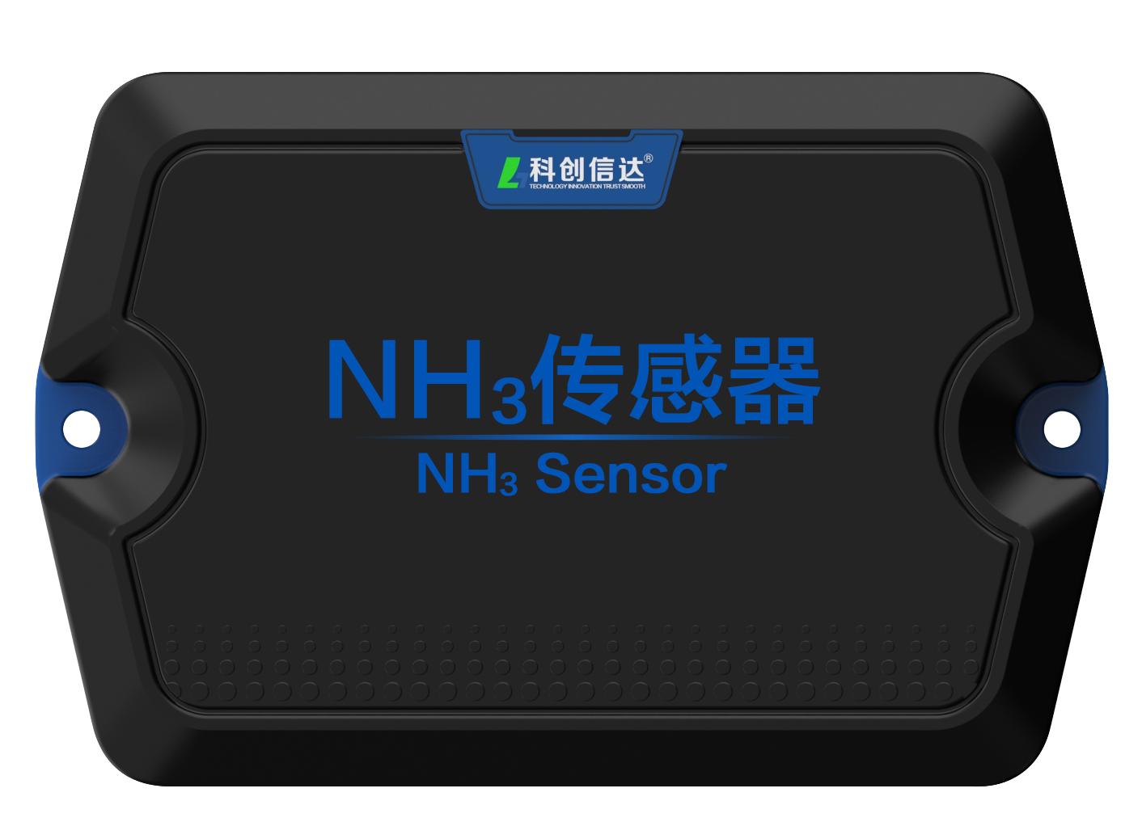
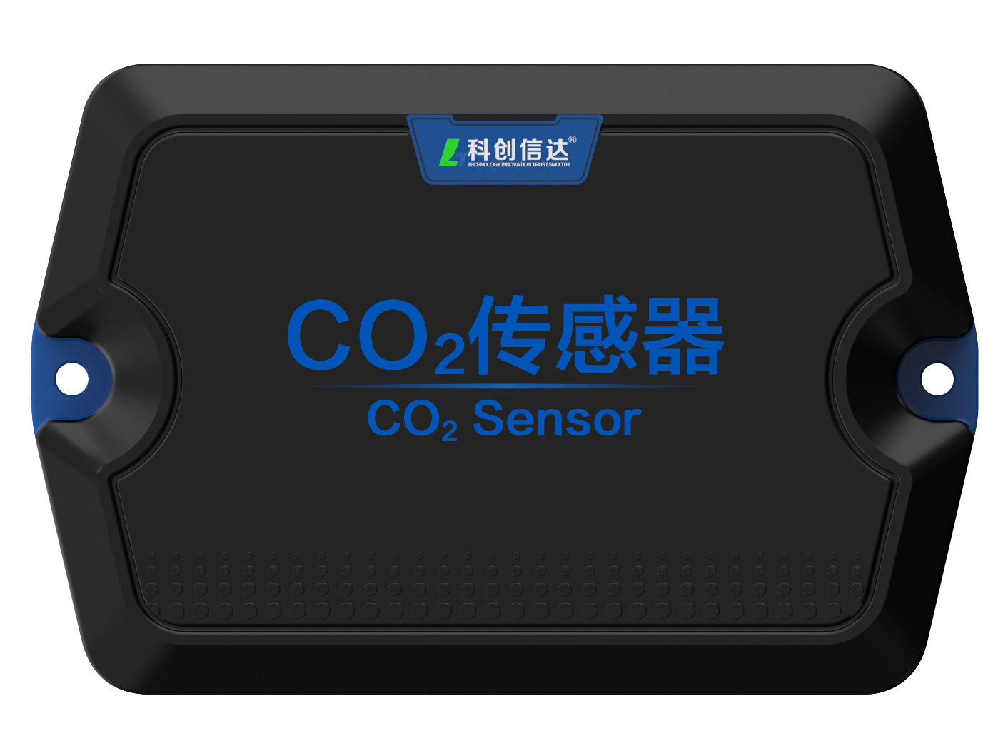
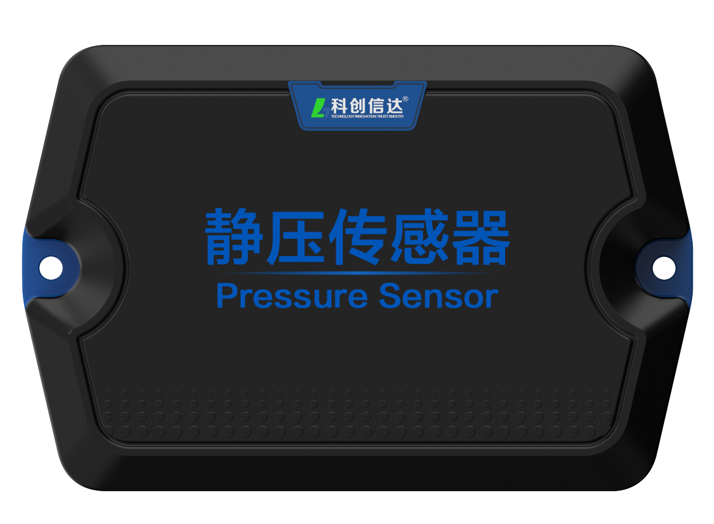
sensor
Temperature kcntc-1m, humidity kctht-102, CO2 kccot-103, humidity & CO2 two in one kchcot-110,NH3 kcnht-104, static pressure kcpt-106
Temperature kcntc-1m
humidity & CO2 two in one kchcot-110
hardware configuration
[1 Channel] 4 ~ 20mA output
[1 circuit] 12V DC power supply
System parameters
Range: 0-100%, 0-5000ppm
Accuracy: 1.5%, 3%
Functional features
Swiss imported modules, high precision and high stability
Hardware configuration: two wire thermistor;
Functional features: high precision imported sensor, good consistency;
system parameter
Range: - 40 ℃ - 80 ℃
Accuracy: 0.2 ℃
humidity kctht-102
NH3 kcnht-104
hardware configuration
[1 Channel] 4 ~ 20mA output
[1 circuit] 12V DC power supply
system parameter
Range: 0-100% ℃
Accuracy: ± 1.5% ℃
Functional features
Swiss imported chips, high precision and high stability
system parameter
Range: 0-100ppm
Accuracy: 3%
Functional features
High precision imported sensor, good consistency;
hardware configuration
[1 Channel] 4 ~ 20mA output
[1 circuit] 12V DC power supply
CO2 kccot-103
System parameters
Range: 0-5000ppm
Accuracy: 3%
Functional features
Swiss imported modules, high precision and high stability;
static pressure kcpt-106
hardware configuration
[1 Channel] 4 ~ 20mA output
[1 circuit] 12V DC power supply
hardware configuration
[1 Channel] 4 ~ 20mA output
[1 circuit] 12V DC power supply
system parameter
Range: - 100 ~ 100Pa
Accuracy: 3%
Functional features
Swiss imported modules, high precision and high stability;

