Slide 1
Introduction to Kubernetes
Jason Farrell

Slide 2
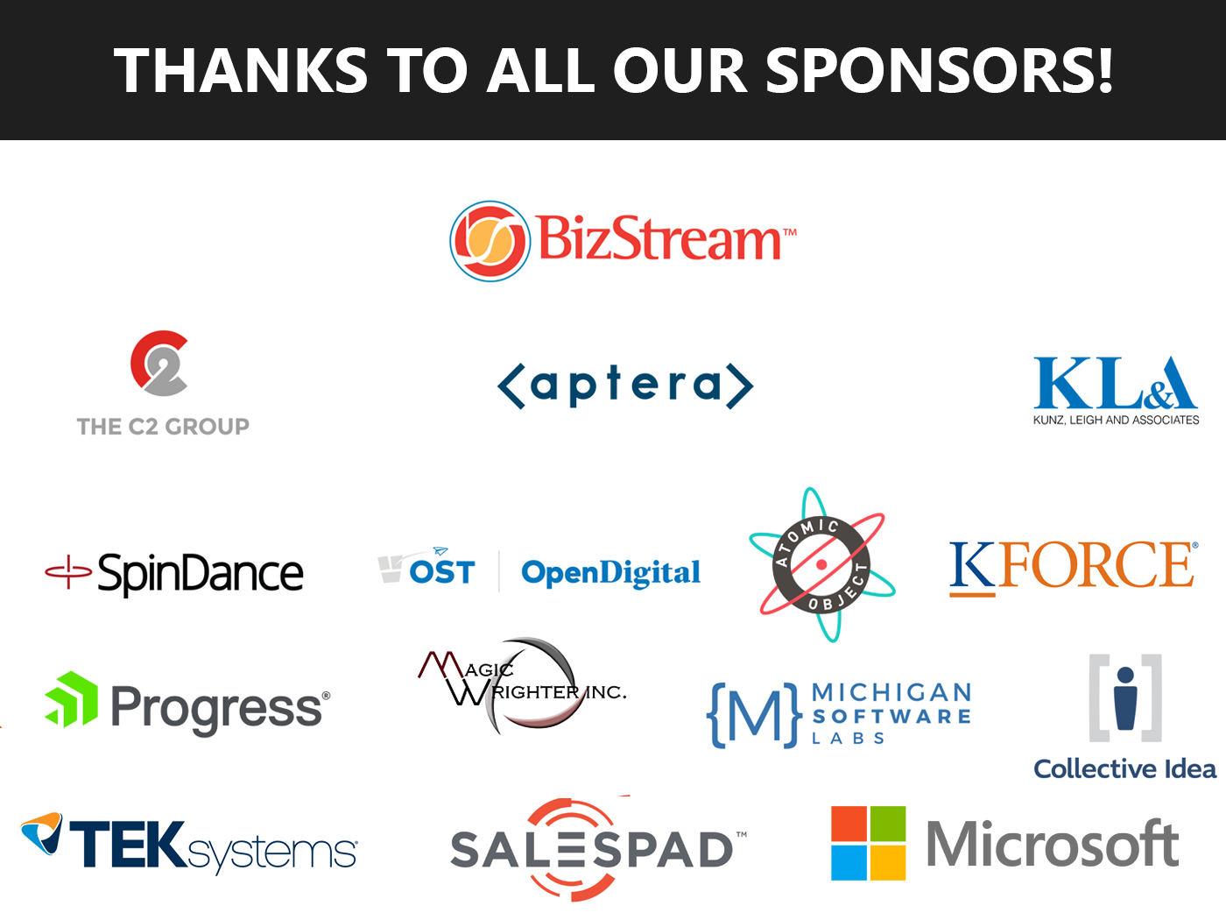

Slide 3

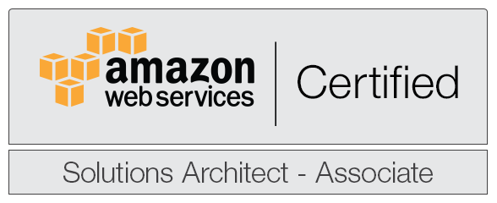

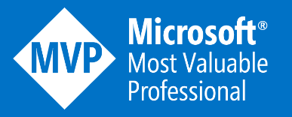

Who’s with you today
JASON FARRELL
Principal
West Monroe Partners
www.jfarrell.net
Chicago, Illinois
twitter.com/jfarrell
github.com/xximjasonxx

Slide 4
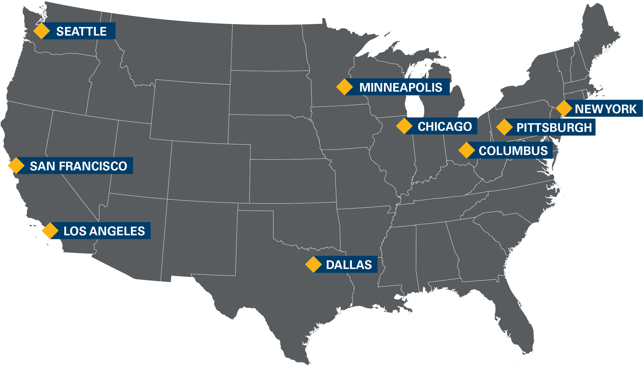
West Monroe Partners is large enough to tackle our clients’ toughest challenges
and nimble enough to adapt to unique requirements with custom solutions
Established in 2002
West Monroe is a full-service business and technology consulting firm.
People
Over 900 consultants, confident enough to engage in constructive debate and understand that it’s okay to disagree.
Organization
We are 100% employee owned. We answer to our people and our clients only.
Community
We are dedicated to improving the communities where we live and work, which is why we donate 1% of our time, talent, and treasure to support organizations with similar values and goals.
Global reach but geographically close
We serve global clients, locally by partnering with BearingPoint Europe and Grupo Assa.

Slide 5
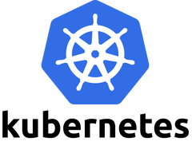
What is Kubernetes?
ORIGIN
Project started by Google in 2014 based on Borg
Project “Seven of Nine” => Friendlier Borg
PURPOSE
Resource management platform built with automation in mind
PUT SIMPLY
It is a platform for running containers
USE
Builds heavily on the fundamental of Cloud Native Computing

Slide 6


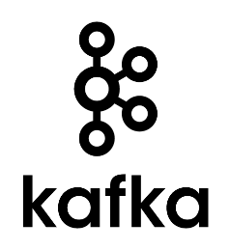
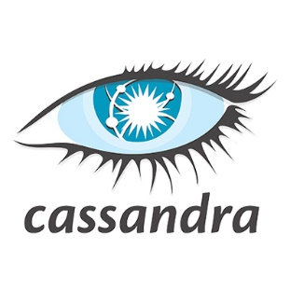

Kubernetes is a platform you run containers on
NS: APPLICATION
NS: UTILITY
NS: STORAGE
Guestbook
Jenkins
Harbor

Slide 7
Why is Kubernetes so popular?
APPLICATION CONTAINERIZATION
PREDICTABILITY
AUTOMATION
EMPHASIS
Kubernetes enables applications to be portable and can be deployed to any environment which supports Kubernetes
Developers can work against the same configuration that will be in Production enabling closer representation
Kubernetes can managed a block of resource to enable large scaling with high resiliency.
ADVANTAGES
The advantages of deploying containers for our applications go well beyond the use with
Kubernetes or other orchestrators. They make applications easier to manage and test across the spectrum

Slide 8
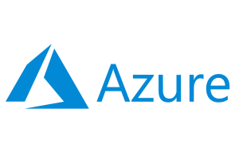
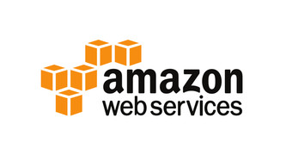
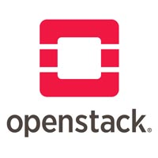

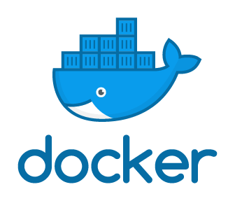

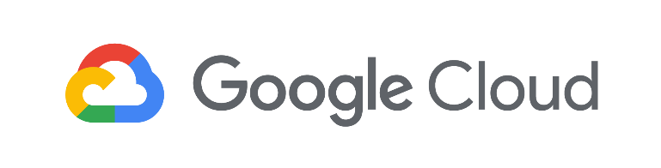

There are many options for running Kubernetes
CLOUD
ON PREM
DEVELOPMENT

Slide 9
The Technicals of
Kubernetes

Slide 10
Kubernetes is based on five key concepts
CLUSTER
The most basic concept. All things are contained within a cluster
NODE
The organized compute resources the cluster is managing
POD
The lowest unit within Kubernetes. Contains one or more containers carrying out work
DEPLOYMENT
A group of Pods that specifies a minimum number that need to be running
SERVICE
Provides balanced access to Pods within and without the cluster

Slide 11
Core Concepts Visualized
CLUSTER
NODE(S)
NODE(S)
DEPLOYMENT
POD
POD
POD
POD
SERVICE

Slide 12
Kubernetes planes of execution
Two planes
Control plane controls all cluster functions and object tracking
kubectl calls talk to Kubernetes master which updates desired state in etcd (hash key store)
kublet acts as agent executing state check and updates on behalf of master
CONTROL PLANE
kubectl
Kubernetes Master
etcd
DATA PLANE
NODE
NODE
NODE
kublet
kublet
kublet
POD
POD
SERVICE
POD
POD
POD

Slide 13
TASK: DEPLOY AN APPLICATION
TARGET: minikube

Slide 14
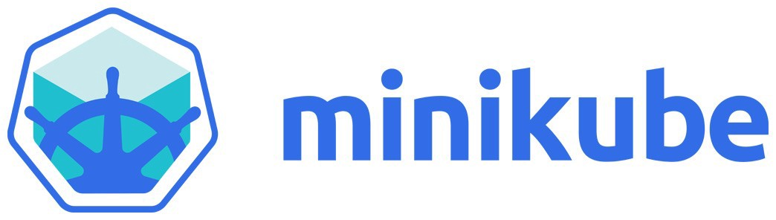
Why minikube?
No risk of an $800 bill for cloud resources
Focused on local development, ideal for test driving Kubernetes
Easy to install
Single node restriction—not recommended in Production

Slide 15
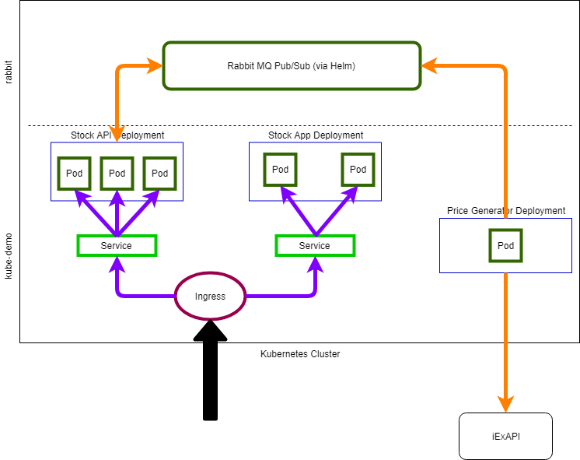
Stock application architecture

Slide 16
EXPLORE: Kubernetes on minikube
minikube start
Creates the default cluster
2GB RAM – 20GB Storage
Can pass custom parameters
minikube dashboard
Launches web dashboard to see cluster diagnostics
Useful for debugging in development
minikube ip
Returns the IP address of the single node
Useful for configuring access and NodePort (Service)

Slide 17

INSTALL: RabbitMQ
Enterprise grade pub/sub and queuing service
Installed via Helm
Package Manager for Kubernetes
Let’s us install preconfigured application onto our platform
Receives messages and broadcasts messages to listeners

Slide 18
Containers
Kubernetes orchestrates OCI compliant containers
Docker is the most popular (2015)
containerd
cr-io
Principle advantage is reduced size and instantiation time over Virtual Machines
https://www.opencontainers.org/

Slide 19
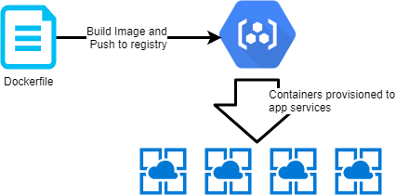
Common containerized workflow (Docker)
Developers create a Dockerfile which lays out how a Docker image is created
Image is stored in a registry with a tag
Running versions of an image are called containers
A PaaS service hosts the container and enables access to the application within

Slide 20
DEMO: Deploy our custom pieces
Downloads latest stock prices. Mimics price changes via random number
Listens to RabbitMQ and publishes received messages via SignalR to clients
Build the Dockerfile to generate a Docker image
Price Generator
Stock API
Push the Image to your desired registry
Receives the price changes via SignalR and displays the data
Apply the spec file via kubectl
Stock App

Slide 21
Thoughts
We used DockerHub to hold our images
Normally we would want to use a private registry (ACR, GCR, ECR)
We did the build, push, and apply manually
Normally we would reserve this for a DevOps pipeline
Our application can be deployed anywhere Kubernetes runs
We could take the same YAML files and deploy to another Kubernetes cluster with no changes
Using Helm we can install Cloud like services consistently without tedious setup. Our job’s get easier and easier
Our applications can be deployed with Helm as well

Slide 22
Let’s bring it home

Slide 23

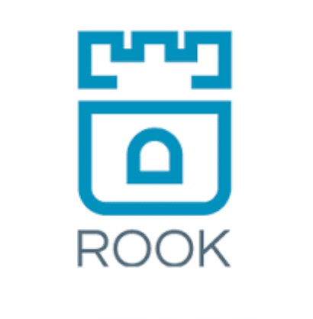

Common Tools used with Kubernetes
PROMETHEUS
Open source monitoring solution built on time series database
ROOK
Storage orchestration solution that enables automated management of storage. Necessary to provide resiliency for stateful storage
ISTIO
Service mesh from Google. Enables tight security and real time tracking of traffic between clusters

Slide 24

Example in the wild: Tinder
EC2 instances were taking minutes to come online for scaling
Containers came online within seconds
Migration started in Jan 2018
200 services
Completed March 2019
Post Migration
1,000 nodes
15,000 pods
48,000 running containers
Substantial cost savings
Improved horizontal density
https://medium.com/tinder-engineering/tinders-move-to-kubernetes-cda2a6372f44

Slide 25
Things we didn’t cover
Stateful Sets
Jobs
Ingress (in-depth)
Security
Sidecar Pattern
Custom Resource Definition (CRD)
Auto Scaling
Volume Mounting
Secrets
ConfigMap
A lot more…
K8S IS AN ECOSYSTEM UNTO ITSELF
It is useful to see k8s as a local cloud that manages local resources. It can do everything the cloud can do

Slide 26
Closing points
Kubernetes is not a silver bullet. At its simplest level it is a resource scheduler that enables automated management of applications
This talk only went into the basics of Kubernetes. This is an entirely new ecosystem with new tools and patterns. More than I can cover here
The key thing to understand are the scenarios that enabled with these sorts of tools. The possibilities are very diverse
SEEING YOUR APPLICATION AS A WHOLE IS CRUCIAL
Applications exist as the sum of their parts. We cannot store critical data in transient ways such as in consoles.
Seek to declare all of your applications pieces together as a package. This will enable better management in the long run

Slide 27
Relevant links
https://kubernetes.io/docs/tasks/tools/install-minikube/
https://kubernetespodcast.com/
https://kubernetes.io/docs/concepts/services-networking/service
https://kubernetes.io/docs/tutorials/kubernetes-basics/
https://cncf.io
https://github.com/kelseyhightower/kubernetes-the-hard-way

Slide 28
Questions

Slide 29
Thank You
www.jfarrell.net
twitter.com/jfarrell
github.com/xximjasonxx
Source code available
https://github.com/xximjasonxx/kubedemo

