Slide 1
Developing the de-novo sequencing algorithm
Xi Xing
4/18/2018

Slide 2
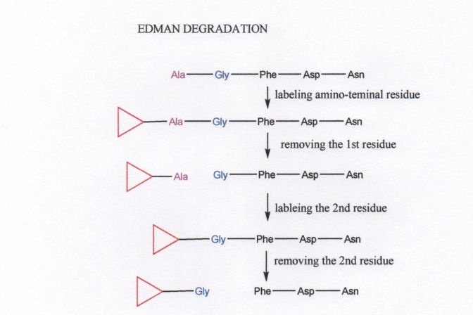
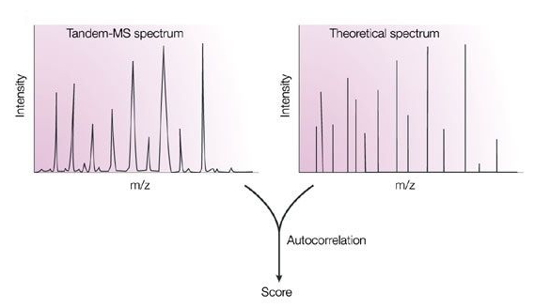
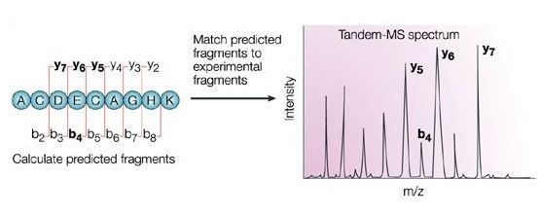
Peptide Sequence determination
Edman degradation
Tandem MS/MS
Database search
De novo
N-terminal amino acid of the protein can be cleaved off one at a time
In contrast to the popular peptide identification approach – “database search”, de novo Peptide sequencing derives an amino acid sequence from a mass spectrum without the need of a sequence database.
-- in 1967 by Edman and Beggs --

Slide 3

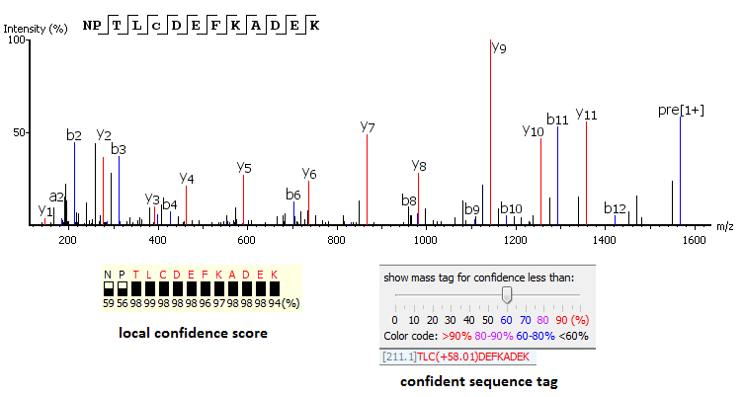

Scoring system-based Algorithm
PEAKS uses a comprehensive scoring system to provide accurate de novo peptide sequencing results. Unique to PEAKS is the Local Confidence Score – the likelihood of each amino acid assignment in a resultant peptide. The local confidence score extends the accuracy to the amino acid level. In the figure, TLCDEFKADEK is a confident sequence tag with significant fragment proof.

Slide 4
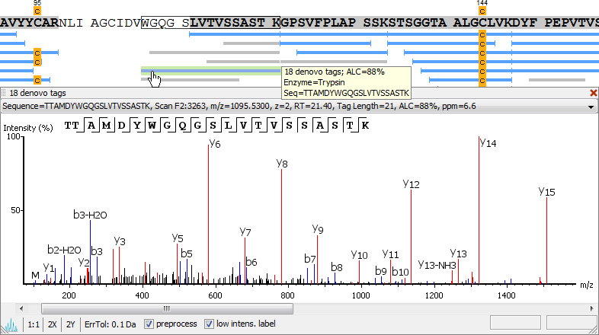
de novo
+
Database search
De novo peptide sequences are aligned with protein database entries to provide additional information about PTMs, mutations, homologous peptides, and novel peptides.

Slide 5
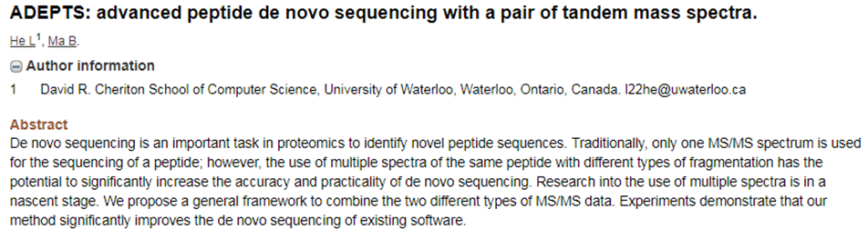
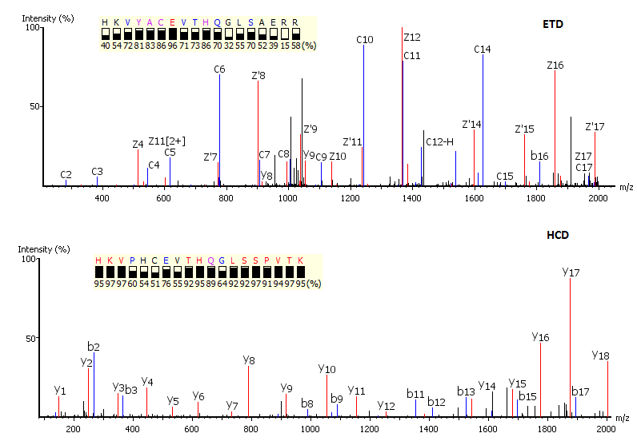
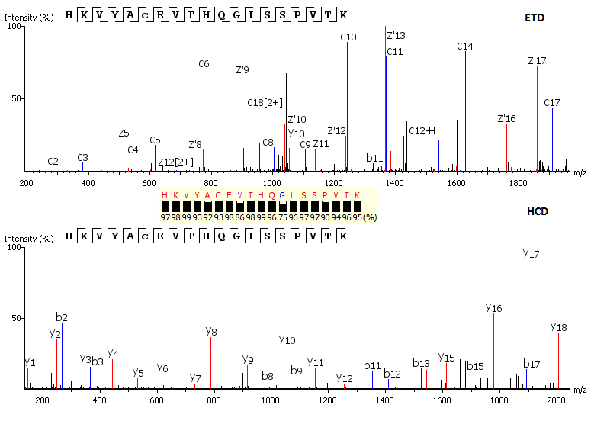
Complementary Fragmentation

Slide 6
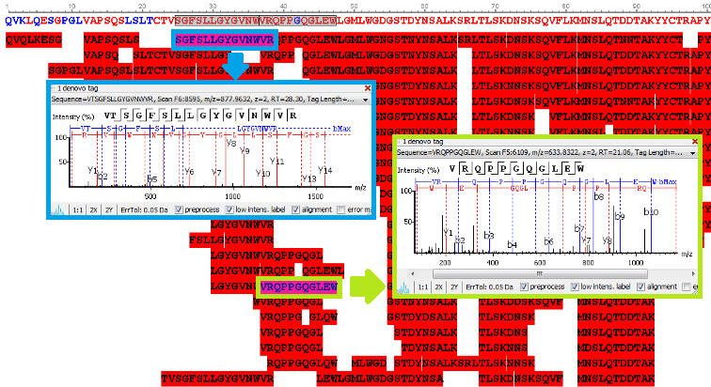
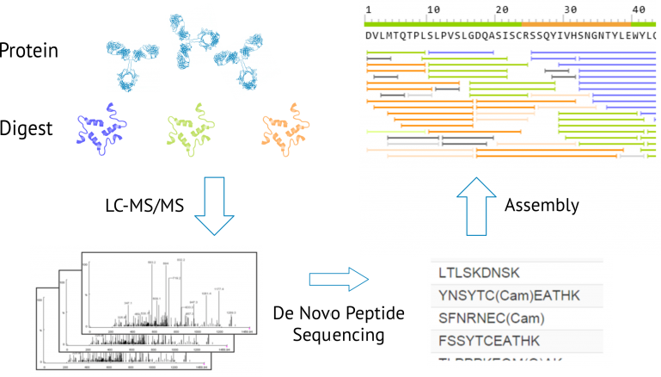
Peptide Sequencing → Protein Sequencing

Slide 7
Developing the de-novo peptide sequencing algorithm of our own
Preparations
Learn from the practice (Experiment → Real Data → analysis)
A start-up working algorithm

Slide 8
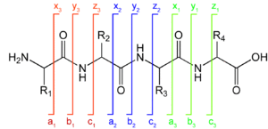
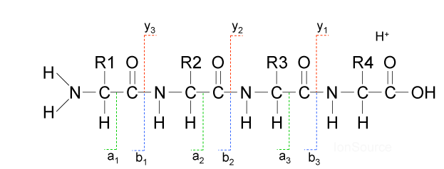
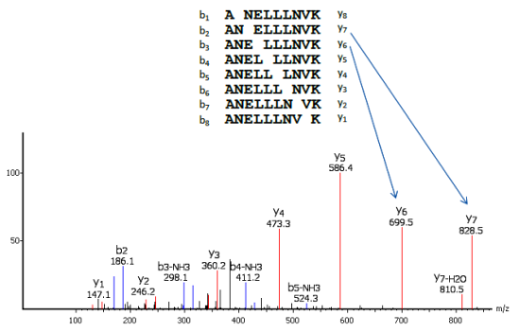

Preparation knowledge
Peptide Fragmentation Nomenclature
When the backbone bonds cleave, six different types of sequence ions are formed as shown in Fig. 1. The N-terminal charged fragment ions are classed as a, b or c, while the C-terminal charged ones are classed as x, y or z.
Among these sequence ions, a, b and y-ions are the most common ion types, especially in the low-energy collision-induced dissociation (CID) mass spectrometers, since the peptide amide bone (CO-NH) is the most vulnerable and the loss of CO from b-ions.

Slide 9
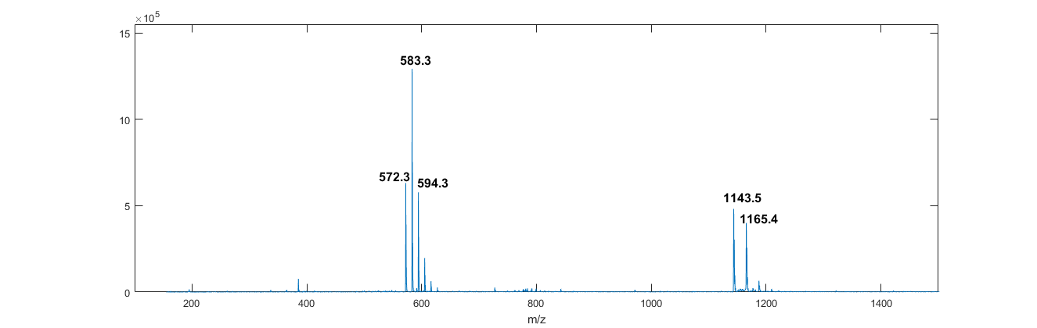
Experiment ESI-MS
Two sample peptide were purchased GenScript USA Inc.
Length=10
Sequence 1: ATEDVQDPRI
Sequence 2: A{PTHR}EDVQDPRI (modified)
Spectrum 1:ESI-MS (No fragmentation!)
++
parent

Slide 10
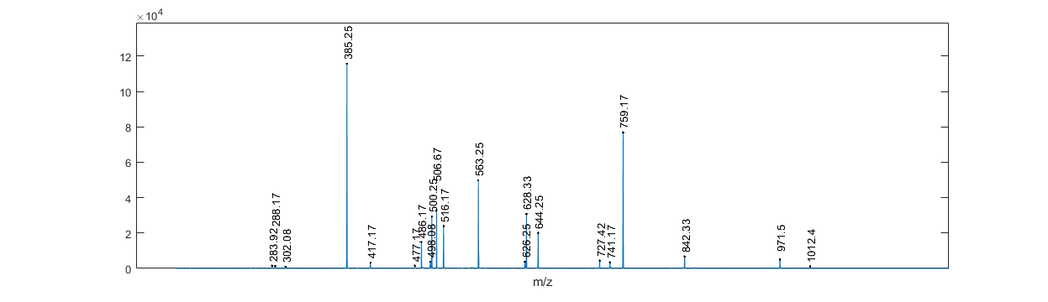
Spectrum 2: CID-MS/MS
Fragmentation arising from breaking the species of m/z = 572.3
How can we deduce the peptide sequence from this ???
Problem 1: We know the content (ADDEIPQRTV)
Problem 2: We don’t known the content, but only the parent mass (1143.5)

Slide 11
Solving Problem 1
Algorithm details:
Important clue: b/y ions are the most common fragment ions
Given an arbitrary sequence, calculate all the possible b/y ions (adding more…), and compare with the experimental peaks and see well how they match.
Define a scoring function that best measures such matching. To start with, we simply use the number of “hits” as the score. Later on, we will need to adjust this scoring function, which will be the main focus of the algorithm development.
Use an optimization algorithm (GA) to find out the best ordering that gives the highest score.
Result:
A T E D V Q D P R I
Found 18 fragment ions
Cannot tell AT/TA sequence

Slide 12
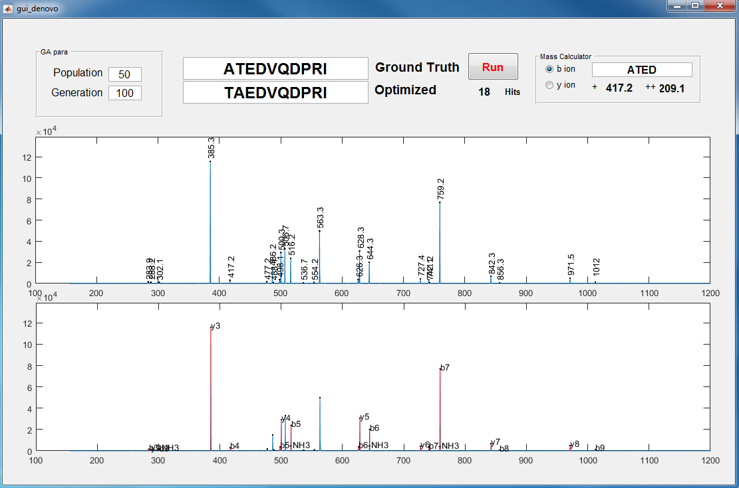

Slide 13
Solving Problem 2 (much harder)
Gly | G | 57.02146
Ala | A | 71.03711
Ser | S | 87.03203
Pro | P | 97.05276
Val | V | 99.06841
Thr | T | 101.0477
Cys | C | 103.0092
Leu | L | 113.0841
Ile | I | 113.0841
Asn | N | 114.0429
Asp | D | 115.0269
Gln | Q | 128.0586
Lys | K | 128.095
Glu | E | 129.0426
Met | M | 131.0405
His | H | 137.0589
Phe | F | 147.0684
Arg | R | 156.1011
Tyr | Y | 163.0633
Trp | W | 186.0793
Given the total MW of 1143.5 (1), how many different combinations of amino acids could it be?
For each combination, there are different permutations (sequencing), this reduces to problem 1.
Find the best sequence and score for each combination and pick the top ones (global optimum )
Find all possible integers (a, b, c …) that satisfies
aX₁+bX₂+cX₃… = 1143.5(1)
Where, X1, X2,… are the amino acid m/z
Simple iterations over all amino acids is not practical (dimension~10^20)
We developed a “recursive algorithm” to figure out this within ~10s
Total of 66,089 peptides are found that gives m/z in between 1143.4 and 1143.6
Surprising!

Slide 14
Results:
'ATEDVQDPRL' | 18
'GDEDVQDPRL' | 18
'MRPDQVDEGP' | 18
'GPETDQVERL' | 17
'WTPDQVDEPG' | 17
'VSDTPQVERL' | 16
'PCSEVQDPRL' | 16
'MREVQPTDAP' | 16
'SAEPDQVDWP' | 16
'QQQDQVDEGP' | 15
'CPSEVQDTHQ' | 15
'GDETPQVFNH' | 15
'SSLEVQDPRL' | 15
'ACLEVQDPRL' | 15
'ASEPDQVERL' | 15
'VREDQVDEGP' | 15
'MREVQDPAVV' | 15
'RMEVQDPGVL' | 15
'PWTDQVEVVA' | 15
'WPTDQVEAPT' | 15
'LCWPQVDEGP' | 15
Algorithm details:
Take the advantage of MS/MS (spectrum 2). From the identified fragment peaks, find out the existing amino acids from calculating the peak differences and matching with the known amino acid mass.
We found ‘P’, ‘V’, ‘D’, ‘Q’, ‘E’. This reduces the total number of combinations from 66,089 to 292
If we know the peptide length = 10, we can further reduce the number to 117.
Next we repeatedly apply our “sequencing algorithm” on all these 117 peptide candidates.

