Slide 1
Data Center TCP (DCTCP)
Presented by Zeyuan Hu
CS 395T – Data Centers @ UTCS Fall 2018

Slide 2
Paper Contributions
Measure and analyze production traffic
Data Center TCP (DCTCP)
CS 395T – Data Centers @ UTCS Fall 2018

Slide 3
Measure and analyze production traffic
CS 395T – Data Centers @ UTCS Fall 2018

Slide 4
Measure and analyze production traffic
Case study: Microsoft Bing
  Measurements from 6000 server production cluster
  passively collects socket level logs, selected packet-level logs, and app-level logs describing latencies
  More than 150TB of compressed data over a month
99.91% of traffic in the Microsoft data center is TCP traffic
Workloads
  Partition/Aggregate [2KB – 20KB] (Query) delay-sensitive
  Short messages [50KB – 1MB] (Coordination, Control state) delay-sensitive
  Large flows [1MB – 50MB] (Data update) throughput-sensitive
CS 395T – Data Centers @ UTCS Fall 2018

Slide 5

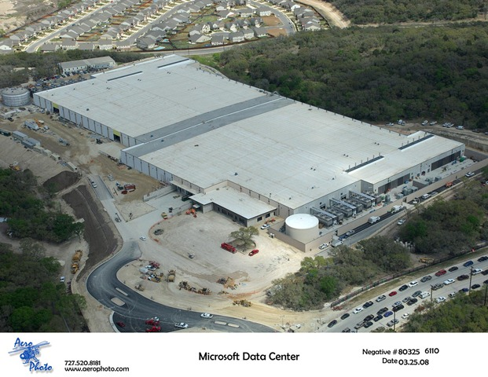












Partition/Aggregation
HLA
Deadline = 250ms
Time is money
  Strict deadlines (SLAs)
Missed deadline
  Lower quality result
MLA
………
MLA
Deadline = 50ms
“Bad artists copy.
Good artists steal.”
“The chief enemy of creativity is good sense.“
“I'd like to live as a poor man
with lots of money.“
“Computers are useless.
They can only give you answers.”
“Everything you can imagine is real.”
“It is your work in life that is the ultimate seduction.“
“Inspiration does exist,
but it must find you working.”
“Art is a lie that makes us
realize the truth.
Deadline = 10ms
Worker Nodes
Picasso
Adapted from Balaji Prabhakar, Stanford University
CS 395T – Data Centers @ UTCS Fall 2018
Notes:
A high-level aggregator (HLA) partitions queries to a large number of mid-level aggregators (MLAs) that in turn partition each query over the 43 other servers in the same rack as the MLA.
NOTE: 250ms, 50ms are all examples

Slide 6
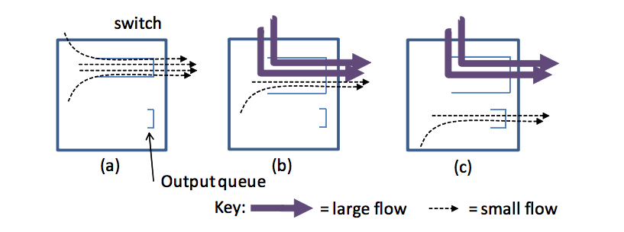
Part of Findings - Three Impairments
Incast
Queue buildup
Buffer pressure
CS 395T – Data Centers @ UTCS Fall 2018
Notes:
Incast
Queue Buildup
Buffer Pressure

Slide 7




Incast
A larger number of synchronized small flows hit the same queue
  Caused by Partition/Aggregate.
Worker 1
Aggregator
Worker 2
Worker 3
RTO_{min} = 300 ms
Worker 4
TCP timeout
Adapted from Balaji Prabhakar, Stanford University
CS 395T – Data Centers @ UTCS Fall 2018
Notes:
- RTOmin : TCP timeout => duration of time before packet retransmission

Slide 8

Queue Buildup
Sender 1
Even when no packets are lost, the short flows experience increased latency as they are in queue behind packets from the large flows.
Receiver
Sender 2
Measurements in Bing cluster
  For 90% packets: RTT < 1ms
  For 10% packets: 1ms < RTT < 15ms
CS 395T – Data Centers @ UTCS Fall 2018
Adapted from Balaji Prabhakar, Stanford University
Notes:
- 10% of responses see an unacceptable queuing delay of 1 to 14ms caused by long flows sharing the queue.

Slide 9
Buffer Pressure
The long, greedy TCP flows build up queues on their interfaces. Since buffer space is a shared resource (shallow buffered switches), the queue build up reduces the amount of buffer space available to absorb bursts of traffic from Partition/Aggregate traffic. Packet loss & timeouts
CS 395T – Data Centers @ UTCS Fall 2018

Slide 10
Data Center Transport Requirements
Low latency for short flows
High burst tolerance (handle incast problem due to Partition/Aggregation)
High throughput for long flows
Switch buffer occupancies need to be persistently low, while maintaining high throughput for the long flows
CS 395T – Data Centers @ UTCS Fall 2018

Slide 11
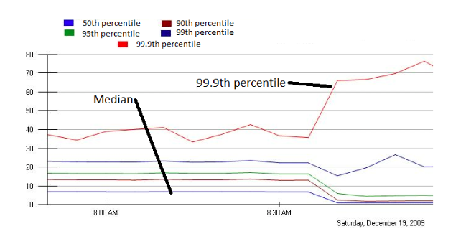
TCP in the Data Center
TCP does not meet demands of apps.
  Incast
    Suffers from bursty packet drops
  Builds up large queues:
    Adds significant latency.
    Wastes precious buffers, esp. bad with shallow-buffered switches.
Operators work around TCP problems.
  Ad-hoc, inefficient, often expensive solutions
CS 395T – Data Centers @ UTCS Fall 2018
Notes:
Carefully control the amount of data each worker sends;
Add jitter to the data communication to avoid synchronization
- Jittering trades off median against high percentiles

Slide 12
DCTCP Algorithm
CS 395T – Data Centers @ UTCS Fall 2018

Slide 13

Congestion Control
Sliding window: A flow control technique
  A generalization of stop-and-wait
  Allow up to W unack packets in flight at any time (W = window size)
Congestion: Different sources compete for resources in the network
  Flows using up all link capacity
  Short flows compete with large flows on buffers
Ways to perform congestion control:
  End-hosts (e.g. TCP congestion control)
  Network-based (e.g. ECN)
CS 395T – Data Centers @ UTCS Fall 2018

Slide 14
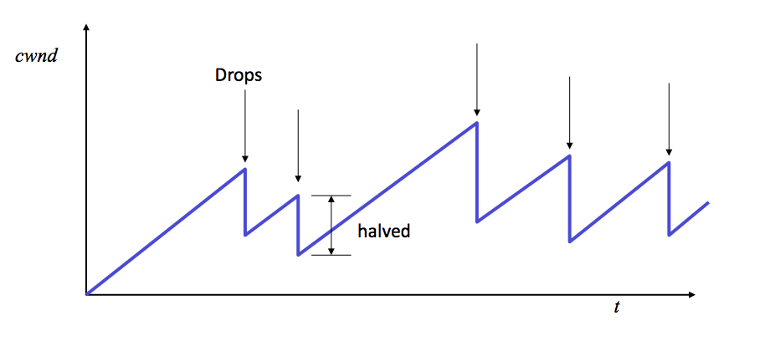
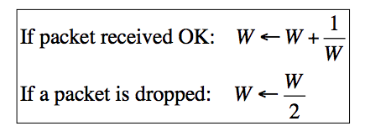
TCP Congestion Control
TCP varies the number of outstanding packets in the network by varying the window size
  Window size = min ( Advertised Window, Congestion Window )
  Congestion Window is denoted as “cwnd”
  Packet dropped congestion
How do we set cwnd? AIMD
  Additive Increase, Multiplicative Decrease
CS 395T – Data Centers @ UTCS Fall 2018

Slide 15

Review: The TCP/ECN Control Loop
Sender 1
ECN = Explicit Congestion Notification
ECN Mark (1 bit)
Receiver
Sender 2
From Balaji Prabhakar, Stanford University
CS 395T – Data Centers @ UTCS Fall 2018

Slide 16
Data Center Environment
Low round trip times (less than 250 microseconds)
Little Statistical Multiplexing
Network is homogeneous
A single administrative control
Separate from external traffic
CS 395T – Data Centers @ UTCS Fall 2018
Notes:
Microseconds = us
Milliseconds = ms

Slide 17
Two Categories of Congestion Control
Delay-based protocols use increases in RTT measurements as a sign of growing queuing delay, and hence of congestion
  Rely heavily on accurate RTT measurement susceptible to noise
Active Queue Management (AQM) approaches use explicit feedback from congested switches
  DCTCP
  RED (randomly early marking): RED monitors the average queue size marks packets based on statistical probabilities. If the buffer is almost empty, then all incoming packets are accepted. As the queue grows, the probability for dropping an incoming packet grows too. When the buffer is full, the probability has reached 1 and all incoming packets are dropped. average queue size is too slow for bursty flow
CS 395T – Data Centers @ UTCS Fall 2018

Slide 18
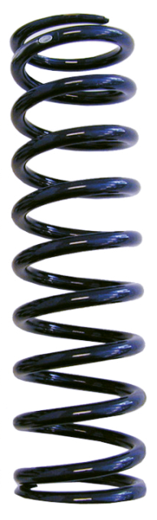

Balance Between Requirements
High Throughput
High Burst Tolerance
Low Latency
Deep Buffers:
Queuing Delays
Increase Latency
Shallow Buffers:
Bad for Bursts &
Throughput
Objective:
Low Queue Occupancy & High Throughput
DCTCP
Reduced RTO_{min} (SIGCOMM ‘09)
Doesn’t Help Latency
AQM – RED:
Avg Queue Not Fast
Enough for Incast
From Balaji Prabhakar, Stanford University
CS 395T – Data Centers @ UTCS Fall 2018
Notes:
- Any AQM scheme operating with TCP in a data-center-like environment requires making a tradeoff between throughput and delay

Slide 19
Two Key Ideas
React in proportion to the extent of congestion, not its presence.
  Reduces variance in sending rates, lowering queuing requirements.
Mark based on instantaneous queue length.
  Fast feedback to better deal with bursts.
ECN Marks | TCP | DCTCP
1 0 1 1 1 1 0 1 1 1 | Cut window by 50% | Cut window by 40%
0 0 0 0 0 0 0 0 0 1 | Cut window by 50% | Cut window by 5%
From Balaji Prabhakar, Stanford University
CS 395T – Data Centers @ UTCS Fall 2018
Notes:
TCP -> Coarse
DCTCP -> fine-grained

Slide 20

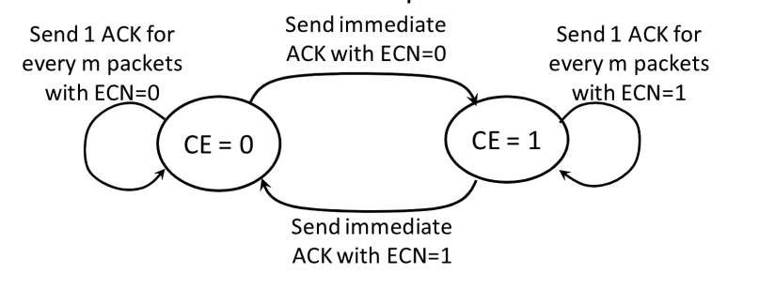
Data Center TCP Algorithm
Switch side:
  Mark packets with Congestion Experienced (CE) code point when Queue Length > K.
B
K
Don’t
Mark
Mark
  Receiver side:
  Use state machine to decide whether to set ECN-Echo flag
CS 395T – Data Centers @ UTCS Fall 2018
Adapted from Balaji Prabhakar, Stanford University
Notes:
- The states correspond to whether the last received packet was marked with the CE codepoint or not

Slide 21
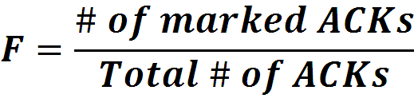


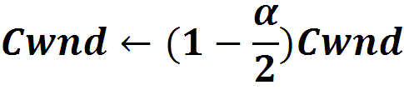
Data Center TCP Algorithm
  Sender side:
  Maintain running average of fraction of packets marked (α).
  In each RTT (i.e., once every W of data):
Adaptive window decreases:
Adapted from Balaji Prabhakar, Stanford University
CS 395T – Data Centers @ UTCS Fall 2018
Notes:
SRTT = (1-alpha)*SRTT+alpha*R’
Alpha close to 0 indicates low, and alpha close to 1 indicates high levels of congestion
When alpha is near 0 (low congestion), the window is only slightly reduced. When congestion is high (alpha = 1), DCTCP cuts window in half just like TCP

Slide 22
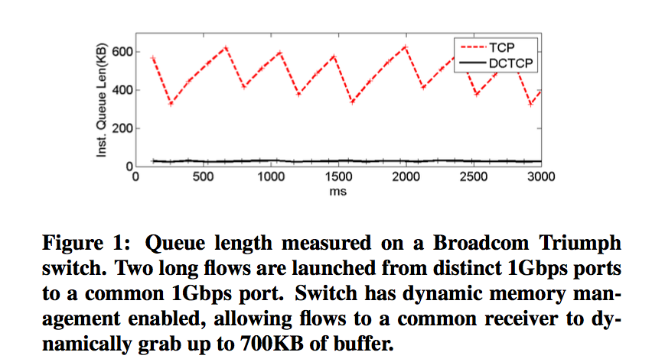
DCTCP in Action
Buffer occupancies are persistently low!
CS 395T – Data Centers @ UTCS Fall 2018
Notes:
- We will talk about K in a moment

Slide 23
Why it Works
High Burst Tolerance
  Large buffer headroom → bursts fit.
  Aggressive marking → sources react before packets are dropped.
Low Latency
  Small buffer occupancies → low queuing delay.
3. High Throughput
  ECN averaging → smooth rate adjustments, cwind low variance.
From Balaji Prabhakar, Stanford University
CS 395T – Data Centers @ UTCS Fall 2018

Slide 24
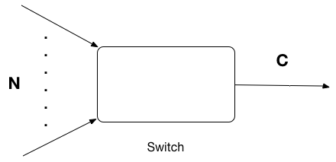
Analysis
Assumptions:
  N infinitely long-lived flows with identical round-trip times RTT, sharing a single bottleneck link of capacity C.
  N flows are synchronized (i.e. their “sawtooth” window dynamics are in-phase).
Window Size
W*+1
W*
(W*+1)(1-α/2)
Time
CS 395T – Data Centers @ UTCS Fall 2018

Slide 25

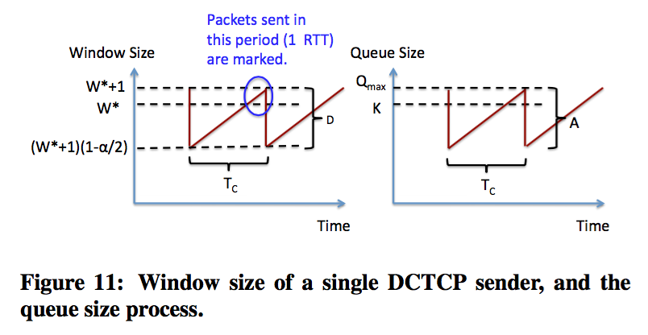
Analysis
Goals:
  Mathematically characterize the “sawtooth” by computing:
    The maximum queue size
    The amplitude of queue oscillations A
    The period of oscillations
  A quantifies how well DCTCP is able to maintain steady queues!
CS 395T – Data Centers @ UTCS Fall 2018

Slide 26


Compute A
By assumption, A = ND, where D is the amplitude of oscillation in window size of a single flow
D
W* is the window size at which the queue size reaches K
D
Thus, to calculate A, we need to compute
    Key observation: the queue size exceeds K for exactly one RTT in each period of the “sawtooth”, before the sources receive ECN marks and reduce their window sizes accordingly.
    We can compute (the fraction of marked packets) by :
      the number of packets sent during the last RTT of the period / the total number of packets sent during a full period of the sawtooth
CS 395T – Data Centers @ UTCS Fall 2018

Slide 27

Compute A
CS 395T – Data Centers @ UTCS Fall 2018

Slide 28
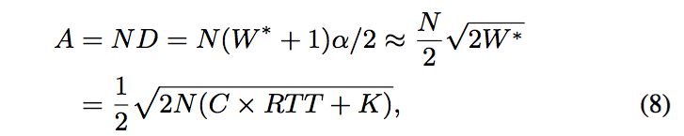
Compute A
CS 395T – Data Centers @ UTCS Fall 2018

Slide 29

Compute
CS 395T – Data Centers @ UTCS Fall 2018
Notes:
Tc = D because each packet takes 1 RTT to come back (finish a full cycle: sender -> receiver -> sender). Thus, the total number of in-flight packets = the total number of RTTs

Slide 30

Compute
Queue size at time t = Arrival rate at t – Departure rate at t
CS 395T – Data Centers @ UTCS Fall 2018

Slide 31
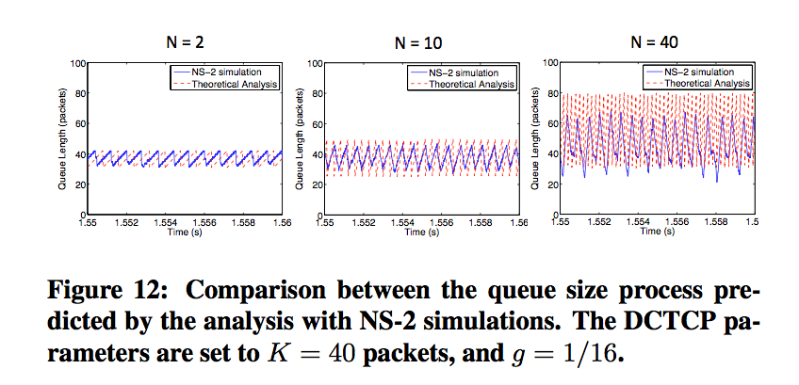
How good is the Analysis?
CS 395T – Data Centers @ UTCS Fall 2018
Notes:
- For large N, as in the N = 40 case, de-synchronization of the flows leads to smaller queue variations than predicated by the analysis

Slide 32
Evaluation
Implemented in Windows stack.
Real hardware, 1Gbps and 10Gbps experiments
  90 server testbed
  Broadcom Triumph 48 1G ports – 4MB shared memory
  Cisco Cat4948 48 1G ports – 16MB shared memory
  Broadcom Scorpion 24 10G ports – 4MB shared memory
Numerous benchmarks
  – Throughput and Queue Length
  – Multi-hop
  – Queue Buildup
  – Buffer Pressure
– Fairness and Convergence
– Incast
– Static vs Dynamic Buffer Mgmt
From Balaji Prabhakar, Stanford University
CS 395T – Data Centers @ UTCS Fall 2018

Slide 33
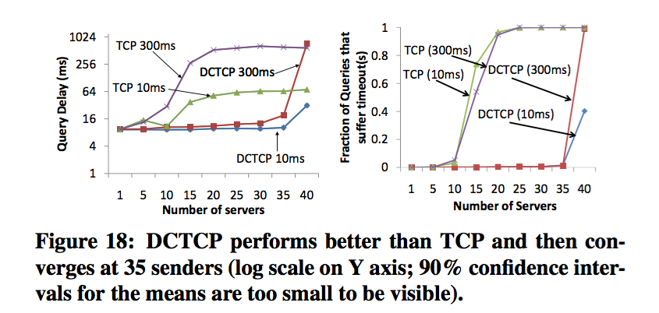
Microbenchmarks: Incast
CS 395T – Data Centers @ UTCS Fall 2018
Notes:
300 ms, 10ms are timeout values ( impact RTOmin -> query completion time)
Use a static buffer of 100 packets at each port
DCTCP is better than TCP and converges at 35 servers
More than 35 servers, every queries suffer timeout, TCP and DCTCP have nothing to do with it

Slide 34
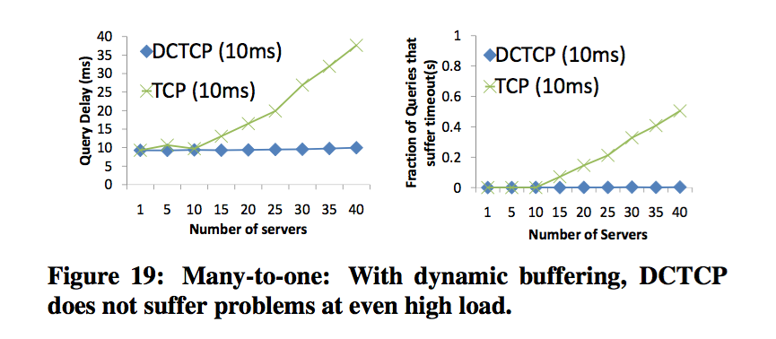
Microbenchmarks: Incast
CS 395T – Data Centers @ UTCS Fall 2018
Notes:
Dynamic buffer
DCTCP no longer suffers incast timeouts even when the number of servers grows to 40.
TCP continues to suffer from incast timeouts

Slide 35
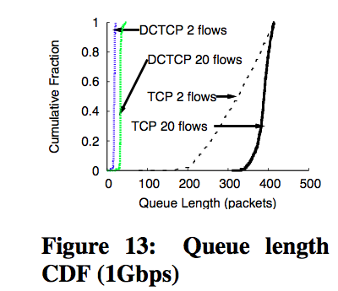
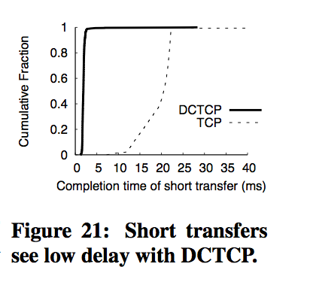
Microbenchmarks: Queue buildup
CS 395T – Data Centers @ UTCS Fall 2018
Notes:
Figure 21:
The amount of data transferred is small (20KB chunks), the completion time is dominated by the round trip time, which is dominated by the queue length at the switch
Figure 13:
- Fraction is just like CDF

Slide 36
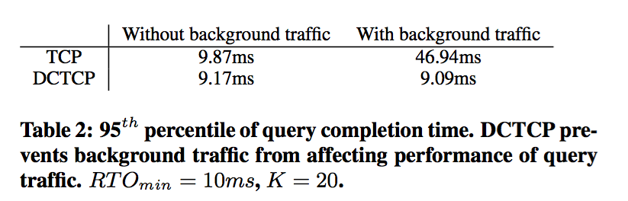
Microbenchmarks: Buffer Pressure
CS 395T – Data Centers @ UTCS Fall 2018

Slide 37
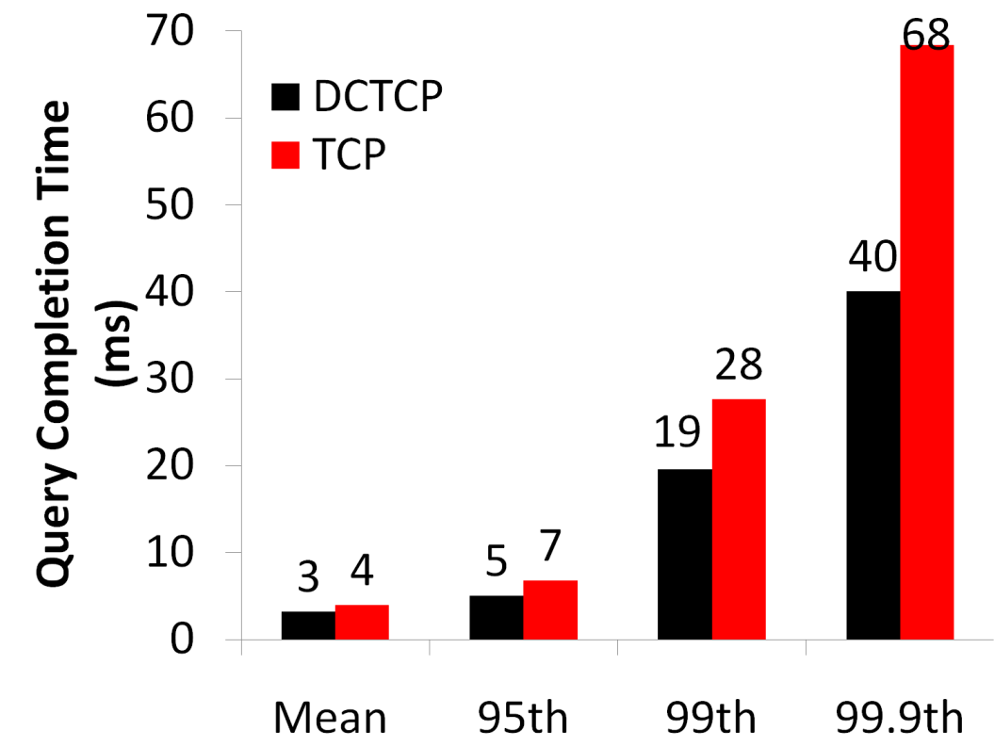
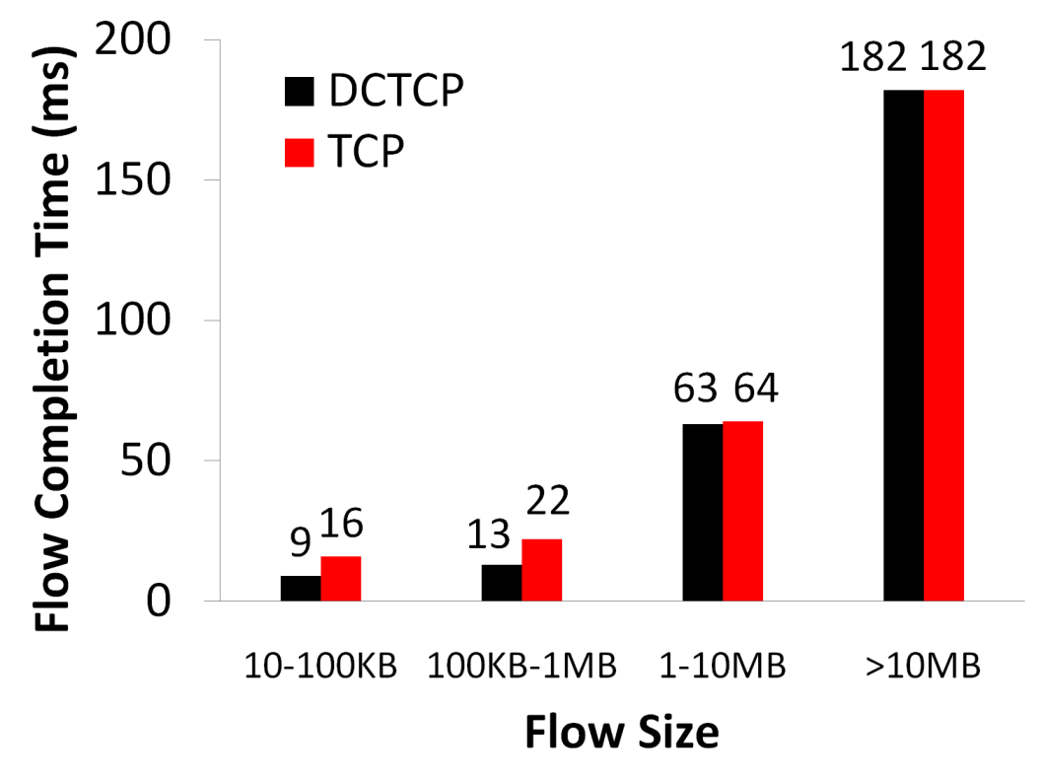
Evaluation
Background Flows
Query Flows
From Balaji Prabhakar, Stanford University
CS 395T – Data Centers @ UTCS Fall 2018

Slide 38

Evaluation
Background Flows
Query Flows
Low latency for short flows.
From Balaji Prabhakar, Stanford University
CS 395T – Data Centers @ UTCS Fall 2018
Notes:
left: flow size
Right: query completion time

Slide 39

Evaluation
Background Flows
Query Flows
Low latency for short flows.
High throughput for long flows.
From Balaji Prabhakar, Stanford University
CS 395T – Data Centers @ UTCS Fall 2018

Slide 40

Evaluation
Background Flows
Query Flows
Low latency for short flows.
High throughput for long flows.
High burst tolerance for query flows.
From Balaji Prabhakar, Stanford University
CS 395T – Data Centers @ UTCS Fall 2018

Slide 41
Conclusions: Measure and analyze production traffic
99.91% of data center traffic is TCP
Throughput-sensitive large flows, delay sensitive short flows and bursty query traffic co-exists in a data center network
  Switch buffer occupancies need to be persistently low, while maintaining high throughput for the long flows
Data Center Transport Requirements
  Low latency for short flows
  High burst tolerance
  High utilization for long flows
CS 395T – Data Centers @ UTCS Fall 2018

Slide 42
Conclusions: DCTCP
DCTCP satisfies all our requirements for Data Center packet transport.
  Handles bursts well
  Keeps queuing delays low
  Achieves high throughput
Features:
  Very simple change to TCP and a single switch parameter K.
  Based on ECN mechanisms already available in commodity switch.
CS 395T – Data Centers @ UTCS Fall 2018

Slide 43
Terms appeared in the paper
MMU (Memory Management Unit): perform translation of virtual memory address to physical address; effectively perform virtual memory management
RTO (Recovery Time Objective): duration of time before packet retransmission (i.e. TCP minimum retransmission timeout)
Statistical multiplexing: the idea of taking a single resource and sharing it across multiple users in a probabilistic or statistical
  It’s statistical in that each user receives a statistical share of the resource based on how much others are using it
  For example, if your friend is reading, you can use all of the link. If both of you are loading a page, you receive half of the link capacity
  Packet switching
CS 395T – Data Centers @ UTCS Fall 2018

