Slide 1
Crop doctor
Image-based crop disease diagnose and forecast
Xinxin Li, 9/20/2016

Slide 2
Motivation
Use deep learning to help growers improve crop yields, save money, and improve crop management

Slide 3
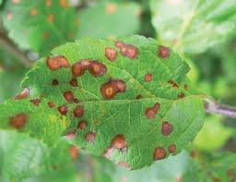
The Questions
Can we diagnose the crop disease by looking at the patterns on the leave?
Can we predict the crop disease in a farm by combining image-based diagnose with weather data?

Slide 4
Hypothesis

Slide 5
Solution part 1 out of 2

Slide 6
Solution part 2 out of 2

Slide 7
Methods (keep in 1 slide)

Slide 8
Insights
Technical takeaway highlight 1:
Technical takeaway highlight 2:
Technical takeaway highlight 3:

Slide 9
Extensions
Apply the methods to other crops/plants
Include weather info to predict crop disease
Include location info to predict crop disease
How business could benefit:
Identify timing of occulation
Identify type of occulation

