Slide 1
Crop doctor
Deep learning for crop disease
Xinxin Li, 9/20/2016

Slide 2
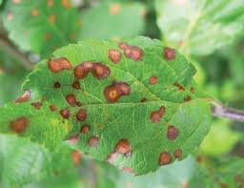
The Questions
Can we diagnose the crop disease by looking at the patterns on the leave?
Can we predict the crop disease in a farm based on weather data?

Slide 3
Proposed solutions
Use case 1: Crop disease diagnose
  Given a photo of a leaf, the crop name, we can evaluate and identify the disease
Use case 2: Crop disease forecasting
  Given a location, a plant type in a farm, we can forecast the arrival/spread of certain disease given weather information.
  Farmers can take measure ahead of time to prevent disease, improve crop management, and increase yield.

Slide 4
Data/Method used
Data from 2 sources
  Crop image from Plantvillage.org
    Plant images data
      Cvs files
        Crop common name,Crop scientific name,Disease common name,Disease scientific name,url,description,metadata
      Jpg files
        Image metadata
  Weather data
    Weather.com

Slide 5
Methods
Base model
  A simple crop: apple
  A simple data: plantvillage
  A simple model
Advanced models
  Model discovery
    Feature engineering
  More complex data: google image
  More crops

Slide 6
Base model outcome
Insight:
  Crop disease diagnose:
    Base model 1 is good
    Base model 2 sucks
    Base model 3 is okay
  Crop disease forecasting:
    Base model 1 is good
    Base model 2 sucks
    Base model 3 is okay
Conclusion:
  Focus on building a good XYZ model for crop disease diagnose
  Focus on building a good XYZ model for crop disease forecasting

Slide 7
Model discovery
Insight:
  Crop disease diagnose
    Feature importance
    Cross-validation
Conclusion

