Slide 1
Enhance Visual Reasoning in VQA Tasks through Architectural Choices and Training Strategies
Xiumei Xue
Jan 17, 2025

Slide 2
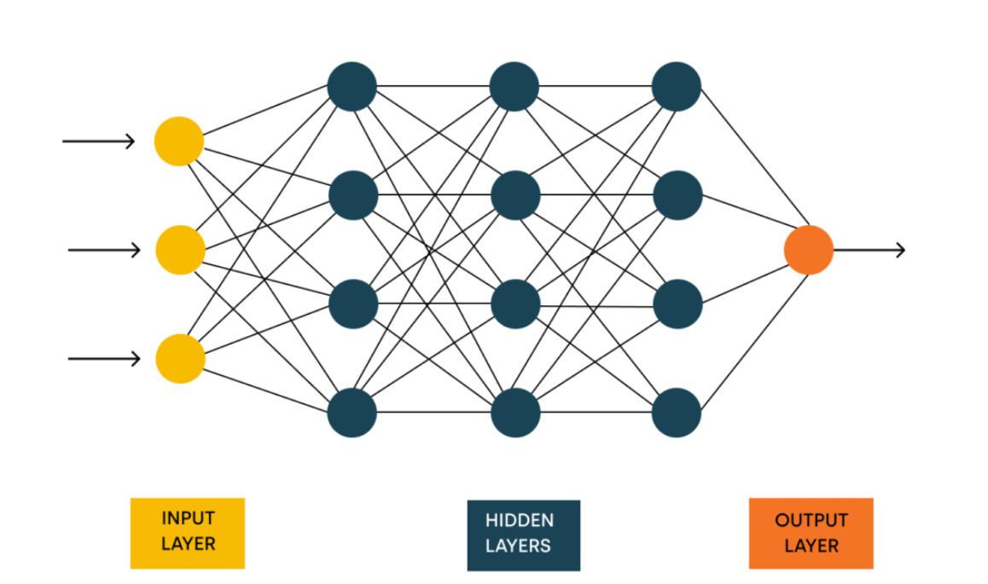
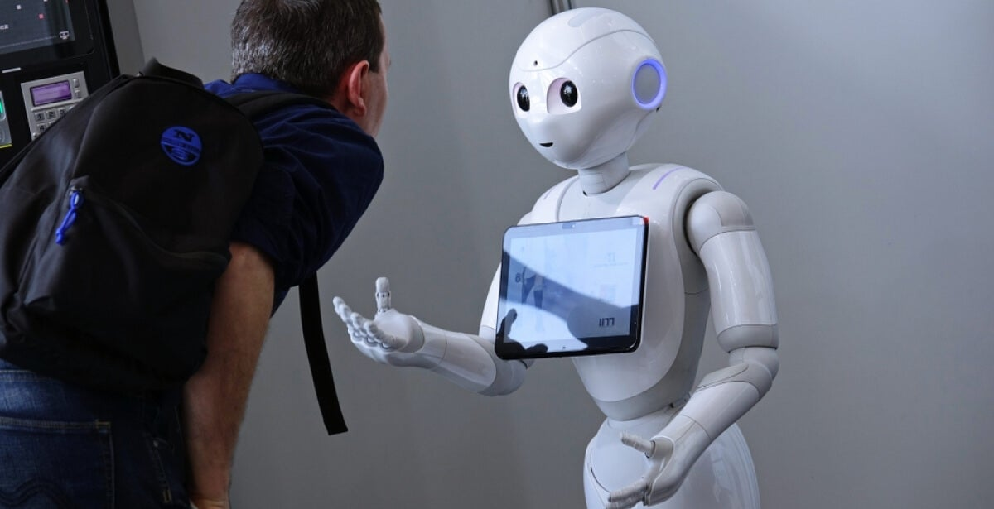
Motivation
Current neural network models struggle with tasks requiring spatial reasoning or counting. They often rely on pattern recognition rather than true spatial understanding.
Given this, I am somewhat skeptical of the research path based on the inherent, restrictive approach and am more drawn to exploring interactive learning.
Interactive learning is a paradigm in artificial intelligence where agents learn to perform tasks through interactions with a teacher or environment. This approach is particularly relevant in dynamic or unforeseen context.

Slide 3
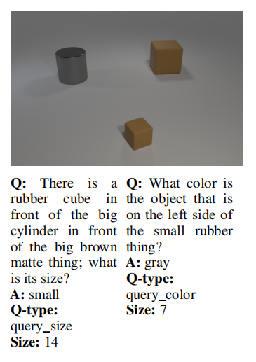
Related Work & Datasets
Large gray rubber
cylinder
Large brown matte
cube
Visual Question Answering (VQA) is a multimodal task that bridges computer vision and natural language processing, requiring models to reason over both visual and linguistic inputs.
Small brown rubber
cube
CLEVR (Johnson et al., 2016)
a diagnostic dataset for compositional language and elementary visual reasoning by providing a series of synthetic 3D rendered images and corresponding complex questions
helps evaluate VQA models on multi-dimensional benchmarks such as Question Type, Relation Type, Question Size, Spatial Reasoning, Compositional Generalization, etc
ensures data diversity and balance, while also providing detailed question parsing, allowing researchers to deeply analyze the model’s reasoning process
Example image and QA pairs in CLEVR

Slide 4
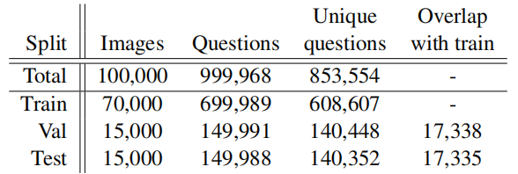
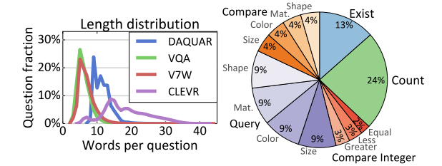
Look into CLEVR
consists of 3 parts: images, questions, scenes
images are annotated with ground-truth object positions and attributes (scene graphs)
questions are represented as functional programs that can be executed to answer the question, such as querying object attributes, counting sets of objects, or comparing values
Statistics for CLEVR
{'image_index': 0, 'program': [{'inputs': [], 'function': 'scene', 'value_inputs': []}, {'inputs': [0], 'function': 'filter_size', 'value_inputs': ['large']}, {'inputs': [1], 'function': 'filter_material', 'value_inputs': ['metal']}, {'inputs': [2], 'function': 'unique', 'value_inputs': []}, {'inputs': [3], 'function': 'same_shape', 'value_inputs': []}, {'inputs': [4], 'function': 'exist', 'value_inputs': []}], 'question_index': 0, 'image_filename': 'CLEVR_val_000000.png', 'question_family_index': 39, 'split': 'val', 'answer': 'no', 'question': 'Are there any other things that are the same shape as the big metallic object?'}
Left - CLEVR questions are generally much longer.
Right - Distribution of question types in CLEVR.
Sample item in CLEVR_val_questions.json
*program_length_range 2~25

Slide 5
Methodology
Start from a baseline model, which utilized LSTM model to process questions and answers, VGG16 to extract image features
=> the prelimnary accuracy is around 3%
Upgrade the baseline model structure, use BERT to encode text and ResNet-50 to process images
How to be “interactive”?
provide human feedback to realize an incremental, online learning
instead of pure correct answer, provide corrections with additional information
introduce program attribute, similar to the concept of Chain-of-Thinking (CoT)
dynamic fusion with multi-head attention
try online learning
Core challenges: the mismatch between batch-encoded inputs and item-specific human corrections in natural language => to collect human feedback is effort-consuming

Slide 6
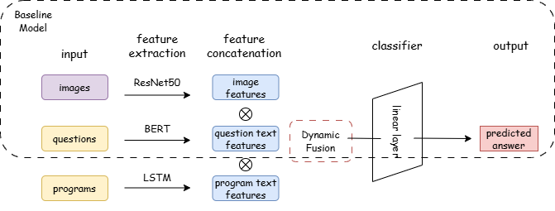

Current approach
AdamW Optimizer, CrossEntropy Loss
3 epochs, learning rate=1e-4
exprimented with max_program_length = 3 and 5
online learning with program-augmented model
sketch map of online learning
Model Architecture
*drawn by draw.io

Slide 7
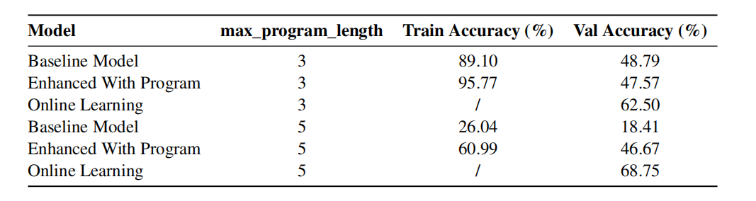
Results
Performance comparison of different models and subsets
By controlling the program length, it becomes evident that performance degrades as the questions become more complex. This suggests that the model struggles with intricate queries, highlighting a limitation in handling higher levels of abstraction or detail.
Programs serve as valuable additional information, particularly for relatively complex questions. Though both training and validation accuracies decrease when max_program_length is set as 5, the program-enhanced model still demonstrates a significant improvement over the baseline.
The generalization capability of model is limited. The results reveal a notable gap between training and validation accuracy, which points to potential over-fitting. This discrepancy underscores the model’s limited ability to generalize to unseen data.
While the results of online learning appear promising, they exhibit a degree of randomness. This suggests that the online learning process may lack stability or consistency, calling further investigation into its reliability and effectiveness.

Slide 8
Discussion
Limitation
The CLEVR dataset is synthetic, making it difficult to generalize to real-world scenarios. Additionally, most real questions lack programming annotations, which limits its applicability.
The use of pre-trained models can be computationally expensive, and the current model architectures and hyperparameter configurations may not be the most advanced.
The current analysis is limited in scope, focusing primarily on overall performance without considering different task types or dimensions.
Future Work
Validate the model on hybrid datasets that combine synthetic and real-world data. This will help assess the model's ability to generalize beyond synthetic environments.
Experiment with more efficient pre-trained models (e.g., RoBERTa) and explore state-of-the-art architectures with optimial hyperparameters.
Error Analysis-Interactive Learning?

Slide 9
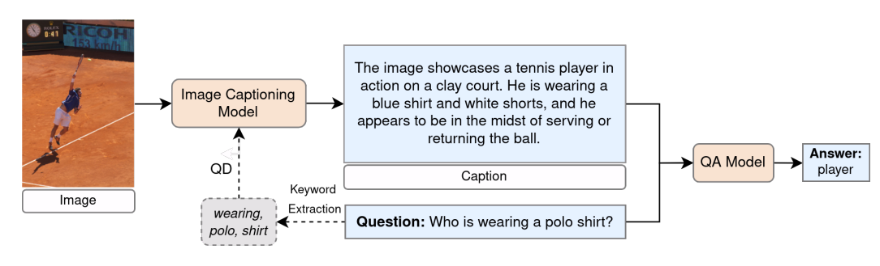
Extended research
Question Rephrasing / Enhancements
VQA-Rephrasings (Shah et al., 2019): A new visual question answering dataset and evaluation protocol to measure robustness of VQA models to linguistic variations and a new cycle-consistency inspired framework to make VQA models robust to these variations.
Question-Driven Image Captions (Ozdemir et al., 2024): incorporates image captioning as an intermediary process within the VQA pipeline; explores the efficacy of utilizing image captions instead of images and leveraging large language models (LLMs) to establish a zero-shot setting.
VQA pipeline exploiting general and the proposed question-driven (QD) image captioning as an intermediate step

