Slide 1
24 POINTS
XIUMEI XUE
2024.03.20

Slide 2
What does it do?
01
Rule Introduction
Rundown Brief

Slide 3
Rule Introduction
You will be given 4 random cards from 1 to 9 (“A” refers to 1), and three entry levels vary
You can use + - x / to generate a result of 24, and each card should only be used once
Decimal, fraction or negative number can appear during operations
Also, a timer will be set according to your chosen level (Easy: 3min | Medium: 1min30s | Hard: 60s)
If you can get 24 in limited time, you win, or you fail.
Dialogue System
+
Page Interaction
=
Dialogue-Driven Interaction

Slide 4
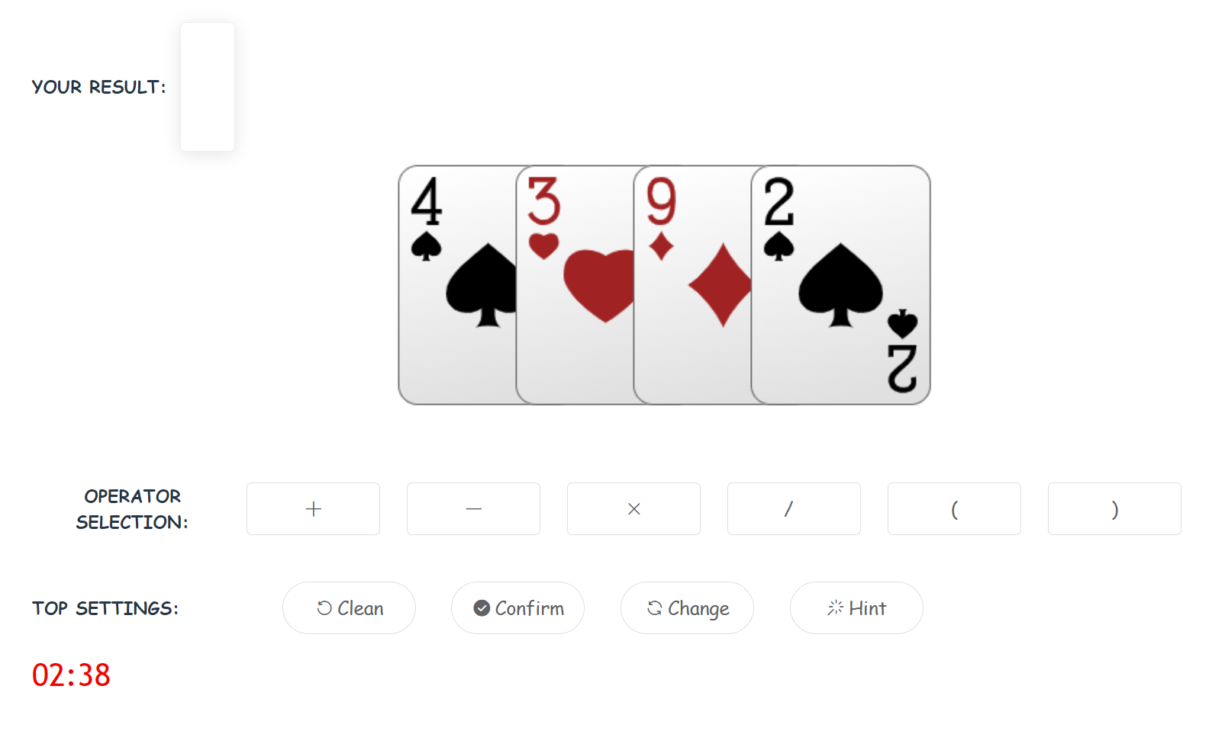
Rundown Brief
display your expression/hint
countdown

Slide 5
02
Technicalities
Platform and Technologies
Library

Slide 6
Technicalities
Platform
Web Platform based
Backend Technology
Node.js (LTS version)
Package Manager: Yarn
Azure service for ASR&TTS&NLU
Frontend Technologies
JavaScript (Xstate, vue.js framework)
azure.js – export relevant KEY
dm.js – manage dialogue-driven interaction
main.js – control the main logic and flow of the game
HTML
index.html – the main entry point of the application, containing the structure and layout of the web page
CSS
style.css – define the styling rules for HTML elements

Slide 7
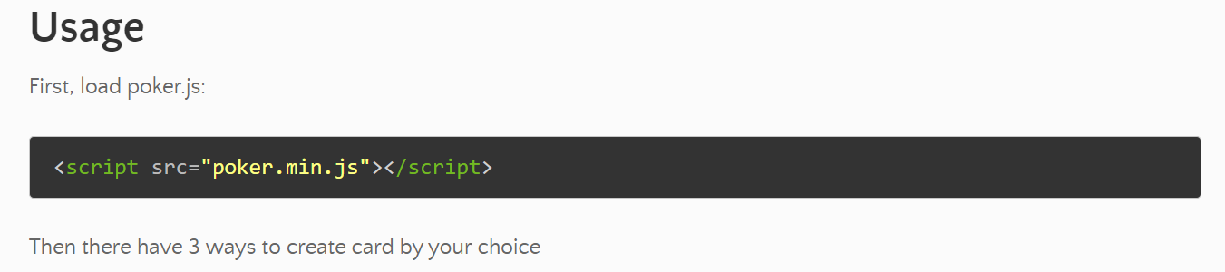
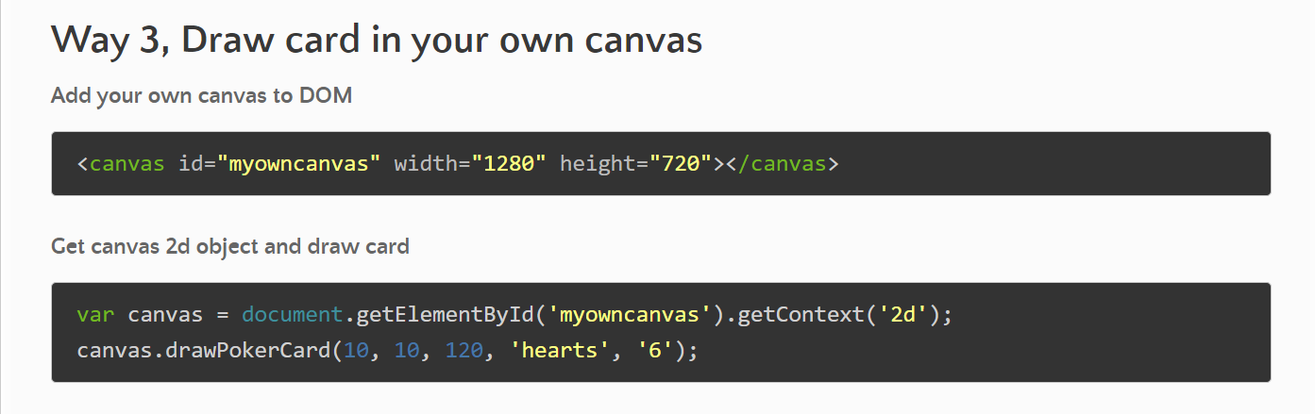
Technicalities| Library
Import a third-party JS library: Poker.JS
https://tairraos.cloud4v.org/Poker.JS/#english-version-readme

Slide 8
03
Recap & Outlook
Challenges
Relation to course contents
Future Work

Slide 9
Recap | Challenges
Variable sharing
variable assignment within dmMachine => no change outside
dmActor.subscribe((state) => {
targetTime = state.context.targetTime;
}); // always reflects the latest state of the targetTime value in the dmActor
Utterance Collapse
Use after for delayed transitions- “Have you thought of a solution?”
Player action unpredictable
Interaction Triggered Utterance(Solved)
function successUtter() {
dmActor.send({
type: "WELLDONE"
});
}

Slide 10
Course contents
Most useful part(s)
Understanding and Implementation: ASR+TTS+NLU+DM
Lightweight Product Development Capability
Statecharts as an implementation framework
Reduced state counts-guard transition, history…
Structural
Rule-based- more flexibly?
Understandable
*(Xstate) Gammar Acquisition!
Development process
Design the main logic => Include the dialog flow => Combination and coordination
Test by myself, by peers => Bug fixing
*Not relates to ethical concerns

Slide 11
Future work
In general, my game is almost end-to-end completed
Improvements on level distinction
Enhancing the coordination between Dialogue and Interaction
Exit & Replay
About conversational features
Assign different voice styles in different occasions – e.g. succeed => “cheerful”, fail => “sad”
Fix/avoid utterance collapse as much as possible - adjust delayed time flexibly?
Mixed-initiative – collect demand by input rather than selection in given choices

Slide 12
THANKS

