Slide 1
关键词&关键短语抽取
AI 中台四组
钟海霞 2020-03-28

Slide 2
Outline
业务背景
方法综述
迭代版本
零碎总结

Slide 3
业务背景
时代光华培训课程推荐 → 给课程打标签

Slide 4
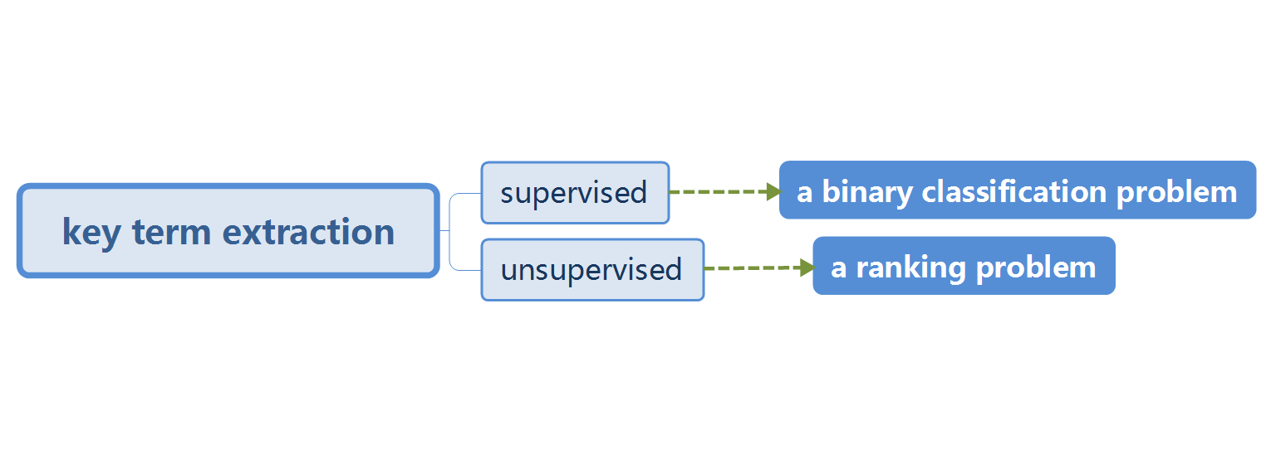
方法综述

Slide 5
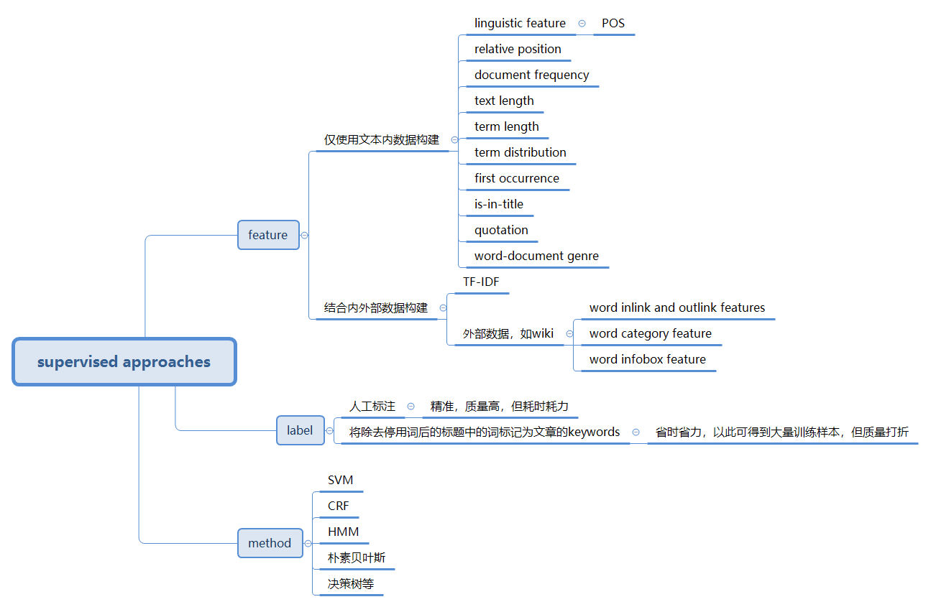

Slide 6
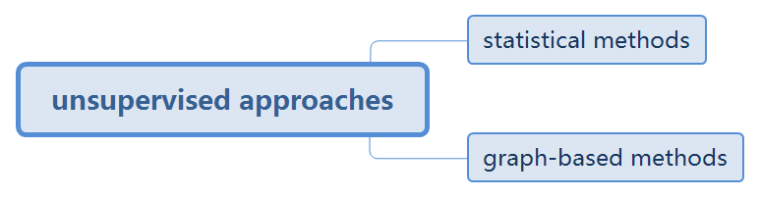

Slide 7
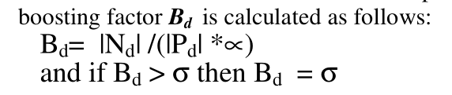
Methods |  | Techniques | Advantages | Drawbacks
Statistical methods | TF-IDF (Li et al., 2007) | 当一个词在文档频率越高并且新鲜度高（即普遍度低），其TF-IDF值越高 | - 无需标注数据 - 方便实施 - 适用于多种语言场景 - 相比PageRank等迭代算法，计算复杂度低，运行快 | - 缺乏对语义相关性的考虑 - 准确度不够
 | KP-Miner (El-Beltagy et al., 2009) | The TF-IDF model in conjunction with the introduced boosting factor (N=word length, P=word positon)
 | RAKE (Rose et al., 2010) | 断句分词：split into sequences of contiguous words at phrase delimiters and stop word positions； 建立co-occurrence共现矩阵； centrality measure：frequence, degree, ratio of degree to frequency； 根据得分高低排序； 每个关键词的分数=sum of its member word scores
 | YAKE (Campos et al., 2020) | 断句分词等数据预处理，得到candidate term； 计算5个features：casing, term position, term frequency normalization, term relatedness to context, term different sentence； 通过公式计算每个term的score； 生成n-grams得到candidate keywords； 通过公式计算得到每个候选keywords的得分； 用三种相似度计算方法去学习deduplication phrase：the Levenshtein similarity, the Jaro-Winkler similarity, the sequence matcher； 最后，对剩下的keywords根据得分得到top K

Slide 8
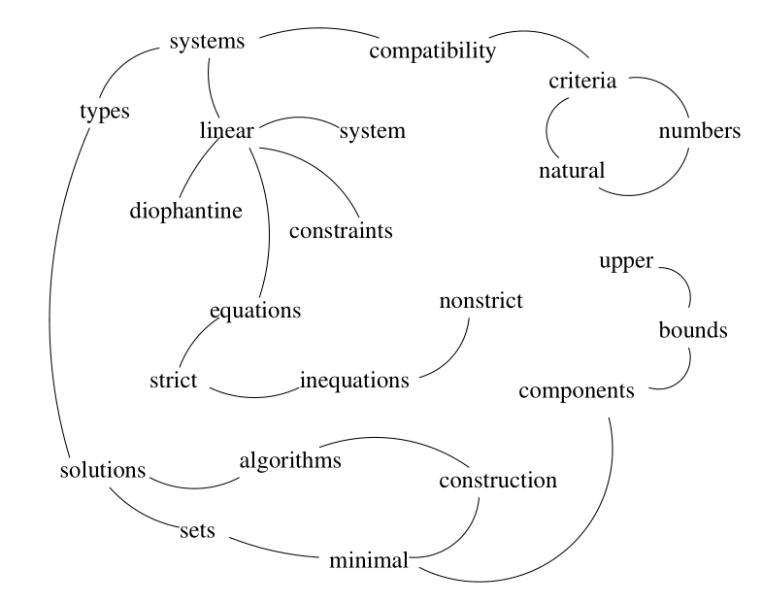
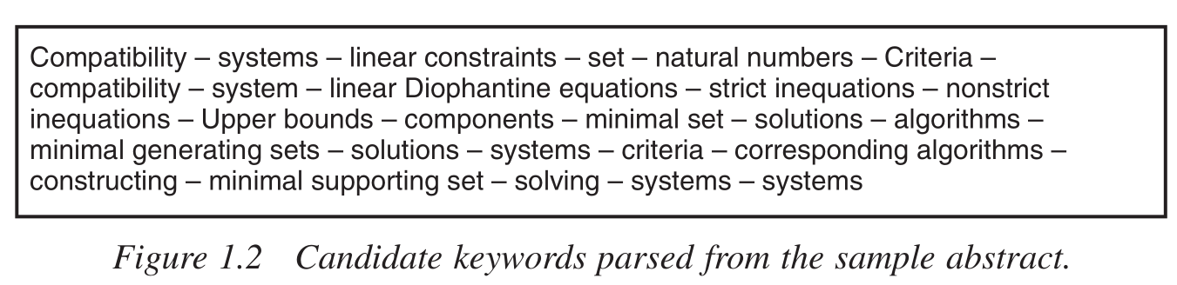
关键短语的构建：
分词到最细粒度的word
→ 过滤停用词/数字/标点符号等，构建关键词候选集
→ ranking algorithim (centrality measure)
→ word scores
→ 过滤脏words
→ top k words， 即keywords
→ 在原始文本中标记keywords，若形成相邻词组，则组合成关键短语
通常，score of keyphrase = sum of its member word scores
2. 分词到phrase粒度
→ n-grams/the longest noun phrases/split at phrase delimiters and stop word positions
→ 结合 pattern、最少出现次数等，构建关键短语候选集 (英文一般取/Adj*Noun+/作为pattern)
→ ranking algorithim (centrality measure)
→ phrase scores
→ 过滤脏phrases (stability test/deduplication phrase check)
→ top K phrases
(Mihalcea & Tarau, 2004)
(Rose et al., 2010)

Slide 9
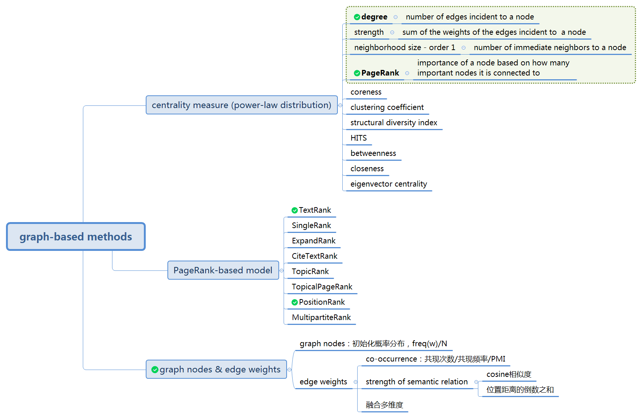
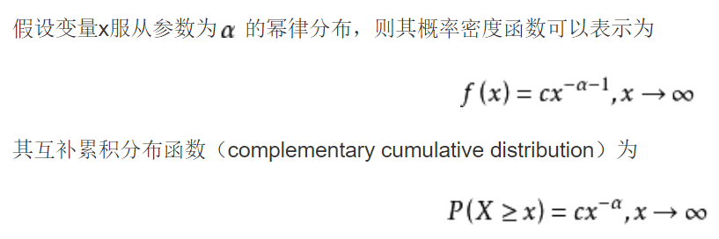
无向图：” For loosely connected graphs, with the number
of edges proportional with the number of vertices,
undirected graphs tend to have more gradual convergence curves.” (Mihalcea, 2004)
共现关系
Co-occurrence relation
within a window
of 2-10 words
求Markov chain的转移概率矩阵，
通过迭代求该矩阵的最大特征值
baike.baidu.com

Slide 10
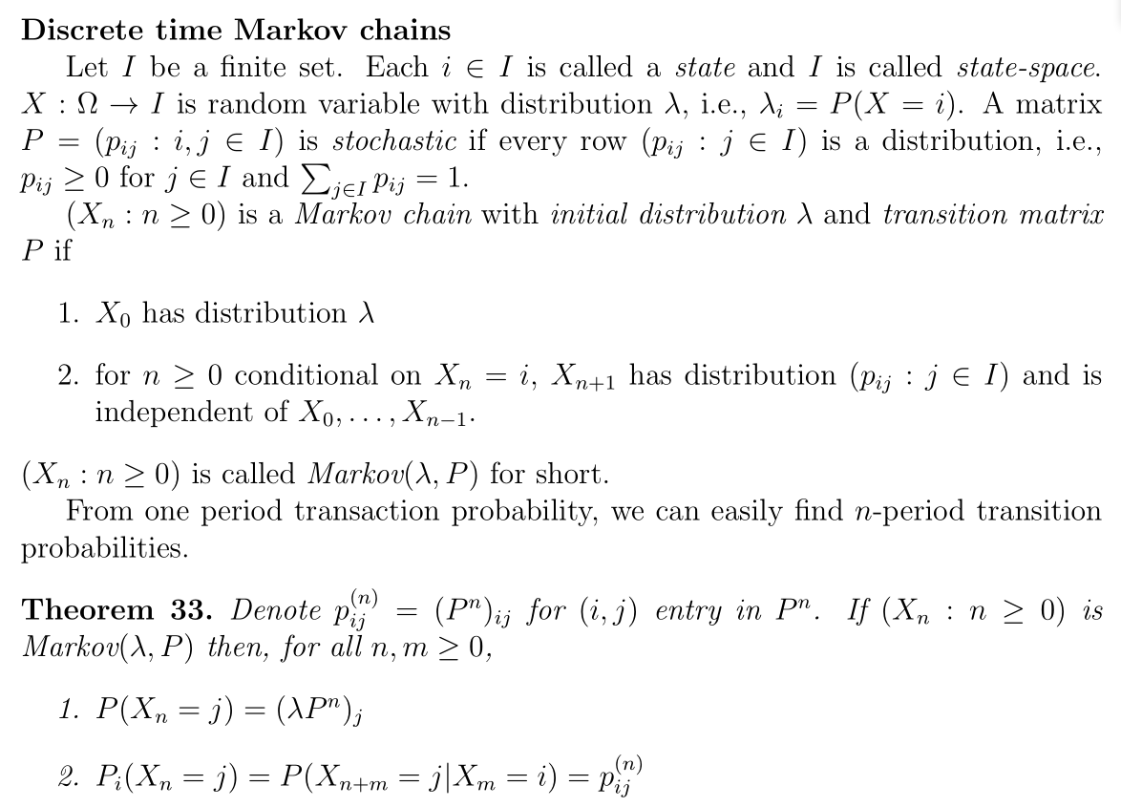
Simulation Methods for Finance (Zheng, 2016:45)

Slide 11
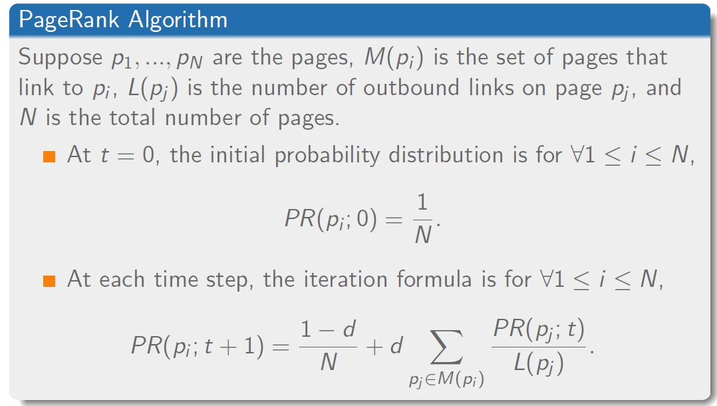
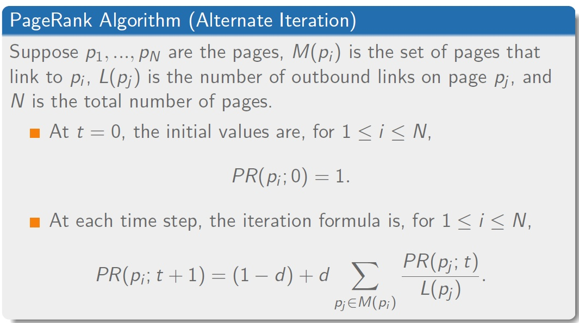
https://zhuanlan.zhihu.com/p/28298952

Slide 12
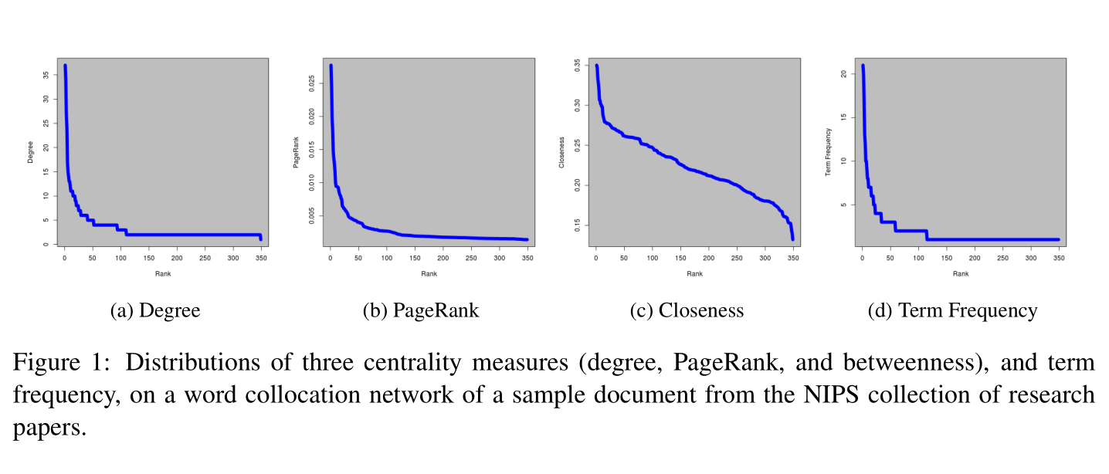
Many centrality measures exhibit a power-law distribution:
(Lahiri et al., 2014)
Decline-based thresholding: “Researchers proposed choosing the most important terms that appear above the “knee” of those distributions. “(Lahiri et al., 2014)
Percentage-based thresholding: choose top k% of words/phrases

Slide 13
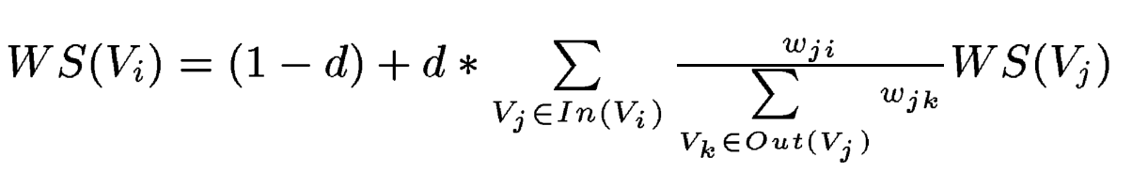

Graph-based methods | TextRank (Mihalcea et al., 2004) | weighted PageRank | Ranking algorithm: 均采取了 weighted PageRank
 | SingleRank (Wan et al., 2008) | - Edge weight = similarity * count -仅使用本文档信息进行图构建
 | ExpandRank (Wan et al., 2008) | - neighborhood-level word evaluation： -用增加了相似主题文档的数据集进行图构建 --> reflect the global information, Global Affinity Graph
 | CiteTextRank (Gollapalli et al., 2014) | - incorporates evidence from both a document’s content as well as the contexts in which the document is referenced within a citation network
 | TopicRank (Bougouin et al., 2013) | - 分词 → the longest noun phrases - HAC with average linkage (层次聚类) → topics - 构建以topics为顶点的图并进行ranking - Edge weight =距离的倒数之和 - 从top k topics里面提取keyphrases (3种方式)
 | TopicPageRank (Liu et al., 2010) | - 使用LDA生成topics并计算word topic distribution, pr - 根据共现关系构建graph，并代入之前算好的pr
 | PositionRank (Florescu et al., 2017) | - Idea: 给文档中出现在前面的、高频词赋予更高的权重 - Edge weight = sum of its inverse positions (before any filters)
 | MultipartiteRank (Boudin et al., 2018) | - 根据pattern /Adj*Noun+/ 提取关键短语候选集 - 用HAC with average linkage (层次聚类) → topics - 构建有向图：仅连接从属于不同topics的候选关键短语 - Edge weight = sum of the inverse distance between the occurrences of candidates - 从topics里提取最终keyphrases

Slide 14
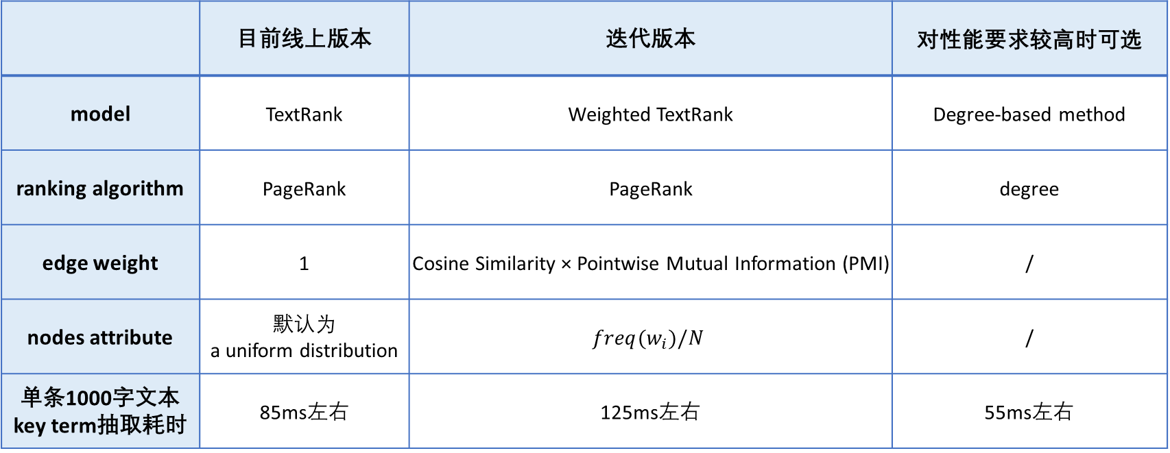
迭代版本
 | 目前线上版本 | 迭代版本 | 对性能要求较高时可选
model | TextRank | Weighted TextRank | Degree-based method
ranking algorithm | PageRank | PageRank | degree
edge weight | 1 | Cosine Similarity × Pointwise Mutual Information (PMI) | /
nodes attribute | 默认为 a uniform distribution | $$freq(w_{i})/N$$ | /
单条1000字文本 key term抽取耗时 | 85ms左右 | 125ms左右 | 55ms左右

Slide 15
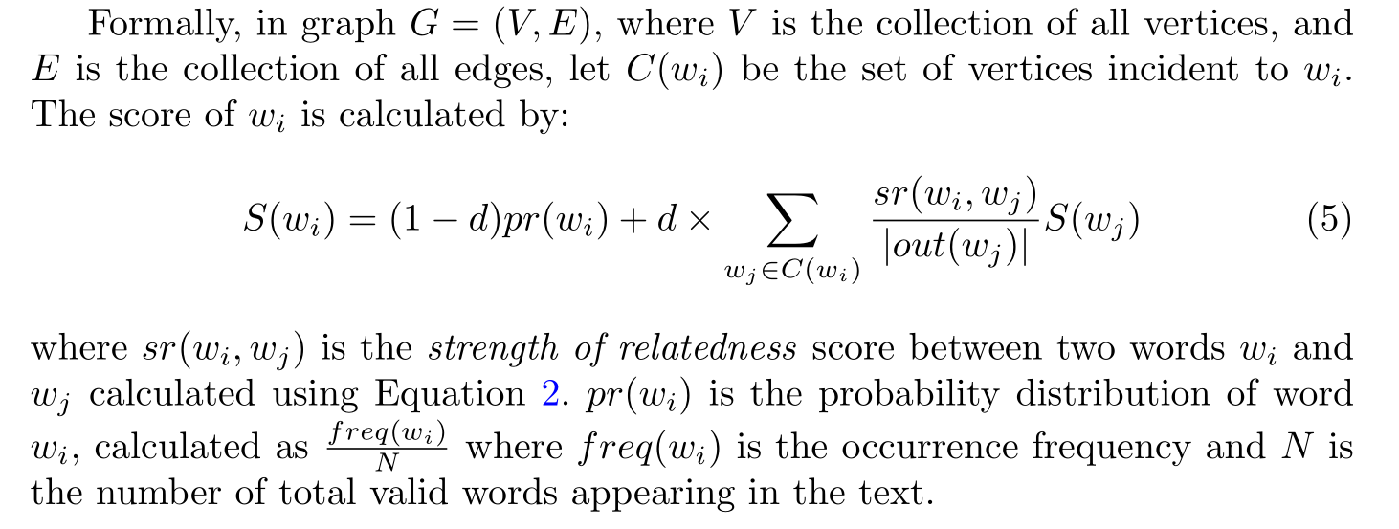
Weighted TextRank:
(Wang et al., 2015)

Slide 16
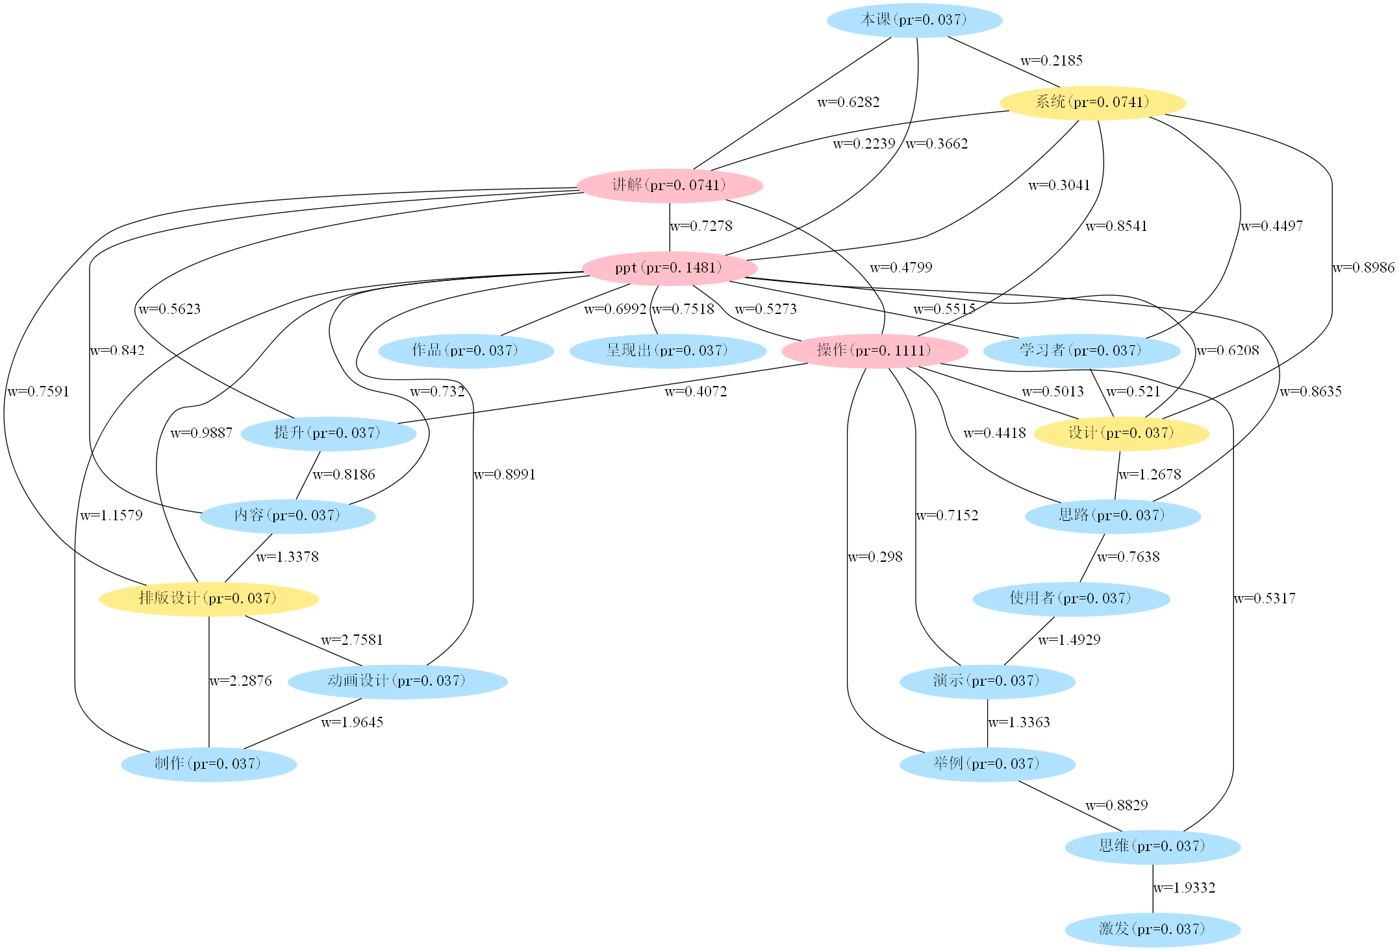
- weighted PageRank与degree方法出的Top5标签交集
- weighted PageRank与degree方法出的Top10标签交集
text = '本课系统讲解了PPT操作中的高阶提升应用，详细讲解了内容页排版设计以及PPT动画设计制作。
帮助学习者系统掌握PPT设计的操作思路及具体步骤，能够举一反三，帮助使用者通过一个个细致的演
示操作以及举例式的思维灵感的激发，能够更快更好的呈现出一份独特属于你自己的PPT作品。'

Slide 17
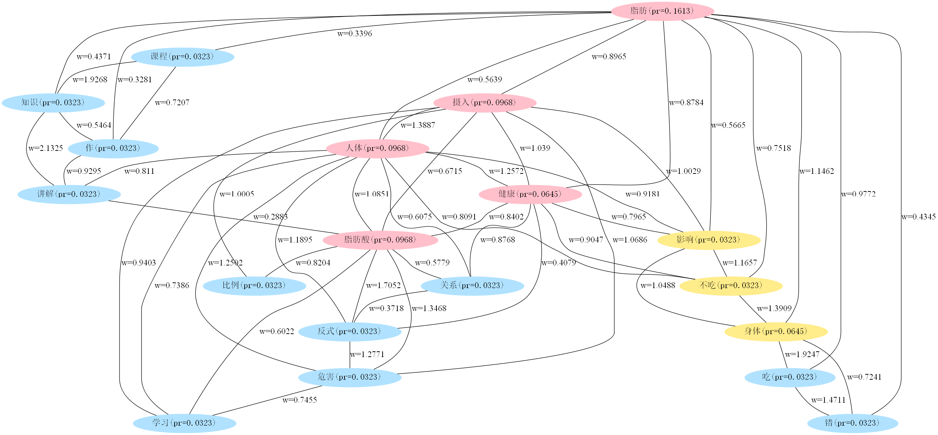
- weighted PageRank与degree方法出的Top5标签交集
- weighted PageRank与degree方法出的Top10标签交集
text = '脂肪的摄入对人体健康会造成重大影响，“不吃脂肪会对身体造成伤害，吃错脂肪对身体伤害更大”。那么到底如何
才能做到正确的摄入脂肪呢？本课程将对脂肪知识作详细讲解，让你充分认识到脂肪酸和人体健康的关系以及反式脂肪酸
对人体的危害，学习摄入脂肪酸最恰当的比例。'

Slide 18
零碎总结
对“课程标题”和“课程描述”分开进行标签抽取 → 让标题中的关键词更好地浮现出来
断句，主要影响两个地方：
Graph edges的构建 → 断长句 (。.！!？?...\n……) → 边的关系更充分
Keyphrase的构建 → 断短句 (,，；;：:\t....\n。.!！?？……), i.e., 只拼接在同一个chunk里的词 → 避免不合理的keyphrase组成
分两阶段做词性过滤：
在构建图之前，进行第一道词性过滤，保留名词、动词、时间词、英文等
在构建完keyphrase之后，再过滤掉纯动词/时间词的keywords → 以生成更多有效keyphrase
需人工维护迭代的几张表：
*自定义词表 (分词器) ：
分词效果将很大程度影响最终抽取效果
对于一些因词性标注错误导致误过滤的tag (例如将“绩效”标注成了b区别词) 、或是希望保留的有效动词tag (例如“养生”) ，也可通过更新自定义词表应对
白名单：长度为2或3的中文维基百科短标题
黑名单：针对抽取出的badcase进行扩充
因不会影响课程推荐效果，暂未全量处理英文脏标签

Slide 19
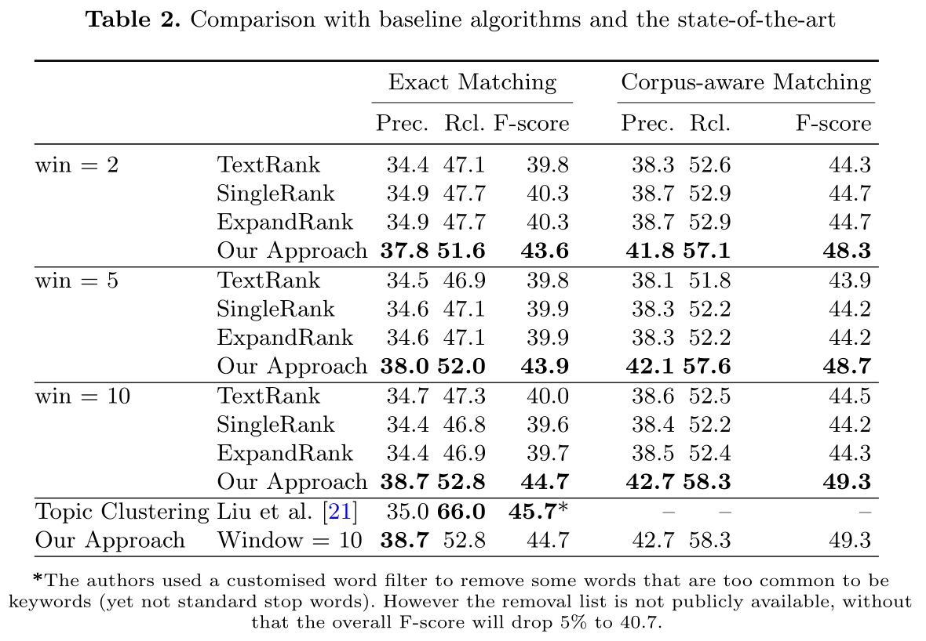
黑白名单的过滤可较大幅度提升标签质量：
(Wang et al., 2015)

Slide 20
根据课程来源作相应文本预处理：
过滤无指代意义的通用词/pattern：
正则过滤
在不同课程来源下分别统计TFIDF
在全部课程中统计TFIDF
调用“句子→技能实体列表”接口，找出无技能召回的句子
扩充黑名单
例如：
百度课程标题：
Mastercam快速入门【原厂商培训课程，品质保证】
UG曲面设计快速入门【原厂商培训课程，品质保证】
Inventor钣金设计快速入门【原厂商培训课程，品质保证】
销售罗盘课程描述：
赢单罗盘系列赋能微课，这套课程将帮助销售人员熟练掌握线索获取…
适用人群：xxxx

Slide 21
References:
Li, J., & Zhang, K. (2007). Keyword extraction based on tf/idf for Chinese news document. Wuhan University Journal of Natural Sciences, 12(5), 917-921.
El-Beltagy, S. R., & Rafea, A. (2009). KP-Miner: A keyphrase extraction system for English and Arabic documents. Information Systems, 34(1), 132-144.
Rose, S., Engel, D., Cramer, N., & Cowley, W. (2010). Automatic keyword extraction from individual documents. Text mining: applications and theory, 1, 1-20.
Campos, R., Mangaravite, V., Pasquali, A., Jorge, A., Nunes, C., & Jatowt, A. (2020). YAKE! Keyword extraction from single documents using multiple local features. Information Sciences, 509, 257-289.
Mihalcea, R., & Tarau, P. (2004, July). Textrank: Bringing order into text. In Proceedings of the 2004 conference on empirical methods in natural language processing (pp. 404-411).
Lahiri, S., Choudhury, S. R., & Caragea, C. (2014). Keyword and keyphrase extraction using centrality measures on collocation networks. arXiv preprint arXiv:1401.6571.
Wang, R., Liu, W., & McDonald, C. (2015). Using word embeddings to enhance keyword identification for scientific publications. In Australasian Database Conference (pp. 257-268). Springer, Cham.
Xu, S., Yang, S., & Lau, F. (2010, July). Keyword extraction and headline generation using novel word features. In Twenty-Fourth AAAI Conference on Artificial Intelligence.
Li, Z., Zhou, D., Juan, Y. F., & Han, J. (2010, April). Keyword extraction for social snippets. In Proceedings of the 19th international conference on World wide web (pp. 1143-1144).
Page, L., Brin, S., Motwani, R., & Winograd, T. (1999). The pagerank citation ranking: Bringing order to the web. Stanford InfoLab.
Wan, X., & Xiao, J. (2008, July). Single Document Keyphrase Extraction Using Neighborhood Knowledge. In AAAI (Vol. 8, pp. 855-860).
Bougouin, A., Boudin, F., & Daille, B. (2013, October). Topicrank: Graph-based topic ranking for keyphrase extraction.
Boudin, F. (2018). Unsupervised keyphrase extraction with multipartite graphs. arXiv preprint arXiv:1803.08721.
Florescu, C., & Caragea, C. (2017, July). Positionrank: An unsupervised approach to keyphrase extraction from scholarly documents. In Proceedings of the 55th Annual Meeting of the Association for Computational Linguistics (Volume 1: Long Papers) (pp. 1105-1115).
Liu, Z., Huang, W., Zheng, Y., & Sun, M. (2010, October). Automatic keyphrase extraction via topic decomposition. In Proceedings of the 2010 conference on empirical methods in natural language processing (pp. 366-376). Association for Computational Linguistics.
Gollapalli, S. D., & Caragea, C. (2014, June). Extracting keyphrases from research papers using citation networks. In Twenty-Eighth AAAI Conference on Artificial Intelligence.

Slide 22
THANKS

