Slide 1
Troubleshooting tools

Slide 2
What is ‘fw monitor’ command?
This command enables network traffic to be captured at different locations within the firewall/VPN enforcement point.
It uses a INSPECT filter to capture and display the packets.

Slide 3
fw monitor
Packet is traveling from eth0 to eth1
OS IP forwarding
I
o
Check Point Virtual Machine
i
O
Eth0
Eth1

Slide 4
fw monitor (con’d)
Packet is traveling from eth1 to eth0
OS IP forwarding
o
I
Check Point Virtual Machine
O
i
Eth0
Eth1

Slide 5
What is difference with tcpdump/snoop
Packet is traveling from eth0 to eth1
OS IP forwarding
I
o
Check Point Virtual Machine
i
O
Eth0
Eth1

Slide 6
fw monitor syntax
fw monitor –e “expr” | -f <filter-file> [-l len] [-m mask] [-x offset[,len]] [-o file]
  Packets are inspected on all 4 points, unless a mask is specified
    -m option, ex –m iI
  -e specifies an INSPECT program line
  -f specifies an INSPECT filter file name
  -l specifies how much must be transferred from the kernel
  -o specifies an output file. The content can viewed later via snoop or ethereal.
  -x display hex dump and printable characters starting at offset, len bytes long.

Slide 7
fw monitor examples
fw monitor –e ‘[9=1]=6,accept;’ –l 100-m iO –x 20
fw monitor –f file name (see next slide)
  Examples
    fw monitor –e ‘ip_src=192.168.10.33,accept;’
    fw monitor –e ‘ip_src=192.168.10.33 and dport=80,accept;’

Slide 8
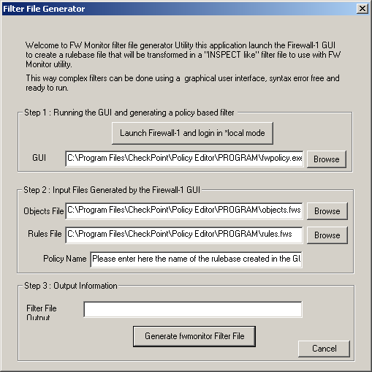
Fwmonitor Filter File Generator (CSP)

Slide 9
////////////////////////////////////////////////////////////////////////////
// Generated by automatically by filtergen v0.6
//
// Rulebase file = C:\Program Files\CheckPoint\Policy Editor\PROGRAM\rules.fws
// Policy used = test3
// Objects file = C:\Program Files\CheckPoint\Policy Editor\PROGRAM\objects.fws
//
////////////////////////////////////////////////////////////////////////////
// Start of IP protocol definition
#define ip_p [9:1]
#define tcp (ip_p = 6)
#define udp (ip_p = 17)
#define icmp (ip_p = 1)
#define esp_ike (ip_p = 50)
#define ah_ike (ip_p = 51)
#define fwz_enc (ip_p = 94)
#define ip_src [12:4,b]
#define ip_dst [16:4,b]
// TCP/UDP
#define sport [20:2,b]
#define dport [22:2,b]
// ICMP
#define icmp_type [ 20 : 1]
// ICMP Message types
#define ICMP_ECHOREPLY 0x0
#define ICMP_UNREACH 0x3
#define ICMP_SOURCEQUENCH 0x4
#define ICMP_REDIRECT 0x5
#define ICMP_ECHO 0x8
#define ICMP_TIMXCEED 0xb
#define ICMP_PARAMPROB 0xc
#define ICMP_TSTAMP 0xd
#define ICMP_TSTAMPREPLY 0xe
#define ICMP_IREQ 0xf
#define ICMP_IREQREPLY 0x10
#define ICMP_MASKREQ 0x11
#define ICMP_MASKREPLY 0x12
// RPC is not supported
#define other ( 1 )
////////////////////////////////////////////////////////////////////////////
// Services
////////////////////////////////////////////////////////////////////////////
// IP Lists
ext_network = {<192.168.10.0, 192.168.10.255>};
int_network= {<10.0.0.0,10.255.255.255>};
////////////////////////////////////////////////////////////////////////////
// Rule Set
// Rule #1
(ip_src in ext_network),
accept;
// Rule #2
(ip_dst in int_nework),
accept;

Slide 10
Debugging Tools
VPN-1/FireWall-1 Debug Commands
  FWDIR
  CPDIR
  Setting Variables
C:\>set
ALLUSERSPROFILE=C:\Documents and Settings\All Users
APPDATA=C:\Documents and Settings\Administrator\Application Data
CommonProgramFiles=C:\Program Files\Common Files
COMPUTERNAME=RADARHACKII
ComSpec=C:\WINNT\system32\cmd.exe
CPDIR=C:\Program Files\CheckPoint\CPShared\NG
CPMDIR=C:\WINNT\FW1\NG
FGDIR=C:\Program Files\CheckPoint\FG1\NG
FWDIR=C:\WINNT\FW1\NG
FW_BOOT_DIR=C:\WINNT\FW1\NG\boot
HOMEDRIVE=C:
HOMEPATH=\
LOGONSERVER=\\RADARHACKII
NMAPDIR=C:\attack\NMapWin\
NUMBER_OF_PROCESSORS=1
OS=Windows_NT
Os2LibPath=C:\WINNT\system32\os2\dll;
Path=C:\WINNT\system32;C:\WINNT;C:\WINNT\System32\Wbem;C:\attack\NMapWin\\bin;
C:\PROGRA~1\CHECKP~1\CPShared\NG\bin;C:\POGRA~1\CHECKP~1\CPShared\NG\lib;
C:\PROGRA~1\CHECKP~1\CPShared\NG\util;C:\WINNT\FW1\NG\lib;C:\WINNT\FW1\NG\bin;C:\PROGRA
1\CHECKP~1\FG1\NG\lib;C:\PROGRA~1\CHECKP~1\FG1\NG\bin
PATHEXT=.COM;.EXE;.BAT;.CMD;.VBS;.VBE;.JS;.JSE;.WSF;.WSH
PROCESSOR_ARCHITECTURE=x86
PROCESSOR_IDENTIFIER=x86 Family 6 Model 5 Stepping 2, GenuineIntel
PROCESSOR_LEVEL=6
PROCESSOR_REVISION=0502
ProgramFiles=C:\Program Files
PROMPT=$P$G
SHARED_LOCAL_PATH=C:\PROGRA~1\CHECKP~1\CPShared\NG\database
SUDIR=C:\WINNT\FW1\NG\sup
SUROOT=C:\SUroot
SystemDrive=C:
SystemRoot=C:\WINNT
…
C:\>
Notes:
Delivery tip:
The environment variables $CPDIR and $FWDIR should be set on the Management Server and Enforcement Module. These allow certain
VPN-1/FireWall-1 debugging functions to operate.

Slide 11
Debugging Tools
C:\>fw ctl pstat
Hash kernel memory (hmem) statistics:
Total memory allocated: 6291456 bytes in 1535 4KB blocks using 1 pool
Total memory bytes used: 140856 unused: 6150600 (97.76%) peak: 141524
Total memory blocks used: 59 unused: 1476 (96%) peak: 60
Allocations: 4200 alloc, 0 failed alloc, 243 free
System kernel memory (smem) statistics:
Total memory bytes used: 8570576 peak: 8689440
Allocations: 803 alloc, 0 failed alloc, 622 free, 0 failed free
Kernel memory (kmem) statistics:
Total memory bytes used: 2413164 peak: 2532308
Allocations: 4453 alloc, 0 failed alloc, 319 free, 0 failed free
NDIS statistics:
Packets in use: 0
Buffers in use: 0
Kernel stacks:
131072 bytes total, 8192 bytes stack size, 16 stacks,
1 peak used, 4516 max stack bytes used, 4516 min stack bytes used,
0 failed stack calls
INSPECT:
450 packets, 26988 operations, 245 lookups,
0 record, 8548 extract
Cookies:
1609 total, 0 alloc, 0 free,
0 dup, 3385 get, 0 put,
8 len, 0 cached len, 0 chain alloc,
0 chain free
Connections:
28 total, 1 TCP, 27 UDP, 0 ICMP,
0 other, 0 anticipated, 0 recovered, 3 concurrent,
5 peak concurrent, 2131 lookups
Fragments:
0 fragments, 0 packets, 0 expired, 0 short,
0 large, 0 duplicates, 0 failures
NAT:
0/0 forw, 0/0 bckw, 0 tcpudp,
0 icmp, 0-0 alloc
C:\>
fw ctl pstat
Notes:
Delivery tip:
The fw ctl pstat command is used for reviewing general statistics on firewall performance.

Slide 12
Debugging Tools
fw ctl debug
  Allocate a buffer to store debug information
    fw ctl debug –buf [buffer size]
  Issuing the debug command
    fw ctl debug command1 command2
  Capturing the debug information into a file
    fw ctl kdebug –f > file
  Stopping the debug process
    Fw ctl debug 0
C:\>fw ctl debug -buf 2048
Initialized kernel debugging buffer to size 2048K
C:\>fw ctl debug packet
Updated kernel's debug variable for module fw
C:\>fw ctl kdebug -f
fwkdebug: start
FW-1: Initializing debugging buffer to size 2048K
fwchain_lock: by rtm_check_heap
fwchain_unlock: by rtm_check_heap
fwchain_lock: by fg_loop_timer
fwchain_unlock: by fg_loop_timer
fwchain_lock: by rtm_check_heap
fwchain_unlock: by rtm_check_heap
fwchain_lock: by fg_loop_timer
fwchain_unlock: by fg_loop_timer
…
Notes:
Delivery tip:
The fw ctl debug command provides an enormous amount of information about every function of the firewall, and its processes. This tool will mainly be used to send information to Check Point Technical Support for specific issues.

Slide 13
Debugging Tools
Debug Mode with fwd
  Restarting fwd/fwm with Debug
  Debugging without Restarting the Process
Notes:
Discussion notes:
fwd in debug mode is used for troubleshooting the firewall daemon. This is useful for locating issues including NAT, dropped/accepted connections that should not be dropped/accepted, and why processes fail to start, or fail, after starting. This can also be helpful for troubleshooting HA cluster communications.
Using fwm in debug mode assists in troubleshooting SMART Client connections to a Management Server. The firewall daemons do not have to be stopped and started for debug mode to operate. These can be activated while the server is running, if the server must maintain a connection.
The cpd process is the daemon for SVN Foundation or cpshared. There are a couple of environmental variables that should be set, similar to $FWDIR, in order to begin collecting debug information on the cpd process. This debug mode is useful for troubleshooting SIC.

Slide 14
Debugging Tools
Debugging the cpd Process
C:\>cpd -d
[30 Mar 11:08:15] SIC initialization started
[30 Mar 11:08:15] Read the machine's sic name: cn=cp_mgmt,o=radarhackii..aiqw69
[30 Mar 11:08:15] Initialized sic infrastructure
[30 Mar 11:08:15] SIC certificate read successfully
[30 Mar 11:08:15] Initialized SIC authentication methods
[30 Mar 11:08:16] Get_SIC_KeyHolder: SIC certificate read successfully
[30 Mar 11:08:16] cpsic_get_cert_renewal_time: Renewal time:
[30 Mar 11:08:16] certificate not before : Fri Jan 24 15:31:43 2003
[30 Mar 11:08:16] certificate not after : Thu Jan 24 15:31:43 2008
[30 Mar 11:08:16] renew ratio : 0.750000
[30 Mar 11:08:16] renew time : Wed Oct 25 04:31:43 2006
[30 Mar 11:08:16] now : Sun Mar 30 11:08:16 2003
[30 Mar 11:08:16] Schedule_SIC_Renewal: SIC certificate should be renewed in 112728207 seconds from now.
Will be checked again in 1209600 seconds from now.
[30 Mar 11:08:16] Cpd started
[30 Mar 11:10:00]
[30 Mar 11:10:00] Installing Security Policy allpolicy on all.all@radarhackii
[30 Mar 11:10:02] Fetching Security Policy Succeeded
[30 Mar 11:10:02]
[30 Mar 11:10:02] Got message of crl reload
[30 Mar 11:10:02] Reloaded crl
Notes:
Slide objective:
To enable debug logging for the cpd process
Lead-in:
“The cpd process is the process that controls SIC and shared-management capabilities between Check Point products and OPSEC-partner products.”

Slide 15
Debugging Tools
The cpinfo File
  Creating a cpinfo file
  Information Retrieval
  Using the Output
Notes:
Delivery tip:
The cpinfo file can be generated on both the Management Server and the Enforcement Module. cpinfo contains all rules, objects, information about the hardware and OS, the current state of the firewall, and table information. This file is mainly used by Check Point Technical Support. It can also be used by senior Security Administrators, for troubleshooting and backups.

Slide 16
Debugging Tools
Using SmartDashboard in *local Mode
infoview
Notes:
Delivery tip:
Remote configuration can be viewed in two ways:
• Allow a remote client to log into a Management Server.
• Provide the following files to the remote system running the correct version of SmartDashboard SMART Client:
• rulebases_5_0.fws
• objects_5_0.C
• objects_graph.mdl
• setup.C
• fgrulebases_5_0.fws
• lcrulebases_5_0.fws
• slprulebases_5_0.fws
These files allow a remote client to view the configuration when using *local in the Management Server, when logging in to SmartDashboard.

Slide 17
VPN Debugging Tools
VPN Log Files
VPN Command
  vpn debug ikeon/ikeoff
    Logs are redirected to $FWDIR/log/ike.elg
  vpn debug on/off
    Logs are redirected to $FWDIR/log/vpnd.elg
  vpn drv on/off
    Starts/stops the vpn process
    Clears the IKE and IPSEC SA
      Can be used to reinitialize tunnels
Notes:
Delivery tip:
Troubleshooting VPN connections can be time-consuming. This section has several tools that may make this process less complicated. Debug environment variables should be set to generate debug logging information on VPN tunnels.
The vpn drv command can be used to force VPN-1/FireWall-1 NG to renegotiate IKE encryption, starting at Phase 1. This is a more efficient way to reinitialize the IKE tunnel than previous methods. Cpstat creates a log file that monitors the status of the product specified. This can be HA, VPN, FW, or FloodGate-1, using alternate syntax.

Slide 18
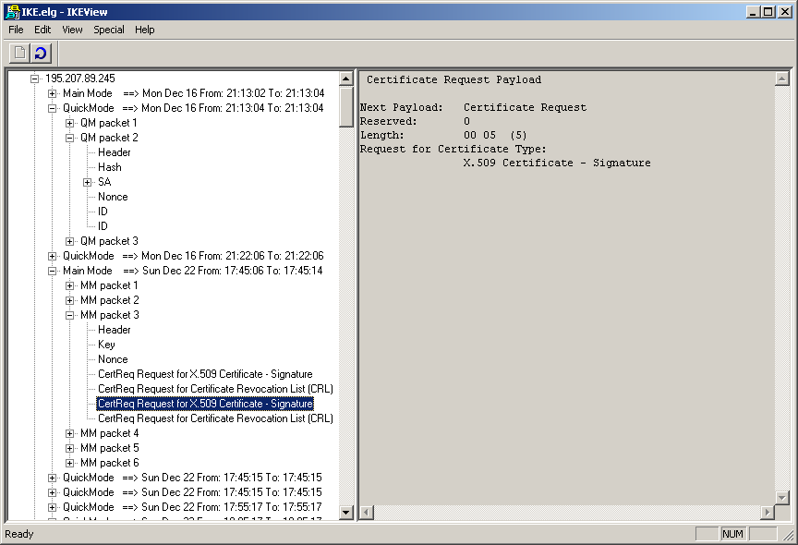
Ikeview

Slide 19
VPN Debugging Tools
vpn tu
C:\>vpn tu
********** Select Option **********
(1) List all IKE SAs
(2) List all IPsec SAs
(3) List all IKE SAs for a given peer
(4) List all IPsec SAs for a given peer
(5) Delete all IPsec SAs for a given peer
(6) Delete all IPsec+IKE SAs for a given peer
(7) Delete all IPsec SAs for ALL peers
(8) Delete all IPsec+IKE SAs for ALL peers
(A) Abort
*******************************************

Slide 20
cpstat
C:\>cpstat fw
Policy name: allpolicy
Install time: Sun Mar 30 11:26:54 2003
Interface table
-------------------------------------
|Name |Dir|Total|Accept|Deny|Log|
-------------------------------------
|NDISWANIP|in | 0| 0| 0| 1|
|NDISWANIP|out| 0| 0| 0| 0|
|ne20000 |in | 0| 0| 0| 0|
|ne20000 |out| 0| 0| 0| 0|
|w89c9401 |in | 492| 492| 0| 1|
|w89c9401 |out| 816| 816| 0| 0|
-------------------------------------
| | | 1308| 1308| 0| 2|
-------------------------------------
C:\>cpstat fg
Product: FloodGate-1
Version: NG Feature Pack 3
Kernel Build: 53186
Policy Name: <not installed>
Install time: <not installed>
Interfaces Num: 0
Interface table
--------------------------------------------------------------
|Name|Dir|Limit|Avg Rate|Conns|Pend pkts|Pend bytes|Rxmt pkts|
--------------------------------------------------------------
--------------------------------------------------------------

Slide 21
C:\>cpstat fw -f all
Product name: FireWall-1
Major version: 5
Minor version: 0
Kernel build num.: 53225
Policy name: allpolicy
Policy install time: Sun Mar 30 11:26:54 2003
Num. connections: 1
Peak num. connections: 12
Interface table
--------------------------------------
|Name |Dir|Accept|Drop|Reject|Log|
--------------------------------------
|NDISWANIP|in | 0| 0| 0| 1|
|NDISWANIP|out| 0| 0| 0| 0|
|ne20000 |in | 15| 0| 0| 4|
|ne20000 |out| 0| 0| 0| 0|
|w89c9401 |in | 1895| 0| 0| 2|
|w89c9401 |out| 2456| 0| 0| 0|
--------------------------------------
| | | 4366| 0| 0| 7|
--------------------------------------
hmem - block size: 4096
hmem - requested bytes: 6291456
hmem - initial allocated bytes: 6291456
hmem - initial allocated blocks: 0
hmem - initial allocated pools: 0
hmem - current allocated bytes: 6291456
….
hmem - blocks unused: 1476
hmem - bytes peak: 161604

Slide 22
Debugging Tools
Debugging Logging
  Analyzing Tools
  How to Debug Logging
    fw log –m initial
    fw log –m raw
    …
Notes:
Delivery tip:
The logs may be displayed from the command line to assist in debugging the logging process. The display can either be in unified-logging format; account logging; or raw, semi, or unified. To set debugging for the logging process, environment variables must be set.

