Slide 1

Hacking ☺

Slide 2
A couple good reasons to be careful

Slide 3
Attack Goals
Common attacker goals include:
Identifying a weakly configured system to turn into a zombie
Compromising a machine as a stepping stone to other linked systems
Acquiring business data
Damaging or destroying information
Defacing a public site
Creating a denial-of-service condition

Slide 4
Attack Strategy
Attackers have developed the following strategy for breaking into networks and systems:
  Passive information gathering
  Active information gathering
  Analysis and interpretation of information
  Vulnerability mapping
  Exploitation (attack)

Slide 5

The Role of Firewalls
Firewalls represent only a portion of what is required for complete security enforcement program
Firewalls are often the first line of defense against external attack and usually the first system that professional intruders attempt to bypass
An opening in a firewall rule base is a vulnerability

Slide 6


















Anatomy of an Attack
Step 3. Attacker exploits trust relationships to get access to a Unix system inside firewall.
Crack
Step 4. Attacker cracks password files and now has root/administrator access to various systems and applications.
Web Server
rlogin
Step 5. Attacker uses password
information to turn
CEO’s system into a
remotely-controlled
zombie.
UNIX
NT
UNIX
NT
UNIX
Router
Firewall
Network
Step 1.
A port scan through the firewall finds active rlogin services on various systems and a vulnerable IMAP service on the corporate e-mail server.
Clients & Workstations
E-Mail
Server
Step 2. Attacker exploits weakness in IMAP to get root access on E-Mail server in the DMZ.
imap
imap

Slide 7
How easy is it to hack into a system ?

Slide 8
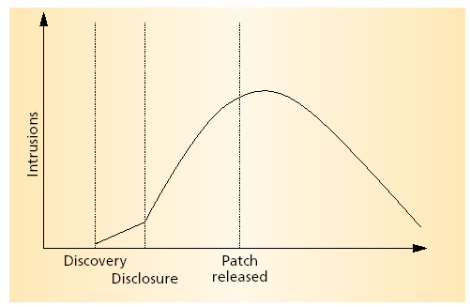

This is the answer …..
???????
Updating of critical systems
is typically done by network administrators and is a slow and time consuming work.

Slide 9
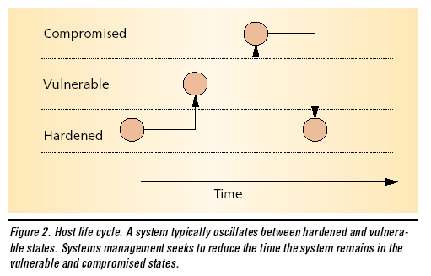

Slide 10
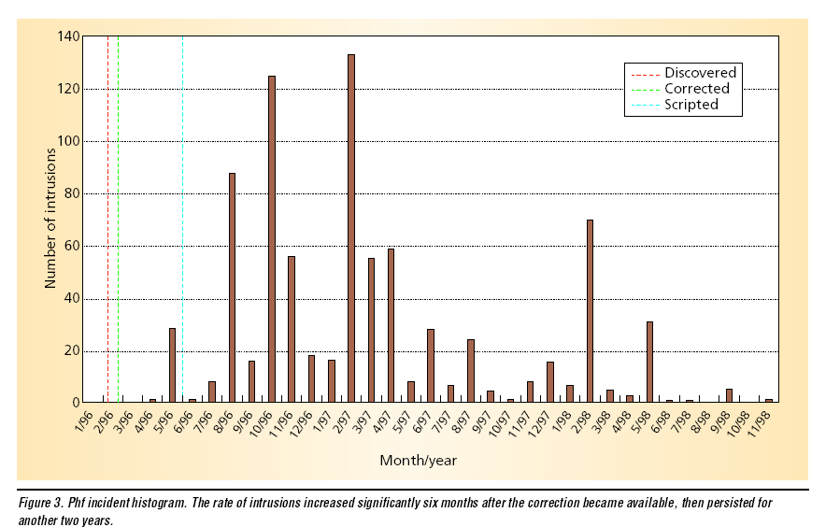
example

Slide 11
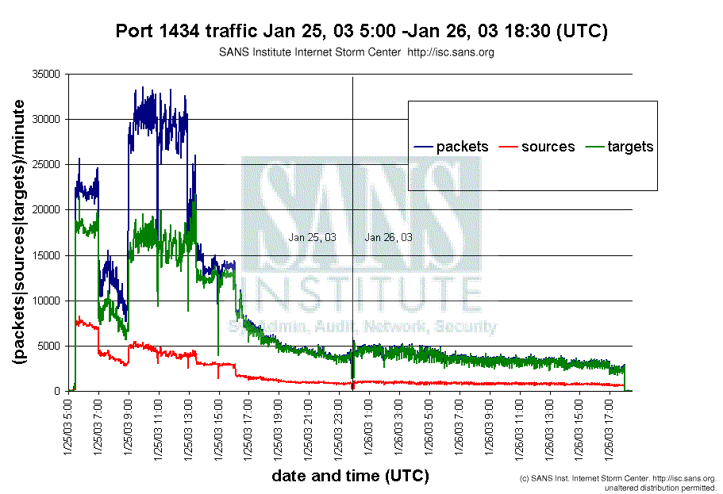

Slide 12
Attack Strategy
Attackers have developed the following strategy for breaking into networks and systems:
  Passive information gathering
  Active information gathering
  Analysis and interpretation of information
  Vulnerability mapping
  Exploitation (attack)

Slide 13
Gathering info
The internet
  Websites
Whois database
  Whois utility
  Web interfaces to whois
    www.ripe.net
    www.networksolutions.com
Nslookup
  Check out www.samspade.org

Slide 14
dns radarhack.com
radarhack.com resolves to 216.148.221.150
www.radarhack.com resolves to 216.148.221.150
Mail for radarhack.com is handled by m.dnsix.com (0) 216.148.213.135 m1.dnsix.com (0) 216.148.213.135
whois -h magic radarhack.com
radarhack.com is registered with NAMESDIRECT.COM, INC. - redirecting to whois.namesdirect.com
whois -h whois.namesdirect.com radarhack.com
Registrant:
Philippe Bogaerts
Veldstraat 18
Tienen, 3300
BT
Domain Name: RADARHACK.COM
Administrative Contact:
Bogaerts, Philippe philippe.bogaerts@wol.be
Veldstraat 18
Tienen, 3300
BT
3216824248
Technical Contact:
Support, NamesDirect.com support@namesdirect.com
Visit us at
www.NamesDirect.com,
BM
000-000-000
Billing Contact:
Bogaerts, Philippe philippe.bogaerts@wol.be
Veldstraat 18
Tienen, 3300
BT
3216824248
Record last updated on 28-Nov-2001.
Record expires on 01-Apr-2003.
Record Created on 01-Apr-2001.
Domain servers in listed order:
NS1.MYDOMAIN.COM 216.148.213.141
NS2.MYDOMAIN.COM 216.148.221.142
NS3.MYDOMAIN.COM 216.148.213.143
NS4.MYDOMAIN.COM 216.148.221.144
whois -h magic 216.148.221.150
radarhack.com resolves to 216.148.221.150
Trying whois -h whois.arin.net 216.148.221.150
TCG CERFnet (NETBLK-CERFNET-BLK-4)
P.O. Box 919014
San Diego, CA 92191-9014
US
Netname: CERFNET-BLK-4
Netblock: 216.148.0.0 - 216.148.255.255

Slide 15
Maintainer: CERF
Coordinator:
AT&T Enhanced Network Services (CERF-HM-ARIN) dns@CERF.NET
(619) 812-5000
Domain System inverse mapping provided by:
DBRU.BR.NS.ELS-GMS.ATT.NET 199.191.128.106
CBRU.BR.NS.ELS-GMS.ATT.NET 199.191.128.105
DMTU.MT.NS.ELS-GMS.ATT.NET 12.127.16.70
CMTU.MT.NS.ELS-GMS.ATT.NET 12.127.16.69
ADDRESSES WITHIN THIS BLOCK ARE NON-PORTABLE
Record last updated on 09-Mar-2000.
Database last updated on 20-May-2002 20:01:13 EDT.
The ARIN Registration Services Host contains ONLY Internet
Network Information: Networks, ASN's, and related POC's.
Please use the whois server at rs.internic.net for DOMAIN related
Information and whois.nic.mil for NIPRNET Information.
traceroute radarhack.com
radarhack.com resolves to 216.148.221.150
3 130.152.80.30 4.258 ms DNS error [AS226] Los Nettos origin AS 4 4.24.4.249 9.211 ms gigabitethernet5-0.lsanca1-cr3.bbnplanet.net [AS1] GTE Internetworking 5 4.24.4.2 10.101 ms p6-0.lsanca1-cr6.bbnplanet.net [AS1] GTE Internetworking 6 4.24.5.49 8.699 ms p6-0.lsanca2-br1.bbnplanet.net [AS1] GTE Internetworking 7 4.24.5.46 9.918 ms p15-0.lsanca2-br2.bbnplanet.net [AS1] GTE Internetworking 8 4.25.111.1 8.415 ms p1-0.lsanca2-cr1.bbnplanet.net [AS1] GTE Internetworking 9 4.25.111.10 7.912 ms p5-1.xlsanca26-att.bbnplanet.net [AS1] GTE Internetworking 10 12.122.11.221 9.914 ms tbr2-p012402.la2ca.ip.att.net (DNS error) [AS7018] AT&T WorldNet Service Backbone 11 12.122.11.154 3.102 ms gbr5-p40.la2ca.ip.att.net (DNS error) [AS7018] AT&T WorldNet Service Backbone 12 12.123.28.169 3.255 ms gar2-p360.la2ca.ip.att.net (DNS error) [AS7018] AT&T WorldNet Service Backbone 13 12.122.255.142 11.044 ms idf26-gsr12-1-pos-7-0.rwc1.attens.net [AS7018] AT&T WorldNet Service Backbone 14 216.148.209.18 15.392 ms mdf2-bi8k-2-eth-1-1.rwc1.attens.net (DNS error) [AS4265] AT&T CERFnet Redwood City 15 216.148.213.158 15.054 ms DNS error [AS4265] AT&T CERFnet Redwood City 16 216.148.221.150 13.027 ms redirect.dnsix.com [AS4265] AT&T CERFnet Redwood City

Slide 16
Nslookup
Nslookup
  Type name of website
    C:\>nslookup
    Default Server: chip.skynet.be
    Address: 195.238.2.21
    > www.radarhack.com
    Server: chip.skynet.be
    Address: 195.238.2.21
    Name: www.radarhack.com
    Address: 216.148.221.150
    >

Slide 17
Query for NS, MX, A, ….
C:\>nslookup
Default Server: chip.skynet.be
Address: 195.238.2.21
> set q=MX
> radarhack.com
Server: chip.skynet.be
Address: 195.238.2.21
radarhack.com MX preference = 0, mail exchanger = m.dnsix.com
radarhack.com MX preference = 0, mail exchanger = m1.dnsix.com
radarhack.com nameserver = ns1.mydomain.com
radarhack.com nameserver = ns2.mydomain.com
radarhack.com nameserver = ns3.mydomain.com
radarhack.com nameserver = ns4.mydomain.com
m.dnsix.com internet address = 216.148.213.135
m1.dnsix.com internet address = 216.148.213.135
ns1.mydomain.com internet address = 216.148.213.141
ns2.mydomain.com internet address = 216.148.221.142
ns3.mydomain.com internet address = 216.148.213.143
ns4.mydomain.com internet address = 216.148.221.144

Slide 18
Attack Strategy
Attackers have developed the following strategy for breaking into networks and systems:
  Passive information gathering
  Active information gathering
  Analysis and interpretation of information
  Vulnerability mapping
  Exploitation (attack)

Slide 19
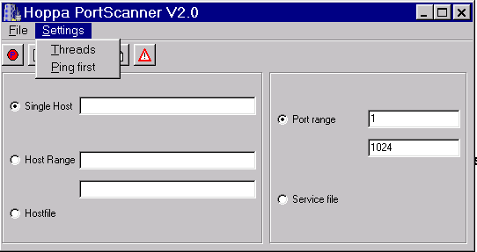
What to do next ….
Scanning
  What systems are alive ?
    Scanning using ping (ICMP echo / reply)
    Simple and fast, BUT simple to counter
      BLOCK ICMP traffic on your border routers
      Defeats most popular scanners and newbies ….

Slide 20
Scanning using other methodology
Try a ‘TCP ping’
  Try to connect to a certain TCP/UDP port
  Time consuming
Try UDP or other ICMP messages
Most popular scanner ever …
NMAP (www.insecure.org/nmap)
Very good documents about all kinds of scanning can be found at
www.sys-security.com

Slide 21
Starting nmapNT V. 2.53 SP1 by ryan@eEye.com
eEye Digital Security ( http://www.eEye.com )
based on nmap by fyodor@insecure.org ( www.insecure.org/nmap/ )
nmap V. 2.53 Usage: nmap [Scan Type(s)] [Options] <host or net list>
Some Common Scan Types ('*' options require root privileges)
-sT TCP connect() port scan (default)
* -sS TCP SYN stealth port scan (best all-around TCP scan)
* -sU UDP port scan
-sP ping scan (Find any reachable machines)
* -sF,-sX,-sN Stealth FIN, Xmas, or Null scan (experts only)
-sR/-I RPC/Identd scan (use with other scan types)
Some Common Options (none are required, most can be combined):
* -O Use TCP/IP fingerprinting to guess remote operating system
-p <range> ports to scan. Example range: '1-1024,1080,6666,31337'
-F Only scans ports listed in nmap-services
-v Verbose. Its use is recommended. Use twice for greater effect.
-P0 Don't ping hosts (needed to scan www.microsoft.com and others)
* -Ddecoy_host1,decoy2[,...] Hide scan using many decoys
-T <Paranoid|Sneaky|Polite|Normal|Aggressive|Insane> General timing policy
-n/-R Never do DNS resolution/Always resolve [default: sometimes resolve]
-oN/-oM <logfile> Output normal/machine parsable scan logs to <logfile>
-iL <inputfile> Get targets from file; Use '-' for stdin
* -S <your_IP>/-e <devicename> Specify source address or network interface
--interactive Go into interactive mode (then press h for help)
Example: nmap -v -sS -O www.my.com 192.168.0.0/16 '192.88-90.*.*'
SEE THE MAN PAGE FOR MANY MORE OPTIONS, DESCRIPTIONS, AND EXAMPLES

Slide 22
Enumerate services
Portscans
  TCP/UDP
    List all services on machines alive.
    Only few tools can list UDP services
Determine OS
  Can be helpful in finding exploits ☺

Slide 23
# nmap (V. 2.54BETA32) scan initiated Sun May 19 12:13:12 2002
bin/nmap -S 66.21.117.10 -O -P0 -oN mirror/2002/05/19/www.canton.edu/nmapOS.txt www.canton.edu
Interesting ports on www.canton.edu (137.37.1.44):
(The 1535 ports scanned but not shown below are in state: closed)
Port State Service
21/tcp open ftp
25/tcp open smtp
80/tcp open http
135/tcp open loc-srv
139/tcp open netbios-ssn
443/tcp open https
445/tcp open microsoft-ds
1030/tcp open iad1
1033/tcp open netinfo
2048/tcp open dls-monitor
2064/tcp open distrib-net-losers
2065/tcp open dlsrpn
2067/tcp open dlswpn
2105/tcp open eklogin
2106/tcp open ekshell
2108/tcp open rkinit
2111/tcp open kx
2112/tcp open kip
2120/tcp open kauth
Remote OS guesses: Windows Me or Windows 2000 RC1 through final release, Windows Millenium Edition v4.90.3000
# Nmap run completed at Sun May 19 12:13:24 2002 -- 1 IP address (1 host up) scanned in 12 seconds

Slide 24
Types of scans
  TCP connect scan: completing full 3 way handshake
  TCP SYN scan: making half open connections
      if reply SYN/ACK: port is listening
      if reply RST/ACK: port is not listening
  TCP FIN scan:
      based on RFC793: system (UNIX) should send back RST for closed port
  TCP Xmas Tree scan:
      based on RFC793: after sending FIN,URG, PUSH system should send back RST for closed sockets
  TCP Null scan: all flags are turned off
      based on RFC793: system should send back RST for closed port
  TCP ACK scan:can be used to map out firewall rulesets and determine if the firewall is statefull or not
  UDP scan: sending a UDP packet to a target port. If reply = icmp port unreachable == port closed

Slide 25
Determine the running applications
Banner grabbing
  Telnet www.server.be 80
    Type get / HTTP/1.0 <enter> <enter>
  HTTP/1.1 400 Bad Request
  Server: Microsoft-IIS/4.0
  Date: Tue, 21 May 2002 19:22:24 GMT
  Content-Length: 407
  Content-Type: text/html
  <html><head><title>Error 400</title>
  <meta name="robots" content="noindex">
  <META HTTP-EQUIV="Content-Type" CONTENT="text/html; charset=iso-8859-1"></head>
  <body>
  <h2>HTTP Error 400</h2>
  <p><strong>400 Bad Request</strong></p>
  <p>Due to malformed syntax, the request could not be understood by the server. T
  he client should not repeat the request without modifications.</p>
  </body></html>
  Connection to host lost.

Slide 26
Banner grabbing continued ..
C:\>ftp ftp.f5.Com
Connected to ftp.f5.com.
220-Please use your tech.f5.com username and password to login.
If you do not have one contact askf5@f5.com
To get a new password go to http://tech.f5.com/password.html
To change your password go to http://tech.f5.com/passchange.htm
220 ProFTPD 1.2.5rc1 Server (ftp.f5.com) [ftp2.f5.com]
User (ftp.f5.com:(none)):
C:\telnet 127.0.0.1 25
220 risc-phbo Microsoft ESMTP MAIL Service, Version: 5.0.2195.2966 ready at Wed, 22 May 2002 20:34:54 +0200

Slide 27
Other interesting info
Netbios info
  Nbtscan
  Sharesniffer
RPC
  Rpcinfo

Slide 28
Attack Strategy
Attackers have developed the following strategy for breaking into networks and systems:
  Passive information gathering
  Active information gathering
  Analysis and interpretation of information
  Vulnerability mapping
  Exploitation (attack)

Slide 29
Find vulnerability
If you know the running app.
  Search the web for expolits
    You know OS, App, Version, service release, … ☺
  Use vulnerability scanners
    ISS internet security scanner
    Retina scanner
    Stealth 1.0 (free, contains 5000 exploits!!!!!!)

Slide 30
Attack Strategy
Attackers have developed the following strategy for breaking into networks and systems:
  Passive information gathering
  Active information gathering
  Analysis and interpretation of information
  Vulnerability mapping
  Exploitation (attack)

Slide 31
Possible ways to continue
DOS / DDOS
Gaining access
  Escalating privilege
    lOphtcrack
    getadmin
  Pilfering
    Once you have a higher privilege, continue enumerating
  Covering tracks
    Rootkits
  Creating backdoors
    Netbus
    Back Orifice

Slide 32
Gaining access
Escalating privilege
  lOphtcrack
  Getadmin
  Using exploits (unicode attack)
Pilfering
  Once you have a higher privilege, continue enumerating
Covering tracks
  Rootkits
  Deleting logs
Creating backdoors
  Netbus
  Back Orifice

Slide 33
DOS / DDOS
Denial of service attack
  SYN flood
  Smurf attack
  Land attack
Distributed Denial of service attack
  Trinoo, ……

Slide 34




Bandwidth attack
Ping 192.168.4.255
Internet
xyz.be
abc.com
http://www.powertech.no/smurf/
Notes:
Tools capable of launching the attack and finding broadcast capable networks are available.
http://www.insecure.org/nmap

Slide 35

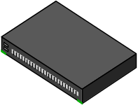
Topology
Firewall
Intranet
Internet
DMZ

Slide 36
Spoofing
Spoofing means ‘to fool somebody’.
IP address spoofing, means in fact stealing an IP address to gain access to a restricted resource or to bypass access control lists.

Slide 37
Defining anti-spoofing rules
IP address based access
Firewall
Intranet
Internet
DMZ

Slide 38
Anti-spoofing control
  IP network and subnet numbers are separated by routers
  Packets coming from different physical media MUST have an IP source address belonging to A DIFFERENT (sub)net number than the IP destination address
  SUBNET(IPd) ≠SUBNET(IPs)
routers can detect this problem because they can track on which interfaces packets come in AND leave

Slide 39
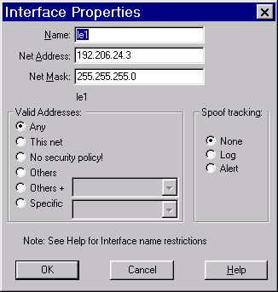
An example
Spoofing control in Checkpoint FW-1

Slide 40
Links and other info
http://packetstormsecurity.nl
http://www.cs.umd.edu/~waa/pubs/Windows_of_Vulnerability.pdf
http://www.Esecurityonline.com
http://www.infosyssec.com
http://www.infosyssec.com
http://Defaced.alldass.org
http://www.hackingexposed.com
http://www.sys-security.com/html/papers.html
http://packetstormsecurity.nl
http://t33kid.com/ta/

