Slide 1
WEBGOAT and the Pantera Web Assessment Studio Project
Philippe Bogaerts

Slide 2
Introduction
During the day
  Coming soon … I hope ☺
During the night
  Independent trainer and consultant
  Trying to acquire a good understanding of
    network security
    web application, web services and XML security
    Pen-testing
  mailto:philippe.bogaerts@radarhack.com
  http://www.radarhack.com
Notes:
Get an idea of population?
InfoSec consultants? Developers? Industry? Finance?

Slide 3

Why am I here ?
A fascination for security…
I like learning and exploring new things…
Continuous education and awareness today is a must and must be kept big fun…
… and this resulted in writing a paper called
  “Getting started with OWASP WebGoat4 and SOAPUI.”
(The paper is available at http://www.radarhack.com)
… and thanks to Erwin Geirnaert from http://www.zionsecurity.com for reviewing the paper.

Slide 4
What is the paper about ?
Explain in a simple and easy way what SOAP and
web services are about.
A unique opportunity to use WebGoat 4.0 for what it is intended to do: education and awareness
The paper is about how a web service can be exploited via simple and free available invocation tools.

Slide 5
Part 1: WebGoat

Slide 6
WebGoat
WebGoat is a deliberately insecure J2EE web application maintained by OWASP
Designed to teach web application security
… but also useful to test security products
  IPS, Firewalls, Web Application Firewalls …
    … against OWASP top 10 promise
    … against XML and AJAX security threats
Who already played around with WebGoat ?

Slide 7
WebGoat versions
Release Quality Projects
Current stable version: 4.0
  http://www.owasp.org/index.php/Category:OWASP_WebGoat_Project
A promising version 5.0 will be available 01/2007.
  Release candidate 1 is available since 17/01/2007

Slide 8
Installing WebGoat
Download available via OWASP project pages
Windows and Unix/Linux versions
Today we are using
Windows_WebGoat-4.0_Release.zip
Windows_WebGoat-5.0-RC1_Release.zip
Just unzip the archive and click webgoat.bat
  Some pitfalls
    Make sure other web servers are stopped
    Skype for some reason dares to use port 80
    Verify with “netstat –an” port 80 is not used

Slide 9
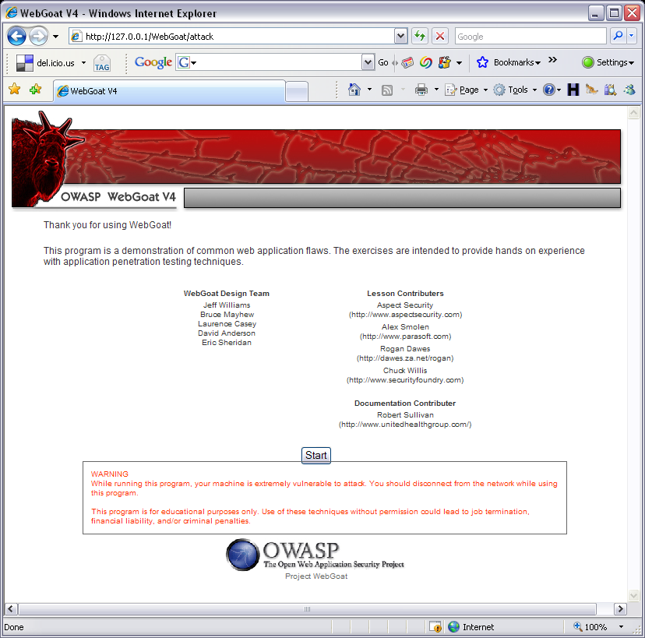
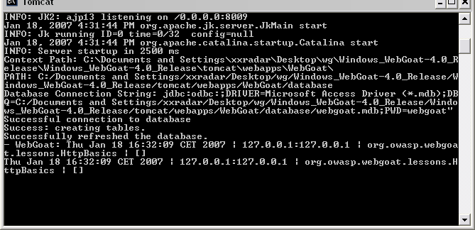
Connecting the first time
http://webgoat_server/WebGoat/attack
login with usn:guest and pwd:guest

Slide 10
Configuration tuning
…Windows_WebGoat-4.0_Release\tomcat\conf\server.xml
  Port numbers of the web server
…Windows_WebGoat-4.0_Release\tomcat\conf\tomcat-users.xml
  Tomcat usernames, passwords and role

Slide 11
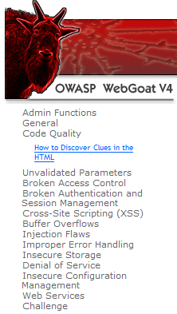
WebGoat V4
A set of lessons and exercises to learn about basic and advanced web application security issues.
  Coverage OWASP TOP 10
  … and more

Slide 12
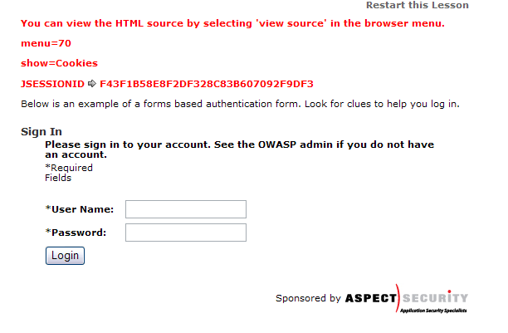
WebGoat is a training tool
Tools to assist
  Hints
    Starting tips up to the solutions of the problem
    Scroll through the hints.
  Show Cookies
  Show Java
  Show Params
  Report Card

Slide 13
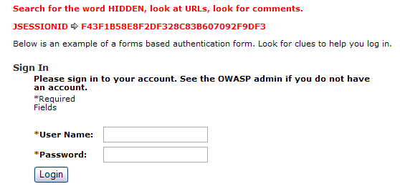
Example 1
Code Quality
  Look in the source code
  Use WebScarab !!!
    Fragments module

Slide 14
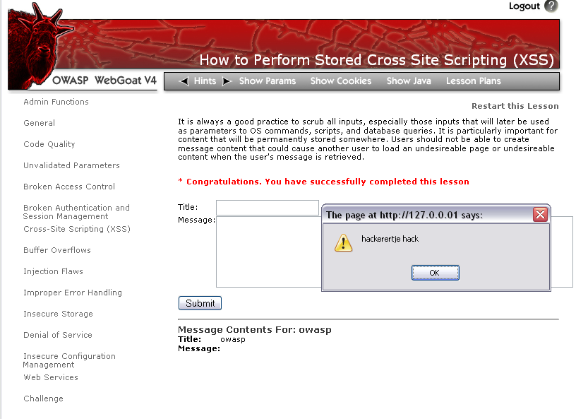
Example 2
Stored XSS

Slide 15
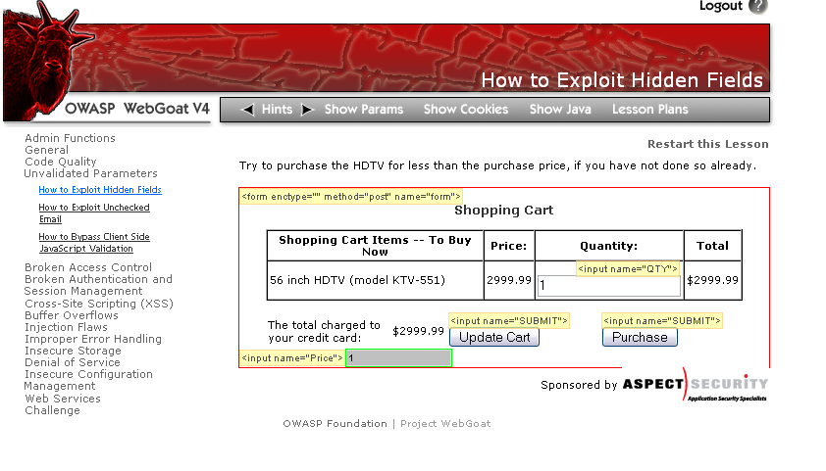
Example 3
Exploiting Hidden Fields
  Web Developer plug-in Firefox

Slide 16
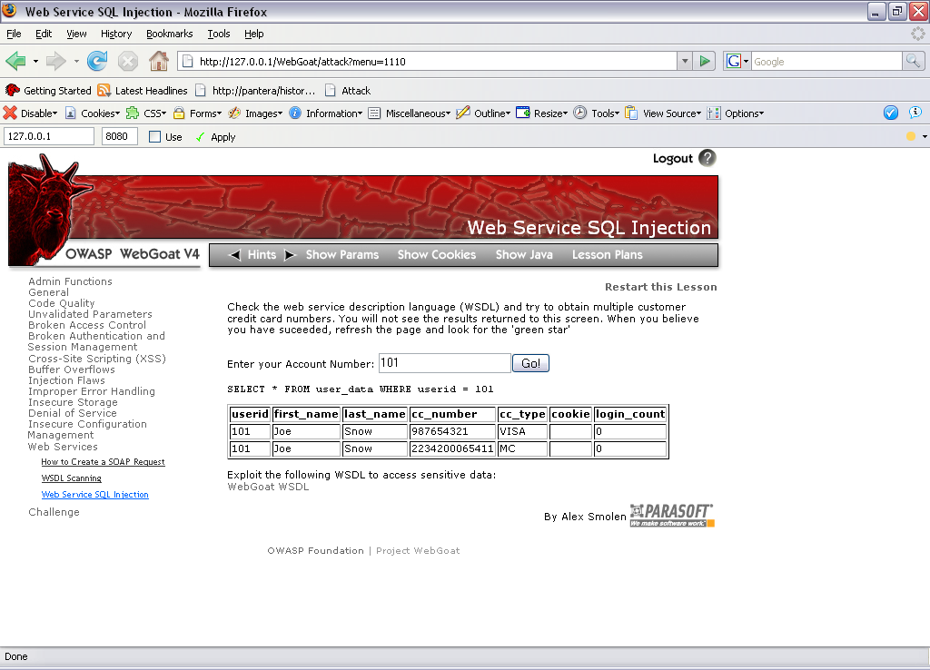
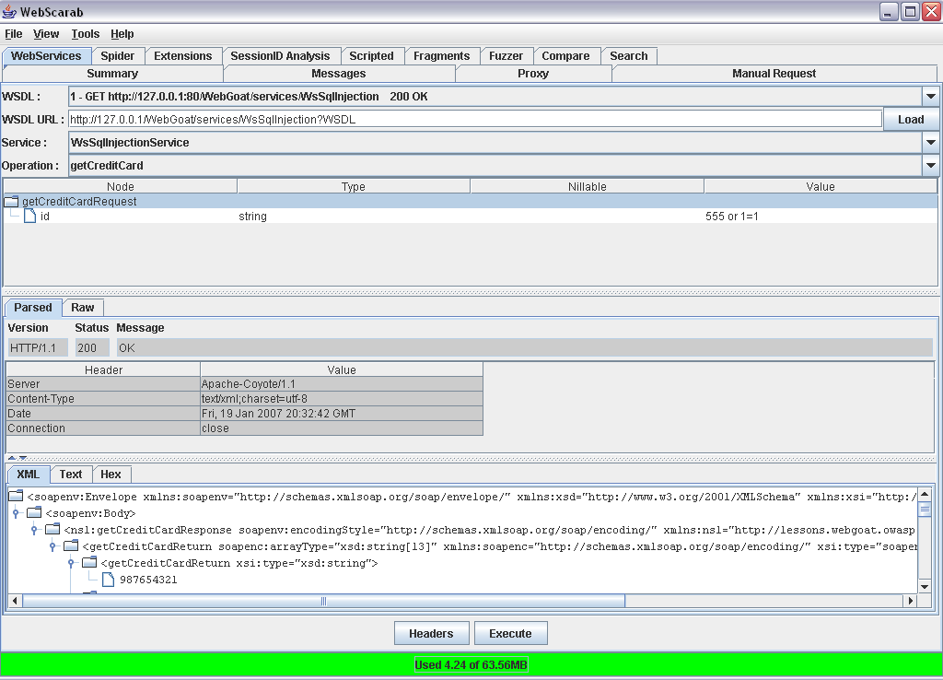
Example 4
Exploiting Web Services with SQL Injection
  WebScarab

Slide 17
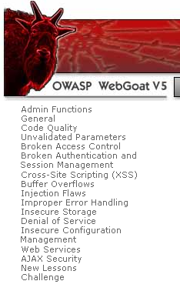
WebGoat V5 (rc1)
What new ?
  More XSS
    Forced Browsing
    How to Perform CSRF
  More on SQL Injection
    Blind SQL Injection
    XPATH Injection
  Web Services
    SAX parser injection
  AJAX security lessons
  … and much more

Slide 18
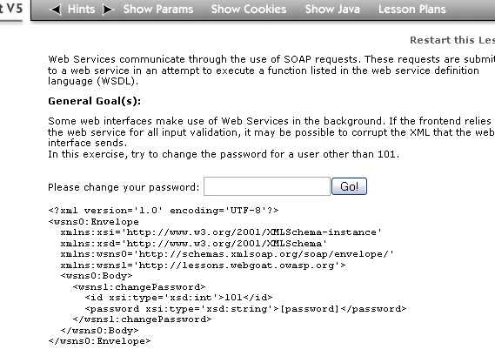
Example 5
Web Service SAX injection

Slide 19
Part 2: Pantera Web Assessment Studio Project

Slide 20
Pantera WASP, what is it ?
“The primary goal of Pantera is to combine automated capabilities with complete manual testing to get the best penetration testing results.”
penetration testing facilitation
  Project management
  Data mining
Beta Status Project

Slide 21
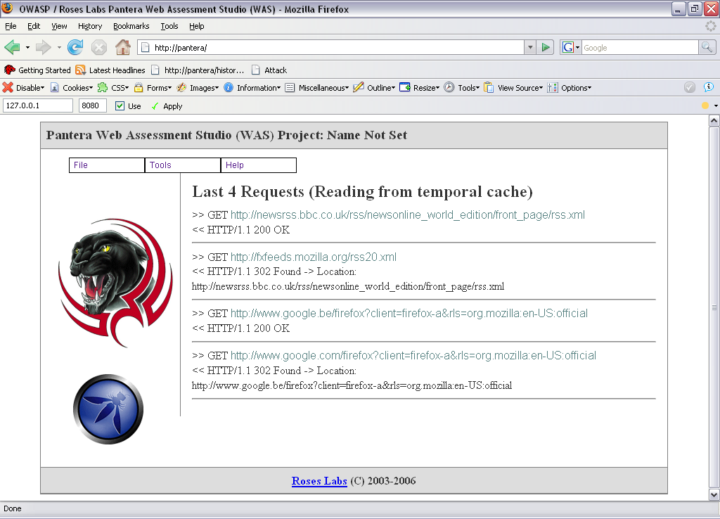
Pantera
(local) proxy
  monitors and intercepts web traffic
  Traffic is analyzed/modified by Pantera Passive Analyzer Plugins (PPA)
Web based management interface
  Project management
  Notes

Slide 22
How to install ?
Pantera is available via the OWASP project pages on http://www.owasp.org
  Current version 0.1.2
Install the correct versions of the required software.
    Python, MySQL, pyOpenSSL, Formbuild…

Slide 23
Install problems
Installation is difficult, but it works and is well described
    Read the INSTALL.TXT
    Very good step by step installation instructions
Problems ?
  Contact the mailing list
    VERY good response.
    Subscribe via the project page

Slide 24
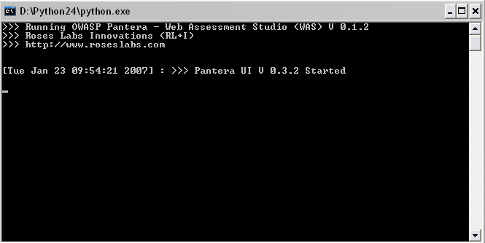
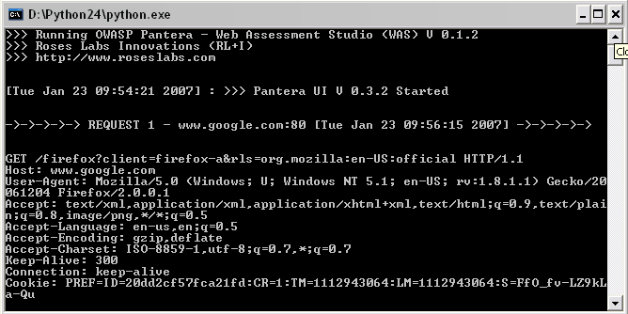
Starting Pantera
python pantera.py

Slide 25

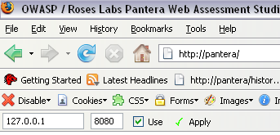
Managing Pantera
Point your browser to the Pantera proxy instance at 127.0.0.1:8080
Browse to http://pantera

Slide 26
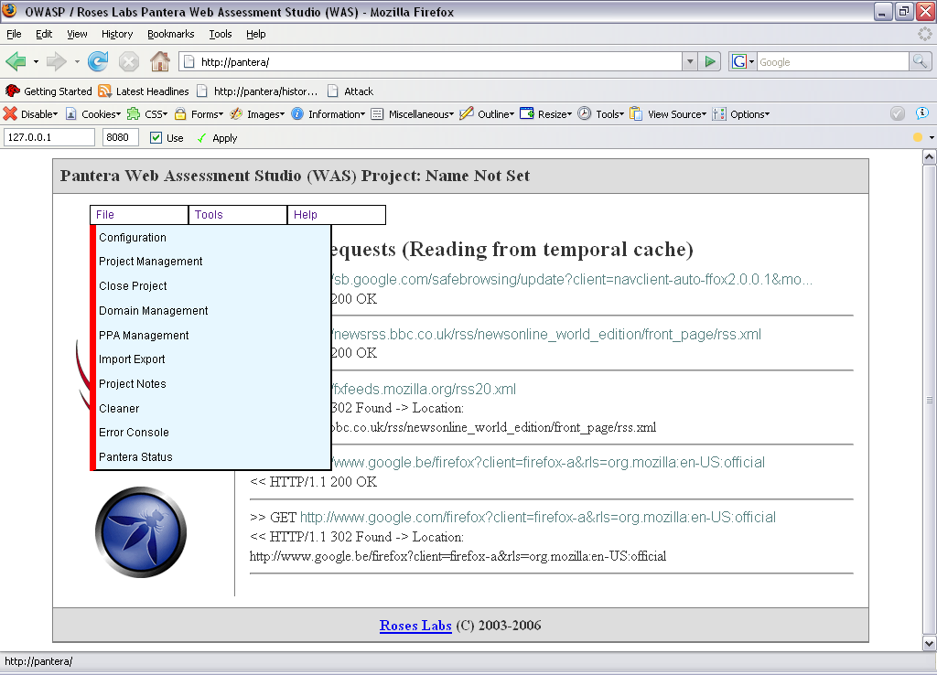
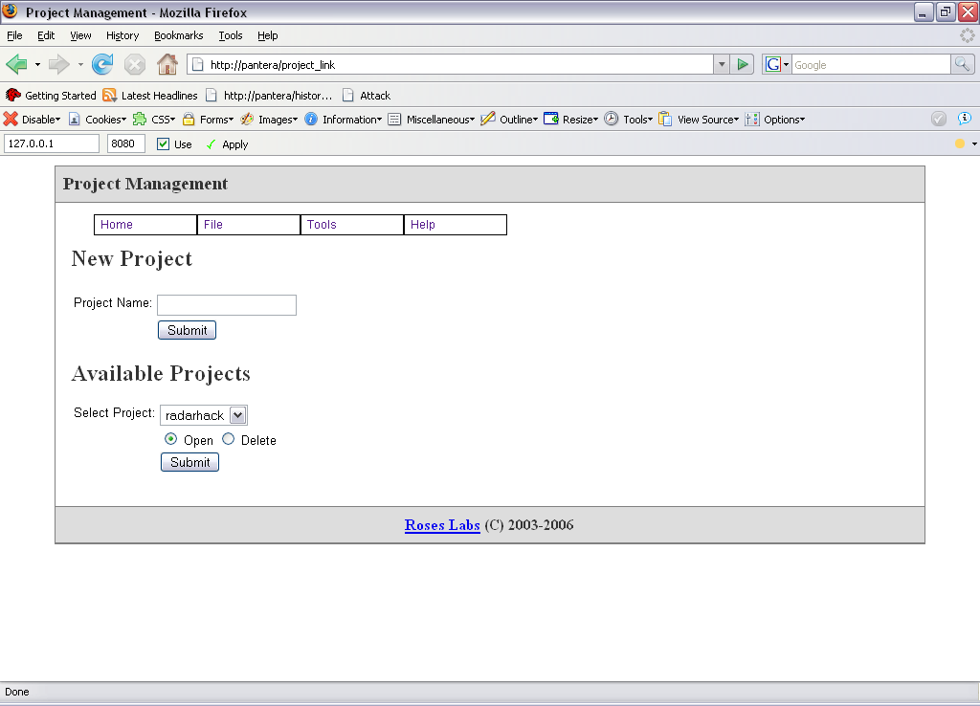
Create a project

Slide 27
PPA plug-in
PPA plug-ins are used to analyze PASSIVELY all web traffic for
  Authentication
  Vulnerabilities
  Comments
  …
File -> Configuration
Results are shown in
Tools -> PPA Analysis summary

Slide 28
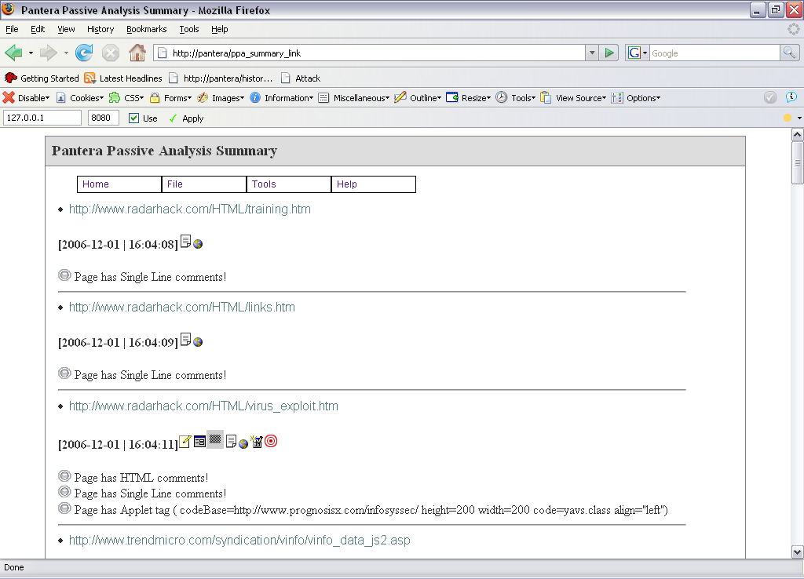
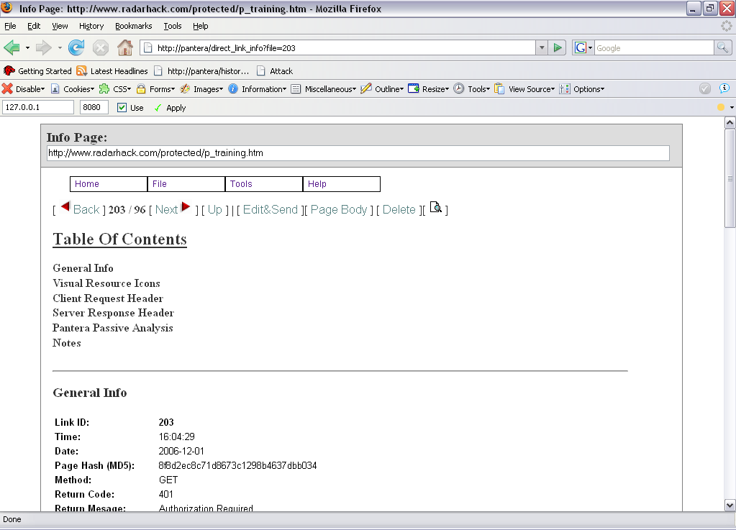
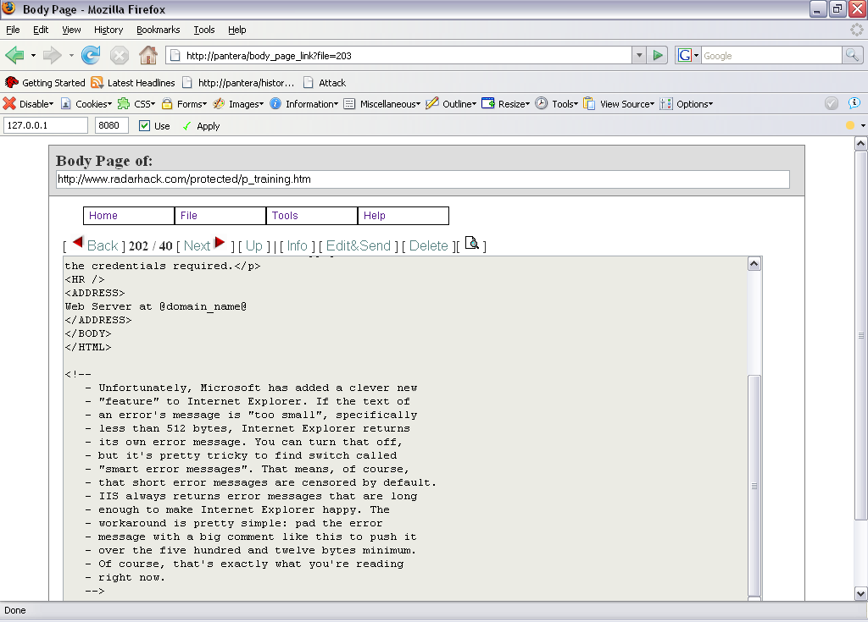
Pantera Passive Analysis Summary

Slide 29
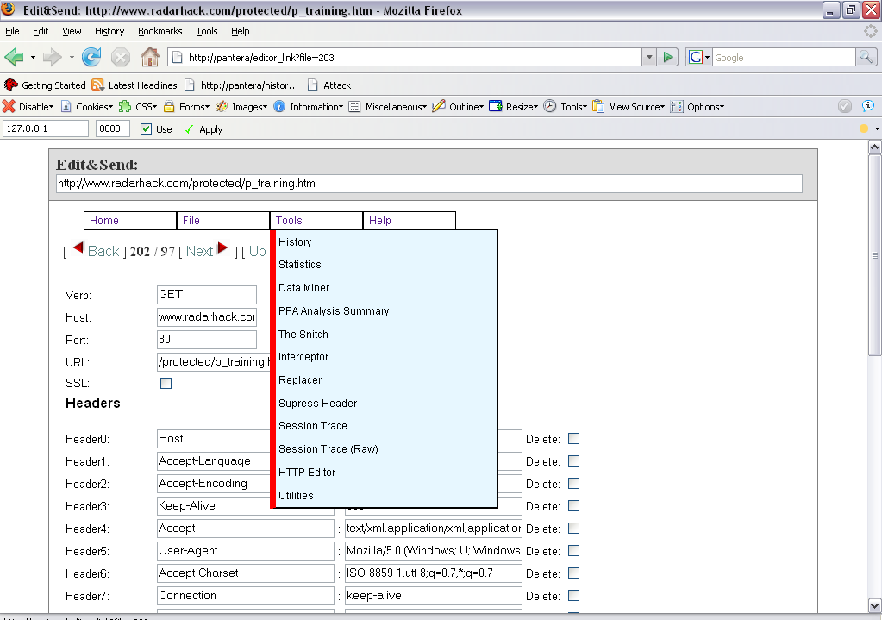
Tools

Slide 30
Tools
Stats and Data Mining
Interceptor, Replacer, Supress Headers
Session Trace and HTTP Editor
Utilities
  En/decode, Hashing...
Demo

Slide 31
Thank You

