Slide 1
Webscarab, an introduction.
Philippe Bogaerts
Bee-ware
philippe.bogaerts@radarhack.com

Slide 2

Who am I?
During the day
  Technical manager at Bee-ware
    http://www.bee-ware.net
During the night
  Trying to acquire a good understanding of
    network security
    web application and web services security
    Pen-testing

Slide 3
Why am I here ?
A good opportunity to hear people talking about applications and the related security implications.
To better understand how applications work and how they are developed.
WebScarab is simply a great tool that gave me ‘the’ better understanding of HTTP and
HTTP-based applications.

Slide 4
What is WebScarab?
A java based tool
  Security analysis
  Application debugging
WebScarab acts as a proxy between a client and an application
  browsers accessing a web application
  a client application accessing a web service
  …

Slide 5
What can you do with WebScarab?
Allows user to view HTTP(S) conversations between browser and server
Allows user to review those conversations
Allows user to intercept and modify on the fly
Allows user to replay previous requests
Allows user to script conversations with full access to the the request and response object models
And much more!

Slide 6
Obtaining WebScarab
More information
  http://www.owasp.org/software/webscarab.html
Hosted on Sourceforge
  http://sourceforge.net/project/showfiles.php?group_id=64424&package_id=61823
Documentation
  http://dawes.za.net/rogan/webscarab/docs/
Mailinglist
  http://lists.sourceforge.net/lists/listinfo/owasp-webscarab

Slide 7
Installing WebScarab
Various package formats
  webscarab-installer-<date>.jar
    java -jar webscarab-selfcontained-20051017-2127.jar
  webscarab-selfcontained-<date>.jar
  webscarab-src-<date>.jar
Beta version available via mailinglist
  Beta version will be discussed during presentation

Slide 8
What is new in the beta version?
More extensive certificate support
  Pkcs#12
  Pkcs#11
  CAPI (to come)
Credential support
  Automatic learning of credentials
  Automated insertion of credentials
Extensions module

Slide 9
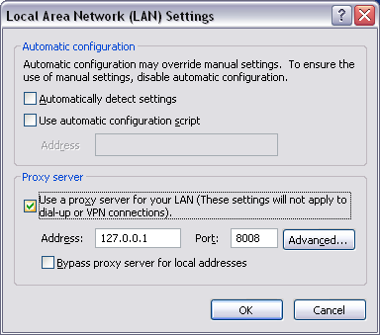
Setting up the environment
Application and WS can be installed on same workstations
  Application is configured to connects to WS at 127.0.0.1:8008 by default
Application and WS can be installed on different machines

Slide 10
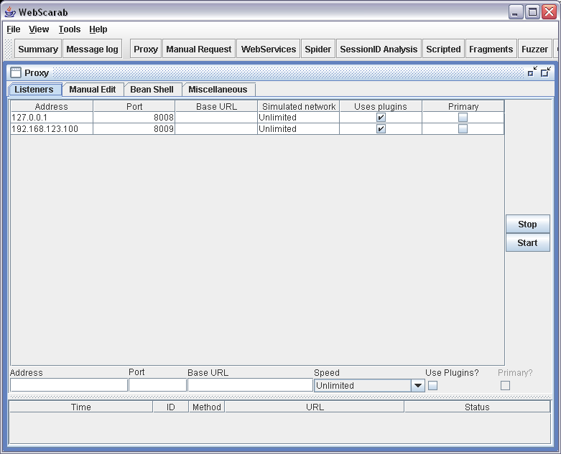
Configuring WebScarab
Multiple instances of reverse proxies
    Proxy Button
WS can use upstream proxies
    Ex. A Web Application Firewall under test
    Tools -> Proxies

Slide 11
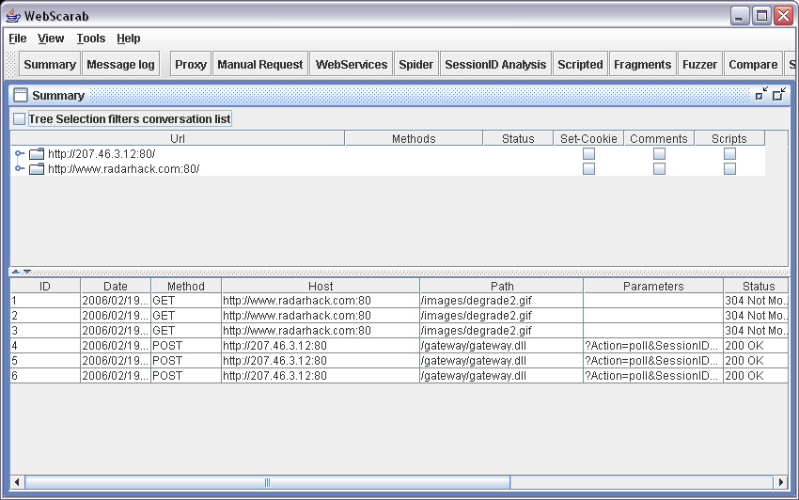
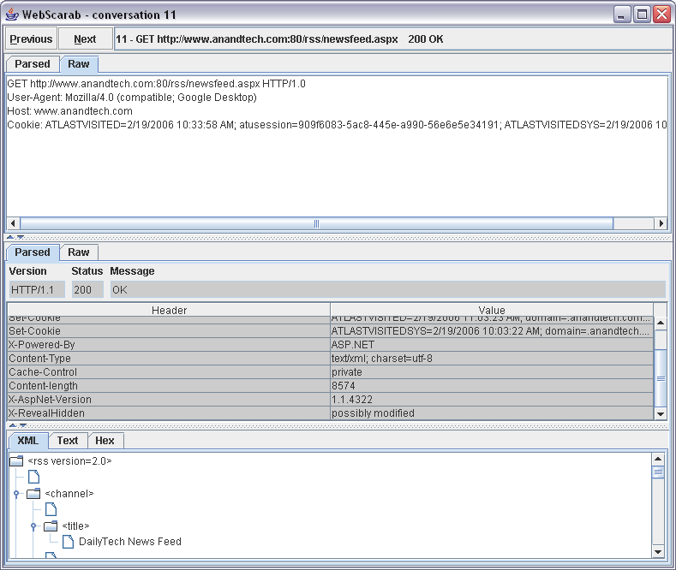
WebScarab is ready to capture traffic
Summary window displays in real-time all traffic passing through.

Slide 12
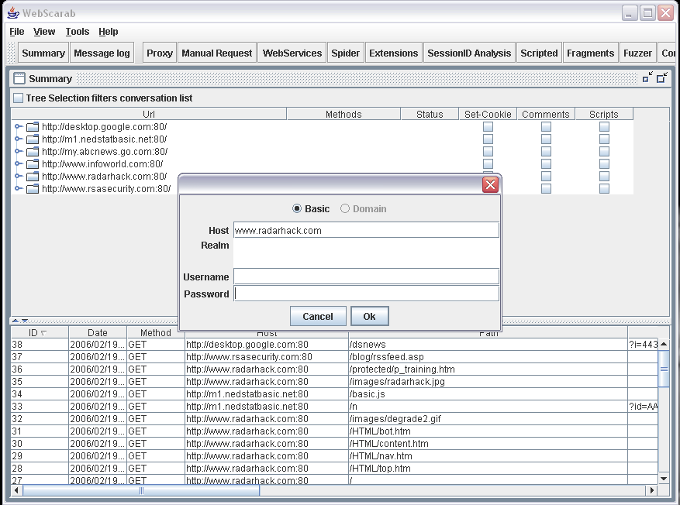
Credential caching/learning
When an application requires authentication, WS will popup to learn the credentials. Credentials will be automatically inserted.
  Basic authentication
  NTLM authentication

Slide 13
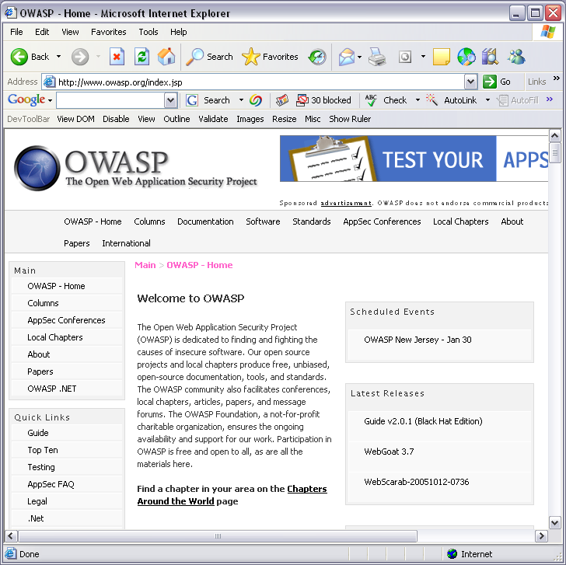
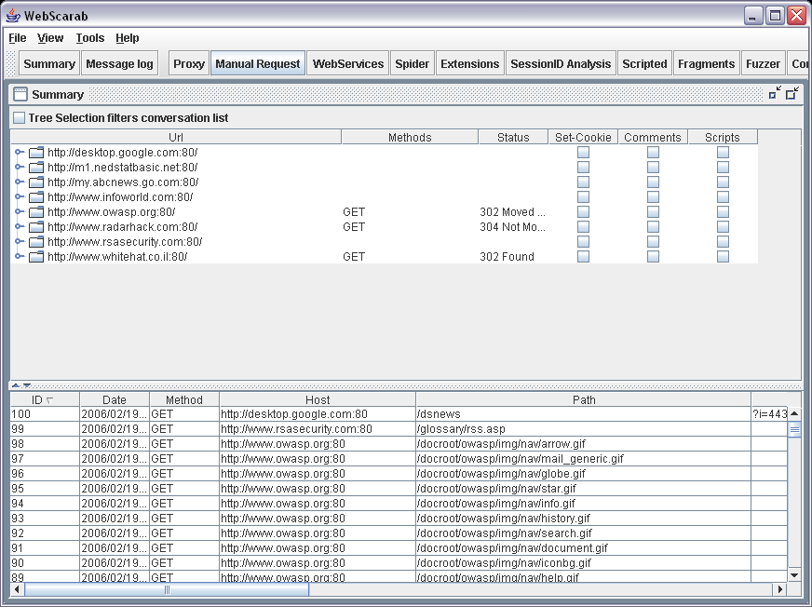

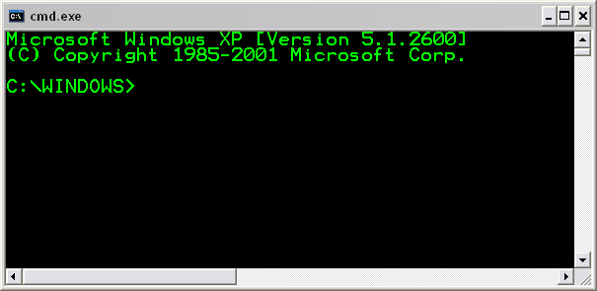
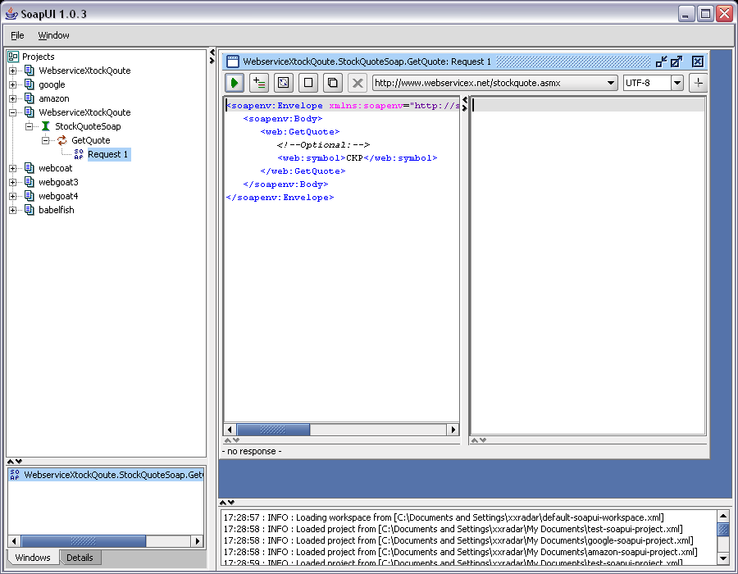
Is this useful ?
Authenticated (w/o WS)
Un-authenticated
Authenticated
Any tool not supporting authentication can now be used to access the application in authenticated domains !
Ex. nc, web service invocation tools … but also build in features such as manual crafted requests, the spider and extension module

Slide 14
SSL support
<- Server certificate (w/o WS)
<- WS certificate
<- Server certificate

Slide 15
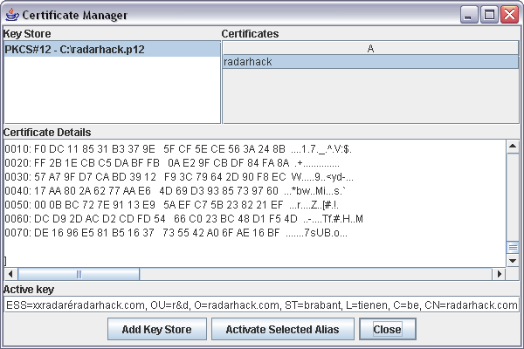
SSL and client certificate support
SSL with client certificate (w/o WS)
SSL
SSL with client certificate
Certificates can be imported via the certificate manager in following formats:
Pkcs#12
Pkcs#11 (smartcard support)
CAPI (road mapped)

Slide 16
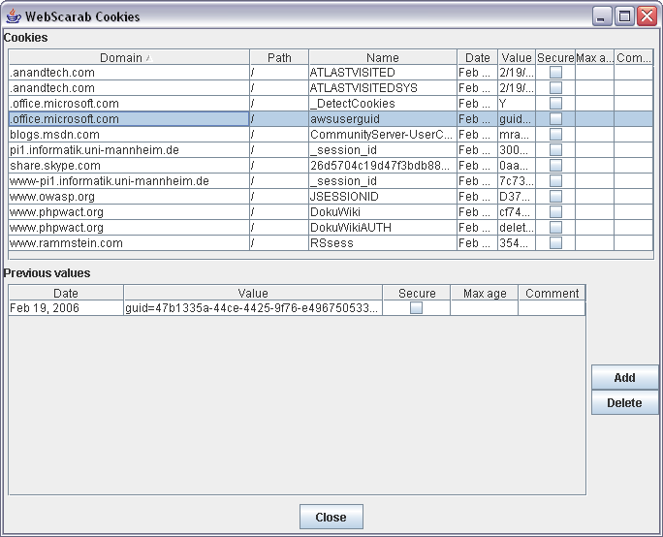
Shared Cookies plug-in
WS will automatically record all cookies seen by other WS plug-ins.
  cookies re-use in
    Spider
    Manual request

Slide 17
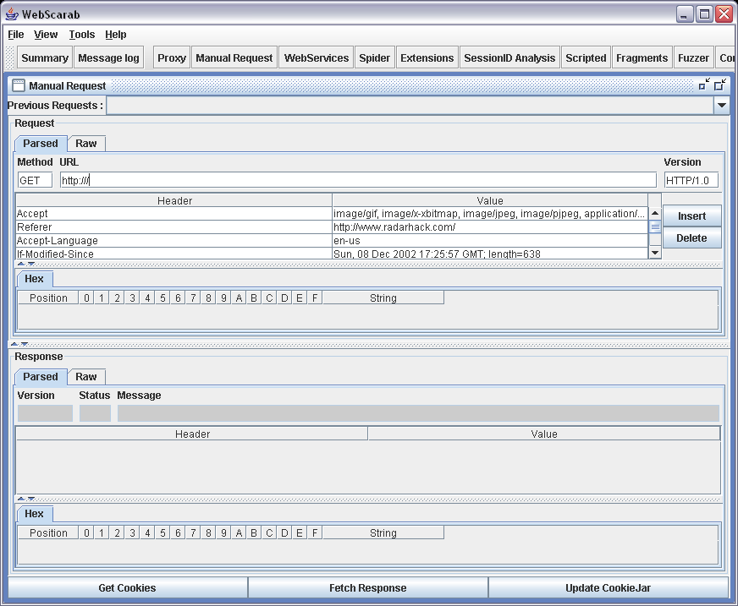
Manual Request plug-in
Previous request can be modified
New requests can be build from scratch
  Shared credential are taken into account!
  Shared cookies can be reused use !

Slide 18
Demo
Demo 1
  Accessing a protected resource via netcat
Demo 2
  Accessing a protected resource via shared cookies

Slide 19
Spider plug-in
The Spider plug-in analyses responses to identify any links in the response body, or the "Location" header.
If the URL represented has not been seen, the URL is added to a tree, and can be automatically downloaded when desired.
Remark:
After a URL has been fetch, it is added to the Summary pane and disappears from the spider pane !

Slide 20
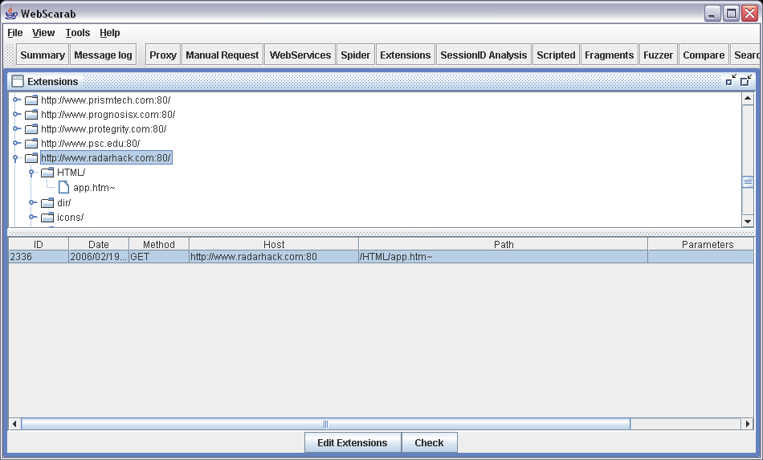
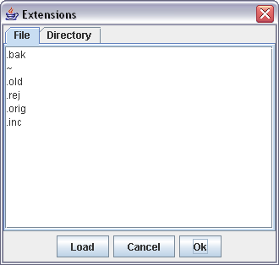
Extension plug-in
The Extension plug-in uses the Extensions tree to brute-forces a set of file extensions.

Slide 21
Web Services plug-in
Web Services Description Language
  Detection of WSDL file in conversations
  Manual import of WSDL file
Automatic parsing of services
Invocation tool
A nice tool in combination with webscarab is
  http://www.soapui.org/

Slide 22
Demo
Demo 1
  Checking out the Amazon web services API
Demo 2
  WebScarab invocation tool
  SOAP UI via WebScarab

Slide 23
Other features
Search
Compare
Fragments
Scripted
SessionID Analysis

Slide 24
Other products
Paros
  http://www.paros.org
Achilles
  http://achilles.mavensecurity.com/
Spike
Burp suite
IEWatch

Slide 25
Thank You

