Slide 1

Improved Assignment Problem
Final Project
of Program Structure & Algorithms
Professor: Robin Hillyard
Team member: Xuanshan Xiao, Xuewen Xu, Tiange Wu

Slide 2
Problem
N tasks and M servers are set, between which have no relations.
A server is able to have different speeds for different tasks.
The total time of a project equals to the longest running time of any server, which might deal with more than one task.

Slide 3
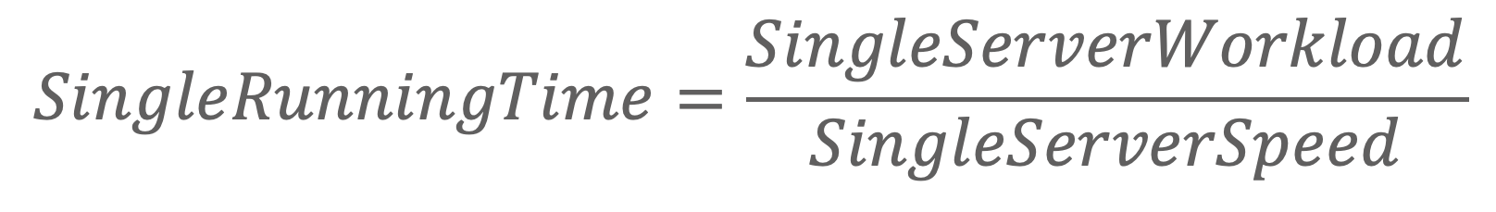
Implementation
Genotype: the list of one possible servers’ combination
Expression: the time of one servers’ combination
Phenotype: the list of a single-running-time combination
Fitness: the mapping to the time of one possible servers’ list
$$SingleRunningTime=\frac{SingleServerWorkload}{SingleServerSpeed}$$

Slide 4
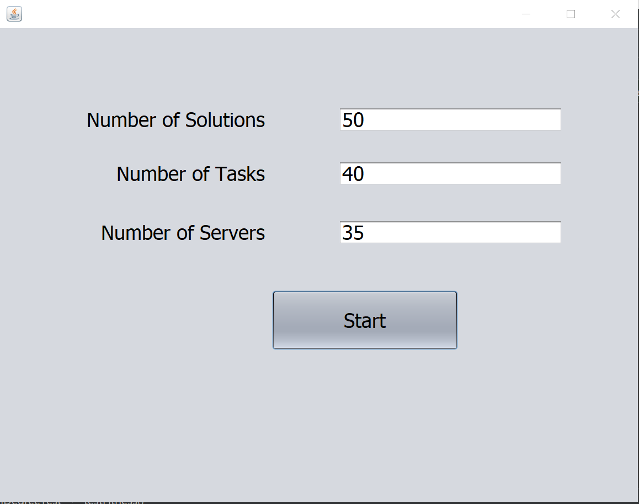
UI

Slide 5
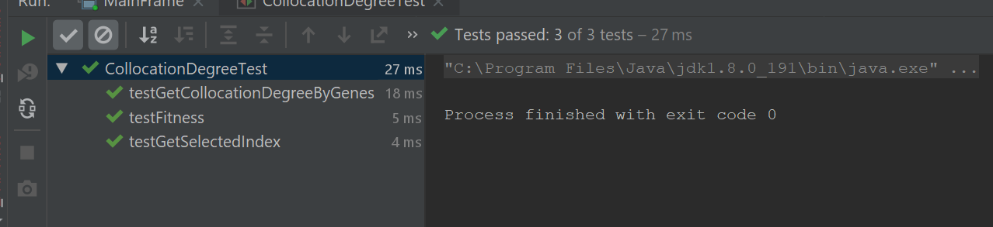
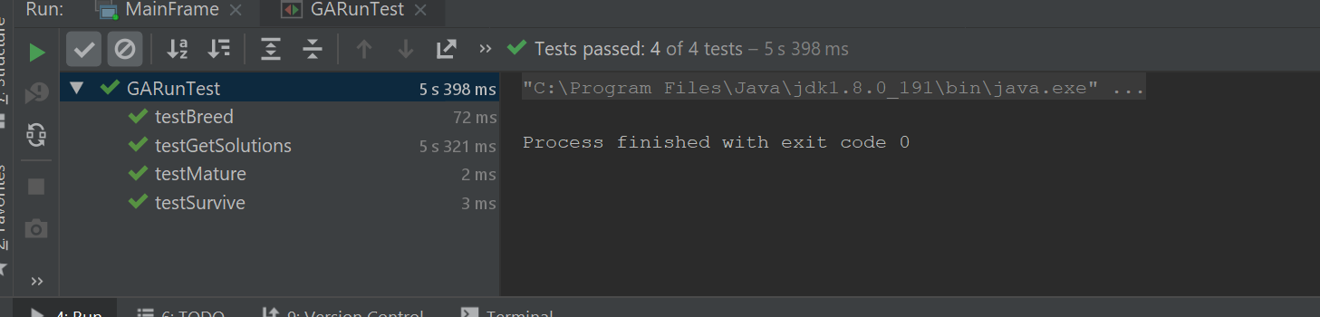
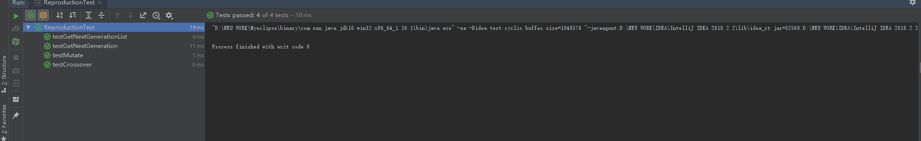
Unit Test

Slide 6
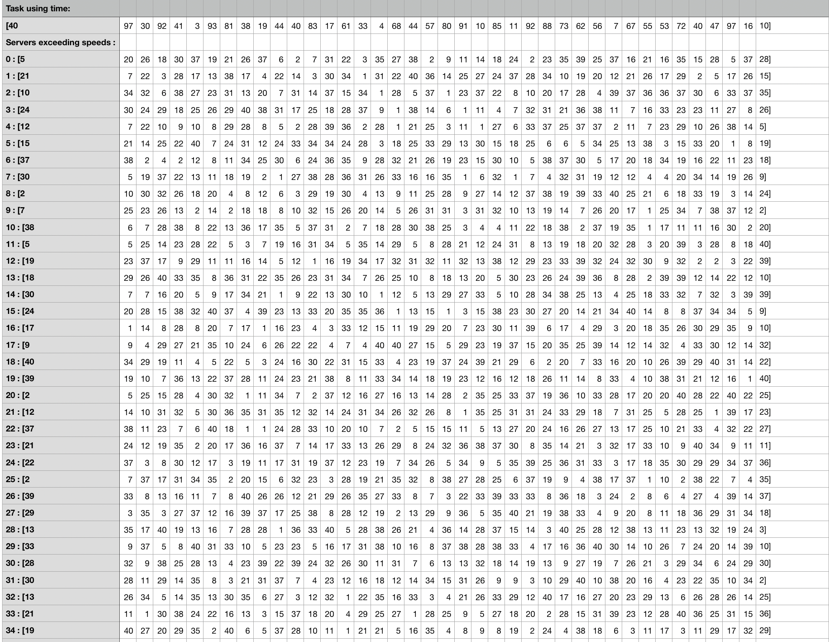
Result

Slide 7
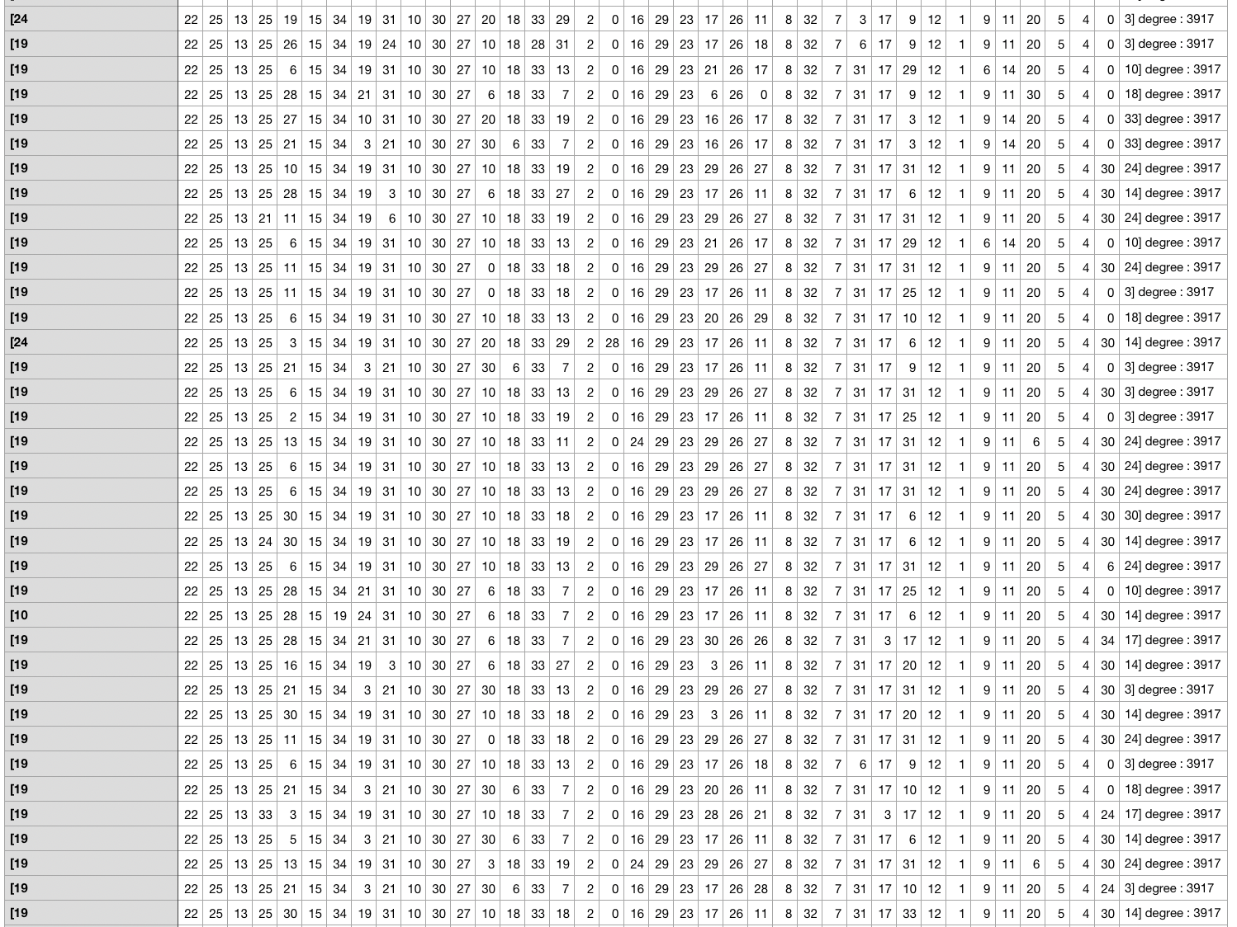

Slide 8
task | server | solution | convergent generation | average solution fitness
20 | 10 | 300 | 73.45 | 2610.64
20 | 20 | 300 | 72.36 | 2856.17
20 | 30 | 300 | 62.00 | 3376.35
20 | 40 | 300 | 70.64 | 3439.33
20 | 60 | 300 | 64.55 | 3812.01
20 | 80 | 300 | 68.91 | 3221.17
20 | 160 | 300 | 56.36 | 3695.44
40 | 10 | 300 | 96.82 | 1079.70
40 | 20 | 300 | 83.00 | 1409.77
40 | 30 | 300 | 81.91 | 1823.90
40 | 40 | 300 | 97.18 | 2096.15
40 | 60 | 300 | 80.91 | 2049.15
40 | 80 | 300 | 93.36 | 2608.04
40 | 160 | 300 | 74.00 | 2318.89
80 | 20 | 300 | 140.82 | 925.74
80 | 40 | 300 | 122.00 | 1098.31
80 | 60 | 300 | 105.09 | 1192.77
80 | 80 | 300 | 152.75 | 1176.00
80 | 160 | 300 | 190.88 | 1232.12
80 | 320 | 300 | 116.50 | 2210.51
80 | 400 | 300 | 111.20 | 1942.71
160 | 80 | 300 | 131.00 | 794.97
160 | 120 | 300 | 128.40 | 813.47
160 | 160 | 300 | 114.10 | 915.37
160 | 240 | 300 | 142.50 | 1119.61
160 | 320 | 300 | 108.80 | 1060.62

Slide 9
conclusions
As the same amount of servers, the convergent generation has positive correlation with the amount of servers.
As the same amount of servers, the average fitness has negative correlation with the amount of tasks.
Given the amount of tasks, fitness is positive correlated to the amount of servers when the amount of servers is less than the amount of tasks.
However, as the amount of servers reaches to some value, which is greater than the amount of tasks, fitness will decrease. That is to say, we assume that there is a value, k, which makes the fitness greatest.

Slide 10
Acknolegment
The picture of the 1st slide: https://blogs.technet.microsoft.com/uktechnet/2017/01/17/how-to-boost-your-windows-server-2016-security/

