Slide 1

SPEECH EMOTION RECOGNIZER IN HINDI
Presented By:
Shafin Ali (BTECH/10151/21)
Divyanshu Kumar (BTECH/10159/21)
Muzamil Anwar (BTECH/10135/21)
Guided By:
Dr. Sanjaya Shankar Tripathy
Department of ECE, BIT, Mesra, Ranchi-835215

Slide 2
OUTLINE
Introduction
Abstract
Methodology
Results
Future Work and Scope
References

Slide 3
INTRODUCTION
Speech is a vocalised mode of human interactions. It is the ability to express thoughts and feelings by spoken language. Emotions depict various states of the nervous system Mood, temperament, personality, disposition, inventiveness, and motivation are frequently entwined with emotions. Speech frequently contains emotion, which can be communicated in a variety of ways. The inability to recognise someone's emotions in a certain circumstance may disrupt the communication process. As a result, identifying emotion is essential.
Since emotions assist in mutual understanding of what is being communicated, it is only logical to extend this comprehension to machines. Though it is quite challenging for a machine to develop this kind of perception because it is unable to discern emotion from spoken words.

Slide 4
ABSTRACT
Emotions are states of the nervous system that are connected to thoughts, sensations, behavioural reactions, and varying degrees of pleasure or annoyance. Failure to recognise emotions may result in communication failure. As a result, identifying emotion becomes crucial. Also, worldwide a total of about 577.8 million people speaks Hindi. Thus, this Speech Emotion Recognition system aims to detect emotion from Hindi audio. Here, the approach used is to extract audio-based features from the input audio speech to detect emotion. Experimentation is done with several machine learning algorithms like Decision Tree, Support Vector Machine(SVM), Random Forest(RF),
Multi-Layer Perceptron(MLP), K-Nearest Neighbours(KNN).

Slide 5
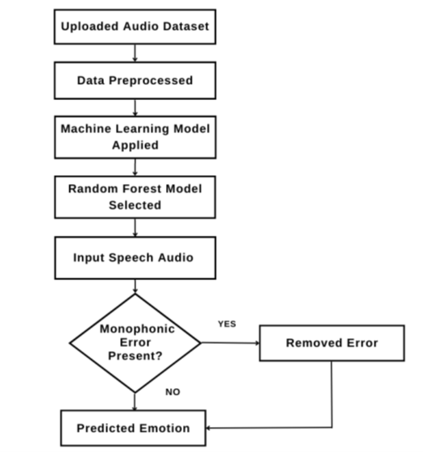
METHODOLOGY

Slide 6
METHODOLOGY (MACHINE LEARNING MODELS)
Dataset Collection:-
1. Organized in directories by emotion labels.
2. Python script using os and glob libraries for efficient data retrieval and labeling.
Audio Preprocessing:-
Audio preprocessing plays a vital role in ensuring the consistency, quality, and usability of the data, as it directly influences the accuracy and performance of machine learning models. In this project, preprocessing was performed using the Librosa library, a widely recognized tool in the field of audio analysis. Librosa offers a comprehensive suite of functions for loading, transforming, and analyzing audio data, making it an ideal choice for this task

Slide 7
METHODOLOGY (MACHINE LEARNING MODELS)
Steps Involved:
1. Conversion to mono audio to reduce complexity.
One of the initial steps in preprocessing involved converting all audio files to mono using Librosa’s to_mono() function. Many audio files are recorded in stereo, meaning they have two audio channels that capture sound from different directions. While stereo sound is advantageous in applications like music, it introduces unnecessary complexity in speech emotion recognition. Emotions in speech are generally conveyed through variations in pitch, tone, and energy, which can be captured effectively in a single channel. Mono conversion ensures that only essential information is retained while simplifying the analysis process, leading to more efficient feature extraction and model training.

Slide 8
METHODOLOGY (MACHINE LEARNING MODELS)
2. Standardization of the sampling rate across all audio files.
Another critical preprocessing step was standardizing the sampling rate across all audio files. The sampling rate determines how frequently audio samples are taken per second and plays a crucial role in ensuring that audio data is consistent. Variations in sampling rates across different audio files can lead to inconsistencies in the extracted features. For this project, a uniform sampling rate was applied to all files, ensuring that each sample contained the same temporal resolution. This standardization ensures that the features extracted, such as Mel-Frequency Cepstral Coefficients (MFCCs), are comparable across all audio samples, leading to more accurate emotion classification.

Slide 9
METHODOLOGY (MACHINE LEARNING MODELS)
3. Visualisation and Quality Assurance
To verify that the audio files were correctly loaded and prepared for analysis, waveforms were visualized using Librosa’s waveshow() function. This visualization provided a graphical representation of the audio signals, displaying how the amplitude of the signal varies over time. By examining these waveforms, potential issues such as clipping, distortion, or incorrect audio file loading could be identified and addressed early in the preprocessing phase. This visual quality check ensured that the data was in the expected format and free from anomalies that could negatively impact the accuracy of the machine learning models.

Slide 10
METHODOLOGY (MACHINE LEARNING MODELS)
4. Normalisation of Audio Signals
Normalization was applied to scale the amplitude of the audio signals uniformly. In speech recordings, variations in recording volume can lead to discrepancies in the amplitude of the audio signals. Normalization adjusts the amplitude to a consistent range, ensuring that the loudness differences do not affect the extraction of key features. This process is particularly important for emotion recognition, as it ensures that emotions like "angry" (typically associated with higher energy) and "calm" (associated with lower energy) are analyzed based on the content of the speech rather than the recording volume.

Slide 11
METHODOLOGY (MACHINE LEARNING MODELS)
Feature Extraction:-
MFCCs (40 coefficients): MFCCs (Mel-Frequency Cepstral Coefficients) are essential for representing the short-term power spectrum of speech and are widely used in SER. Here each coefficient corresponds to a specific feature or characteristic of the spectrum. The number 40 refers to how many of these coefficients are computed for each frame of the audio signal. The choice of 40 coefficients is somewhat arbitrary but often strikes a balance between capturing enough information for accurate feature representation to avoid overfitting. In tasks like SER, 40 is common as it offers a good trade off. In this project, 40 MFCC coefficients were extracted from each audio sample, capturing variations in tone and pitch critical for emotion detection.
2. Chroma-stft: Chroma features capture the distribution of energy across different pitch classes, aiding in the identification of tonal variations. This feature helps distinguish between emotions like "happy" (with more pitch variation) and "calm" (with a flatter pitch profile).

Slide 12
METHODOLOGY (MACHINE LEARNING MODELS)
Feature Extraction:-
3. Mel-Spectrogram:The mel spectrogram provides a time-frequency representation of the audio by mapping frequencies onto the mel scale, approximating human auditory perception. It visualizes how energy varies across frequencies over time, which is useful for recognizing emotional speech patterns. (Mel Scale: It is designed to reflect the human ear's sensitivity to frequency changes, which is nonlinear.)
4. Spectral Contrast: This feature measures the difference between spectral peaks and valleys, indicating energy distribution across frequencies. Emotions like "angry" often exhibit high spectral contrast due to sharp energy fluctuations.

Slide 13
METHODOLOGY (MACHINE LEARNING MODELS)
Feature Extraction:-
5. Tonnetz: The tonnetz feature captures harmonic relationships in the speech signal, aiding in the detection of subtle tonal shifts associated with emotions such as sadness or happiness.
Model Training and Evaluation:-
Data Split: 80% Training, 20% Testing using train_test_split
Algorithms Used:
1. Decision Tree (56%)
2. Support Vector Machine (SVM) (Linear: 58%, Ploy: 36%)
3. Random Forest (RF)(82%)
4. Multi-Layer Perceptron (MLP)(66%)
5. K-Nearest Neighbors (KNN)(65%)

Slide 14
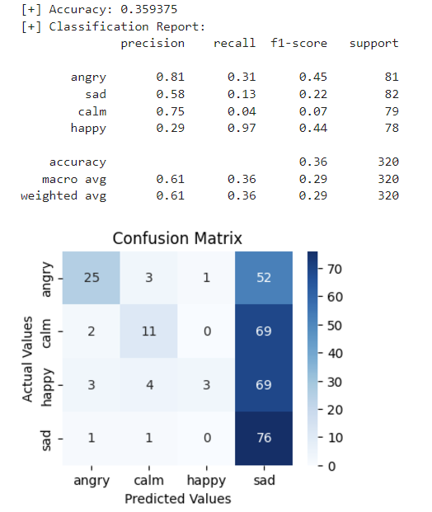
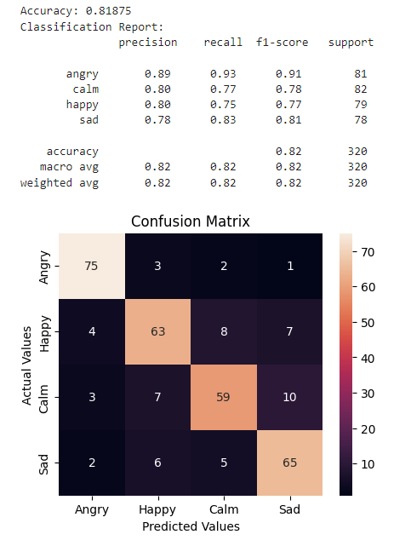
RESULTS
SVM(POLY. KERNEL)
RANDOM FOREST

Slide 15
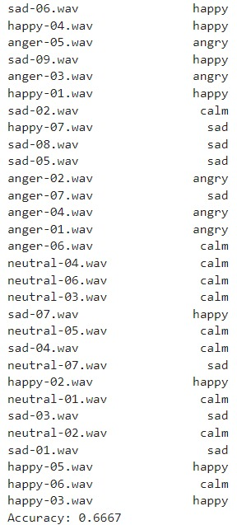
RESULTS

Slide 16
FUTURE WORK AND SCOPE
Collect more dataset and refine our model
2. Provide more emotions

Slide 17
REFERENCES
Mehmet Berkehan Akçay and Kaya Oğuz, "Speech emotion recognition: Emotional models databases features;. preprocessing methods supporting modalities and classiriers", Speech Communication, vol. 116, pp. 56-76, 2020.
Björn W. Schuller, "Speech emotion recognition: Two decades in a nutshell benchmarks; and on going trends", Communications of the ACM61, no. 5, pp. 90-99, 2018.
Cowie Roddy, Ellen Douglas-Cowie, Nicolas Tsapatsoulis, George Votsis, Stefanos Kollias, Winfried Fellenz, et al., "Emotion recognition in human -computer interaction", IEEE Signal processing magazine, vol. 18, no. 1, pp. 32-80, 2001.

Slide 18
THANK YOU

