Slide 1
Introduction to agile
ITPM5.248 Agile Projects

Slide 2
Aim / Learning Outcomes
To provide students with knowledge and skills to understand and contribute to the successful planning and execution of information technology (IT) related projects.
Learning Outcome 1: | Describe and apply project planning, scheduling, and project lifecycles.
Learning Outcome 2: | Describe the role of governance and risk management when managing projects.
Learning Outcome 3: | Describe the role of project management in software/systems development methodologies.
Learning Outcome 4: | Apply project management principles and techniques to manage teams and resources.

Slide 3
Schedule
Week 1: Project Life Cycle
Week 2: Paradigms & Models
Week 3: Agile Methods
Week 4: Planning & Scheduling
Week 5: Documentation
Week 6: Risk & Governance
Week 7: Process Improvements & Quality Assurance (QA).

Slide 4
Assessments - Project
40% of final mark.
Learning outcomes 1, 2, 3 & 4.
Group work.
Based partially on tutorials and lab.
Due date: based on 3 iterations.

Slide 5
Assessments - Test
60% of final mark
Learning outcomes 1, 2 & 3
Individual work
Based on lectures.
Date: TBC

Slide 6

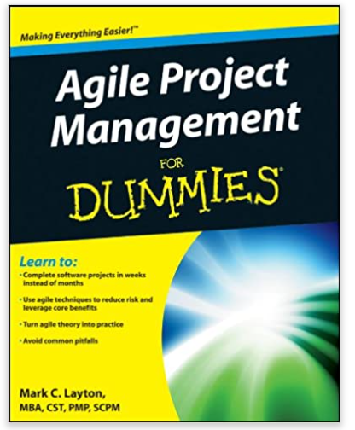

Recommended Reading
Rothman, J. (2017). Create Your Successful Agile Project: Pragmatic Bookshelf.
Layton, M. (2012). Agile Project Management For Dummies, 2nd Edition.
Stellman, A., and Greene, J. (2017). Head First Agile: A Brain-Friendly Guide to Agile Principles, Ideas, and Real-World Practices.
Notes:
Both available in digitally via the EIT Library

Slide 7
Agile is not a noun
agile
/ˈadʒʌɪl/
adjective
1.
able to move quickly and easily.
"Ruth was as agile as a monkey"
https://www.lexico.com/en/definition/agile

Slide 8
Project definition
project
/ˈprɒdʒɛkt/
noun
1.
A novel undertaking or systematic process to create a new product or service the delivery of which signals completion. Projects involve risk and are typically constrained by limited resources.
http://www.maxwideman.com/pmglossary/PMG_P12.htm#Project

Slide 9
Agile Teams
Small:
under ~12 members
Members trust each other:
they know each other well and depend on each other
Mostly stable:
members come and go rarely

Slide 10
Manifesto for Agile Software Development
We are uncovering better ways of developing software by doing it and helping others do it.
Through this work we have come to value:
Individuals and interactions over processes and tools
Working software over comprehensive documentation
Customer collaboration over contract negotiation
Responding to change over following a plan
That is, while there is value in the items on the right, we value the items on the left more.
from: agilemanifesto.org

Slide 11
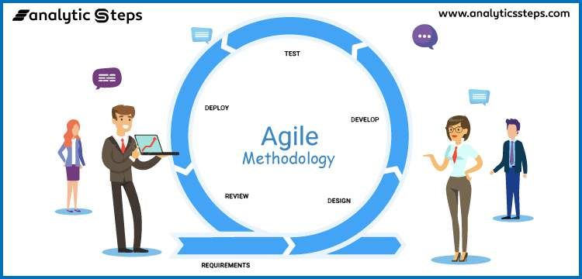
Agile development
Image source: https://www.analyticssteps.com/blogs/7-types-agile-methodologies

