Slide 1
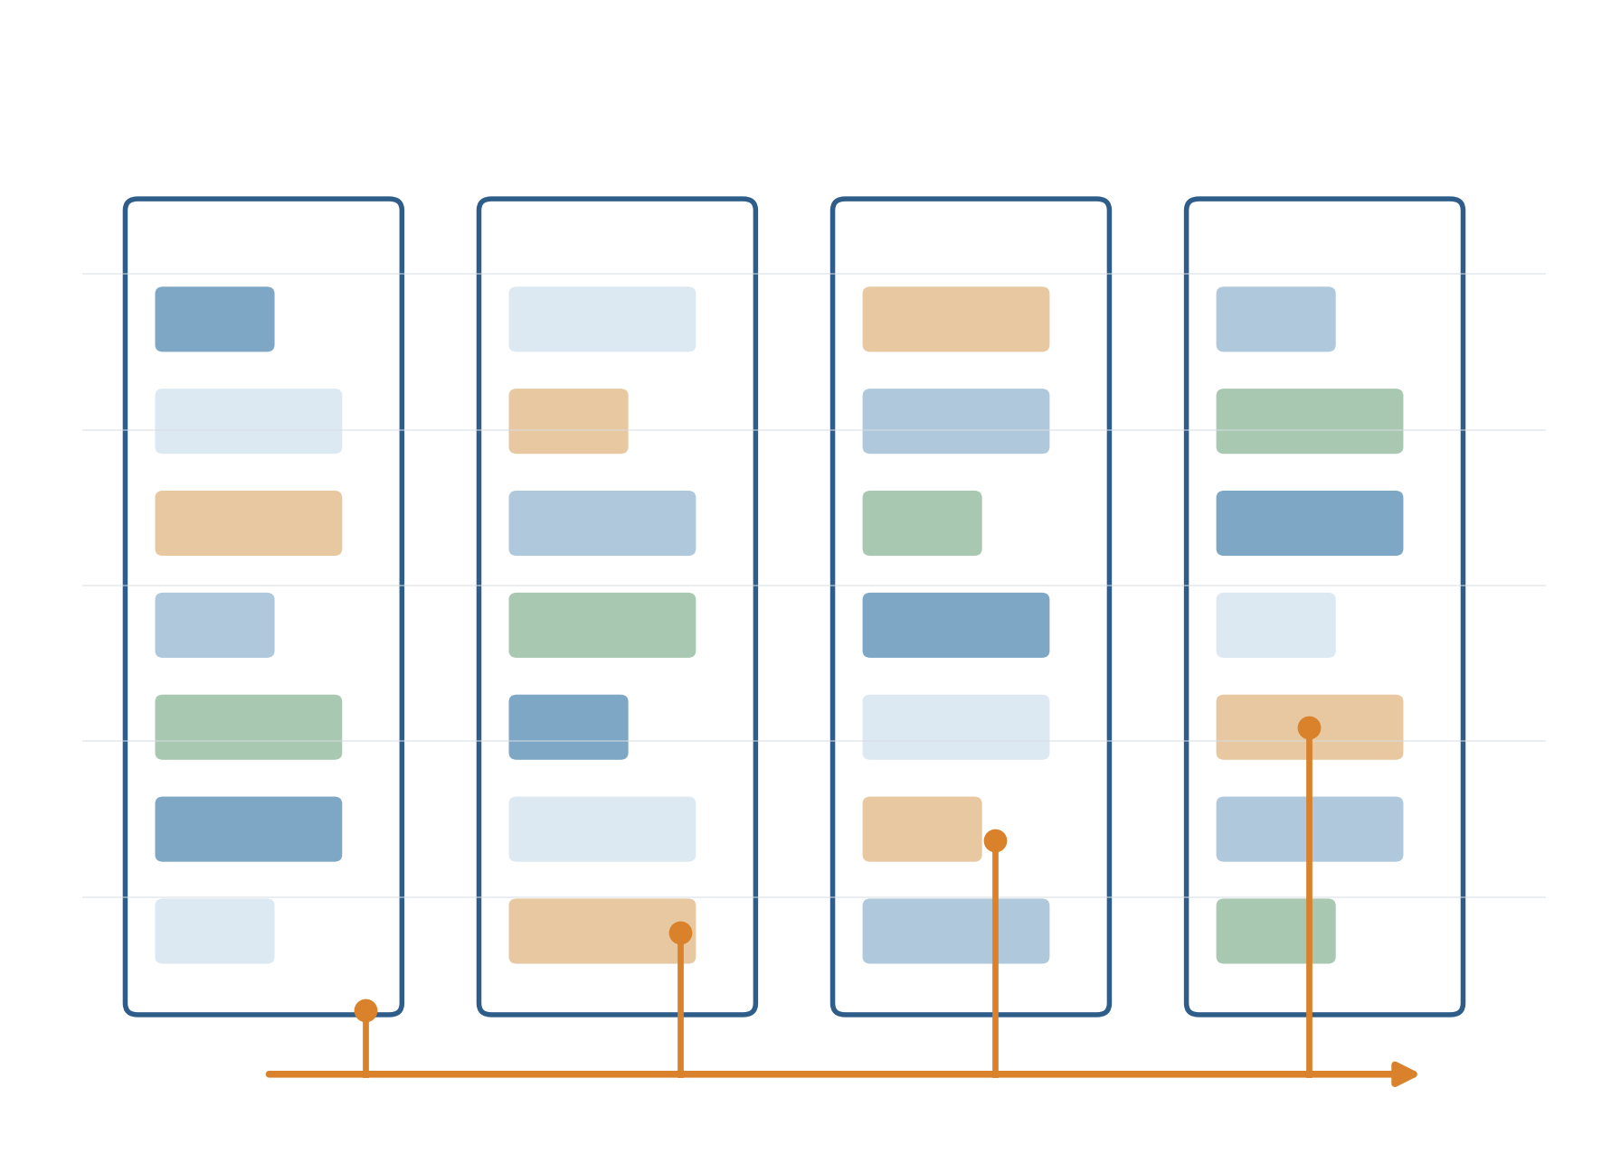
Revisiting Lifetime-Aware
VM Allocation
Reconstruction, Diagnosis and
Prior-Fused Lifetime Prediction
Lifetime prediction, confidence routing and prior fusion
Synthetic reconstruction
100 fresh test seeds
Pre-registered, Holm-corrected
CE7490 Course Project
Revised 29 October 2026
Notes:
Talking points: Our project revisits LAVA, Google's lifetime-aware VM allocator from MLSys 2025. The original course code and traces were lost, so we rebuilt the system in a transparent simulator and used it to ask how lifetime-prediction quality and uncertainty handling change the scheduling benefit.
Timing: about 18 minutes for the 20 main slides; slides 21-22 are backup.

Slide 2
02
Three questions, three answers
RQ1 · Prediction quality
RQ2 · Confidence routing
RQ3 · Prior fusion
Does LAVA’s benefit depend on how accurate lifetime predictions are?
Does routing low-confidence VMs away from LAVA help?
Can the lifetime prediction itself be made robust?
−0.19 → +0.51 pp
−0.090 pp
3 of 4
Yes. LAVA loses to Best-Fit at 25% accuracy and gains clearly at 100%.
No. Host-level routing is below Best-Fit; three measured causes contribute.
Yes. Beats LAVA in 3 of 4 pre-registered tests and no longer loses at low accuracy.
Lesson: uncertainty helped inside the lifetime estimate, not as a policy switch.
Fresh test seeds 1000–1099 (n = 100); all values relative to same-seed Best-Fit.
Independent reconstruction 29 October 2026
2
Notes:
Talking points: The whole talk on one slide. RQ1: prediction quality is first-order; LAVA loses to Best-Fit at 25% accuracy and gains clearly at 100%. RQ2: routing low-confidence VMs away from LAVA does not help; host-level routing is even below Best-Fit, and we measure three causes. RQ3: fusing each noisy prediction with the profile's lifetime distribution fixes the low-accuracy problem; it beats LAVA in 3 of 4 pre-registered tests on 100 fresh seeds. New in this revision: the RQ2 diagnosis and the RQ3 method.
Source: results/improvement/test/summary.json.

Slide 3
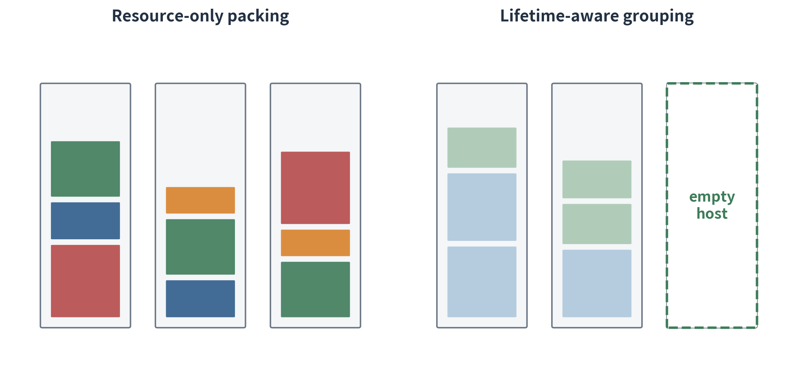
03
VM placement and resource fragmentation
Multidimensional fragmentation
CPU and memory can each be free but unusable together.
Time is the hidden dimension
VMs that fit equally well can exit at very different times.
Operational consequence
Empty hosts support maintenance, larger VMs and energy management.
Objective: maximize the time-weighted share of empty hosts without rejecting any VM.
Scale: about 90% of host-time is empty under every policy (low load, long drain tail); 1 pp ≈ 1.8 of 180 hosts.
Independent reconstruction 29 October 2026
3
Notes:
Talking points: VM placement is multi-dimensional bin packing. CPU and memory can each be free but unusable together. Time is the hidden dimension: two VMs that fit equally well today may leave at very different times, so one long-lived VM can keep an otherwise empty host busy. Our metric is the time-weighted share of empty hosts. Because load is low and the drain tail is long, about 90% of host-time is empty under every policy, so differences are small in percentage points: 1 pp is about 1.8 hosts.
Source: report Sections 1 and 5.

Slide 4
04
LAVA prediction and host lifecycle
Distributions
Re-prediction
Host lifecycle
Temporal placement
Estimate a remaining-lifetime distribution for each VM.
Condition on uptime to revise the expected remaining lifetime.
Empty, open and recycling states guide placement.
Align departures and fill recycling hosts with shorter VMs.
first VM
≥90% CPU or memory
empty
open
recycling
last VM exits → host is empty again
Adaptation to mistakes
Residual cohorts lower the host class when they leave; missed deadlines raise it when VMs outlive their prediction.
Ling et al., “LAVA: Lifetime-Aware VM Allocation with Learned Distributions and Adaptation to Mispredictions”, MLSys 2025 (arXiv:2412.09840).
Independent reconstruction 29 October 2026
4
Notes:
Talking points: LAVA predicts a lifetime distribution, re-predicts the remaining lifetime as a VM ages, and manages each host as empty, open or recycling. Hosts carry a lifetime class with boundaries at 1, 10 and 100 hours. When the residual cohort leaves early the host moves down a class; when VMs outlive a deadline it moves up. This is how LAVA adapts to mispredictions.
Source: Ling et al., arXiv:2412.09840, Sections 4.2-4.3.

Slide 5
05
Reconstruction scope and seed splits
Recovered settings
Inferred defaults
Unrecoverable inputs
180 hosts, 2,500 VMs per trace, 8 arrivals per hour, seed splits and metric.
Mixture parameters, VM shapes, scoring details and the controlled confidence model.
Original traces, random streams, code history and per-seed results.
Split | Seeds | Used for
Initial sweep | 0–19 | RQ1 accuracy sweep; development of the new method
Validation | 200–205 | Report’s threshold selection; τ = 0.3 kept frozen
Held-out | 20–39 | Report’s test split; rerun with all ten policies
Fresh test | 1000–1099 | Pre-registered evaluation of prior fusion (n = 100)
Robustness | 2000–2049 | Predictor variants, same-seed control and load × 2 (n = 50)
Threshold sensitivity | 200–219 | Descriptive τ scan for the new method (n = 20)
Independent reconstruction 29 October 2026
5
Notes:
Talking points: The original code and traces were lost, so we rebuilt the simulator from the surviving report: 180 hosts, 2,500 VMs per trace and 8 arrivals per hour. Values we could not recover are declared once as inferred defaults and never tuned to match old numbers. The table lists every seed split; the new method is judged only on the fresh test seeds 1000-1099.
Source: REPRODUCTION_DIFFERENCES.md; configs/provenance.json.

Slide 6
06
Methods compared
Best-Fit
LA-Binary
NILAS
Resource-only baseline: minimize residual CPU and memory.
One-shot short/long label at arrival, then Best-Fit.
Re-predicted temporal extension cost, then Best-Fit.
LAVA
VM-Level CA (VM-CA)
Host-Level CA (Host-CA)
Lifetime classes and host states; adapts when VMs outlive their prediction.
Per-arrival confidence gate between LAVA and Best-Fit on shared hosts.
Same gate, but each host keeps one mode until it empties.
New in this project: *-Bayes variants (RQ3)
NILAS-Bayes, LAVA-Bayes, VM-CA-Bayes and Host-CA-Bayes run exactly the same scheduling code as their base policy and only swap in the prior-fused lifetime predictor.
Independent reconstruction 29 October 2026
6
Notes:
Talking points: Best-Fit only packs resources. LA-Binary and NILAS add simple lifetime signals; LAVA adds classes and host states. VM-Level CA and Host-Level CA route low-confidence requests to Best-Fit, per VM or per host. Each *-Bayes variant runs exactly the same scheduling code and only swaps in the prior-fused predictor, so any change comes from the prediction.
Source: lava/simulator.py.

Slide 7
07
Prediction settings and information boundary
Controlled accuracy = share of VMs in the correct bucket
Correct bucket
25%
50%
75%
85%
100%
Log10 error with σ = 0.001.
Default predictor
Incorrect bucket
Profile-level two-exponential mixtures give the conditional remaining lifetime and a class probability. Numeric parameters are inferred.
Log10 error with σ = 3 (orders of magnitude).
Oracle reference
Statistical protocol
Information boundary
True remaining lifetime; a full-information reference, not an upper bound.
Identical traces and noise for all policies; paired Student-t 95% intervals.
The scheduler never sees the bucket or the true lifetime.
*-Bayes adds only the profile prior, which the default predictor already uses.
Independent reconstruction 29 October 2026
7
Notes:
Talking points: Controlled accuracy follows LAVA's Appendix G.1: with probability equal to the accuracy the log10 error has sigma 0.001, otherwise sigma 3, i.e. errors of several orders of magnitude. The default predictor uses profile-level mixtures; the Oracle knows the true remaining lifetime and is a reference, not an upper bound. The scheduler never sees the bucket or the true lifetime; the fused predictor additionally uses the profile prior that the default predictor already has.
Source: lava/model.py.

Slide 8
08
RQ1: Prediction accuracy drives LAVA’s gain
First significant point
75% accuracy: +0.275 [+0.147, +0.403] pp
Default predictor
+0.124 pp here; not replicated on held-out (+0.001) or fresh seeds (−0.043).
Oracle reference
+0.575 [+0.433, +0.718] pp
Initial split (n = 20 per point), paired 95% intervals. The 75% crossing point is specific to this reconstruction.
Independent reconstruction 29 October 2026
8
Notes:
Talking points: RQ1. LAVA's gain over Best-Fit grows with accuracy; 75% is the first tested level whose interval excludes zero (+0.275 [+0.147, +0.403] pp), and the Oracle reaches +0.575 [+0.433, +0.718] pp. Under the default predictor LAVA's small gain here did not replicate on later seeds. The accuracy axis is to scale.
Source: results/sweep/summary.json.

Slide 9
09
Held-out sensitivity and the RQ2 hypothesis
+0.001 pp
+0.661 pp
−0.187 pp
LAVA, default predictor (held-out 20–39)
LAVA with true lifetimes (held-out 20–39)
LAVA at 25% accuracy (fresh seeds)
Observation
Hypothesis
Constraint
LAVA gains little with the default predictor and loses to Best-Fit when predictions are poor.
The earlier report’s idea: send low-confidence requests to Best-Fit, per VM or per host.
Workload and threshold stay fixed; no search for a result that matches the earlier report.
All values are paired differences relative to same-seed Best-Fit.
Independent reconstruction 29 October 2026
9
Notes:
Talking points: On held-out seeds the default predictor gives LAVA essentially nothing (+0.001 pp) while the Oracle gives +0.661 pp, and on fresh seeds LAVA at 25% accuracy is −0.187 pp. The earlier report's answer was confidence routing; we test it with the workload and threshold fixed.
Source: results/heldout and results/improvement/test.

Slide 10
10
RQ2: Two ways to route by confidence
VM-Level CA
Host-Level CA
yes
LAVA scoring
yes
LAVA-mode hosts only
Arrival
Confidence
≥ τ ?
Arrival
Confidence
≥ τ ?
Best-Fit scoring
Best-Fit-mode hosts only
no
no
Both decisions land on one shared set of hosts: modes mix on a host.
A host keeps its first mode until empty; cross-mode only if nothing else fits.
608 + 319 → 0
20%
0
cross-mode placements per trace,
VM-CA → Host-CA
of arrivals pass the gate,
identical in both variants
capacity fallbacks in any run
Mechanism check on held-out seeds 20–39, default predictor: isolation does exactly what it was designed to do.
Independent reconstruction 29 October 2026
10
Notes:
Talking points: Two designs. VM-Level CA gates each arrival between LAVA and Best-Fit on shared hosts, so decisions of both kinds mix on a host. Host-Level CA keeps each host in its first mode until it is empty. With the same gate sequence, isolation removes all cross-mode placements, about 608 plus 319 per trace, and never needs a capacity fallback. Both variants see the same gate decisions: about 20% of arrivals pass under the default predictor. So the mechanism works as designed.
Source: results/heldout/raw.csv.

Slide 11
11
Diagnostic negative result: routing does not beat Best-Fit
Fresh seeds (n = 100)
Host-CA − Best-Fit: −0.090 [−0.147, −0.034] pp, significantly below zero.
Held-out seeds 20–39
Host-CA −0.045 vs Best-Fit, −0.158 vs VM-CA; VM-CA’s +0.114 did not replicate.
Surviving report (historical)
Reported Host-CA − Best-Fit: +0.241 [+0.125, +0.357] pp; not reproduced here.
Paired 95% intervals; threshold τ = 0.3 as in the report.
Independent reconstruction 29 October 2026
11
Notes:
Talking points: But it does not help. On 100 fresh seeds Host-Level CA is significantly below Best-Fit (−0.090 [−0.147, −0.034] pp). On the held-out seeds it was also below VM-CA, and VM-CA's small held-out gain did not replicate. The surviving report had claimed +0.241 pp; we could not reproduce it. We treat this as a diagnostic negative result.
Source: results/improvement/test; results/heldout; reference/report_table1.csv.

Slide 12
12
Why confidence routing does not help here
Inverted confidence
Interactive VMs are 88% likely to exit within 1 h but get 0.092; service VMs get 0.364.
Blind gate
Under controlled noise ≥99.96% of arrivals pass τ = 0.3, so both variants essentially reduce to LAVA.
τ = 0.3
Isolation costs packing
Host-CA loses 0.99 pp of empty hosts during arrivals; the tail recovers about 72%.
Default predictor at arrival; gate rates and windows on fresh seeds. Fixing the inversion alone did not help on development seeds either.
Independent reconstruction 29 October 2026
12
Notes:
Talking points: Three measured causes. One, confidence is inverted: interactive VMs are 88% likely to exit within an hour but get confidence 0.092, because confidence measures the class containing the mean of a bimodal mixture; service VMs get 0.364. Two, under controlled noise the gate passes almost every request. Three, isolation costs about 0.99 pp of empty hosts during arrivals. Fixing the inversion alone did not help on development seeds, so these factors contribute; none is a full explanation on its own.
Source: configs/report_scale.json; results/improvement/test; results/improvement/dev.

Slide 13
13
RQ3: Prior-fused lifetime prediction
Inputs
Posterior over T
Uptime filter
Outputs
Scheduler
Profile prior, noisy value, accuracy and σ
Log-grid atoms; values at the 336 h cap are censored
Keep only atoms above the current age
Mean remaining lifetime and class confidence
NILAS, LAVA and CA rules unchanged
Implausible values fall back
Censoring at the cap
No overdue jump
Interactive VM at 25% accuracy predicted 300 h: the original predictor uses 300 h, the fused one 1.52 h (prior mean 1.07 h).
A value at 336 h means “at least 336 h”. At uptime 300 h the original expects 36 h left, the fused one 151 h.
A VM that outlives its prediction keeps a posterior estimate instead of jumping to “remaining = uptime”.
Same information as the original confidence model plus the profile prior; never the bucket or the true lifetime.
Implementation: BayesPredictor in lava/model.py (44 lines), unit-tested in tests/test_bayes.py; examples computed by the code.
Independent reconstruction 29 October 2026
13
Notes:
Talking points: So we repair the estimate instead of switching policies. Bayes' rule combines each noisy prediction with the profile's lifetime distribution; the 14-day cap is treated as censoring; the posterior is conditioned on uptime. The output interface is unchanged, so every scheduling rule stays the same. Example: an interactive VM predicted at 300 hours is implausible under its prior, so the fused estimate is 1.52 hours. No extra information is used beyond the error model and the profile model the scheduler already had.
Source: lava/model.py (BayesPredictor).

Slide 14
14
Pre-registered evaluation protocol
1 Develop
2 Register
3 Test
4 Infer
Seeds 0–19 only. Two other ideas rejected there.
28 Oct, 20:10 (UTC+8): hypotheses, seeds, τ, decision rule and code hashes frozen.
Fresh seeds 1000–1099 (n = 100); τ = 0.3 from the report, nothing tuned.
Eight paired t-tests,
Holm–Bonferroni at α = 0.05.
Compute
23,240
64
≈6 min
0
simulations
low-priority CPU processes
on the H20 server
wall time; no GPU needed
scheduling failures
Also run: robustness seeds 2000–2049 (control and load × 2 added after review), τ scan on 200–219, and the report’s held-out seeds 20–39.
Only the eight registered tests are multiplicity-adjusted; everything else is descriptive.
Independent reconstruction 29 October 2026
14
Notes:
Talking points: To avoid choosing a method after seeing results, we developed on seeds 0-19 only, then froze hypotheses, test seeds, threshold, decision rule and code hashes at 2026-10-28 20:10 (UTC+8) before any test run. The registration is a local, self-timestamped file. The test uses 100 fresh seeds and eight paired t-tests with Holm correction. All 23,240 improvement simulations ran in about 6 minutes on 64 CPU processes of our H20 server; no GPU is needed.
Source: configs/improvement_protocol.json; results/improvement/*/manifest.json.

Slide 15
15
Fusion removes LAVA’s low-accuracy penalty
Registered: vs LAVA
+0.224, +0.147, +0.054, +0.088 pp at 25–85%; 3 of 4 hold.
Registered: vs Best-Fit
Holds at 50–85%; at 25%: +0.037 pp, not significant.
Oracle reference
LAVA with true lifetimes: +0.552 pp
Whiskers: unadjusted 95% intervals (n = 100). LAVA-Bayes was not registered and is shown for reference.
Independent reconstruction 29 October 2026
15
Notes:
Talking points: Main result. The grey line is the original LAVA: below Best-Fit at 25% and about zero at 50%. The registered variant, VM-CA-Bayes, differs from LAVA by +0.224, +0.147, +0.054, +0.088 pp at 25-85% accuracy; all but the 75% difference are significant after Holm correction. LAVA-Bayes, shown for reference, behaves almost identically. At 100% all methods approach the Oracle reference.
Source: results/improvement/test/summary.json.

Slide 16
16
Pre-registered results: 3 of 4 hold against LAVA
Accuracy | VM-CA-Bayes − LAVA | Holm p | Holds | VM-CA-Bayes − Best-Fit | Holm p | Holds
25% | +0.224 [+0.174, +0.275] | <0.001 | yes | +0.037 [−0.012, +0.086] | 0.14 | no
50% | +0.147 [+0.088, +0.205] | <0.001 | yes | +0.122 [+0.064, +0.180] | <0.001 | yes
75% | +0.054 [−0.001, +0.109] | 0.11 | no | +0.272 [+0.217, +0.327] | <0.001 | yes
85% | +0.088 [+0.037, +0.139] | 0.003 | yes | +0.398 [+0.338, +0.457] | <0.001 | yes
Not supported vs LAVA at 75%
Not supported vs Best-Fit at 25%
+0.054 [−0.001, +0.109] pp: the interval includes zero (Holm p = 0.11).
+0.037 [−0.012, +0.086] pp. Secondary, unadjusted: NILAS-Bayes +0.084 (p < 0.001), LAVA-Bayes +0.055 (p = 0.03).
Decision rule fixed before testing: mean > 0 and Holm-adjusted p < 0.05. Intervals are unadjusted 95% CIs.
Plain LAVA would also pass the Best-Fit tests at 75% and 85%, so those two say little about fusion itself.
Independent reconstruction 29 October 2026
16
Notes:
Talking points: 3 of 4 registered tests against LAVA hold after Holm correction; at 75% the interval includes zero. Against Best-Fit 3 of 4 hold, but the 75% and 85% tests would also pass for plain LAVA, so the fusion-specific evidence is the LAVA tests and the 50% Best-Fit test. At 25% the Best-Fit test fails; the NILAS-Bayes and LAVA-Bayes results there are secondary and unadjusted.
Source: results/improvement/test/summary.json (primary = true).

Slide 17
17
Post hoc: the gain comes from the estimate, not the gate
Fusion vs its ingredients
+0.10 to +0.46 pp over the prior alone; +0.04 to +0.24 over noisy values alone (n.s. at 75%).
Gate on top
−0.02 to +0.01 pp; every 95% interval includes zero (half-width ≈ 0.05). The development-seed gain did not replicate.
Weakly selective gate
Routes 82–87% of correct and 73–75% of wrong predictions to LAVA.
Post hoc, not registered; fresh seeds (n = 100). “Prior alone” = the same seeds under the default predictor.
Independent reconstruction 29 October 2026
17
Notes:
Talking points: Where does the gain come from? This is post hoc. Fusion improves on both ingredients at almost every accuracy: the prior alone (the same seeds under the default predictor, +0.10 to +0.46 pp) and the noisy predictions alone (not significant at 75%). Adding the gate on top changes little (−0.018 to +0.011 pp; every 95% interval includes zero, half-width about 0.05). The fused gate is only weakly selective, so the estimate rather than the gate appears to absorb most of the damage from wrong predictions. On development seeds the gate seemed to help; that did not replicate.
Source: results/improvement/test/raw.csv; results/improvement/gate_by_bucket.json.

Slide 18
18
Robustness and the failure mode
VM-CA-Bayes − LAVA (pp) | 25% | 50% | 75% | 85%
Protocol, same seeds | +0.225 | +0.185 | +0.113 | +0.127
Incorrect bucket σ = 1 | +0.024 | +0.102 | +0.025 | +0.093
Incorrect bucket σ = 0.5 | +0.070 | +0.062 | +0.037 | +0.092
Fusion assumes σ = 3 (true 1) | +0.083 | +0.074 | +0.002 | +0.066
Fusion assumes σ = 1 (true 3) | +0.168 | +0.173 | +0.109 | +0.069
Prior means × 0.5 | +0.267 | +0.135 | −0.033 | −0.116
Prior means × 2 | +0.223 | +0.215 | +0.149 | +0.112
Arrival rate × 2 | +0.476 | +0.271 | +0.177 | +0.101
Failure mode: short prior
Prior means × 0.5 at 85% is the only significantly negative cell (−0.116 pp; 1 of 32).
Load × 2 (16 VMs/h)
Gain over LAVA rises to +0.476, +0.271, +0.177 pp at 25%, 50% and 75%.
Threshold τ
0.1–0.5: positive mean at every accuracy; τ ≥ 0.7 loses the gain at 50–85% (backup slide).
Seeds 2000–2049 (n = 50), descriptive. Green / red: 95% interval above / below zero.
Same-seed control and load × 2 were added after review; the registered 90-host variant only rescales the 180-host run and is omitted.
Independent reconstruction 29 October 2026
18
Notes:
Talking points: Robustness on 50 fresh seeds, compared with the protocol on the same seeds. Milder errors and misspecified error spreads shrink the gain but never make it significantly negative. Doubling the arrival rate makes fusion more valuable at low accuracy. The failure mode is a prior that underestimates lifetimes: halved prior means are worse than LAVA at 85% (−0.116 [−0.197, −0.034] pp, one descriptive cell). Thresholds from 0.1 to 0.5 give positive mean gains; 0.3 was fixed in advance. Be open that the same-seed control and the load test were added after review: the registered 90-host variant only rescaled the 180-host run, so it is not shown.
Source: results/improvement/robust, robust_control, robust_load, tau.

Slide 19
19
Findings and limits
What we found
Limits
RQ1: prediction quality is first-order
Synthetic workload: about 20% offered load; the drain tail is about two thirds of the metric.
Calibrated prior: the generating distribution; halved means fail at 85%.
Reconstruction: NILAS beats LAVA at most accuracies here; original code and traces were lost.
Statistics: registration is self-timestamped; robustness cells are descriptive.
LAVA moves from −0.187 to +0.507 pp between 25% and 100% accuracy.
RQ2: a diagnostic negative result
Inverted confidence, a blind gate and the cost of isolation each contribute to the missing gain.
RQ3: prior fusion works
Beats LAVA in 3 of 4 registered tests; post hoc, the estimate rather than the gate appears to carry the gain.
Lesson: uncertainty helped inside the lifetime estimate, not as a policy switch.
Independent reconstruction 29 October 2026
19
Notes:
Talking points: Summary. Prediction quality is first-order. Confidence routing is a diagnostic negative result with measurable causes. Prior fusion is a drop-in predictor change: it improves NILAS, LAVA and VM-CA at most accuracies but makes Host-CA worse, and 3 of 4 registered tests against LAVA hold. Limits: a synthetic workload whose metric is dominated by the drain tail, a calibrated prior, a reconstruction in which NILAS beats LAVA at most accuracies, and a self-timestamped registration.
Source: report Sections 11-12.

Slide 20
20
Thank you
Questions?
−0.19 → +0.51 pp
−0.090 pp
3 of 4
RQ1: LAVA vs Best-Fit, 25% → 100% accuracy
RQ2: Host-Level CA vs Best-Fit
RQ3: registered wins against LAVA
Report: Revisiting_Lifetime_Aware_VM_Allocation_Report_v3.pdf · Artifact: lava_reproduction/ (code, raw results, registration).
Independent reconstruction 29 October 2026
20
Notes:
Talking points: Thank you. The three numbers summarize the answers to RQ1, RQ2 and RQ3. The report and the full artifact, with raw per-seed results and the registration file, are available for checking.

Slide 21
21
Backup: threshold sensitivity
τ | 25% | 50% | 75% | 85%
0.1 | +0.208 [+0.079, +0.338] | +0.139 [+0.023, +0.256] | +0.109 [−0.024, +0.241] | +0.139 [+0.021, +0.258]
0.2 | +0.268 [+0.185, +0.352] | +0.112 [+0.002, +0.222] | +0.135 [+0.002, +0.268] | +0.109 [+0.023, +0.194]
0.3 | +0.274 [+0.156, +0.392] | +0.192 [+0.072, +0.312] | +0.130 [−0.021, +0.281] | +0.157 [+0.063, +0.252]
0.5 | +0.172 [+0.093, +0.252] | +0.074 [−0.041, +0.189] | +0.039 [−0.076, +0.154] | +0.142 [+0.002, +0.281]
0.7 | +0.197 [+0.086, +0.308] | −0.037 [−0.165, +0.090] | −0.125 [−0.240, −0.011] | −0.090 [−0.196, +0.016]
0.8 | +0.124 [+0.040, +0.208] | −0.005 [−0.106, +0.096] | −0.113 [−0.256, +0.029] | −0.148 [−0.234, −0.062]
0.9 | +0.180 [+0.074, +0.287] | −0.023 [−0.130, +0.084] | −0.094 [−0.228, +0.040] | −0.104 [−0.198, −0.011]
VM-CA-Bayes minus LAVA (pp), seeds 200–219 (n = 20), descriptive; τ = 0.3 was frozen from the report, not chosen here.
At τ ≥ 0.7 the gate still sends 64–80% of arrivals to LAVA at 75–85% accuracy (81–85% at τ = 0.3).
Independent reconstruction 29 October 2026
21
Notes:
Backup: threshold sensitivity on seeds 200-219. Use if asked whether tau = 0.3 was cherry-picked: it was frozen from the earlier report, and thresholds from 0.1 to 0.5 all give positive means.
Source: results/improvement/tau.

Slide 22
22
Backup: all policies versus Best-Fit (fresh seeds)
Setting | LAVA | NILAS | VM-CA | Host-CA | LAVA-B | NILAS-B | VM-CA-B | Host-CA-B
25% | −0.187 | −0.055 | −0.178 | −0.180 | +0.055 | +0.084 | +0.037 | −0.271
50% | −0.025 | +0.076 | −0.025 | −0.025 | +0.118 | +0.135 | +0.122 | −0.162
75% | +0.218 | +0.218 | +0.218 | +0.218 | +0.261 | +0.324 | +0.272 | +0.030
85% | +0.309 | +0.349 | +0.309 | +0.309 | +0.414 | +0.386 | +0.398 | +0.199
100% | +0.507 | +0.476 | +0.507 | +0.507 | +0.551 | +0.599 | +0.551 | +0.551
Default | −0.043 | +0.049 | −0.015 | −0.090 | −0.043 | +0.049 | −0.015 | −0.090
Oracle | +0.552 | +0.581 | +0.552 | +0.552 | +0.552 | +0.581 | +0.552 | +0.552
Mean pp versus same-seed Best-Fit (n = 100); “-B” = prior-fused variant. Green / red: 95% interval above / below zero.
Under the default predictor and the Oracle the fused variants equal their base policies by construction.
Independent reconstruction 29 October 2026
22
Notes:
Backup: every policy on the fresh test seeds. Use if asked about NILAS (it beats LAVA at most accuracies here) or LA-Binary (slightly below Best-Fit everywhere).
Source: results/improvement/test/summary.json.

