Slide 1
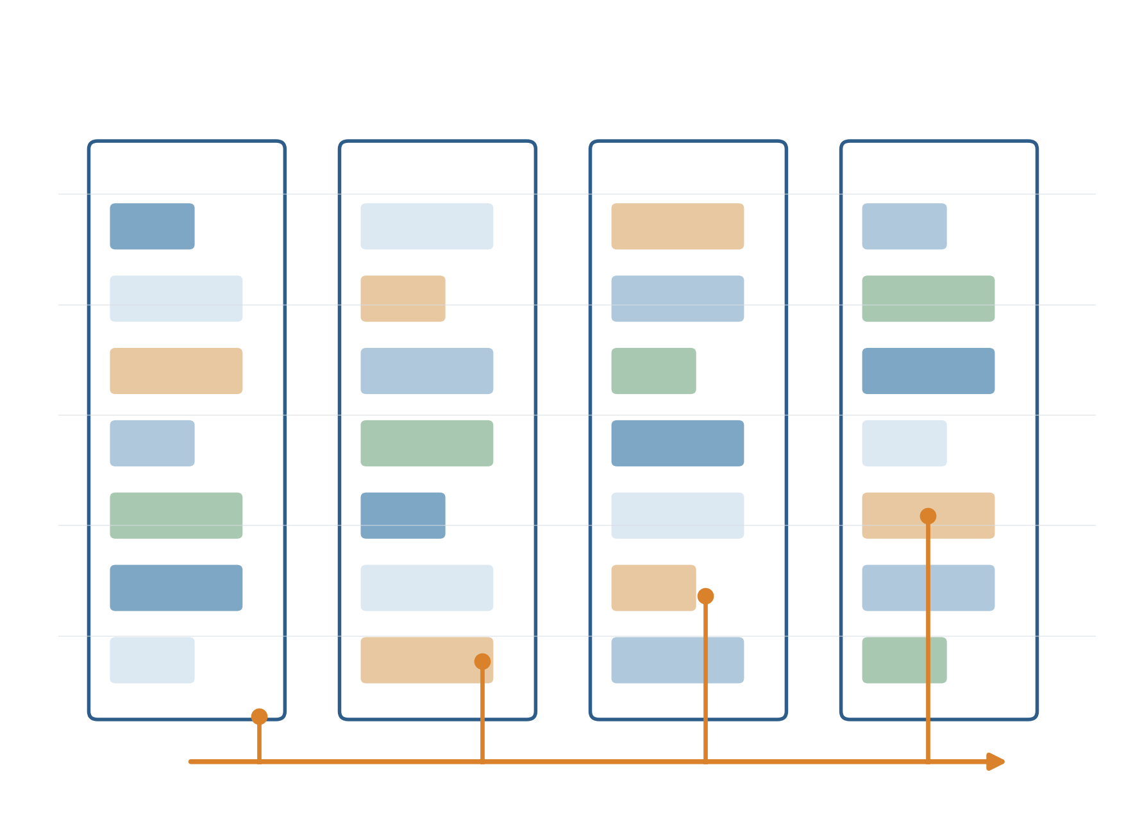
Revisiting Lifetime-Aware
VM Allocation
Prediction Sensitivity and Host-Level
Confidence-Aware Scheduling
From reproduction → negative result → mechanism-driven improvement
MLSys 2025 reproduction
20 paired test seeds
95% confidence intervals
Course Project Author
Frozen artifact: 377cbb1

Slide 2
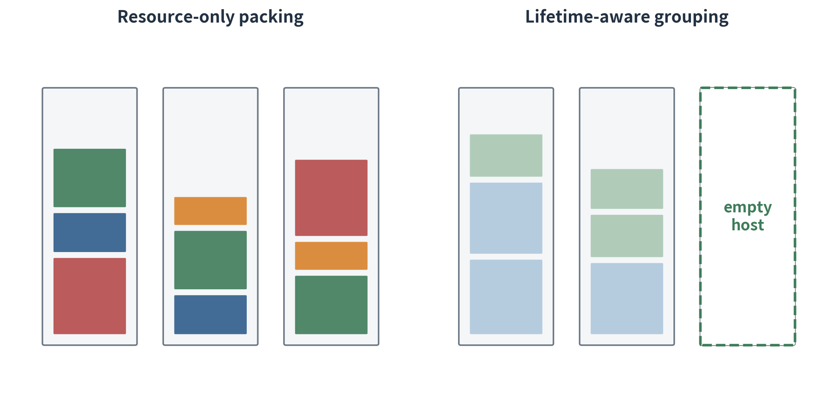
02
The problem: packing today can fragment tomorrow
Multidimensional fragmentation
CPU and memory can remain individually free but unusable together.
Time is the hidden dimension
VMs that fit equally well may exit hours—or months—apart.
Operational consequence
Fewer empty hosts means lower obtainability, less maintenance flexibility, and weaker energy opportunities.
Research objective: maximize time-weighted empty-host percentage without rejecting VMs.
LAVA reproduction · commit 377cbb1
2

Slide 3
03
What LAVA adds to conventional bin packing
1 · Distributional prediction
2 · Re-prediction
3 · Host lifecycle state
4 · Temporal placement
Predict remaining-lifetime distributions rather than a single permanent label.
Condition on uptime so initially unpredictable long-lived VMs can be corrected later.
Hosts move from empty → open → recycling and adapt their lifetime class.
Prefer placements that allow host cohorts to exit together.
empty
first VM
open
≥90% CPU or memory
recycling
Adaptation to mistakes
Residual cohorts lower the host class when they depart; missed deadlines raise it when VMs outlive their prediction.
LAVA reproduction · commit 377cbb1
3

Slide 4
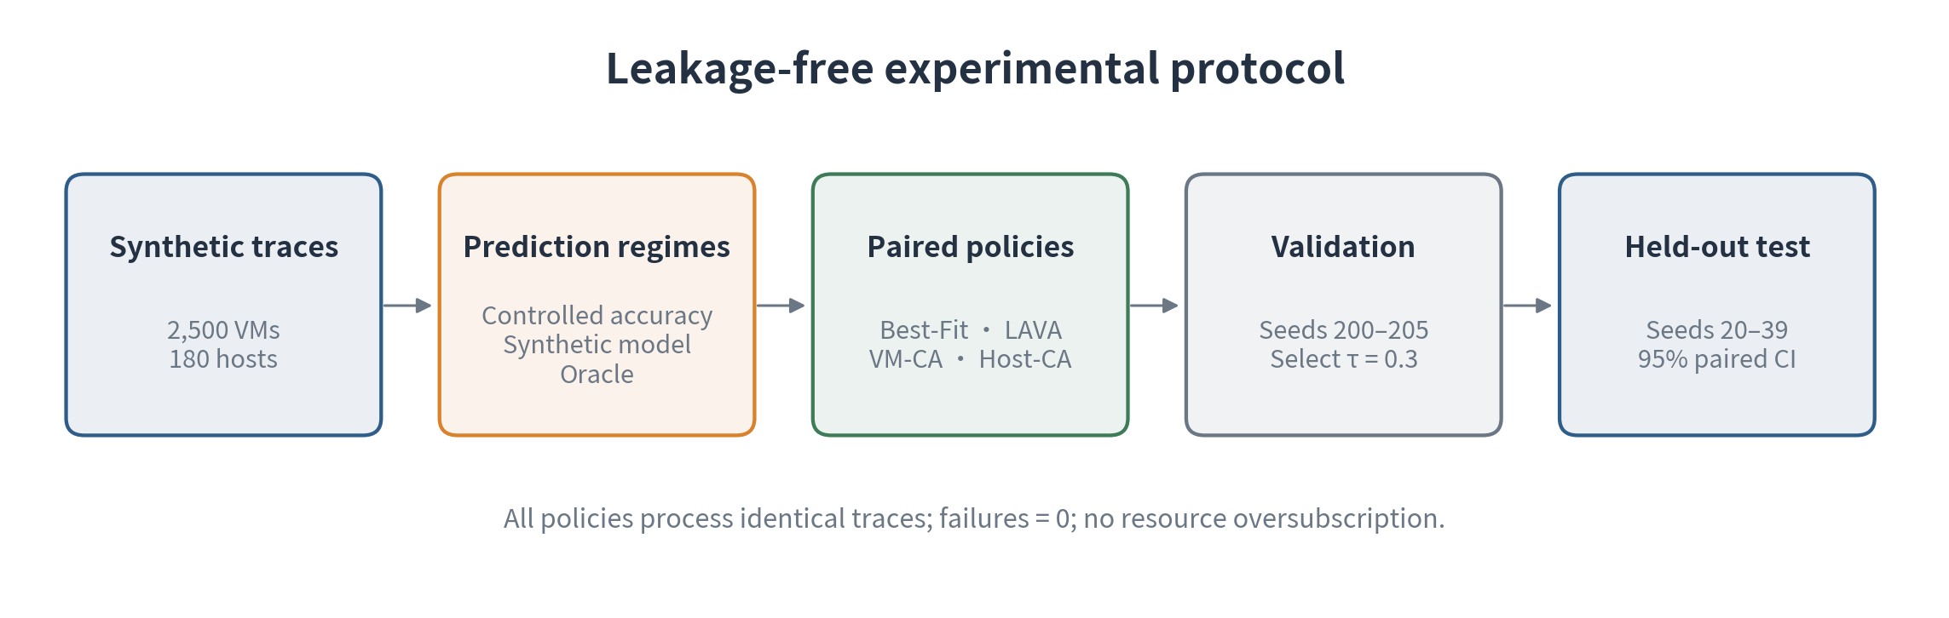
04
What this project reproduces—and what it does not
Reproduced
Not reproducible
Claim boundary
Public algorithms, two-dimensional constraints, re-prediction, host states, controlled noise, paired statistics.
Borg source, Google production traces, private features, hierarchical scores, rollout and warm-up behavior.
Mechanistic reproduction and comparative synthetic evidence—not numerical replication of Google results.
LAVA reproduction · commit 377cbb1
4

Slide 5
05
Methods compared
Best-Fit
LA-Binary
NILAS
Resource-only baseline
Minimize residual CPU/memory
One-shot short/long label
Then Best-Fit
Re-predicted temporal cost
Then Best-Fit
LAVA
VM-Level CA
Host-Level CA
Lifetime classes + host states
Adapt to outliving VMs
Per-arrival LAVA / Best-Fit switch
Negative result
Stable mode per non-empty host
Final improvement
LAVA reproduction · commit 377cbb1
5

Slide 6
06
Prediction quality is experimentally controlled
Correct bucket
0%
25%
50%
75%
100%
Log10-domain Gaussian error
σ = 0.001
Default synthetic predictor
Incorrect bucket
Profile-specific two-exponential mixtures estimate E[T−u | T>u] and the probability mass inside the predicted lifetime class.
Log10-domain Gaussian error
σ = 3
Strict Oracle
Statistical protocol
No information leakage
Uses realized remaining lifetime to measure algorithmic headroom.
20 paired seeds · identical traces · two-sided Student-t 95% CI.
Scheduler sees only the noisy prediction and calibration model—not realized lifetime or hidden bucket.
LAVA reproduction · commit 377cbb1
6

Slide 7
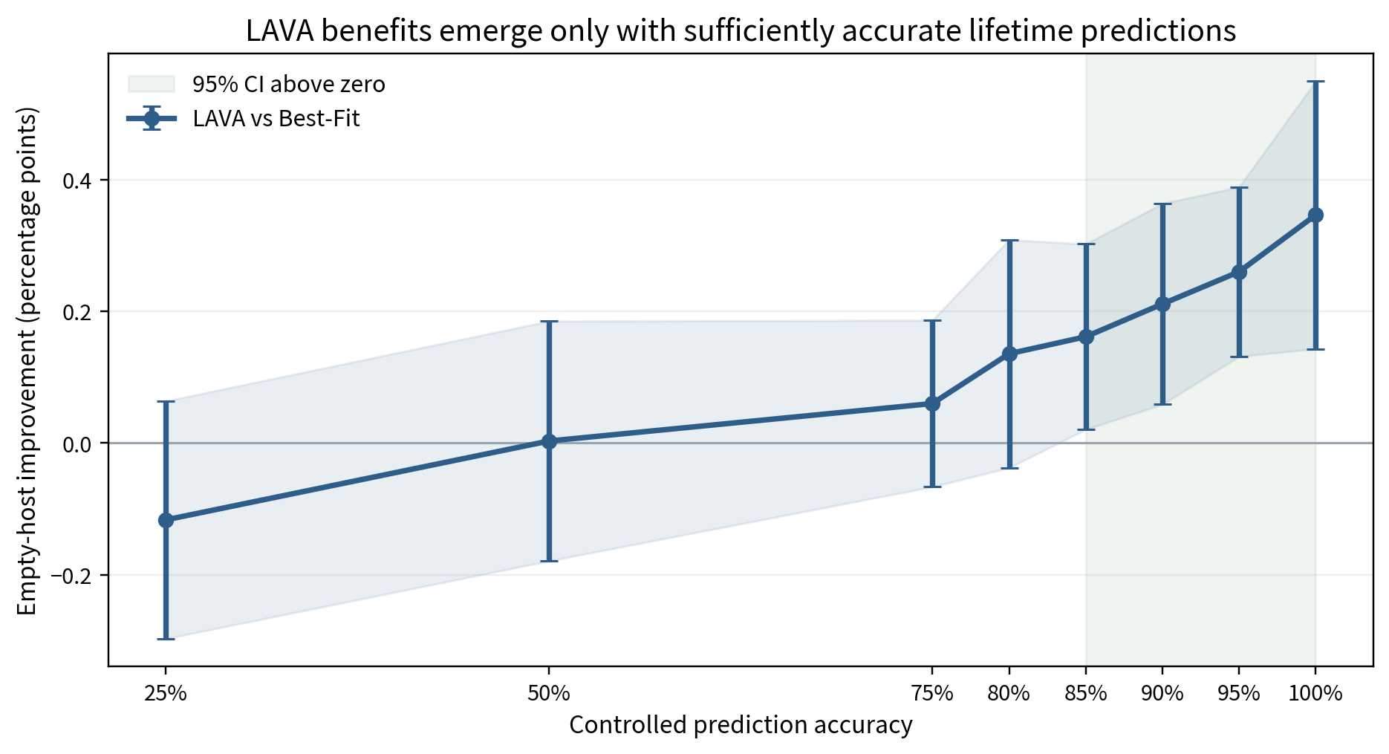
07
RQ1 · LAVA requires sufficiently accurate predictions
First significant point
85% accuracy
+0.161 pp [0.021, 0.302]
Default model
−0.026 pp
CI crosses zero
Oracle headroom
+0.721 pp
[0.548, 0.894]
Prediction quality is not a model-only metric; it changes the scheduler's conclusion.
LAVA reproduction · commit 377cbb1
7

Slide 8
08
The accuracy sweep creates the innovation motive
−0.026 pp
+0.721 pp
85%
Default synthetic model
Strict Oracle
First significant controlled level
Observation
Hypothesis
Constraint
Accurate lifetime information can help, but the default predictor does not realize that potential.
Use prediction confidence to decide when lifetime-aware placement is trustworthy.
Confidence cannot use realized future lifetime or the injected correct/incorrect label.
Next question: where should the policy switch live—at the VM or the host?
LAVA reproduction · commit 377cbb1
8

Slide 9
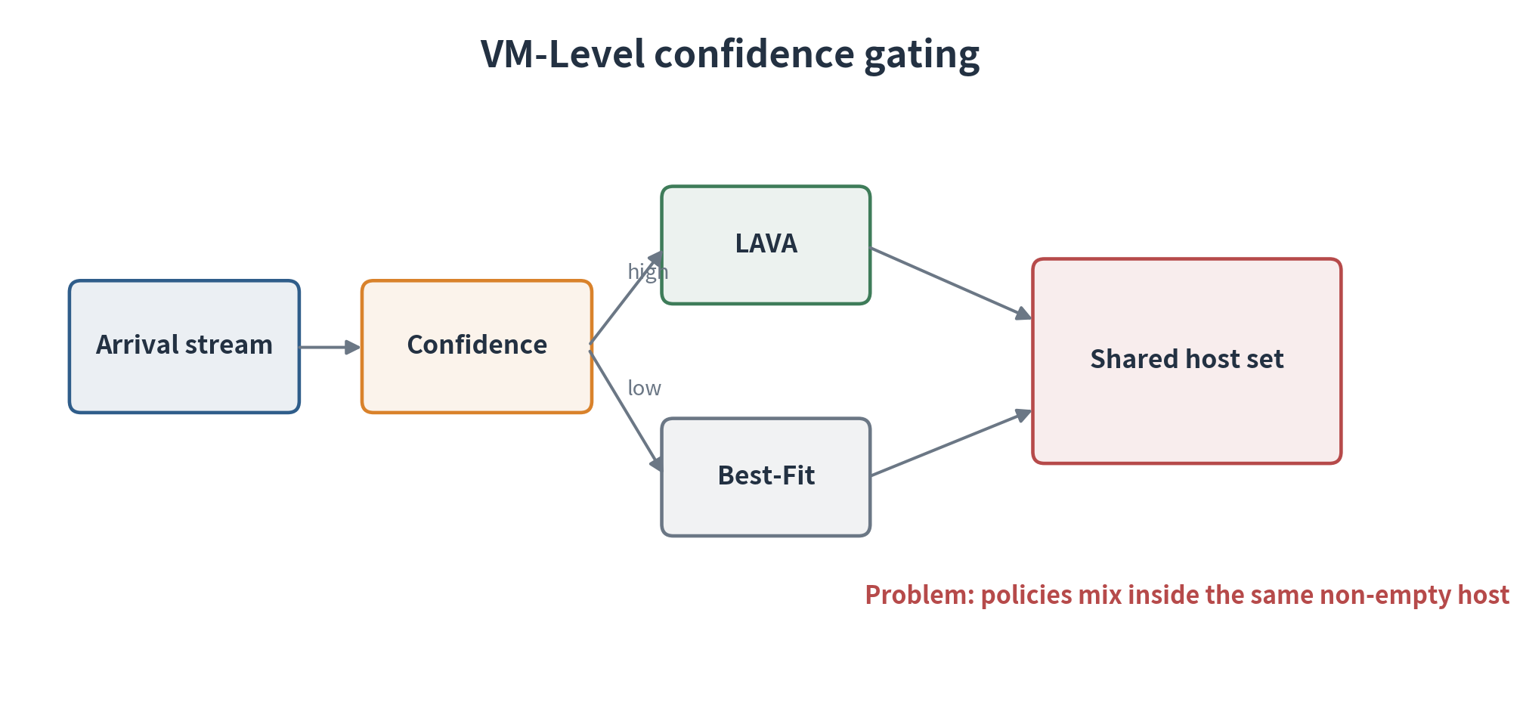
09
Attempt 1 · VM-Level Confidence-Aware LAVA
Decision rule
High confidence → LAVA
Low confidence → Best-Fit
Held-out result
No significant improvement over LAVA. High-quality groups simply pass every VM.
Why keep the negative result?
It reveals that per-request confidence gating is incompatible with stateful host lifecycle management.
LAVA reproduction · commit 377cbb1
9

Slide 10
10
Failure diagnosis · the policy switch contaminates host state
252.58
552.85
235.55
0
switches per 1,000 VMs
Best-Fit → LAVA host
LAVA → baseline host
scheduling failures
Mechanism
New hypothesis
LAVA assumes hosts represent lifetime cohorts. A low-confidence Best-Fit decision can inject an incompatible VM; later high-confidence decisions cannot undo that history.
Keep confidence decisions, but isolate their effects: once a host enters baseline or lifetime-aware mode, retain that mode until the host becomes empty.
The redesign follows measured failure evidence—not a search for favorable parameters.
LAVA reproduction · commit 377cbb1
10

Slide 11
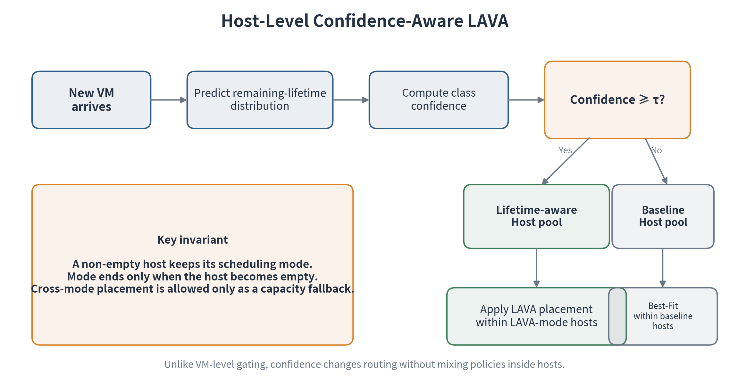
11
Attempt 2 · Host-Level Confidence-Aware LAVA
Stable host mode
A non-empty host does not switch between lifetime-aware and baseline scheduling.
Natural reset point
Mode ends only when the host becomes empty—the same boundary used by LAVA state.
Admission fairness
Cross-mode placement remains a capacity fallback, so the algorithm does not reject extra VMs.
LAVA reproduction · commit 377cbb1
11

Slide 12
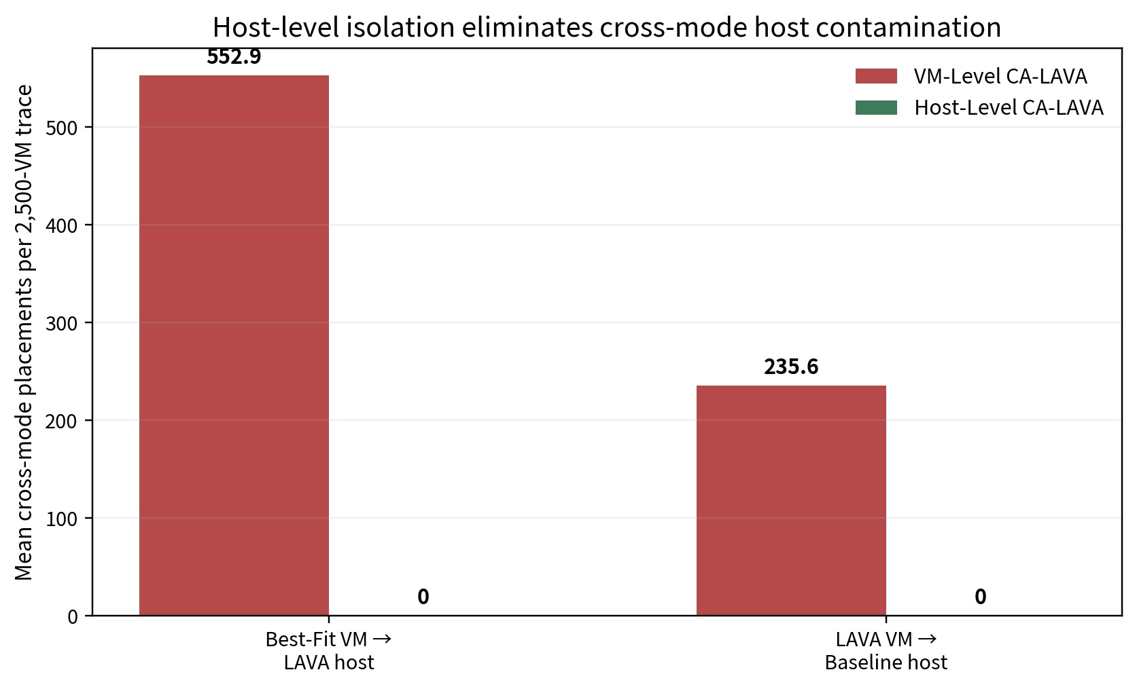
12
Host isolation removes the measured failure mechanism
Same confidence sequence
Both algorithms see 252.58 gate changes per 1,000 VMs.
Only routing changes
VM-Level mixes policies inside hosts; Host-Level isolates modes.
Controlled mechanism test
Cross-mode placements fall from hundreds per trace to zero.
LAVA reproduction · commit 377cbb1
12

Slide 13
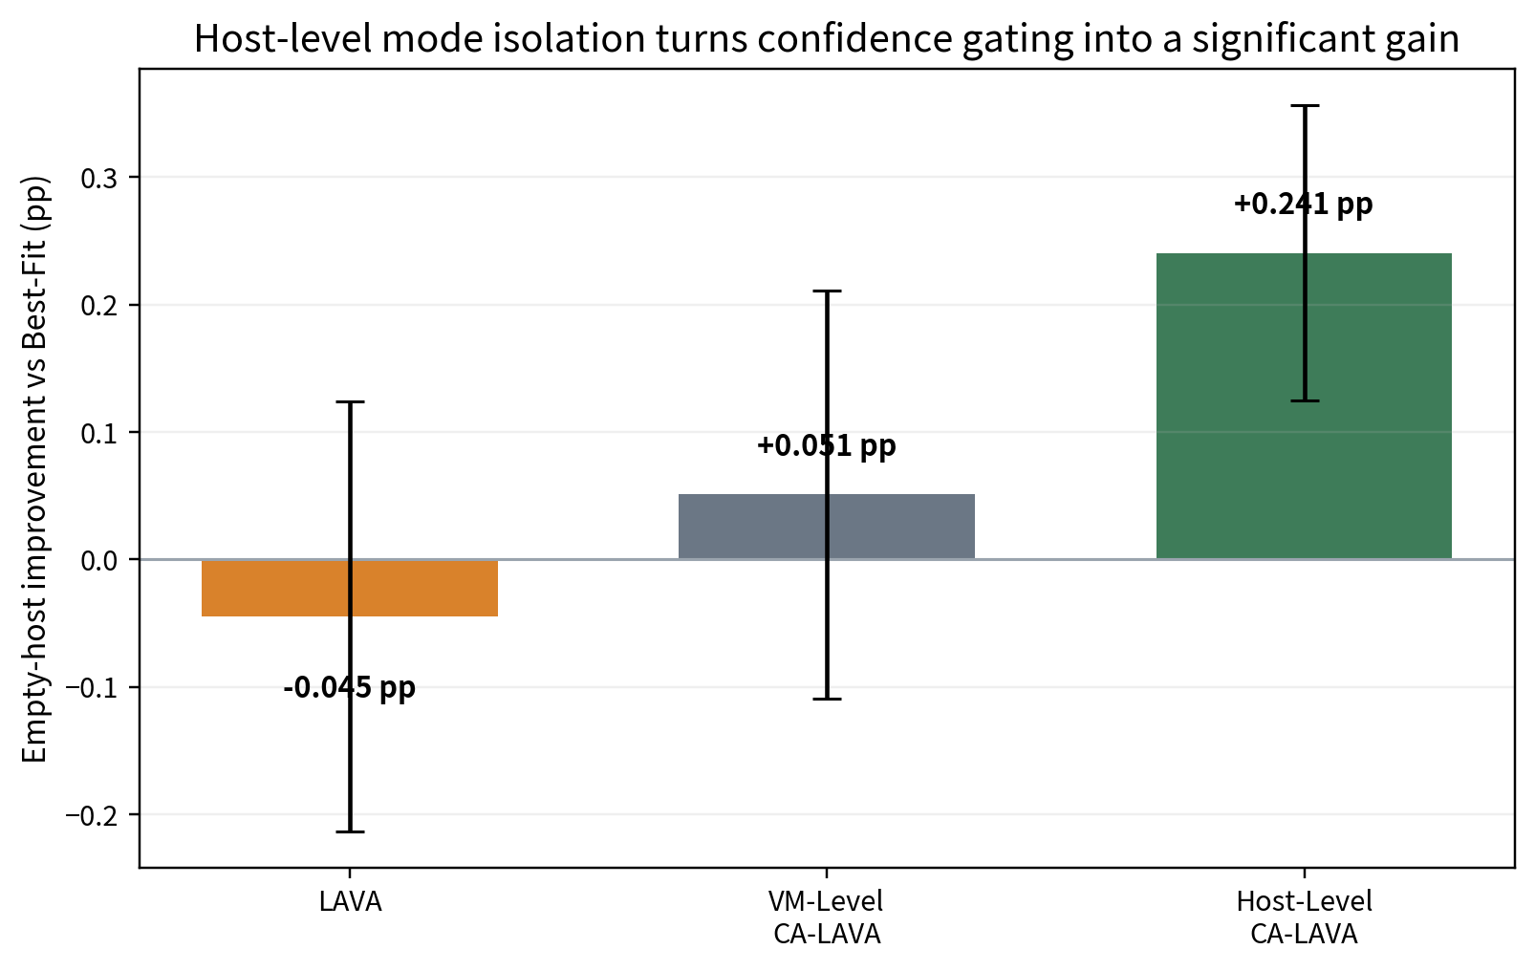
13
Final held-out result · significant improvement
vs Best-Fit
+0.241 pp
95% CI [0.125, 0.357]
vs original LAVA
+0.285 pp
95% CI [0.112, 0.459]
vs VM-Level CA-LAVA
+0.190 pp
95% CI [0.004, 0.375]
New test seeds 20–39 · threshold fixed on validation seeds 200–205
LAVA reproduction · commit 377cbb1
13

Slide 14
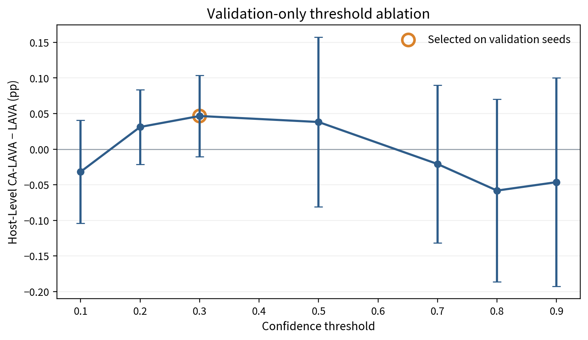
14
Ablation, controls, and limitations
Validation only
Fair admission
τ = 0.3 selected before final test.
0 failures; equal accepted VMs; no oversubscription.
Preserved gains
Main limitation
Host-Level equals LAVA at 50%+ and Oracle.
Synthetic traces and only three predictor profiles.
Claim boundary
Mechanistic synthetic evidence—not a numerical reproduction of Google's production deployment.
LAVA reproduction · commit 377cbb1
14

Slide 15
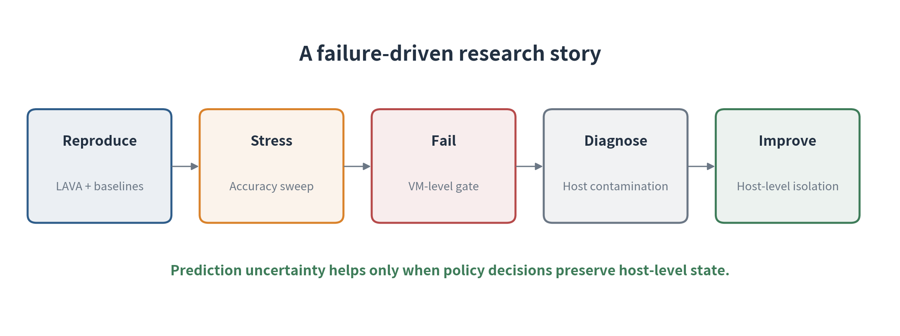
15
Takeaways
1 · Prediction quality matters
85% is the first tested significant LAVA point; Oracle reveals larger headroom.
2 · Uncertainty alone is insufficient
VM-level confidence gating does not significantly improve LAVA.
3 · Match policy to state granularity
Host-level isolation turns the same confidence sequence into a significant gain.
Prediction uncertainty becomes actionable only when the control policy preserves host-level state.
LAVA reproduction · commit 377cbb1
15

