Slide 1
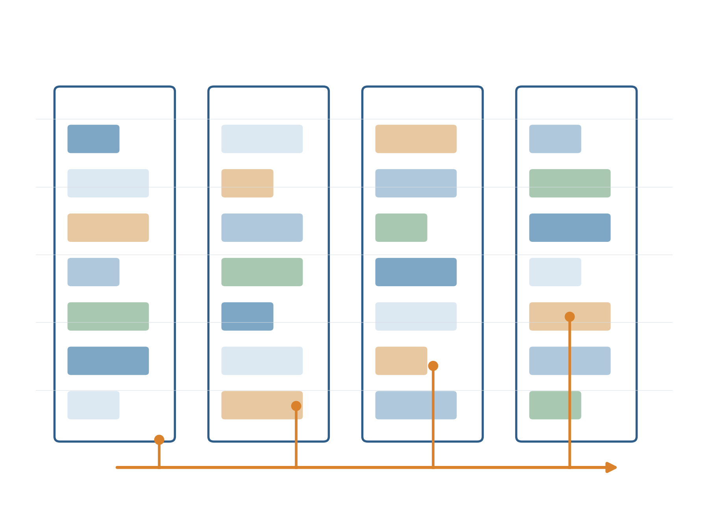
Revisiting Lifetime-Aware
VM Allocation
Does better prediction make
better VM placement?
Part 1 The original method
Part 2 Reproduction
Part 3 Improvement
CE7490 Course Project · 26S1 Group 5
Zhang Qi (G2510784F)
qi015@e.ntu.edu.sg
Zhang Saining (G2511061H)
Based on LAVA (MLSys 2025)
Reproduction first, then improvement
saining002@e.ntu.edu.sg
Zheng Yitao (G2608664B)
YZHENG056@e.ntu.edu.sg
Notes:
三部分为原方法、复现、改进。重点在原方法的可执行重建、实验验证、结果对照与复现差异，最后用复现发现的问题引出预测器改进。
Sources:
Report v8; lava_reproduction/REPRODUCTION_DIFFERENCES.md; frozen results in lava_reproduction/results/.
https://github.com/xxxmian/CE7490-P2_Revisiting_LAVA

Slide 2
PART 1 THE ORIGINAL METHOD
VM placement uses both capacity and time
A placement must fit CPU and memory. Departures determine when a whole host becomes empty.
VM: a virtual computer
Host: a physical server running several VMs
A request fits only when BOTH resources are available.
Even one remaining VM prevents the host from becoming completely empty.
Capacity example: CPU has room, memory is full.
Our metric measures time with empty hosts. It does not directly measure electricity savings.
CE7490 · 26S1 Group 5
2 / 15
Notes:
先讲两个维度：空间上同时满足CPU与内存，时间上要等最后一个VM退出才能清空整台主机。右图是容量示例，非生产测量。为什么不是看CPU空闲百分比？因为维护、承载大请求等目标需要整台主机可用；本实验只测空主机时间，未直接测电力。
Sources:
Report v8; lava_reproduction/REPRODUCTION_DIFFERENCES.md; frozen results in lava_reproduction/results/.
https://github.com/xxxmian/CE7490-P2_Revisiting_LAVA

Slide 3
PART 1 THE ORIGINAL METHOD
Best-Fit chooses the tightest feasible host
Best-Fit is the baseline: use the current resource space to select a feasible placement.
1 Check CPU and memory limits
2 Prefer less unused space after placement
Example VM: 25% CPU and 12.5% memory. All feasible candidates have enough memory.
Best-Fit uses current space. LAVA additionally uses expected departure times.
CE7490 · 26S1 Group 5
3 / 15
Notes:
图中A有3个、B有1个、C有4个相同形状VM。加入新VM后，A的CPU刚好满，B仍留较多空间，C的CPU无法容纳。实际分数最小化CPU剩余平方与内存剩余平方之和；这里只用明确的资源条件说明规则。时间维度留给下一页。
Sources:
Report v8; lava_reproduction/REPRODUCTION_DIFFERENCES.md; frozen results in lava_reproduction/results/.
https://github.com/xxxmian/CE7490-P2_Revisiting_LAVA

Slide 4
PART 1 THE ORIGINAL METHOD
LAVA adds expected departure times
The same VMs can occupy hosts for different lengths of time, depending on how they are grouped.
Four simultaneous arrivals: two run for 1 h, two for 10 h. Each host fits two VMs.
Arrangement | Host A | Host B
Mixed | 1 h + 10 h | 1 h + 10 h
Similar exits | 1 h + 1 h | 10 h + 10 h
After 1 hour: grouping similar departures frees one whole host.
This illustrates the intuition. Full LAVA also updates predictions and adapts host lifecycle states.
CE7490 · 26S1 Group 5
4 / 15
Notes:
这是明确条件下的定量例子，而不是完整LAVA伪代码。混放两台都会被长VM拖住；按离开时间配对，短VM主机1小时后清空。真实LAVA还会把更短VM填进较长生命周期主机，并根据open/recycling状态、剩余cohort和重预测选择放置。
Sources:
Report v8; lava_reproduction/REPRODUCTION_DIFFERENCES.md; frozen results in lava_reproduction/results/.
https://github.com/xxxmian/CE7490-P2_Revisiting_LAVA

Slide 5
PART 1 THE ORIGINAL METHOD
Prediction errors can reverse the benefit
An unexpectedly long VM can keep a host busy after the other VMs leave.
Illustrative prediction error
A VM looks short, so the scheduler expects its host to empty soon.
If it runs much longer, that planned departure alignment breaks.
LAVA adapts to mispredictions. We test how much the initial prediction quality still matters.
CE7490 · 26S1 Group 5
5 / 15
Notes:
1小时预测、100小时实际只是解释机制的例子。不能据此说LAVA完全不会修正，原论文已包含自适应；我们实际问这种自适应在不同预测质量下能保护多少。下一部分用相同输入的配对实验回答。
Sources:
Report v8; lava_reproduction/REPRODUCTION_DIFFERENCES.md; frozen results in lava_reproduction/results/.
https://github.com/xxxmian/CE7490-P2_Revisiting_LAVA

Slide 6
PART 2 REPRODUCTION
What we could reconstruct
We rebuild the published mechanisms and the available course setup, then test their behavior.
Available evidence | What we implement | What remains an assumption
LAVA paper + course artifacts | Six placement policies; host lifecycle; prediction updates | Exact original code and production traces unavailable
Course experiment settings | 180 hosts; 2,500 VMs; 8 arrivals/h | Poisson arrivals; profile proportions; resource shapes
Prediction model description | Three VM profiles; controlled prediction errors | Missing mixture parameters and some update rules
This is a synthetic mechanism reconstruction, not an exact replay of the original experiments.
CE7490 · 26S1 Group 5
6 / 15
Notes:
复现先说明证据与边界。六策略为Best-Fit、LA-Binary、NILAS、LAVA、VM-CA、Host-CA。公开论文用于补足生命周期和类别规则，课程材料提供规模、指标与部分设置；未知参数固定为声明的合成假设，没有搜索参数追平旧结果。原生产trace、原源码和课程原始逐种子样本均不可用。
Sources:
Report v8; lava_reproduction/REPRODUCTION_DIFFERENCES.md; frozen results in lava_reproduction/results/.
https://github.com/xxxmian/CE7490-P2_Revisiting_LAVA

Slide 7
PART 2 REPRODUCTION
LAVA improves as prediction quality rises
Fresh-seed comparison: LAVA minus Best-Fit on the same 100 workloads.
Accuracy = probability of a near-correct estimate in this controlled test.
25% accuracy
−0.187 pp
95% CI [−0.240, −0.135]
100% accuracy
+0.507 pp
95% CI [+0.445, +0.569]
Poor estimates can make lifetime-aware placement worse. This motivates a way to handle unreliable predictions.
CE7490 · 26S1 Group 5
7 / 15
Notes:
accuracy是进入近准确噪声分量的概率，不是短长分类正确率。正确桶log10误差σ=.001，错误桶σ=3，预测在336小时截尾。图显示平均差值，右侧补充两个端点的区间。75%后的正区间是此合成工作负载上的结果，不是通用门槛。Oracle是全信息参照，不是所有变体的理论上界。
Sources:
Report v8; lava_reproduction/REPRODUCTION_DIFFERENCES.md; frozen results in lava_reproduction/results/.
https://github.com/xxxmian/CE7490-P2_Revisiting_LAVA

Slide 8
PART 2 REPRODUCTION
Reproducing confidence-aware routing
Alongside LAVA, we rebuild two course-project extensions that route uncertain arrivals to Best-Fit.
Confidence = probability of the lifetime class containing the estimate. Threshold: 0.3.
Mechanism | VM-level CA | Host-level CA
Decision | Choose LAVA or Best-Fit for each arrival | Choose a LAVA or Best-Fit host pool
Host sharing | Both decisions use the same hosts | Keep host modes separate until empty
Intended benefit | Avoid trusting a weak prediction | Also avoid interference between the modes
A high probability for a lifetime class need not imply that choosing LAVA will improve packing.
CE7490 · 26S1 Group 5
8 / 15
Notes:
CA是confidence-aware。概率超过阈值则走LAVA，否则Best-Fit。Host-CA仅在无同模式主机与空主机可放时跨池回退，实验中未发生。这里要区分概率事件正确与下游决策有价值，两者不是同一个问题。
Sources:
Report v8; lava_reproduction/REPRODUCTION_DIFFERENCES.md; frozen results in lava_reproduction/results/.
https://github.com/xxxmian/CE7490-P2_Revisiting_LAVA

Slide 9
PART 2 REPRODUCTION
Reproduction experiment and implementation checks
The same workload and noisy observations are replayed for every policy in a paired comparison.
Check | Implementation | Why it matters
Workload and metric | 180 hosts, CPU + memory; empty-host-time % | Same requests; no capacity oversubscription
Independent seed groups | Initial 0–19; validation 200–205; heldout 20–39 | Select settings without tuning to heldout outcomes
Original reconstruction audit | 1,644 runs; 16 independent tests passed | All VMs admitted; no resource-limit violations
Information boundary | Scheduler cannot read true lifetime | Only the Oracle control gets future information
Differences are percentage points (pp), with paired 95% intervals across workloads.
CE7490 · 26S1 Group 5
9 / 15
Notes:
1,644=36 smoke+168 validation+600 sweep+840 heldout；16是原复现阶段独立测试，不是后来完整项目测试总数。指标从首次到达到最后退出，包含排空尾段。测试含同刻先退出、容量、时间积分、主机隔离、确定性和预测无未来信息；通过不代表原算法逐行等价。新验证阈值0.5，heldout仍按历史冻结0.3，不为追平结果改设置。Sources: results/{smoke,validation,sweep,heldout}/manifest.json; REPRODUCTION_DIFFERENCES.md.
Sources:
Report v8; lava_reproduction/REPRODUCTION_DIFFERENCES.md; frozen results in lava_reproduction/results/.
https://github.com/xxxmian/CE7490-P2_Revisiting_LAVA

Slide 10
PART 2 REPRODUCTION
Which findings reproduced, and which did not?
Compare the historical course report with our heldout reconstruction: 20 paired workloads per setting.
Setting / policy vs Best-Fit | Historical course report | Our reconstruction [95% CI]
25% accuracy / LAVA | −0.005 pp | −0.137 [−0.247, −0.026] pp
85% accuracy / LAVA | +0.200 pp | +0.399 [+0.281, +0.517] pp
Perfect information / LAVA | +0.584 pp | +0.661 [+0.549, +0.774] pp
Default predictor / Host-CA | +0.241 pp | −0.045 [−0.138, +0.049] pp
The accuracy trend is similar; the reported Host-CA advantage does not reproduce here.
Historical course numbers are not the original paper’s production measurements.
CE7490 · 26S1 Group 5
10 / 15
Notes:
此处只用seeds20–39，与第7页后续100种子结果分开。历史各行95%CI依次为[-.131,+.122]、[+.040,+.359]、[+.463,+.705]、[+.125,+.357]。缺失workload参数、原trace和更新细节可解释差异，但没有因果归因实验，不能认定某个参数就是原因，也不能说原论文被证伪。Sources: reference/report_table1.csv; results/heldout/summary.json; REPRODUCTION_DIFFERENCES.md.
Sources:
Report v8; lava_reproduction/REPRODUCTION_DIFFERENCES.md; frozen results in lava_reproduction/results/.
https://github.com/xxxmian/CE7490-P2_Revisiting_LAVA

Slide 11
PART 2 REPRODUCTION
Diagnosing the unreproduced Host-CA benefit
We check whether the isolation mechanism failed, before interpreting its performance.
Heldout default predictor | VM-level CA | Host-level CA
Gate changes per 1,000 arrivals | 318.640 | 318.640
Best-Fit decisions into LAVA hosts / trace | 607.750 | 0
LAVA decisions into Best-Fit hosts / trace | 319.400 | 0
Capacity fallback / trace | 0 | 0
Isolation works as designed, yet its packing benefit is not confirmed.
That motivates the next step: improve the lifetime estimate itself, rather than rely only on routing.
CE7490 · 26S1 Group 5
11 / 15
Notes:
同组heldout20–39默认预测模型。Host-CA模式隔离把跨模式放置降到0，未发生回退，说明不是简单实现漏掉隔离。不能据此证明隔离必然无效，也不能将类别置信度直接当作调度收益概率。完整项目的后续诊断还发现受控噪声下门控几乎总通过；不将不同预测设置混淆。Sources: results/heldout/summary.json; REPRODUCTION_DIFFERENCES.md default-model diagnostics.
Sources:
Report v8; lava_reproduction/REPRODUCTION_DIFFERENCES.md; frozen results in lava_reproduction/results/.
https://github.com/xxxmian/CE7490-P2_Revisiting_LAVA

Slide 12
PART 3 IMPROVEMENT
Improvement: combine the prediction with a prior
Prior = the usual lifetime pattern for this kind of VM. Fusion combines it with a new estimate.
The prior asks: how plausible is this observation for this kind of VM?
Example | Prior mean | Noisy estimate | Fused estimate
Interactive VM 25% accuracy | 1.07 h | 300 h | 1.52 h
Service VM 50% accuracy | 85.2 h | 2 h | 27.0 h
An implausible observation gets less weight. A plausible observation can still update the prior.
We change the predictor while preserving the placement code.
CE7490 · 26S1 Group 5
12 / 15
Notes:
融合不是简单取平均或把所有预测缩短。它用profile分布和已知噪声模型，给每个可能总寿命按观测似然加权；再据uptime条件化。上面两个数字由原build_report.predict_pair直接计算。先验是生成分布，属于重要强假设，后面做误设敏感性。
Sources:
Report v8; lava_reproduction/REPRODUCTION_DIFFERENCES.md; frozen results in lava_reproduction/results/.
https://github.com/xxxmian/CE7490-P2_Revisiting_LAVA

Slide 13
PART 3 IMPROVEMENT
Improvement results on 100 fresh workloads
Registered VM-CA-Bayes combines fusion with VM-level routing. Paired gains in pp, n = 100.
Accuracy | Gain over LAVA [95% CI] | Gain over Best-Fit [95% CI]
25% | +0.224 [+0.174, +0.275] Confirmed | +0.037 [-0.012, +0.086] Not confirmed
50% | +0.147 [+0.088, +0.205] Confirmed | +0.122 [+0.064, +0.180] Confirmed
75% | +0.054 [-0.001, +0.109] Not confirmed | +0.272 [+0.217, +0.327] Confirmed
85% | +0.088 [+0.037, +0.139] Confirmed | +0.398 [+0.338, +0.457] Confirmed
75% versus LAVA remains unconfirmed (Holm p = 0.11).
25% versus Best-Fit also remains unconfirmed. Intervals are unadjusted, decisions use Holm correction across 8 tests.
CE7490 · 26S1 Group 5
13 / 15
Notes:
四个预注册准确率对LAVA为3/4，对Best-Fit也为3/4，共6/8。75%对LAVA+.054[−.001,+.109]、Holm p≈.11；25%对BF+.037[−.012,+.086]、Holm p≈.14。75%和85%的原LAVA已优于BF，因此融合特有证据须看对LAVA比较和50%对BF。不要把正均值都说成显著改善。
Sources:
Report v8; lava_reproduction/REPRODUCTION_DIFFERENCES.md; frozen results in lava_reproduction/results/.
https://github.com/xxxmian/CE7490-P2_Revisiting_LAVA

Slide 14
PART 3 IMPROVEMENT
A useful predictor still depends on its assumptions
Robustness changes one assumption at a time, using 50 fresh workloads per setting.
Change | Observed result | Interpretation
Milder incorrect predictions | Only 1–2 of 4 intervals above zero | Smaller errors are harder to distinguish
Prior lifetimes × 0.5 | At 85%: −0.116 [−0.197, −0.034] pp vs LAVA | Underestimating long lifetimes can hurt
Prior lifetimes × 2 | All four gains over LAVA have positive intervals | The direction of prior error matters
Twice the arrivals and requests | Gains over LAVA at 25–75%, 85% uncertain | Load changes the size of the benefit
The failing prior case is still +0.191 pp above Best-Fit. These robustness tests are exploratory and unadjusted.
CE7490 · 26S1 Group 5
14 / 15
Notes:
σ从3减到1或.5时，收益变小，不能说无论噪声如何都有效。先验均值×.5、85%时是32个vs-LAVA单元格中唯一完全负的区间，未校正p=.006；同格对BF仍+.191[+.111,+.272]。负载增加是16VM/h和5000VM、主机数仍180。不能把90主机纯分母缩放当负载测试。
Sources:
Report v8; lava_reproduction/REPRODUCTION_DIFFERENCES.md; frozen results in lava_reproduction/results/.
https://github.com/xxxmian/CE7490-P2_Revisiting_LAVA

Slide 15
PART 3 IMPROVEMENT
Reproduction findings and the improvement boundary
Rebuild the method, examine the gaps, then test a targeted improvement.
Reproduction
Improvement
LAVA benefits from better predictions.
The historical Host-CA advantage does not reproduce in our synthetic setting.
Checks support the implemented mechanisms, not exact equivalence to missing code.
Prior fusion improves on LAVA in 3 of 4 planned tests.
Known priors and a known error model are strong assumptions.
Next: learn priors from history and test real traces.
Code, frozen settings and per-workload results are available in the project repository.
CE7490 · 26S1 Group 5
15 / 15
Notes:
收束复现为主的作业逻辑：实现与验证→趋势和差异→有针对性的改进。主结论应同时保留成功与失败，不能只报改进正结果。报告不变。融合75%对LAVA未证实，先验误设有失败情形，生产收益尚未验证。
Sources:
Report v8; lava_reproduction/REPRODUCTION_DIFFERENCES.md; frozen results in lava_reproduction/results/.
https://github.com/xxxmian/CE7490-P2_Revisiting_LAVA

