Slide 1

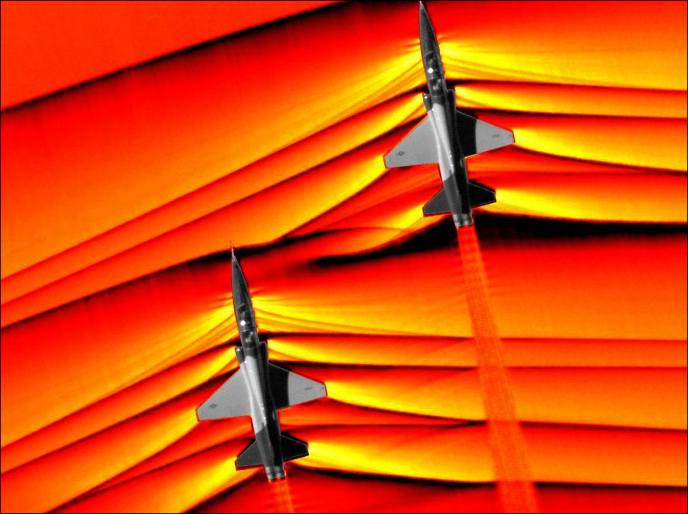
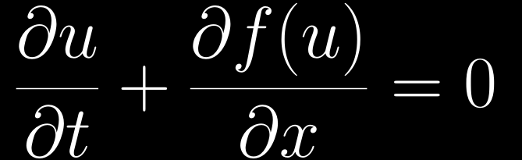
PHYSICS × NUMERICS × LEARNING
Machine Learning for
Shock-Capturing
Numerical Schemes
Learning reconstruction decisions for
1D hyperbolic conservation laws
Capturing sharp fronts
without spurious oscillations
WENO-NN / NN-TENO5 / DIFFERENTIABLE CFD
Yasser Baouzil
Supervisor: Radouan Boukharfane
UM6P · College of Computing

Slide 2
MOTIVATION · RESEARCH QUESTION
Can learned reconstruction improve TENO5?
Research question
Can a small learned correction reduce
solution error relative to TENO5,
while keeping Euler rollouts stable?
What changes?
Candidate decisions and a learned mixing coefficient.
What stays?
The conservative flux update and SSPRK3 solver.
How is it tested?
Sharp fronts require both accuracy and control of oscillations.
Four 1D benchmarks against physical references.
Aim: improve reconstruction inside the solver—not replace the physical equations.
SHOCKS & WENO / YASSER BAOUZIL
02 / 16

Slide 3
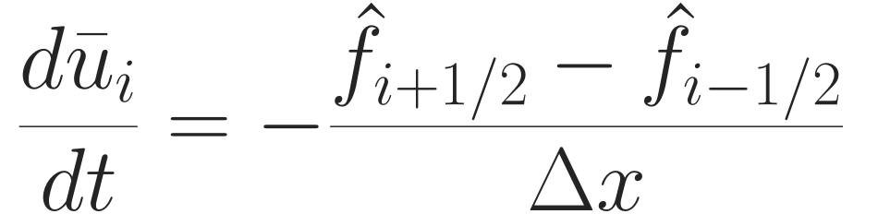
NUMERICAL SOLVER · COMPLETE WORKFLOW
The solver follows a conservative numerical path
Forward numerical path
State +
local stencil
→
Scalar / Euler
setup
→
WENO / TENO
or NN selector
→
Interface
flux
→
SSPRK3
step
→
K-step
rollout
Learned component
Conservation through shared fluxes
Follow the path in order
Set up the physical problem.
Reconstruct the interface flux.
Advance with SSPRK3, then repeat K steps.
Each cell changes by its incoming and outgoing flux.
Detailed slides follow this path: physical setup → reconstruction → fluxes → time stepping.
SHOCKS & WENO / YASSER BAOUZIL
03 / 16

Slide 4
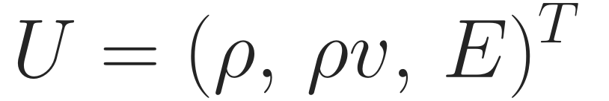
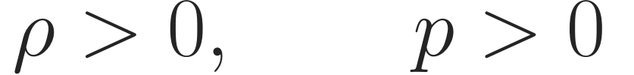
PHYSICAL MODEL · EULER SYSTEM
Euler equations describe compressible flow
The system tracks three conserved quantities throughout the flow.
Density
Momentum
Total energy
How mass is distributed in the flow.
How the motion of the fluid is transported.
Internal and kinetic energy together.
State used by the solver
Physical states must remain valid
ρ: density v: velocity E: total energy
Density and pressure must remain positive.
Sod and Shu–Osher test the learned reconstruction in compressible Euler flows.
SHOCKS & WENO / YASSER BAOUZIL
04 / 16

Slide 5









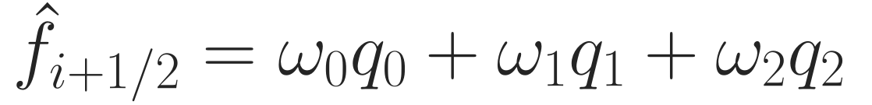
CLASSICAL RECONSTRUCTION
WENO and TENO combine three local reconstructions
Five stencil values → three third-order candidates → one interface flux
ENO selects
WENO weights
TENO discards
Choose the smoothest candidate.
Reduce troubled candidates continuously.
Reject troubled candidates, then reweight.
Keep one reliable candidate.
Smooth region:
spread trust across the candidates.
Near a shock:
reject a candidate crossing the jump.
Combine with local weights.
SHOCKS & WENO / YASSER BAOUZIL
05 / 16

Slide 6



CONTRIBUTION · FINAL NN-TENO5 ARCHITECTURE
The final model learns decisions and their influence
Two reconstruction paths share the same local data; a small head controls their blend.
Local five-point stencil
Only 4 trainable parameters
↓
↓
Classical TENO5
Neural reconstruction
Dedicated mixing head
Baseline reconstruction
Classifier: 5 → 64 → 32 → 16 → 8 → 3
→
Three probabilities → sigmoid → λ
Outputs: p₀, p₁, p₂
↓
↓
↓
↓
Conservative flux update + SSPRK3
SHOCKS & WENO / YASSER BAOUZIL
06 / 16

Slide 7
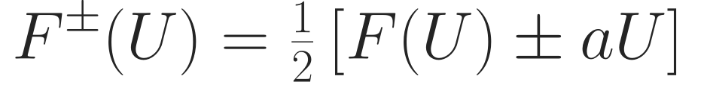
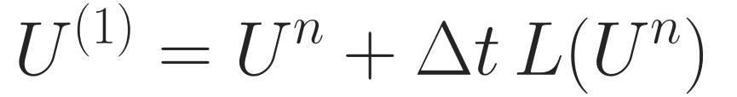
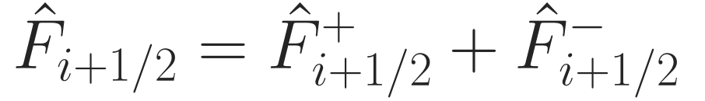
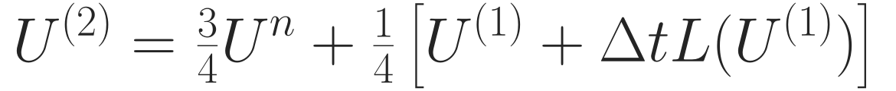
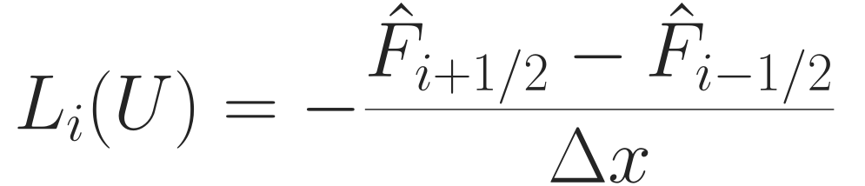
NUMERICAL IMPLEMENTATION · ORDERED SOLVER STEPS
Build the interface flux, then advance with RK3
Flux splitting → WENO / TENO or NN reconstruction → interface flux → SSPRK3 → K-step rollout.
01 Flux splitting and interface flux
02 SSPRK3 · three stages
WENO / TENO or NN reconstructs each split flux.
Recompute reconstruction and fluxes at each stage.
→
L(U): spatial flux balance. a: wave-speed bound. Each RK stage recomputes reconstruction and fluxes.
03 K-step rollout: repeat the complete SSPRK3 update K times.
SHOCKS & WENO / YASSER BAOUZIL
07 / 16

Slide 8
METHOD · FROM IMITATION TO SOLVER-IN-THE-LOOP
Train on the solution after real solver steps
Imitation learns TENO5 labels. Physics training instead optimizes the evolved solution.
Start from a physical state
→
Run K complete SSPRK3 steps
→
Compare with the reference
The training gradient passes through reconstruction, fluxes and every time-integration stage.
The α weights balance the loss terms; λ is reserved for the learned reconstruction mix.
MSE · accuracy
TV · oscillations
BVD · interfaces
Reg · anchoring
Fit the reference
solution after K steps.
Penalize excess variation
relative to the start.
Penalize extra interface
jumps beyond TENO5.
Keep weights close to
the pretrained model.
Euler also adds a positivity penalty, measured before state repair; TV and Reg are normalized.
SHOCKS & WENO / YASSER BAOUZIL
08 / 16

Slide 9
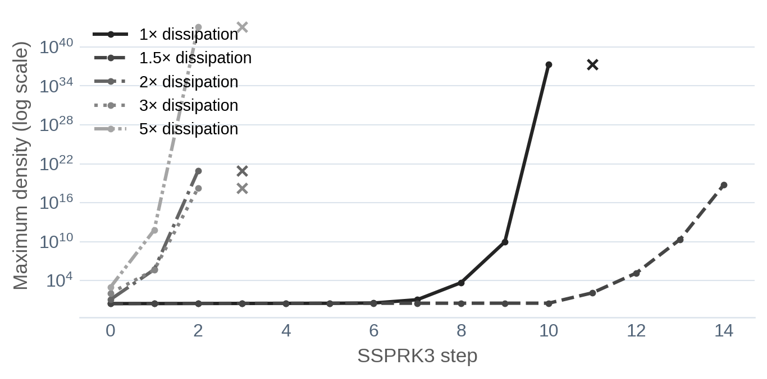
RESEARCH PROGRESSION · DIAGNOSE, THEN REPAIR
Euler instability shaped the training procedure
What failed
What changed
Historical training trace—not the final benchmark runs.
01 Detect the real violation
Penalize invalid states before repair—not afterward.
02 Repair every SSPRK3 stage
Treat isolated violations; guard nonfinite states.
03 Normalize and bound training
Scale TV / Reg terms and clip large gradients.
04 Extend the horizon gradually
Warm-start the Euler curriculum: K = 2 → 4 → 8 → 15.
Invalid density or pressure destabilizes the
Roe characteristic reconstruction.
Stable training enables evaluation; it does not by itself prove better accuracy.
SHOCKS & WENO / YASSER BAOUZIL
09 / 16

Slide 10
METHOD · LESSONS AND SAFEGUARDS
What mixing solved—and what it did not
A small neural correction keeps the final reconstruction close to the classical baseline.
Imitation
→
Physics training
→
Euler repairs
→
Learned mixing
Separate two decisions
Begin close to TENO5
Keep guarantees separate
Classifier: which candidates
to reject.
Mixing head: how much of the
neural reconstruction to use.
The head starts near a
5% neural contribution.
A small scalar blend already
helps; training improves it further.
Convex mixing is not a
positivity or TVD proof.
State repairs are safeguards,
not mathematical guarantees.
Final Sod and Shu–Osher runs remain finite and positive without invoking state repairs.
Sod still has slightly higher error: better mixing alone has not removed the backbone's limit.
SHOCKS & WENO / YASSER BAOUZIL
10 / 16

Slide 11
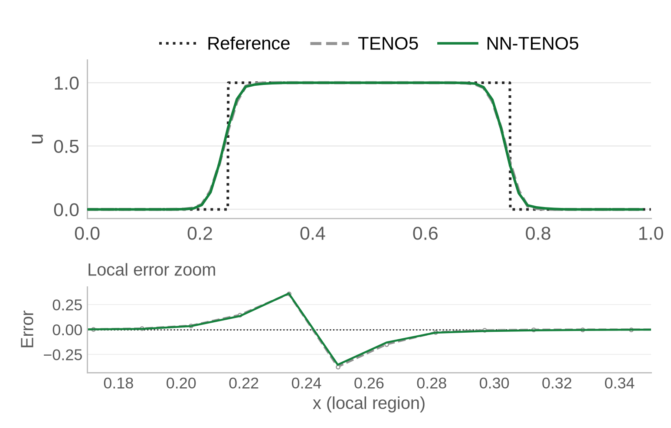
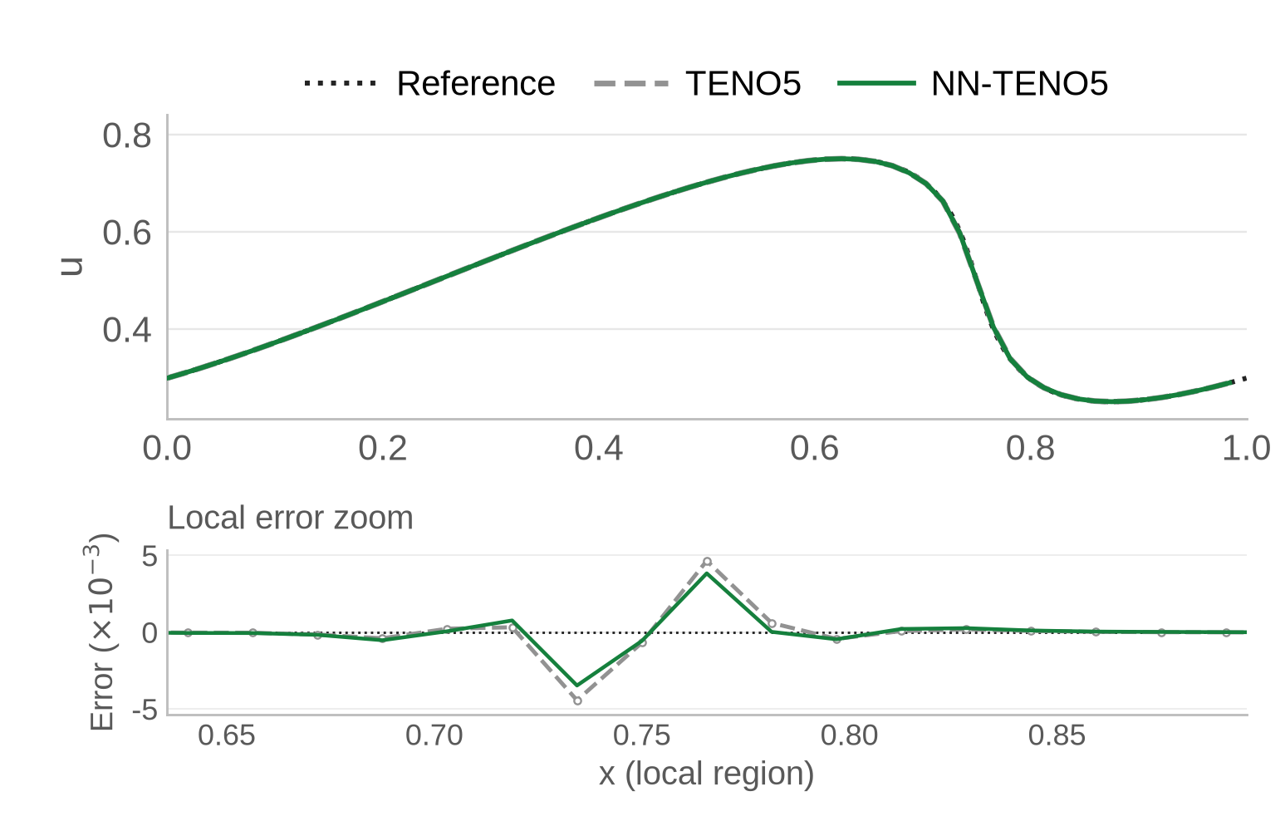
RESULTS · FINAL SCALAR CHECKPOINT
Final scalar models improve both benchmarks
Advection
Burgers
3.5% lower L₂ error
18.6% lower L₂ error
64 cells · CFL 0.5 · t = 1.0 · exact reference
64 cells · CFL 0.5 · t = 0.5 · exact reference
Burgers is evaluated before shock formation. Each lower panel shows a separate local-error zoom.
SHOCKS & WENO / YASSER BAOUZIL
11 / 16

Slide 12
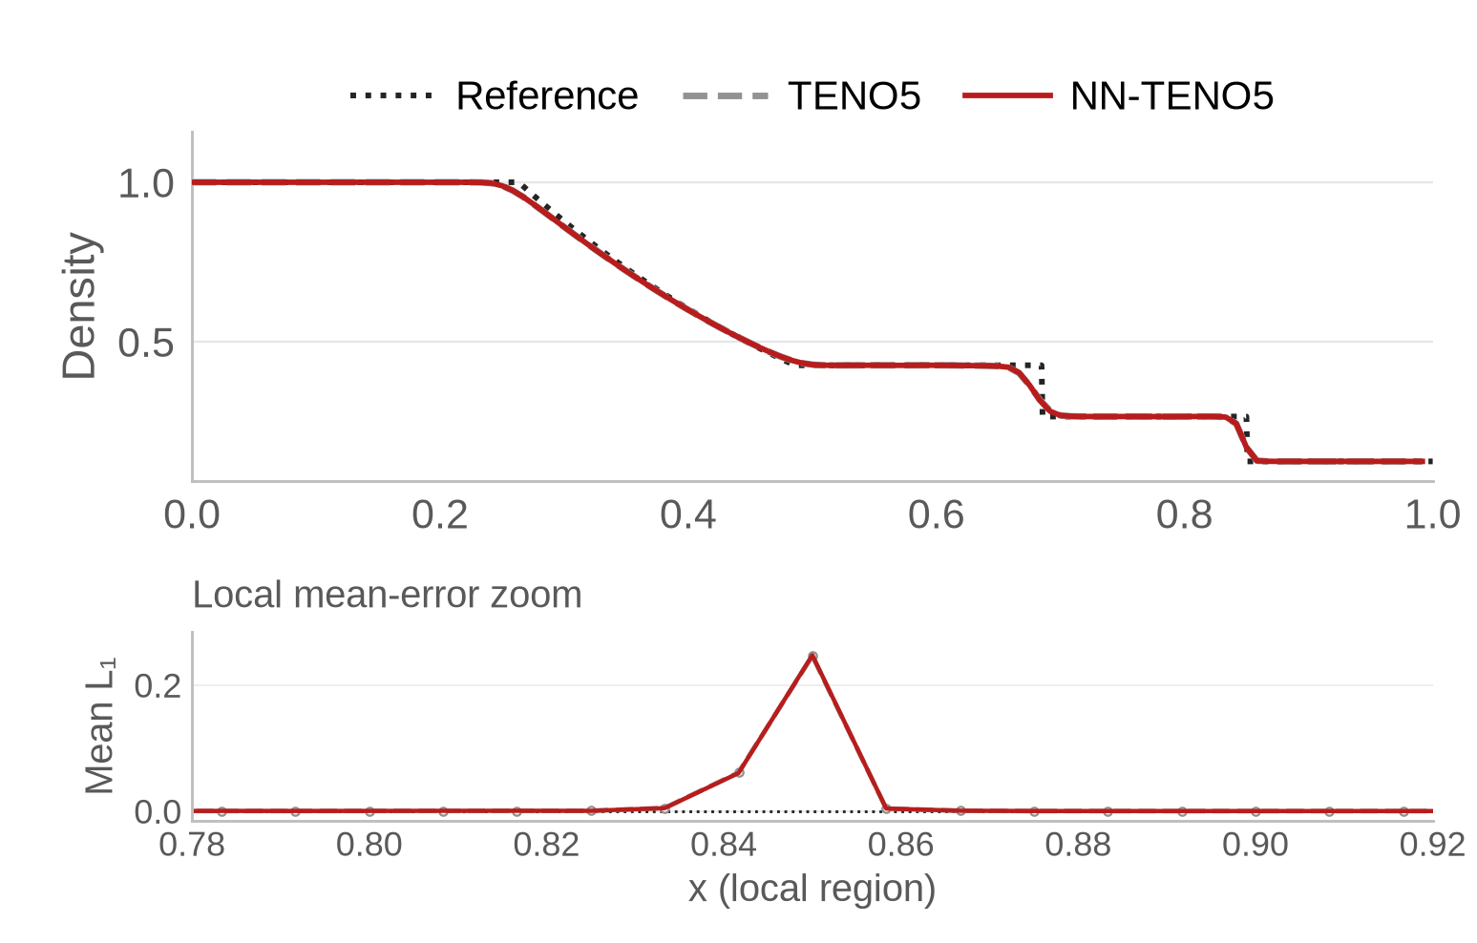
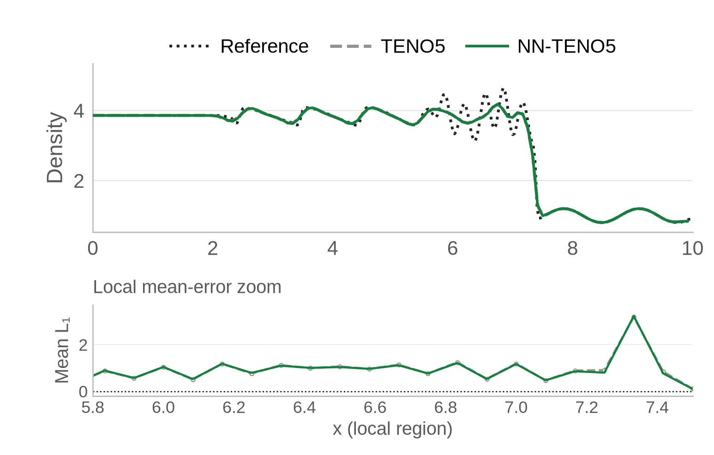
RESULTS · FINAL EULER CHECKPOINT
Euler gains depend on the benchmark
Sod
Shu–Osher
+0.35% error · slightly worse
−1.84% error · modest improvement
120 cells · t = 0.2 · exact Riemann reference
120 cells · t = 1.8 · 320-cell TENO5 reference
CFL 0.4. Top: density. Local errors and percentages use mean L₁ over density, momentum and energy.
SHOCKS & WENO / YASSER BAOUZIL
12 / 16

Slide 13
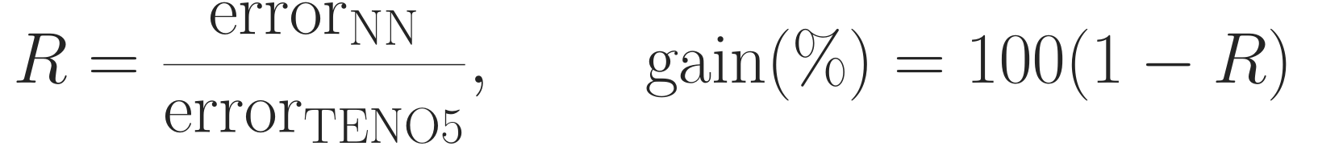
RESULTS · BENCHMARK SUMMARY
Canonical benchmarks quantify the final gains
Learned convex mixing compared with classical TENO5 on the same benchmark configuration.
BENCHMARK
ERROR METRIC
TENO5
NN-TENO5
RATIO R
CHANGE IN ERROR
Advection
Scalar L₂
9.8960 × 10⁻²
9.5521 × 10⁻²
0.9653
-3.47%
Burgers
Scalar L₂
8.1670 × 10⁻⁴
6.6493 × 10⁻⁴
0.8142
-18.58%
Sod
Mean Euler L₁
8.2583 × 10⁻³
8.2871 × 10⁻³
1.0035
+0.35%
Shu–Osher
Mean Euler L₁
2.1319 × 10⁻¹
2.0926 × 10⁻¹
0.9816
-1.84%
Green: lower error. Red: higher error. Euler: mean L₁ over (ρ, ρv, E). Scalar: L₂.
Scope: four 1D cases at fixed grids—not a convergence study or a controlled runtime comparison.
SHOCKS & WENO / YASSER BAOUZIL
13 / 16

Slide 14
CONCLUSION · SCIENTIFIC CONTRIBUTION
A solver-integrated correction with measured limits
The contribution is the full tested workflow—not a classifier in isolation.
Differentiable reconstruction
Euler diagnosis and repairs
Dedicated learned mixing
TENO5 inside a differentiable
conservative solver.
Train on evolved states using
the four-term physics loss.
Identify invalid-state failures.
Combine pre-repair penalties,
substage safeguards and
a rollout curriculum.
Separate candidate decisions
from their final influence.
A small mixing head retains
the classical baseline.
Measured evidence
3 of 4 benchmarks improve
Sod: +0.35% error
Next: more grids and cases, backbone improvement, and a controlled accuracy–cost study.
No established convergence result, general accuracy guarantee, or formal positivity / TVD proof.
SHOCKS & WENO / YASSER BAOUZIL
14 / 16

Slide 15
ACADEMIC GROUNDING
Selected references
Stevens & Colonius · 2020
Enhancement of shock-capturing methods via machine learning.
Theoretical and Computational Fluid Dynamics, 34, 483–496.
DOI: 10.1007/s00162-020-00531-1
Fu, Hu & Adams · 2016
A family of high-order targeted ENO schemes for compressible-fluid simulations.
Journal of Computational Physics, 305, 333–359.
DOI: 10.1016/j.jcp.2015.10.037
Li, Fu & Adams · 2022
A six-point neuron-based ENO (NENO6) scheme for compressible fluid dynamics.
arXiv preprint 2207.08500.
arXiv: 2207.08500
Related foundations: NENO6 uses six stencil points; the model presented here uses five.
SHOCKS & WENO / YASSER BAOUZIL
15 / 16

Slide 16
Thank you
Questions & discussion
SHOCKS & WENO / YASSER BAOUZIL
16 / 16

