Slide 1

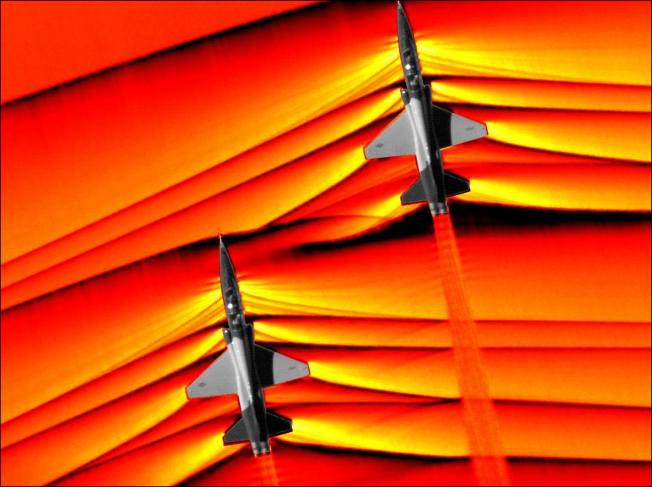

PHYSICS × NUMERICS × LEARNING
Machine Learning for
Shock-Capturing
Numerical Schemes
Learning reconstruction decisions for
1D hyperbolic conservation laws
Capturing sharp fronts
without spurious oscillations
WENO-NN / NN-TENO5 / DIFFERENTIABLE CFD
Yasser Baouzil
Supervisor: Radouan Boukharfane
UM6P · College of Computing

Slide 2
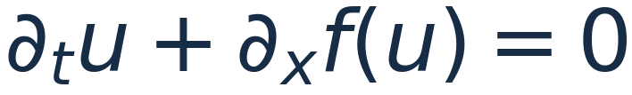
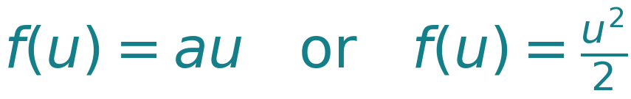
MOTIVATION
Shock capturing balances accuracy and stability
The governing conservation law
Smooth regions
Resolve the solution with high-order accuracy.
Discontinuities
Suppress nonphysical oscillations near shocks.
Euler flows
Maintain positive density and pressure.
Schlieren imaging reveals abrupt changes in compressible flow.
The learned component must work within the structure of a conservative numerical solver.
SHOCKS & WENO / YASSER BAOUZIL
02 / 13

Slide 3
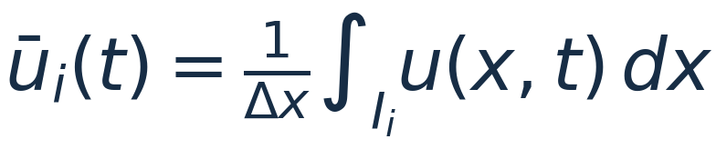
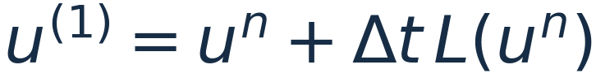
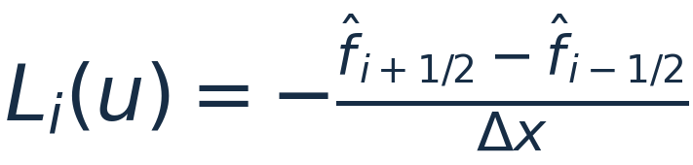
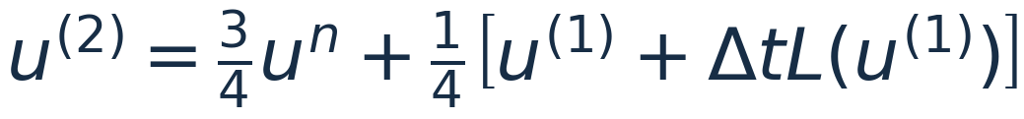
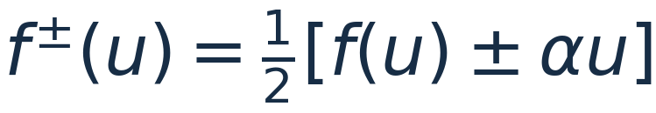
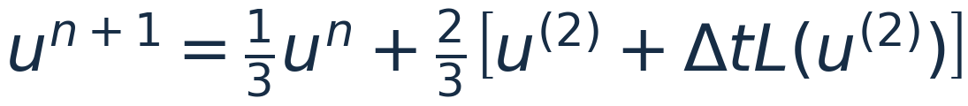
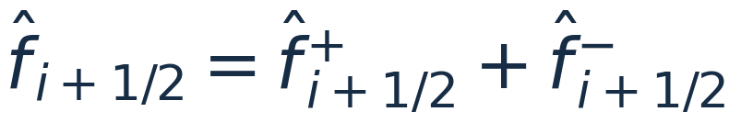
NUMERICAL BACKBONE
Local interface fluxes drive a conservative solver
01 Finite-volume discretization
03 SSPRK3 time integration
02 Lax–Friedrichs interface flux
The reconstruction is evaluated at every stage.
CFL time-step restriction
SHOCKS & WENO / YASSER BAOUZIL
03 / 13

Slide 4









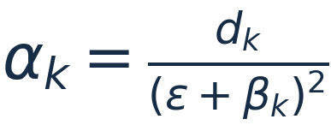

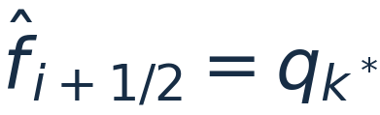

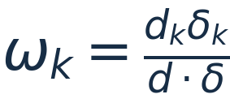
CLASSICAL RECONSTRUCTION
WENO and TENO combine three local reconstructions
Five stencil values → three third-order candidates → one interface flux
ENO selects
WENO weights
TENO discards
Choose the smoothest candidate.
Reduce troubled candidates continuously.
Reject troubled candidates, then reweight.
Select using divided differences.
β: smoothness χ: TENO sensor
SHOCKS & WENO / YASSER BAOUZIL
04 / 13

Slide 5
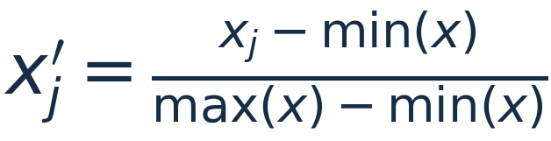



NN-TENO5 ARCHITECTURE
The network predicts which candidates to trust
A local five-point stencil feeds a classifier with three troubled-candidate probabilities.
FEED-FORWARD CLASSIFIER
Normalize the input
→
5
→
64
→
32
→
16
→
8
→
3
Constant stencils use a guarded denominator.
5 inputs
ReLU hidden layers
Sigmoid
Training: continuous keep weights
Optional hard inference: threshold decisions
The network changes candidate decisions; the solver still determines fluxes and time evolution.
SHOCKS & WENO / YASSER BAOUZIL
05 / 13

Slide 6
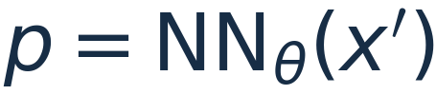
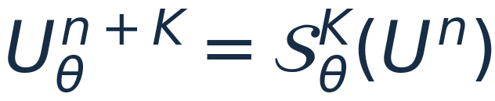

LEARNING METHODOLOGY
Physics training evaluates the evolved solution
01 Imitation learning
02 Unrolled physics training
Learn the classical TENO5 keep/discard labels.
Differentiate through K complete SSPRK3 steps.
Useful initialization; the teacher supplies no direct
signal for lower physical solution error.
The gradient crosses reconstruction, fluxes
and every Runge–Kutta substage.
Combined training objective
Pretrain by imitation, normalize loss terms, then fine-tune against a physical reference.
SHOCKS & WENO / YASSER BAOUZIL
06 / 13

Slide 7
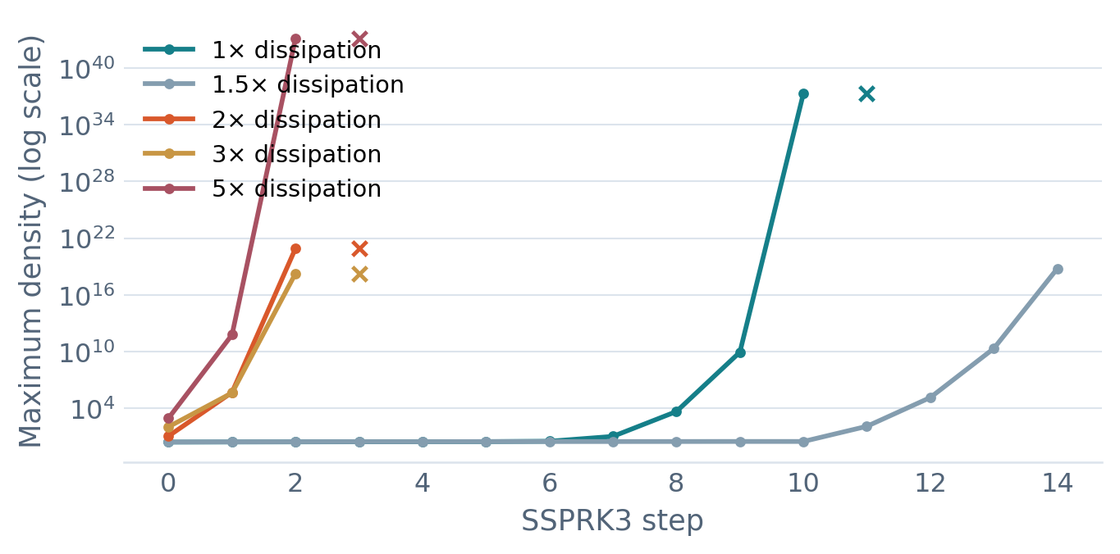
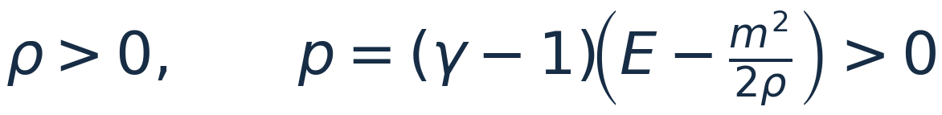
STABILITY AND PHYSICAL CONSTRAINTS
Hybrid reconstruction supports stable Euler training
A dedicated sigmoid head starts near TENO5: σ(−3) ≈ 0.047.
Observed Euler training instability
Physical admissibility
m = ρv; γ = 1.4 for the project benchmarks.
Guard every substage
Measure positivity violations before repair.
Control optimization
Use rollout curriculum, anchoring and clipping.
Validate the final solver
× marks a nonfinite state. Extra dissipation alone did not stabilize training.
Mixing alone is not a positivity or TVD proof.
SHOCKS & WENO / YASSER BAOUZIL
07 / 13

Slide 8
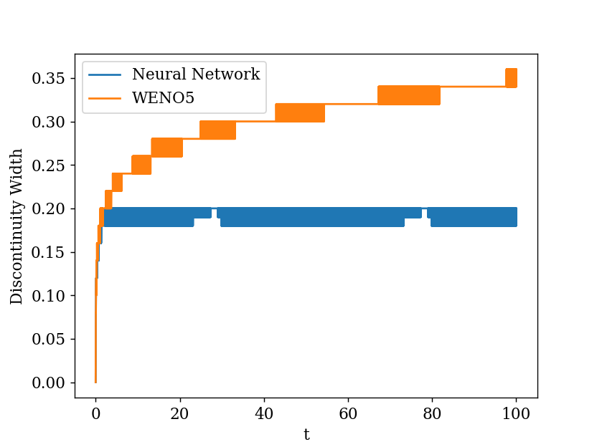
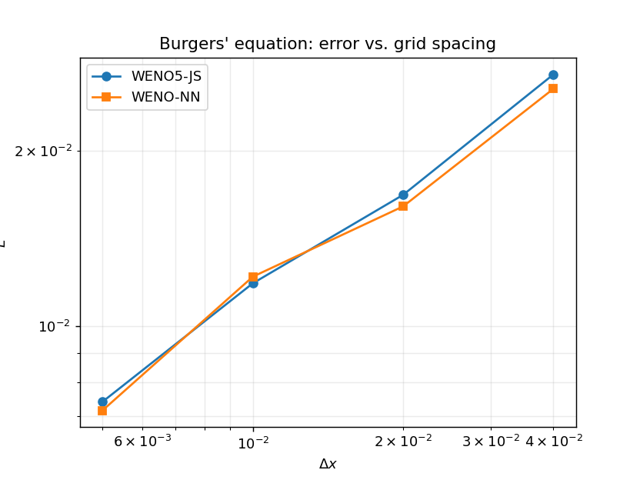
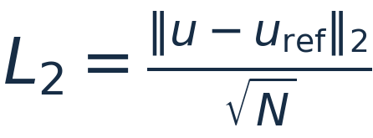
RESULTS · SCALAR CONSERVATION LAWS
Final scalar benchmarks improve on TENO5
Earlier WENO-NN experiments
Final NN-TENO5
Dedicated mixing head · Phase 19
3.5%
lower L₂ error on advection
18.6%
Sharper advected discontinuities
Competitive Burgers convergence
lower L₂ error on Burgers
Advection: 9.8960×10⁻² → 9.5521×10⁻² | Burgers: 8.1670×10⁻⁴ → 6.6493×10⁻⁴
SHOCKS & WENO / YASSER BAOUZIL
08 / 13

Slide 9
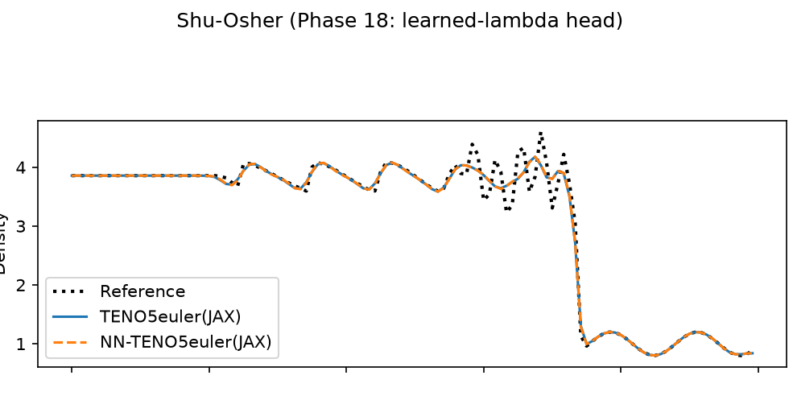
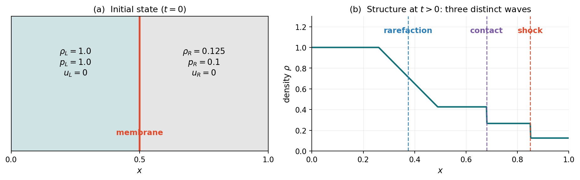
RESULTS · COMPRESSIBLE EULER EQUATIONS
Euler gains depend on the benchmark
Sod shock tube
Shu–Osher shock–entropy interaction
Rarefaction, contact discontinuity and shock
+0.35% error
Near parity; TENO5 remains slightly better.
−1.84% error
A modest gain with the learned mixing head.
Metric: mean L₁ over (ρ, ρv, E). 120 cells, CFL 0.4. Sod: exact reference; Shu–Osher: 320-cell TENO5 reference.
SHOCKS & WENO / YASSER BAOUZIL
09 / 13

Slide 10
CONCLUSION
Learning adds value inside a robust numerical solver
Learn the reconstruction decision.
Keep the numerical and physical structure visible.
What I built
What the results show
What comes next
WENO/TENO reconstruction framework
Scalar gains: 3.5% and 18.6% in L₂
Improve the Euler reconstruction model
Neural stencil-decision models
Shu–Osher: 1.84% lower mean L₁
Validate across grids and flow cases
Differentiable CFD training in JAX
Sod: near parity, 0.35% higher error
Extend the framework toward 2D CFD
Discussion
SHOCKS & WENO / YASSER BAOUZIL
10 / 13

Slide 11
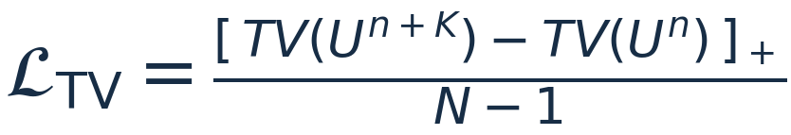

MATHEMATICAL BACKUP · TRAINING LOSS
The physics loss balances accuracy and regularity
Accuracy
Total variation
Mean square error against the evolved reference.
Penalize extra variation; normalize by cell count.
Boundary variation
Anchor regularization
Compare neighbors at the same interface.
Limit drift from the stable pretrained parameters.
[z]₊ = max(z, 0); TV(U) = Σᵢ |Uᵢ₊₁ − Uᵢ|; P = parameter count. Euler positivity is measured before state repair.
SHOCKS & WENO / YASSER BAOUZIL
11 / 13

Slide 12
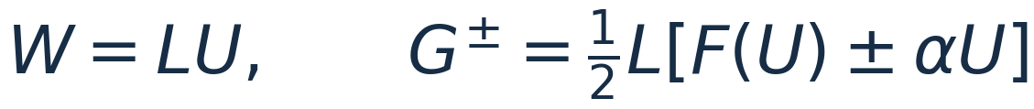

MATHEMATICAL BACKUP · COMPLETE WORKFLOW
The learned decision sits inside every solver step
Forward numerical path
State +
local stencil
→
Scalar / Euler
setup
→
WENO / TENO
or NN selector
→
Interface
flux
→
SSPRK3
step
→
K-step
rollout
Learned component
Euler: reconstruct characteristic fluxes
Training: backpropagate physical error
Reference → loss → gradient through every step
→ update the neural reconstruction parameters.
Scalar implementation: reconstruct states before Lax–Friedrichs flux evaluation. Euler: split characteristic fluxes before reconstruction.
SHOCKS & WENO / YASSER BAOUZIL
12 / 13

Slide 13
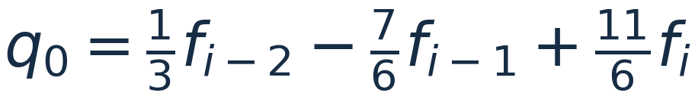
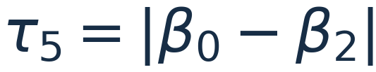
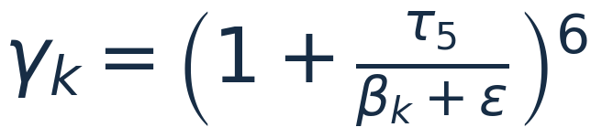
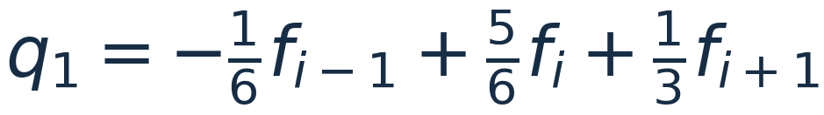
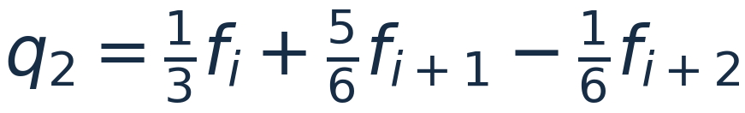

MATHEMATICAL BACKUP · RECONSTRUCTION DETAILS
Fifth-order reconstruction: candidates and TENO sensor
Three third-order candidate polynomials
TENO smoothness and scale separation
Optimal linear weights: d = (0.1, 0.6, 0.3).
βₖ are the Jiang–Shu smoothness indicators. NN-TENO5 learns candidate decisions with the same polynomials.
If every candidate is rejected, return the center value; otherwise normalize the retained weights.
SHOCKS & WENO / YASSER BAOUZIL
13 / 13

