Slide 1

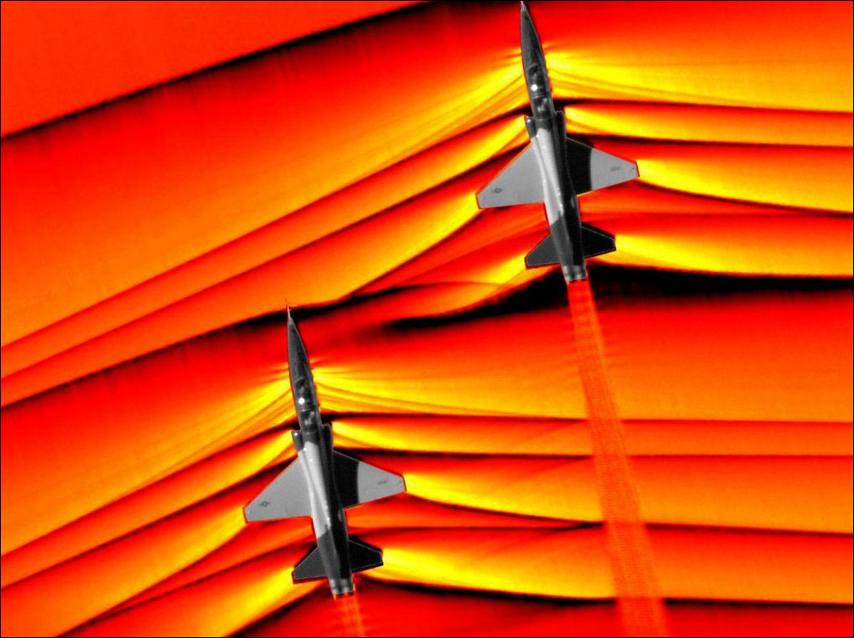

PHYSICS × NUMERICS × LEARNING
Machine Learning for
Shock-Capturing
Numerical Schemes
Learning reconstruction decisions for
1D hyperbolic conservation laws
Capturing sharp fronts
without spurious oscillations
WENO-NN / NN-TENO5 / DIFFERENTIABLE CFD
Yasser Baouzil
Supervisor: Radouan Boukharfane
UM6P · College of Computing
Notes:
Slide 1: Original landing page
Duration: 0:25
SCRIPT
Thank you for meeting with me. I’m Yasser Baouzil, and I’ll present my research internship on neural shock capturing. I’ll focus on what the Euler experiments taught me: which failures were real, why some fixes were insufficient, and how numerical structure could make learned methods more reliable.
MATHEMATICAL TERMS
Conservation law; reconstruction; shock capturing; numerical reliability.
QUESTIONS
What was your own contribution?
A modular reconstruction/solver framework, neural integration and training/evaluation experiments, and investigation of stability and generalization limits. Attribute the classical schemes and established limiters to their literature, and distinguish the later validation work and method generations.
What is the main result you want me to remember?
Useful accuracy gains were possible on some configurations, but independent conservation, stage admissibility, consistency and reference checks exposed limitations that a favorable error number alone would miss.

Slide 2
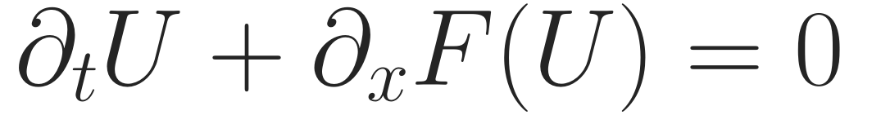
RESEARCH BACKGROUND · SCIENTIFIC MACHINE LEARNING
Learning inside a classical shock-capturing solver
Scientific-ML research internship · UM6P
ENO baseline · WENO/TENO orders 3, 5, 7
Neural reconstruction inside a modular solver
Advection, Burgers, Sod and Shu–Osher
WENO-NN
NN-TENO
JAX / unrolled
Later V2
Coefficient corrections
Candidate selection
Rollout loss + blending
Classical gate + NN
Objective: improve solution accuracy while retaining numerical reliability.
Project scope: src/schemes/ · src/core/ · scripts/legacy_imitation_training/ · scripts/unrolled_physics_loss/
SHOCKS & WENO / YASSER BAOUZIL
02 / 9
Notes:
Slide 2: Research background and objectives
Duration: 1:00
SCRIPT
The starting point was a classical solver for conservation laws. The equation says that a cell changes because a physical flux enters and leaves it. Near a shock, high-order reconstruction must resolve sharp changes without introducing unacceptable numerical oscillations.
During the internship I worked with an ENO baseline and WENO and TENO implementations of orders three, five and seven. I tested scalar advection and Burgers, then compressible Euler problems such as Sod and Shu–Osher.
The project went through four generations. The original WENO network corrected reconstruction coefficients. Neural TENO selected candidate stencils. The JAX work trained through solver rollouts and tested blending. Later V2 retained a classical trouble gate around a learned correction. These are different methods and checkpoints, so I will identify which experiment belongs to which generation.
MATHEMATICAL TERMS
U: conserved state; F: physical flux; ENO/WENO/TENO; reconstruction order; benchmark; method generation.
QUESTIONS
Why learn only part of the solver?
It keeps the known physical flux and conservative update visible. Learning can propose local reconstruction decisions while numerical constraints and diagnostics can remain independently defined.
Does higher reconstruction order imply a more accurate shock?
No. Formal smooth-solution order, resolution of a discontinuity, nonlinear stability and errors at a fixed grid are different properties. The general nonlinear FV consistency test later shows a limitation shared with the classical baseline.

Slide 3
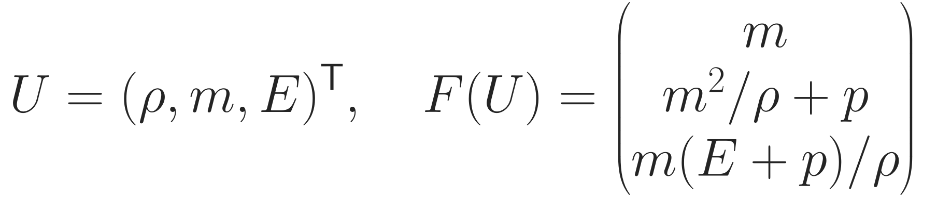
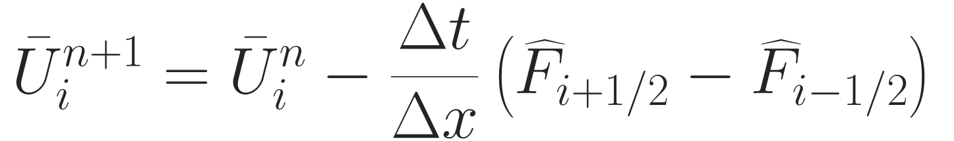
NUMERICAL FRAMEWORK · ACTUAL EULER PIPELINE
Where the network enters the Euler solver
Conservative forward-Euler building block
Conserved
state U
→
Roe basis
L and R
→
LF split
fluxes
→
TENO / NN
reconstruction
→
Shared-face
flux
→
SSPRK3
stages
Default path: reconstruct characteristic split fluxes, not physical left/right interface states.
Later V2
G: classical TENO trouble gate
λ: controlled correction strength
Implemented: euler_jax.py:166–254 · gated_teno5_jax.py:19–67. SSPRK3 reevaluates reconstruction at every stage.
SHOCKS & WENO / YASSER BAOUZIL
03 / 9
Notes:
Slide 3: Where the network enters the Euler scheme
Duration: 1:45
SCRIPT
For Euler, the conserved state contains density, momentum and total energy. The physical flux contains momentum, momentum transport plus pressure, and energy transport. Velocity is momentum divided by density.
The update on the right is the forward-Euler building block: the difference of two numerical face fluxes changes the cell average. When neighboring cells use the same face flux, their interior contributions cancel in the global budget. SSPRK3 combines several such evaluations.
The actual reconstruction path matters. At each face I compute a Roe characteristic basis. I project a local stencil, form positive and negative Lax–Friedrichs split fluxes, and reconstruct each characteristic field. I then transform the combined numerical flux back to conserved variables. The default method therefore reconstructs characteristic split fluxes; it does not first reconstruct two separate physical Euler interface states.
In later V2, the classical TENO reconstruction remains the baseline. The gate G activates where classical TENO rejects a candidate. Lambda scales the neural correction. A zero lambda recovers classical TENO, but a nonzero correction still changes the entire coupled Euler evolution. The reconstruction and the physical wave speeds are evaluated again at every Runge–Kutta stage.
MATHEMATICAL TERMS
U=(ρ,m,E); v=m/ρ; total energy density; Roe averages; left/right eigenvector matrices; characteristic field; LF split; shared-face flux; SSPRK3; G and λ.
QUESTIONS
What exactly does the neural network see?
Five neighboring values of one characteristic split flux after local min/range normalization, not the three conserved variables presented jointly. The same small classifier is applied over fields and LF directions.
Is using a Roe basis the same as using a Roe Riemann solver?
No. Here Roe averages define the projection basis. LF splitting and reconstruction define the numerical flux; it is not the Roe approximate Riemann flux.

Slide 4
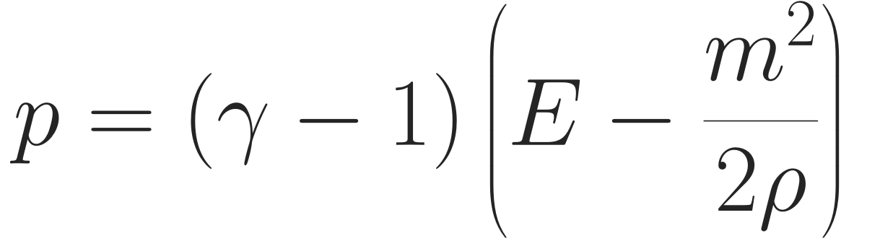

OBSERVED FAILURE · DENSITY AND INTERNAL ENERGY
Conservation does not ensure positive Euler states
Oracle NN-TENO5 · Sod, N=120
Non-positive density · step 6
V2 soft/.75 · Riemann, N=128
Negative pressure · step 13, stage 1
V2 soft/.25 · same short IVP
15 steps · all raw stages admissible
Why the attempted safeguards were insufficient
Established remedy · not implemented
Flux corrections can make internal energy negative.
Normalized weights do not constrain Euler states.
SSPRK3 needs an admissible forward-Euler block.
Limit shared-face corrections toward an
admissible low-order flux, under its CFL.
Observed: audit §§3.1/3.3. Theory: Hu–Adams–Shu (2013); Zhang–Shu (2012); Gottlieb–Shu–Tadmor (2001).
SHOCKS & WENO / YASSER BAOUZIL
04 / 9
Notes:
Slide 4: Negative density and pressure
Duration: 2:00
SCRIPT
This was a concrete failure, not simply a less accurate shock profile. The oracle-trained Keras NN-TENO5 failed Sod with non-positive density at step six. In a later V2 random Riemann case, soft strength point seven five first produced negative pressure at step thirteen, stage one. On the same short case, strength point two five completed all fifteen steps with admissible raw stages.
The pressure equation explains why positive density alone is not enough. Internal energy is total energy minus kinetic energy. The learned face correction changes density, momentum and energy together, and the subtraction can become negative. The following sound-speed calculation then leaves the real physical domain.
We tried reduced correction strength, classical blending, stage guards, repair and training penalties. These helped empirically, but they did not enforce the invariant domain of the Euler update. Nonnegative normalized candidate weights combine characteristic flux polynomials, not admissible physical states. Conservation only balances shared fluxes; it does not bound each cell’s pressure.
SSPRK3 also does not create a property that its forward-Euler building block lacks. A suitable positivity property and timestep restriction must hold at every relevant stage.
An established alternative is conservative flux limiting toward an admissible low-order flux, as in Hu, Adams and Shu. That was not implemented and validated in this neural solver. It is the kind of structural remedy I would investigate next.
MATHEMATICAL TERMS
Admissible set; internal energy E−m²/(2ρ); positivity versus conservation; forward Euler; SSP coefficient; invariant domain; low-order admissible baseline.
QUESTIONS
Can conservation and positivity fail independently?
Yes. A conservative flux difference can produce a cell with negative internal energy while conserving the implemented global budget. Conversely, overwriting a state can restore positive pressure but change mass and energy.
What does SSPRK3 actually guarantee?
It can inherit a forward-Euler convex stability or invariant-set property under an appropriate step bound, if the spatial forward-Euler map has that property. Its three-stage form alone is not a positivity proof.

Slide 5
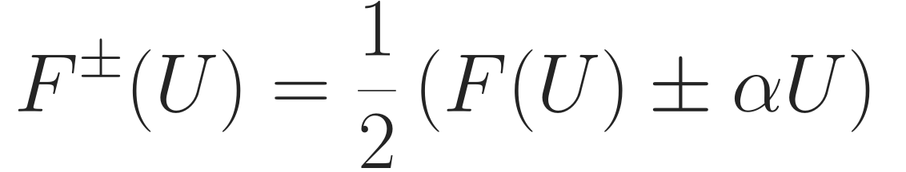
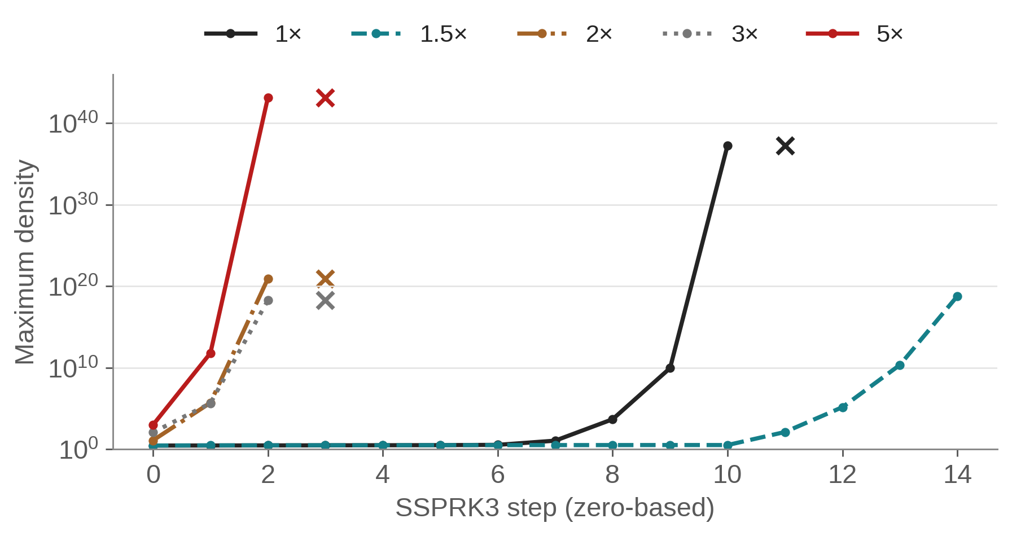
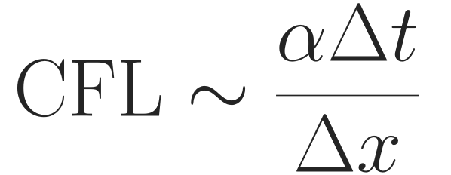
HISTORICAL JAX EXPERIMENT · A CONFOUNDED CONTROL
The dissipation sweep did not isolate the cause
Historical Euler training trace · fixed timestep
Timestep restriction changed
Increasing α at fixed Δt changes stability.
Neural inputs changed
The split-flux stencil also changes.
Roe conditioning was a hypothesis
No condition-number trace isolated it.
×: next non-finite step. 1.5× ends finite but enormous.
Required control: matched CFL, first-invalid-stage diagnostics and cond(R).
Data: models/euler_instability_trace.csv. Test: EulerInstability_TraceCapture.py:66–114. No unique cause established.
SHOCKS & WENO / YASSER BAOUZIL
05 / 9
Notes:
Slide 5: Increasing dissipation: what the experiment did not establish
Duration: 1:25
SCRIPT
This historical JAX trace originally encouraged a strong diagnosis. At multiplier one, density ran away and became non-finite. At one point five, growth was delayed, but density was already enormous when the stored trace ended. Multipliers two, three and five became non-finite earlier.
The numerical observation is real, but the causal interpretation was incomplete. In this experiment the timestep stayed fixed. Increasing the LF coefficient also changes the timestep restriction, roughly through alpha times delta t over delta x. In an explicit method, more diffusion is not automatically safer at the same timestep.
There was another changed variable: alpha enters the split flux itself, so the neural model received different stencil inputs. Roe eigenbasis conditioning was suspected, but the saved trace contains no condition-number history establishing it as the initiating cause.
A proper follow-up should vary alpha with a compensating timestep change, compare classical TENO5 on identical states, and record the first invalid stage, effective CFL and basis conditioning. I therefore treat the old result as a failed uncontrolled stabilization attempt, not proof that dissipation itself causes instability.
MATHEMATICAL TERMS
LF coefficient α; αΔt/Δx; explicit diffusion restriction; confounding variable; characteristic condition number κ(R); first-invalid stage.
QUESTIONS
Why can more diffusion destabilize an explicit scheme?
A larger dissipative spatial eigenvalue can require a smaller timestep to stay within the time integrator’s stability region. The fixed-dt sweep changes that product instead of holding a matched stability scale.
Would matched CFL prove the Roe basis is responsible if the run still fails?
No. It removes one confound. Candidate choices, input shift and nonlinear admissibility can still matter. A first-failure trace with condition numbers and controlled solver ablations is needed for attribution.

Slide 6
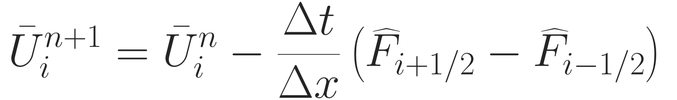
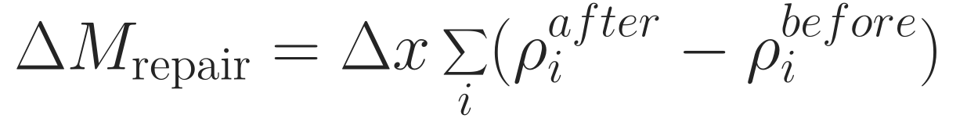
ATTEMPTED FIX · COMPUTATIONAL SURVIVAL VERSUS PHYSICAL BALANCE
Direct state repair breaks the conservative budget
Implemented · post-update repair
Established · conservative limiting
Flux update
→
Invalid stage
→
Overwrite cell
NN flux
→
Limit face flux
→
Update cells
RK-weighted repair: Δmass ≈ +0.001611
Δenergy ≈ +0.000889
One accepted flux is shared by both cells.
Requires an admissible baseline and stage CFL.
Post-repair penalties once hid violations.
Guarded training ≠ unguarded validation.
The alternative has not yet been validated
in this neural implementation.
A finite repaired trajectory does not certify the unguarded learned solver.
Measured: results/repair/repair.json, soft/.75, one repaired stage row. Conservative remedy: Hu–Adams–Shu (2013).
SHOCKS & WENO / YASSER BAOUZIL
06 / 9
Notes:
Slide 6: Numerical repair and the conservative budget
Duration: 1:25
SCRIPT
Repair solved a computational problem, but it changed the numerical problem. The flux-difference update cancels interior exchanges between neighboring cells. If I subsequently replace a cell’s state by its neighbors’ average, that replacement generally does not have a compensating change elsewhere.
The repair diagnostic measures the resulting integrated mass change. In a saved V2 comparison, one repaired stage row contributed about point zero zero one six one one mass and point zero zero zero eight eight nine energy. The accounting can include those artificial sources, but that is not conservation of the original Euler equations restored.
There was also a training-loss issue. A positivity penalty applied after repair could miss the violation that had just been removed. Moving that measurement before every repair corrected the signal, while gradient clipping helped contain destructive updates. Yet guarded training and unguarded validation still followed different dynamics.
The established alternative on the right is to limit a common face flux before updating adjacent cells, or recompute an admissible stage conservatively. That alternative remains to be tested in this neural implementation. A trajectory surviving artificial intervention is not enough to certify it.
MATHEMATICAL TERMS
Physical balance; repair source; integrated mass versus density; shared numerical face flux; RK-weighted repair budget; guarded training/deployment mismatch.
QUESTIONS
Is a neighbor average guaranteed to be physically valid?
For admissible neighbors, convexity of the ideal-gas Euler admissible set supports positivity of their average. That does not preserve the global conserved sum when used to overwrite a different state, and the actual fallback has additional thresholds.
How did you account for the repair during SSPRK3?
The final budget includes boundary flux exchanges with weights 1/6,1/6,2/3 and repair increments with weights 1/6,2/3,1. Subtracting these gives a bookkeeping residual; the repair contribution still represents a nonphysical source for the original conservative PDE.

Slide 7
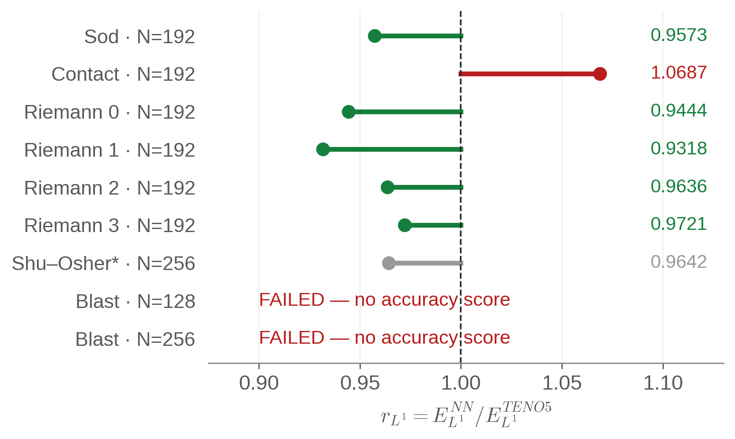
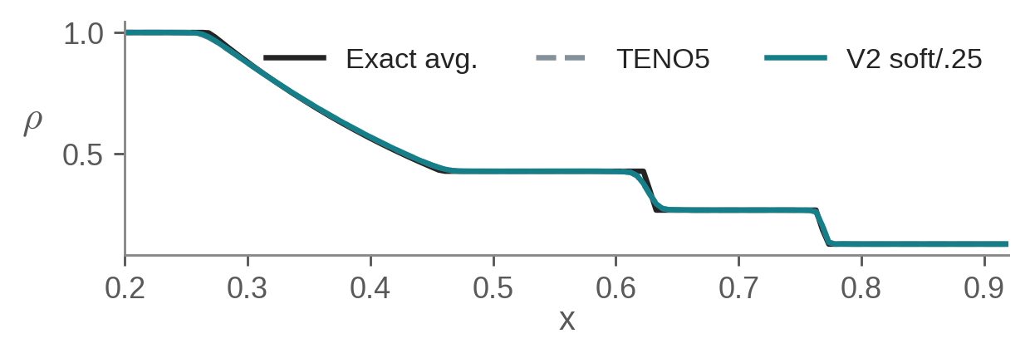
LATER V2 · FROZEN MODEL AND SELECTED SOFT STRENGTH .25
Validation gains did not imply universal transfer
0.94794
Validation macro L¹ ratio
307 short Euler IVPs · no invalid stages
Sod N=192: 4.3% lower L¹, but TV rises
and density undershoot ≈ 3.51×10⁻⁴.
* Shu–Osher ranking: reference uncertainty unresolved.
Blast: no accuracy score; selected model fails at both grids.
Candidate shifts: horizon, shock strength, walls.
Warm-up states ≠ deployed split-flux inputs.
Frozen V2 only. Data: full-validation/summary.json · independent/benchmark.json · wall-closure/benchmark.json.
SHOCKS & WENO / YASSER BAOUZIL
07 / 9
Notes:
Slide 7: Generalization beyond short validation
Duration: 2:00
SCRIPT
Later V2 gave encouraging validation results: the selected soft strength point two five had no invalid raw stages on three hundred and seven short Euler trajectories. Its macro L1 ratio relative to TENO5 was about point nine four eight. This score helped select the correction policy, so it is validation evidence, not a universal deployment guarantee.
The independent experiments give a mixed picture. Sod at one hundred and ninety-two cells had about four point three percent lower mean conserved-state L1 error. But density total variation increased, and a small density undershoot appeared. A lower error therefore did not mean every oscillation measure improved. The contact at the same resolution became about six point nine percent worse. The selected model failed the much stronger closed-wall blast at both tested grids, while the classical control completed it. Shu–Osher’s numerical-reference ranking remained unresolved.
Several mechanisms could explain the transfer gap. Training used short, mainly single-Riemann trajectories; the stress case had stronger pressure contrasts, interacting waves and reflective boundaries absent from the corpus. Errors also alter future Euler states and future neural inputs. We measured another mismatch: warm-up used characteristic states, whereas deployment used characteristic split fluxes. Soft and hard masks also define different numerical methods.
These are measured mismatches or candidate mechanisms, not isolated causes of the blast failure. Better deployment-aligned training and out-of-distribution tests are useful, but more data alone does not replace admissibility constraints and a reliable fallback.
MATHEMATICAL TERMS
Macro L1 ratio; family×resolution averaging; validation selection; prospective IVP; distribution shift; total variation; undershoot; short rollout; soft/hard policy.
QUESTIONS
Why does increased TV not necessarily mean instability?
Shu–Osher contains physical oscillations, and sharper or less damped structures can change variation. On Sod, the explicit small undershoot is stronger evidence of a nonphysical range excursion. Report norms, extrema and a common reference instead of equating TV with stability.
What would make the generalization experiment more convincing?
Freeze training/policy choices before a separate family-, strength-, location-, grid- and horizon-varied test suite. Use multiple seeds, exact or controlled references, all-stage admissibility, conservation and variation diagnostics, with failures retained rather than excluded from the scientific conclusion.

Slide 8
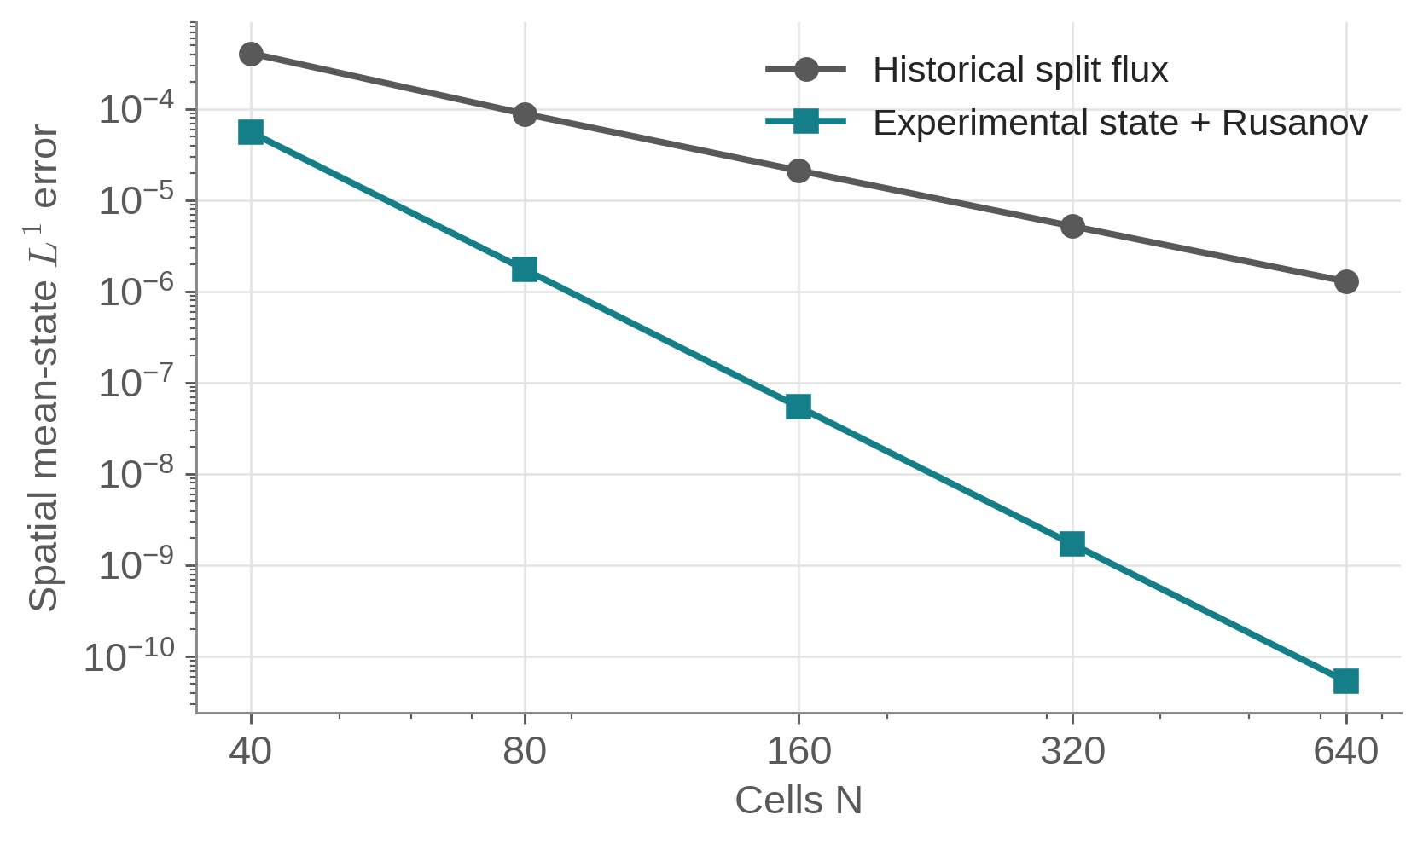
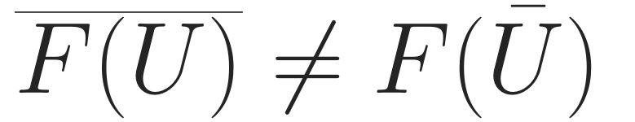
CONSISTENCY INVESTIGATION · GENERAL NONLINEAR SMOOTH EULER DATA
The classical FV pipeline also limited accuracy
Nonlinear flux evaluation and
cell averaging do not commute.
Historical split flux: order ≈ 2.01
State + Rusanov: order ≈ 5.00
Experimental remedy
Consistent FV state reconstruction.
Shock/positivity behavior unvalidated.
This limitation affects classical TENO5 too; it is not a neural-only failure.
Data: nonlinear_euler.json; semidiscrete exact-average divergence. WENO7 details → Backup B. Wall correction ≠ blast robustness.
SHOCKS & WENO / YASSER BAOUZIL
08 / 9
Notes:
Slide 8: Finite-volume consistency and implementation limitations
Duration: 1:20
SCRIPT
An important finding was not specific to the network. On general nonlinear smooth Euler data, the historical finite-volume split-flux path approached only second-order spatial consistency, including classical TENO5. An experimental characteristic-state reconstruction followed by a Rusanov flux approached fifth order on the same diagnostic.
The reason is the noncommutation shown here. Flux evaluated at a cell-average state is generally not the cell average of the physical flux. The historical path supplied the former to reconstruction coefficients intended for averaged data. A special constant-pressure, constant-velocity entropy wave could hide this because its flux is linear in density.
The state-flux formulation is an implemented experimental remedy, but only its smooth consistency and basic contracts were checked; shock robustness and positivity remain unvalidated. A correctly formulated finite-difference interpretation is another possibility, not a reason to ignore the finite-volume test.
There were also implementation issues: WENO7 epsilon sensitivity, and a neural wall-flux contract. Fixing those specific defects did not establish general Euler robustness.
MATHEMATICAL TERMS
Cell average; point value; nonlinear consistency; semidiscrete divergence; truncation error; Rusanov flux; entropy wave; finite volume versus finite difference.
QUESTIONS
Why did the fifth-order entropy-wave test not reveal this?
With constant pressure and velocity, the conserved flux is linear in the varying density. Nonlinear averaging errors vanish in that special subfamily. General variable-velocity/pressure smooth data exercise terms it does not.
Did you demonstrate a fifth-order robust neural Euler solver with the new flux?
No. The optional state-flux path passes a smooth instantaneous consistency diagnostic and basic conservation/constant controls. It has not been shock-/positivity-validated or retrained as a production neural solver.

Slide 9
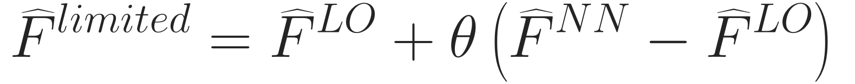

RESEARCH DIRECTION · RELIABLE MACHINE-LEARNING-ASSISTED METHODS
Learn within verifiable numerical constraints
Observed limitations
Established foundations
Open research
Negative stages · repair sources
Transfer gaps · accuracy/robustness
Positivity · convex limiting
Moments · conditional SSP
Constrained learned corrections
Independent residual assessment
Shared-face limited flux
Independent space–time residual
θ must satisfy stage constraints; an arbitrary value in [0,1] is insufficient.
Giesselmann, Kwon & Krumscheid (2026) · RKDG + SIAC
Entropy-compatible convection–diffusion; regular reconstruction and stability analysis required.
This does not certify the present neural Euler solver.
Can learned high-order reconstruction improve numerical accuracy while retaining
provable structural constraints and independently verifiable error control?
Hu–Adams–Shu (2013) · Guermond et al. (2018) · Gottlieb et al. (2001) · arXiv:2604.01200. Discussion; backups follow.
SHOCKS & WENO / YASSER BAOUZIL
09 / 9
Notes:
Slide 9: Lessons and reliable numerical research
Duration: 1:55
SCRIPT
My main lesson is to separate a learned proposal from the numerical contracts used to accept it. The project exposed negative stages, nonconservative repairs, transfer gaps and accuracy–robustness tradeoffs. Classical numerical analysis offers tools for each of these, rather than requiring the network to discover every constraint from data.
The first equation illustrates a possible direction: blend a neural face flux toward an admissible low-order flux using a shared limiter. The limiter must satisfy the coupled stage constraints and the appropriate timestep condition. An arbitrary theta between zero and one is not a positivity proof. Moment-preserving reconstruction and SSP time integration would provide other parts of the structure.
The second equation concerns independent error assessment. Given a sufficiently regular space–time reconstruction, its continuous PDE residual measures how far it is from satisfying the equation. Turning that quantity into an error bound still needs reconstruction assumptions and a suitable stability estimate; a residual sensor or network confidence alone is not a certificate.
This connects naturally to the work of Giesselmann, Kwon and Krumscheid on RKDG reconstruction and SIAC postprocessing for convection–diffusion systems. I would start with smooth settings where the assumptions can be checked, and then study what remains useful near shocks. Their result does not certify my neural Euler solver.
The research question I would like to pursue is whether learned high-order reconstruction can improve numerical accuracy while retaining provable structural constraints and independently verifiable error control.
MATHEMATICAL TERMS
Invariant domain; convex limiting; admissible low-order update; polynomial moments; space–time reconstruction; PDE residual; relative entropy; estimator effectivity; SIAC.
QUESTIONS
What is one concrete first research experiment?
Use a smooth scalar or Euler/p-system case with exact reference, compare classical and moment-constrained learned reconstruction, and independently compute the space–time residual. Measure actual error, estimator effectivity, order, admissibility and cost before attempting post-shock guarantees.
What remains genuinely open rather than already solved by the literature?
An efficient learned high-order correction whose accepted Euler updates satisfy the appropriate structural conditions, together with useful independent error control on the intended flow class. Extending practically sharp estimates through shocks and preserving accuracy under constraints are substantive questions, not consequences of the existing code or preprint.

Slide 10
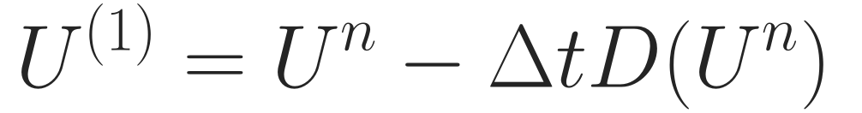
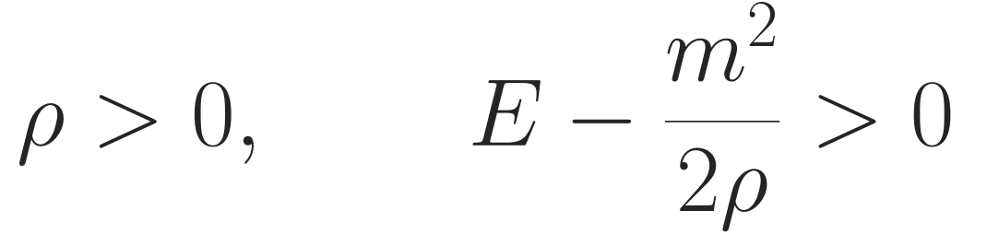
BACKUP A · MATHEMATICAL FORMULATION
Euler reconstruction and SSPRK3: the full map
Face characteristic decomposition
SSPRK3 · admissible at every stage
Same face basis for both LF directions.
Negative branch: shift by one cell and reverse.
Default a: maximum speed of adjacent cells.
D(U) = (F̂right − F̂left)/Δx. Implementation: euler_jax.py:166–254; numerics_jax.py:92–115. SSP: Gottlieb et al. (2001).
SHOCKS & WENO / YASSER BAOUZIL
BACKUP A / 03
Notes:
Slide 10: Backup A — Detailed Euler formulation
Duration: Backup; outside main timing
SCRIPT
The characteristic speeds are velocity minus sound speed, velocity, and velocity plus sound speed. A common Roe face basis projects every stencil entry. The LF splitting uses one face coefficient across the reconstruction stencil, and the negative direction is shifted and mirrored. The two reconstructed characteristic flux branches are added and transformed back. D denotes the conservative flux difference divided by cell width. SSPRK3 evaluates this operator at its intermediate states, so every state entering a new flux calculation must be physically admissible.
MATHEMATICAL TERMS
Roe enthalpy average; characteristic projection; LF stencil coefficient; D(U); SSPRK3 stages; ρ>0 and internal energy>0.
QUESTIONS
Why use characteristic rather than component-wise reconstruction?
It separates local wave families and is a standard shock-capturing strategy. This repository has no controlled neural component-wise-versus-characteristic comparison proving a quantified benefit or isolating the failure cause.

Slide 11
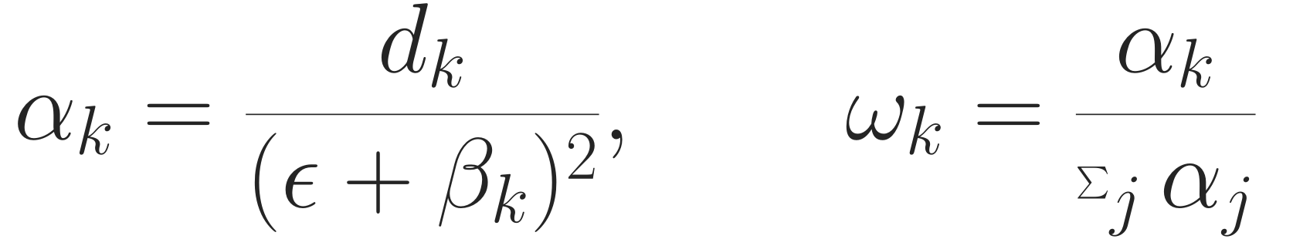
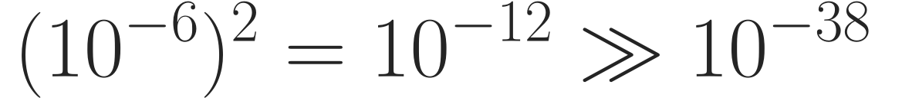
BACKUP B · FLOATING-POINT CONDITIONING
WENO7: a defect and an empirical mitigation
Reproduced coefficient-layer test
Unresolved NaN mechanism
100,000 stored normalized Euler stencils
ε = 10⁻⁶: 10 non-finite coefficient rows
ε = 10⁻⁴: 0 in the same forward test
Expanded β polynomials can cancel.
An instrumented near-flat row has β < 0.
Exact NaN operation remains unisolated.
Epsilon mitigation removed sampled NaNs; it did not prove order or Euler stability.
WenoNetworks.py:106–137 · commit 753d526 · audit §§3.6/10.4. Backend/graph changes can affect bad-row counts.
SHOCKS & WENO / YASSER BAOUZIL
BACKUP B / 03
Notes:
Slide 11: Backup B — WENO7 numerical conditioning
Duration: Backup; outside main timing
SCRIPT
The classical WENO coefficients divide optimal weights by squared regularized smoothness indicators, then normalize. In the legacy backend, the stored hundred-thousand-row test produced ten non-finite coefficient rows with epsilon ten to the minus six and none with ten to the minus four. That supports the sampled mitigation. However, squaring ten to the minus six does not by itself underflow float32. Expanded smoothness polynomials can suffer cancellation, and a diagnostic near-flat row had a negative computed indicator. Exposing intermediate graph outputs can itself change arithmetic, so I have not isolated the exact NaN operation or established a globally stable seventh-order method.
MATHEMATICAL TERMS
WENO-JS α and ω; smoothness β; epsilon regularization; cancellation; float32 normal range; finite-output test versus accuracy/stability.
QUESTIONS
Does the epsilon change affect accuracy?
It can change the smoothness weighting and sensitivity. The zero-NaN count establishes sampled finiteness only; a separate asymptotic/critical-point accuracy study is needed.

Slide 12
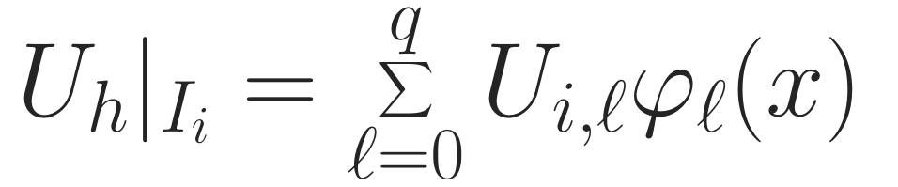

BACKUP C · RESEARCH CONNECTION AND ASSUMPTIONS
DG and SIAC: reconstruction before certification
Moment-preserving approximation
Independent residual assessment
Relative entropy needs regular reconstruction
and suitable admissible state ranges.
Sharp gradients can weaken error bounds.
A residual sensor alone is not a certificate.
r = 1,…,s: chosen reproduction moments.
Unit mass ≠ cellwise mean preservation.
Signed kernels need not preserve positivity.
2026 paper: periodic Cartesian RKDG + SIAC;
convection–diffusion with compatible entropy.
No learned filter or neural Euler shock theorem.
Primary references · full metadata and links in Sources_and_Evidence.md
Guermond et al., SISC 40 (2018) A3211–A3239, doi:10.1137/17M1149961 · Giesselmann–Kwon–Krumscheid, arXiv:2604.01200.
Hu et al., JCP 242 (2013) 169–180 · Zhang & Shu, JCP 231 (2012) 2245–2258 · Gottlieb et al., SIAM Rev. 43 (2001) 89–112.
SHOCKS & WENO / YASSER BAOUZIL
BACKUP C / 03
Notes:
Slide 12: Backup C — DG, SIAC and error estimates
Duration: Backup; outside main timing
SCRIPT
DG makes the local polynomial representation explicit. A SIAC-type convolution can supply a smoother reconstruction, with polynomial reproduction governed by kernel moments. I would constrain any learned correction to preserve the required moments, and evaluate the PDE residual independently. A unit-mass kernel preserves a global integral in an appropriate periodic setting; it need not preserve each cell average, and signed kernels need not preserve positivity. The 2026 RKDG–SIAC paper supplies an error-analysis connection under its own hypotheses, not a trained neural filter or a general Euler shock certificate. Near shocks, large reconstruction gradients can make stability constants and estimates much less useful.
MATHEMATICAL TERMS
DG modal coefficients; kernel convolution; reproduction moments; unit mass; relative entropy; reconstruction regularity; effectivity.
QUESTIONS
Could a learned SIAC filter simply smooth the shock?
It might, and small residual or visual smoothness alone is insufficient. Accuracy, physical admissibility, shock location, boundary treatment and the estimator’s assumptions must be checked. Restricting/gating the filter near shocks may also change its superconvergence behavior.

