Slide 1

Classification and prediction for the breast cancer tumors
Report by Xinyi Xie, Kexin Fan, Jiawei Zeng

Slide 2
Background
Cancer is a disease in which cells in the body grow out of control. Breast cancer is one of the most common cancers diagnosed. Many of us think of breast cancer as a female disease, but it can also occur in men. We filtered out some of the features in the progress of searching data. Based on these features, we can determine whether a tumor is benign(B) or malignant(M).

Slide 3
Data & objective
Features are computed from a digitized image of a fine needle aspirate of a breast mass.
Diagnosis as attribute factors and 10 real-valued features.
No missing attribute values
Our objective of this project is to investigate the most optimal way to classify tumors as benign and malignant, provide an understanding of the process of organizing and preparing data, selecting features and applying machine learning tools.

Slide 4
Data preparation
Clean and Generate data
Visualizing data
Ensemble
The key objective of the ensemble methods is to reduce bias and variance.
Ensembles of Classifiers is combining the classification results from different classifiers to produce the final output.
Four type: Stacking, Blending, Bagging and Boosting

Slide 5
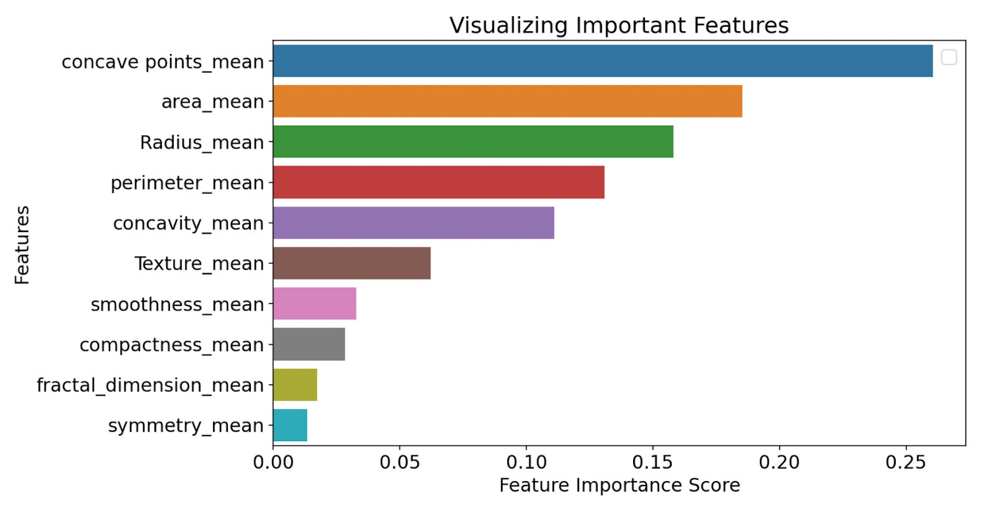
Decision tree(base model)
Accuracy score: 91.228% & Recall score is 0.97115
Random forest(bagging)
Accuracy score: 94.152% & Recall score is 0.98077
Bagging Algorithm:
Sample N times from the training set
Each sample is drawn randomly with replacement (a bootstrap).
Learn a classifier on each bootstrap sample set
For prediction: Make the classifiers vote
Random forest method is better than decision tree
Accuracy score: 0.9532
Recall score: 0.9455
Drop 4 variable which score less than 0.05

Slide 6
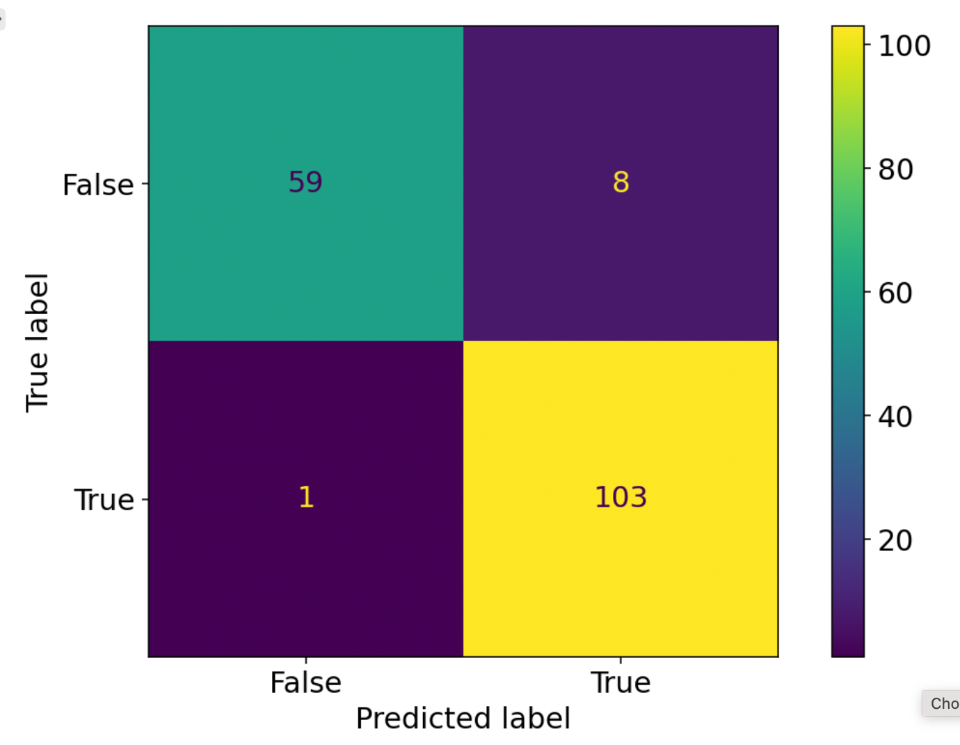
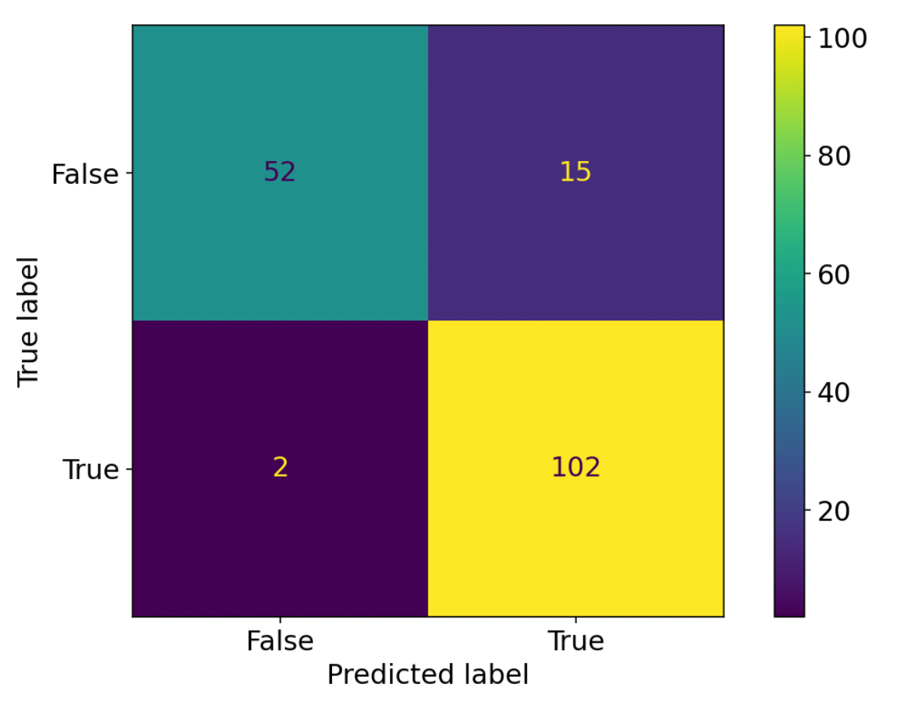
ADABOOST(Boosting)
Algorithm:
Train a sequence of classifiers.
A new classifier should focus on those cases which were incorrectly classified in the last round.
Such focus is implemented by using a weighted dataset.
Weight:
Each instance i has an associated weight
Model get correct, weight decrease; incorrect, weight increase.
These weights are used as a distribution over which the dataset is sampled to create a replicated training set,
Based on decision tree :
Accuracy score: 0.94737
Recall score: 0.99034
Based on SVM(space):
Accuracy score: 0.90058
Recall score: 0.98077

Slide 7
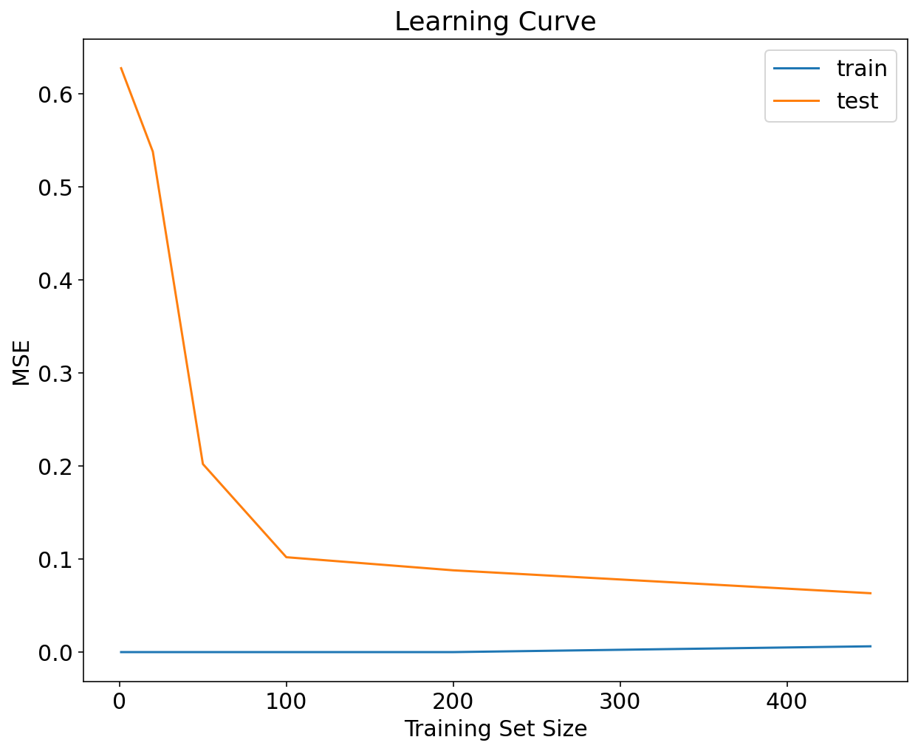

Comparison & Conclusion
Comparison:
Tree: Parallel independently; dependent on previous
Vote: Combine all models; some models by weight
Conclusion:
Adaboost method with decision tree method is best for us to classify whether the tumors are benign or malignant.
Test sample: 100, MSE small

