Slide 1
Data sample: n samples * m features
Conventional data normalization (get the zscore): set x = (x-mean)/std
The DAIN process can be seen as a more sophisticated process of getting the zscore for each sample
For example, let the window_size = 15
the nth sample is normalized using the [n-window_size]th to nth sample
The 15th sample is normalized using the 1st to the 15th sample
NOTE
The dataset the author used in his code is time series data with multiple stock ids. To make things easier to understand, here the data is simplified to have only one stock id.
Data is sorted by time (or datetime or date) in ascending order.

Slide 2
…
Deep Adaptive Input Normalization
Notes:
2d data (n samples * m features) will be transformed into 3d data with n-window size samples * m features * window size
For example, data with 20 samples and 5 features (in pandas dataframe is 20 rows * 5 columns, in numpy it is a 20*5 2d array)
If setting the window size at 15, the transformed data will have 5 samples * 5 features * 15
The transformed data is then fed into the DAIN process

Slide 3

Refresher on pytorch
FloatTensor: is 32bit. Any data out of the 32bit range should be converted into data within the 32bit range.
tensor type for target variable (i.e. y):
continuous y (regression): use FloatTensor
discrete y (classification):
binary – can be LongTensor or FloatTensor (use DoubleTensor if needs to be 64bit)
Multi-class: LongTensor for loss function (cross-entropy)
MLP (multi-layer perceptron) output dimension
Classification:
For multi-class: is the number of classes
For binary: 1
Regression: output dimension = 1
Dataset class has 3 core components
init: initiate an object
len: get the length of data. The length will be used in iterating through the data in get_item function
get_item: get the smallest unit of a ‘sample’ from the input dataset
In Pandas, it is pretty simple to get rolling k-day (k can be any integer) zscore.
Assume p is a pandas Series with prices data sorting in ascending order by timestamp. To get rolling 15-day zscore

Slide 4
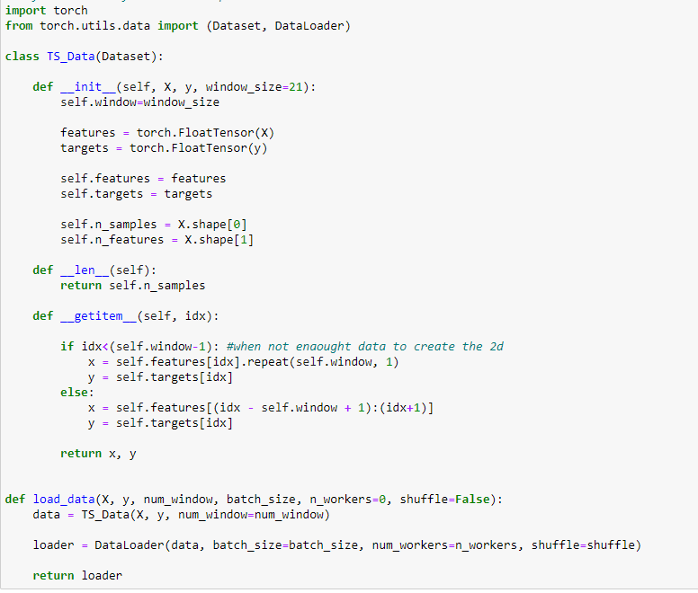
_getitem_ function returns a 2d array
…
DataLoader returns batches of 3d array. Each 3d array has batch-size of 2d array from _getitem_ function

Slide 5
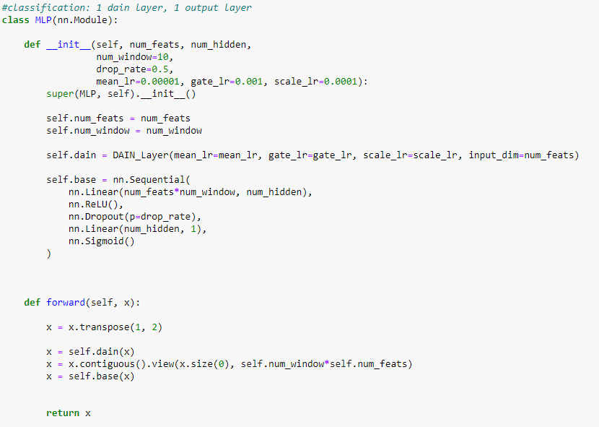
Input data | DataLoader
Features: 453975 x 144 n_samples m_features | X: 128 x 15 x 144 128 is batch_size 15 is window_size 144 is m_features
Targets: 453975 x 1 n_samples 3 classes 2 classes : (0, 1) | y: 128 x 1 128 is batch_size 2 classes (0, 1)
X: transpose(1, 2) | transpose(1, 2) From To 128 x 15 x 144 128x144x15 [batch_size] window_size n_features
From 128 x 15 x 144 | To 128 x 144 x 15
batch size
window size
m features
X: 128 x 15 x 144 >> view(size(0), 15*144)
From To
128 x 15 x 144 128 x 2160
2160 = 15*144

Slide 6
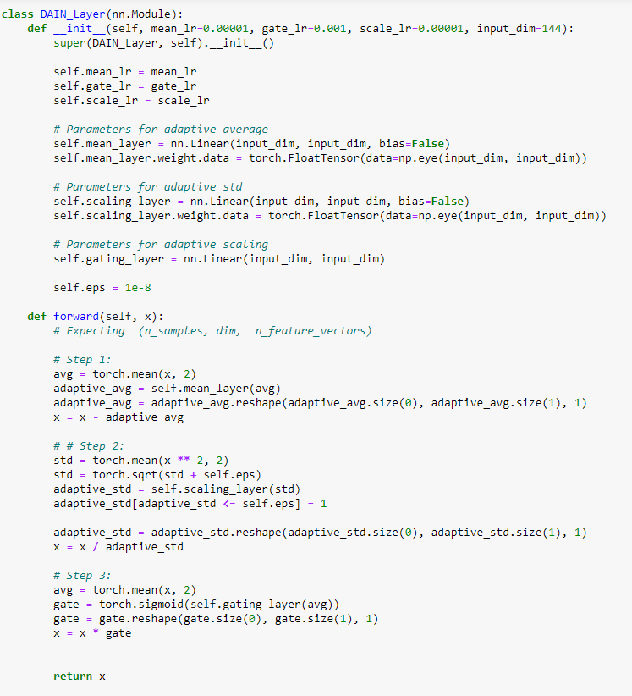
DAIN steps:
mean_layer | mean_lr | Linear(144, 144) w/ weight | x = x – avg
scaling_layer | scale_lr | Linear(144, 144) w/ weight | x = x/std
gating_layer | gate_lr | Linear(144, 144) | X = x*gate gate -> [sigmoid]

Slide 7
Sliding window setup
Gap between train and testing data to avoid any information leak
Testing data
Train data
Window size for DAIN. Data will not be used

