Slide 1
Introduction to
Artificial Intelligence in Games
Lecture 3

Slide 2
AI Search Algorithms
Example: Implement BFS and DFS search algorithms to find the path from S to G.
S
 |  | G

Slide 3
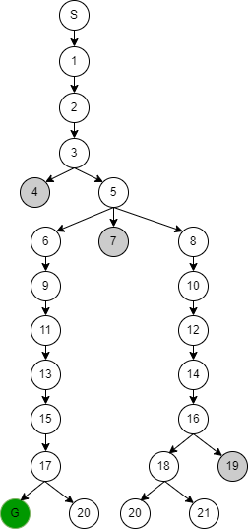
AI Search Algorithms
Solution: BFS Algorithm
S
11
13
15
1
9
G
17
21
2
6
20
18
3
5
7
19
16
4
8
10
12
14
S → 1 → 2 → 3 → 5 → 6 → 9 → 11 → 13 → 15 → 17 → G

Slide 4
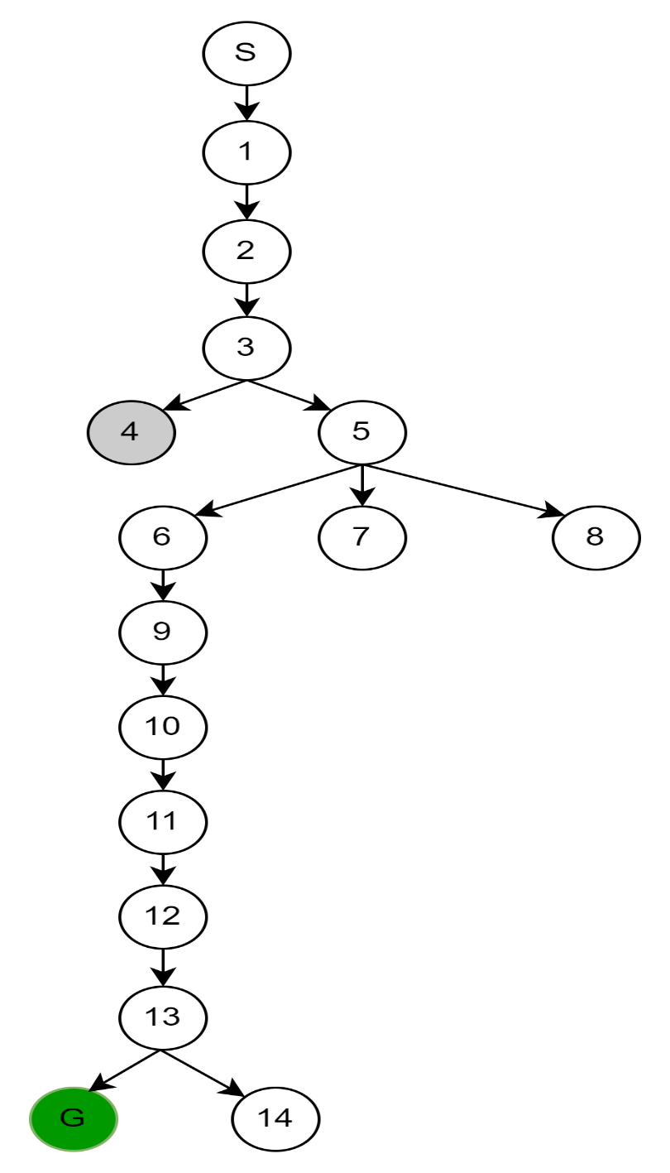
AI Search Algorithms
Solution: DFS Algorithm
S
10
11
12
1
9
G
13
2
6
14
3
5
7
4
8
S → 1 → 2 → 3 → 5 → 6 → 9 → 10 → 11 → 12 → 13 → G

Slide 5
Iterative deepening depth-first Search
This search algorithm finds out the best depth limit for DLS algorithm.
This algorithm performs depth-first search up to a certain "depth limit", and it keeps increasing the depth limit after each iteration until the goal node is found.
This search algorithm combines the benefits of Breadth-first search's fast search and depth-first search's memory efficiency.

Slide 6
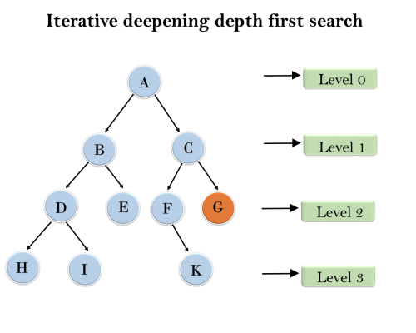
Iterative deepening depth-first Search
Example:
IDDFS algorithm performs various iterations until it finds the goal node.
At each iteration, it increases the depth limit by 1
The iteration performed by the algorithm is given as:
1'st Iteration (depth=0) → A
2'nd Iteration (depth=1) → A, B, C
3'rd Iteration (depth=2) → A, B, D, E, C, F, G
In the third iteration, the algorithm will find the goal node.
How much this algorithm improves the traditional DFS algorithm?

Slide 7
Iterative deepening depth-first Search
Advantages:
It combines the benefits of BFS and DFS search algorithm in terms of fast search and memory efficiency.
Disadvantages:
The main drawback of IDDFS is that it repeats all the work of the previous phase.
Completeness:
This algorithm is complete.
Optimal:
IDDFS algorithm is optimal if path cost is a non- decreasing function of the depth of the node.

Slide 8
Bidirectional Search Algorithm
Bidirectional search algorithm runs two simultaneous searches, one form initial state called as forward-search and other from goal node called as backward-search.
Bidirectional search replaces one single search graph with two small subgraphs in which one starts the search from the start node and other starts from the goal node.
The search stops when these two graphs intersect each other.
Bidirectional search can use search techniques such as BFS, DFS, DLS, etc.

Slide 9
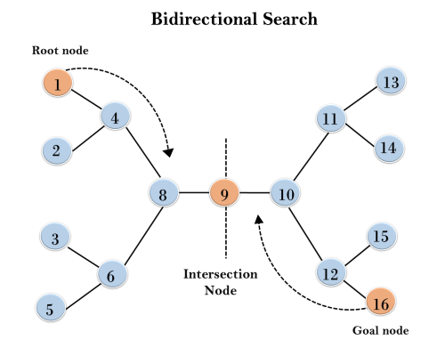
Bidirectional Search Algorithm
Example:
This algorithm divides one graph/tree into two sub-graphs.
It starts traversing from node 1 in the forward direction, and from goal node 16 in the backward direction.
The algorithm terminates at node 9 where two searches meet.

Slide 10
Bidirectional Search Algorithm
Advantages:
Bidirectional search is fast.
Disadvantages:
Implementation of the bidirectional search tree is difficult.
In bidirectional search, one should know the goal state in advance.
Completeness:
Bidirectional Search is complete if we use BFS in both searches.
Optimal:
Bidirectional search is Optimal.

Slide 11
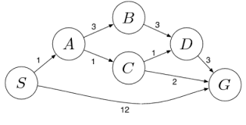
Uniform-Cost Search
It is used when the cost of traversing from one node to another is given (weighted graph).
The primary goal of the uniform-cost search is to find a path to the goal node which has the lowest cumulative cost.
It selects nodes according to their path costs form the root node.
It uses a priority queue instead of a simple queue (used by BFS).
Uniform cost search is equivalent to BFS algorithm if the path cost of all edges is the same.

Slide 12
Uniform-Cost Search
Advantages:
Uniform cost search is optimal because at every state the path with the least cost is chosen.
Disadvantages:
It does not care about the number of steps involve in searching and only concerned about path cost. Due to which this algorithm may be stuck in an infinite loop.
Completeness:
Uniform-cost search is complete, such as if there is a solution, UCS will find it.

Slide 13
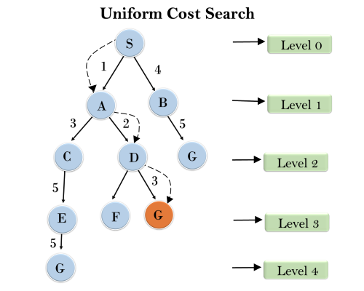
Uniform-Cost Search
Example:
The path which has the minimum path cost (beginning from the root) is S → A → D → G
Path cost = 1 + 2 + 3 = 6

Slide 14
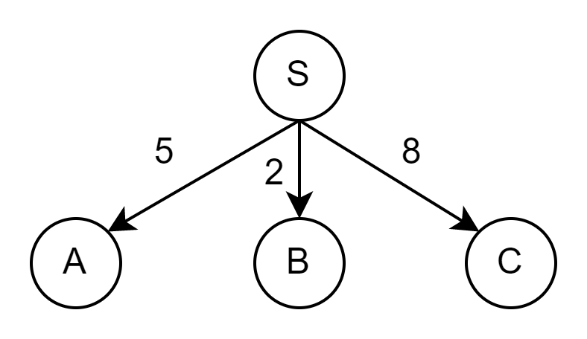
Uniform-Cost Search
Steps
Enqueue nodes by path cost.
That is, let g(n) = cost of the path from the start node to the current node n.
Sort nodes by ascending value of g
If there is more than one path to the same node, keep only the path with the lowest cost in the queue.
Stop when the goal is the first node in the queue
Else, expand nodes starting from the first node in the queue
Ignore back paths to the start node.
Ignore back paths to the parent node.
g(A) = 5
g(B) = 2
g(C) = 8
Sort: {B, A, C}

Slide 15
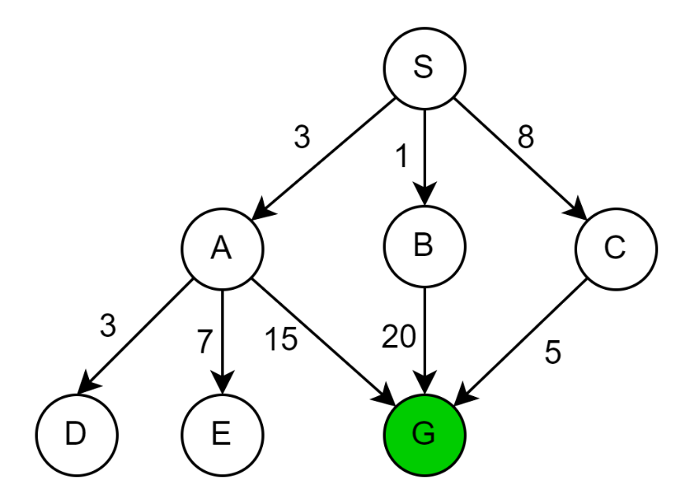
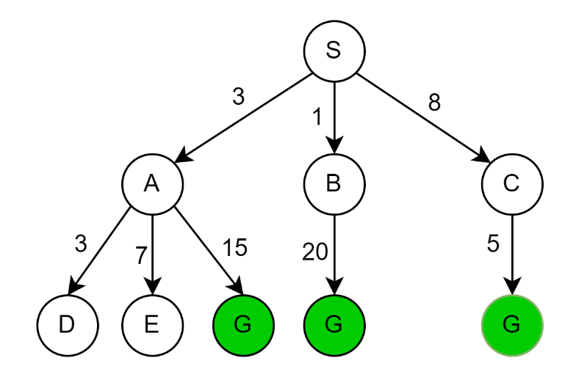
Uniform-Cost Search
Example
Expanded nodes list (sort then expand)
{ S0 }
S0 { B1, A3, C8 }
B1 { A3, C8, G21 }
A3 { D6, C8, E10, G18, G21 }
D6 { C8, E10, G18, G21 }
C8 { E10, G13, G18, G21 }
E10 { G13, G18, G21 }
G13
Solution path found is S → C → G, cost =13
Number of nodes expanded (including goal node) = 7
path cost

Slide 16
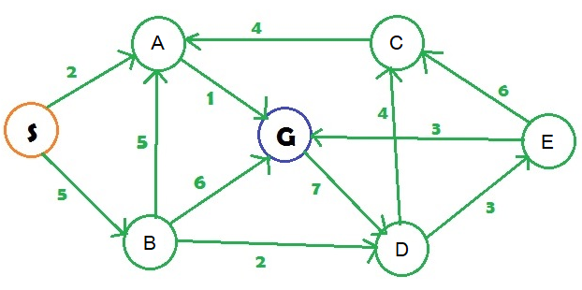
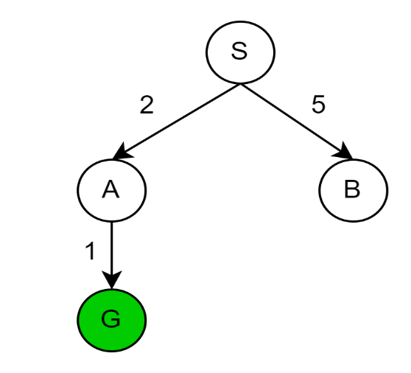
Uniform-Cost Search
Example
Expanded nodes list (sort then expand)
{ S0 }
S0 {A2, B5 }
A2 { G3, B5}
G3
Solution path found is S → A → G, cost= 3
Number of nodes expanded (including goal node) = 3

Slide 17
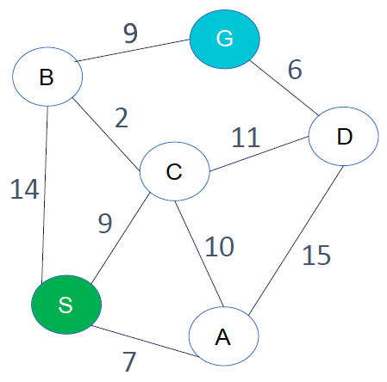
Uniform-Cost Search
Task
Construct the search tree and find the optimum path from S to G using the uniform-cost search algorithm.

Slide 18
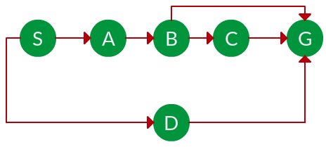
Example
Which solution path would BFS and DFS find to move from node S to node G if run on the graph below?

Slide 19
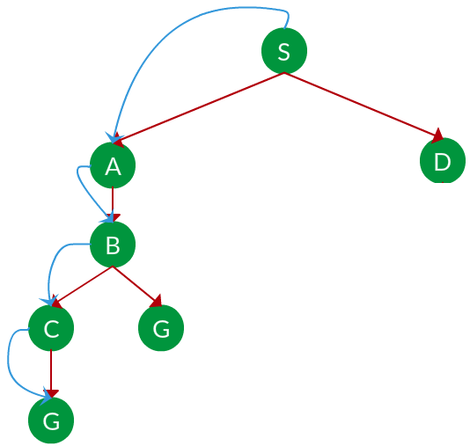
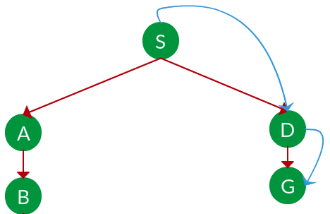
Solution
BFS
DFS
Path: S → D → G
Path: S → A → B → C → G

Slide 20
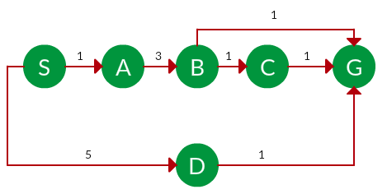
Example
Which solution path would uniform-cost search algorithm find to move from node S to node G if run on the graph below?

Slide 21
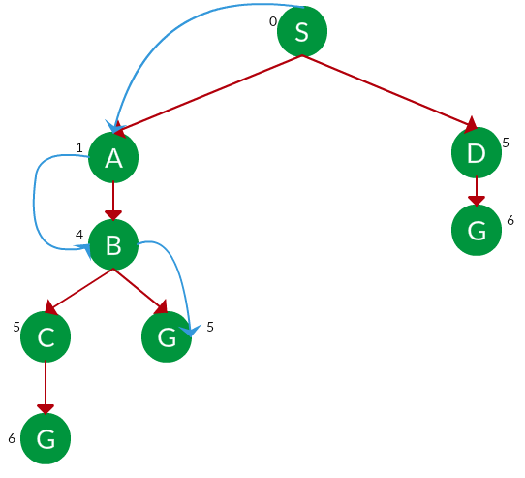
Solution
UCS
Path: S → A → B → G
Path cost : 5

Slide 22


