Slide 2
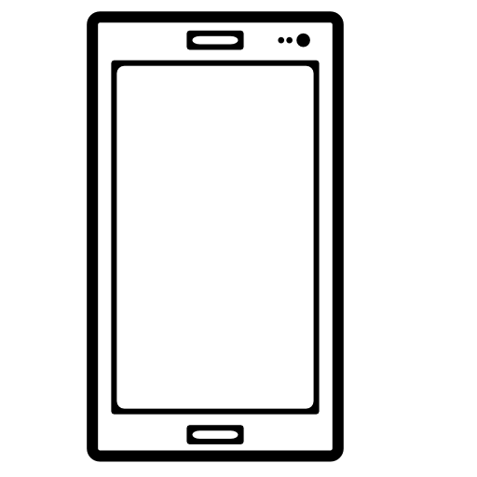


System States
Device
(1)
Network
CPU
Memory
Social Network 1
(2)
(2)
Social Network 2
Activity Transitions and System Events of SN 1’s App
Activity Transitions and System Events of SN 2’s App
DS-SN Correlation
(3)
(3)
Events Sequence of Social Network 1
Events Sequence of Social Network 2
(4)
(4)
SN-SN Correlation
Obtaining system states
Inferring activity transitions
Inferring social network events
Associating device with social network identities

