Slide 2
Input EEG Signal
RCNN Learning
Input layer (FC)
H1 layer (FC)
H2 layer (LSTM)
H3 layer (LSTM)
Output layer (FC)
Concatenated
Features
Prediction
Vector
RNN
Single EEG sample
Low Alpha
High Alpha
Low Beta
High Beta
.
.
.
Convolution
[1,1]
CNN
Pooling
[1,2]
Convolution
[1,2]
Input layer
C 1 layer
P 1 layer
C 2 layer
Output layer

Slide 3

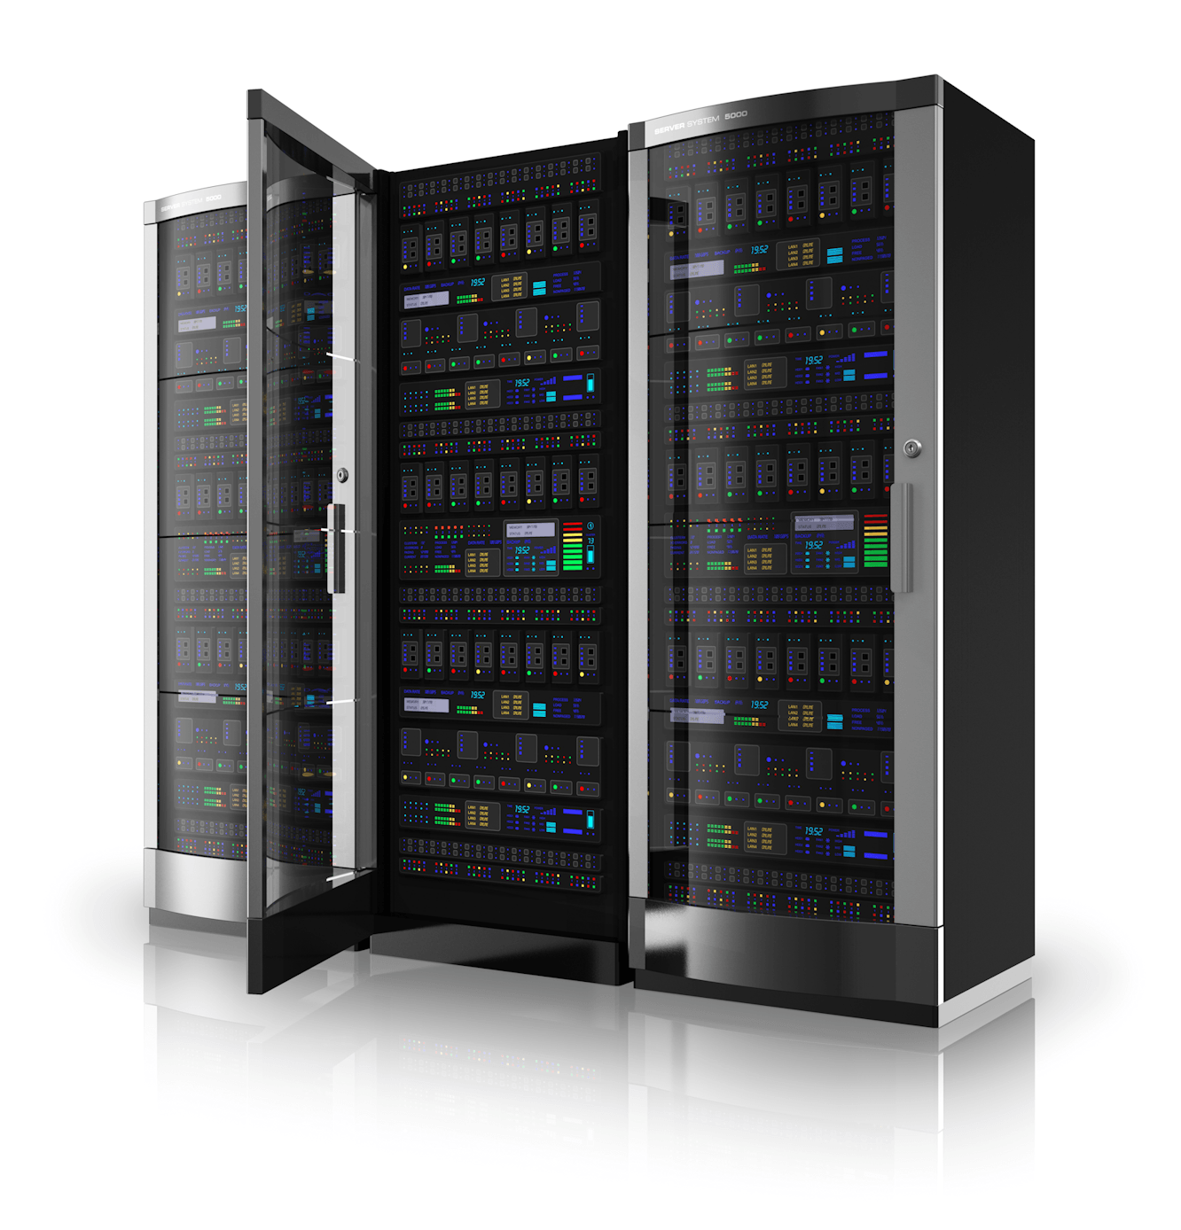
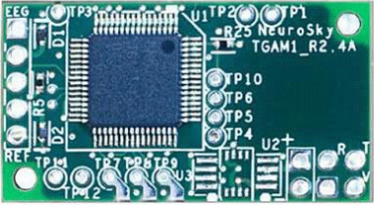
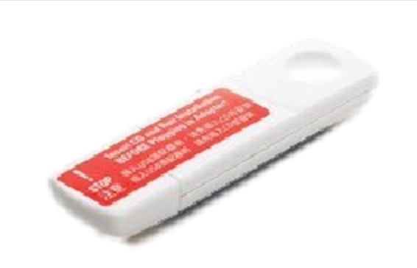
User Application Side
User’s PC
BCI Apps
TGSP Server
TGSP
Headset Side
Standard SDK
TGSP
SDR
Frequency
TGSP
RF Dongle
TGAM
BCI Apps

Slide 4
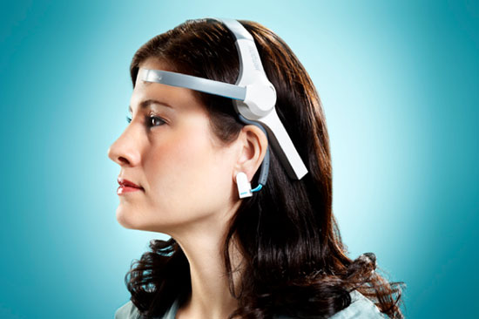
User Application Side
User’s PC
BCI Apps
TGSP Server
TGSP
Headset Side
Standard SDK
TGSP
SDR
Frequency
TGSP
TGAM
RF Dongle
BCI Apps in
Other Platforms

Slide 6
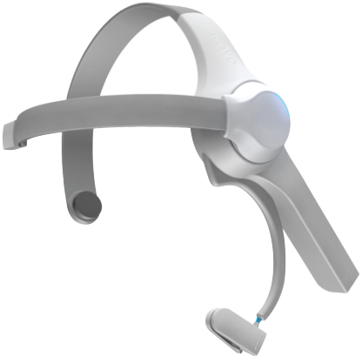

Slide 7
Low Pass Filter
Decimation: 1
Gain: 1
Sample Rate: 4M
Cutoff Freq: 160k
Transition Width: 100k
Window: Hamming
Beta: 6.76
WX GUI FFT Sink
Title: FFT Plot
Sample Rate: 4M
Baseband Freq: 0
Y per Div: 10 dB
Y Divs: 10
Ref Level (dB): 0
Ref Scale (p2p): 2
FFT Size: 1.024k
Refresh Rate: 15
Freq Set Varname: None
Variable
ID: offset_freq
Value: 500k
Variable
ID: samp_rate
Value: 4M
Variable
ID: dc_freq
Value: 2.4579G
Frequency Xlating FIR Filter
Decimation: 1
Taps: 1
Center Frequency: 500k
Sample Rate: 4M
Multiply Const
Constant: 10
Variable
ID: channel_freq
Value: 2.4584G
Osmocom Sink
Device Arguments: so…hackrf
Sample Rate (sps): 4M
Ch0: Frequency (Hz): 2.4584G
Ch0: Freq.Corr. (ppm): 0
Ch0: RF Gain (dB): 0
Ch0: IF Gain (dB): 46
Ch0: BF Gain (dB): 20
Throttle
Sample Rate: 4M
WX GUI FFT Sink
Title: FFT Plot
Sample Rate: 4M
Baseband Freq: 0
Y per Div: 10 dB
Y Divs: 10
Ref Level (dB): 0
Ref Scale (p2p): 2
FFT Size: 1.024k
Refresh Rate: 15
Freq Set Varname: None
File Source
File: …oject/eeg_sample.raw
Value: Yes

Slide 8
Variable
ID: samp_rate
Value: 4M
QT GUI Time Sink
Number of Points: 1.024k
Sample Rate: 4M
Autoscale: No
Osmocom Sink
Device Arguments: hackrf
Sample Rate (sps): 4M
Ch0: Frequency (Hz): 2.4584G
Ch0: Freq.Corr. (ppm): 0
Ch0: DC Offset Mode: off
Ch0: IQ Balance Mode: off
Ch0: Gain Mode: Manual
Ch0: RF Gain (dB): 0
Ch0: IF Gain (dB): 20
Ch0: BF Gain (dB): 20
File Sink
File: …oject/eeg_sample.raw
Unbuffered: off
Append file: Overwirite
QT GUI Time Sink
FFT Size: 1.024k
Center Frequency (Hz): …79G
Bandwidth (Hz): 4M
Update Rate: 10
Variable
ID: dc_freq
Value: 2.4579G

Slide 9
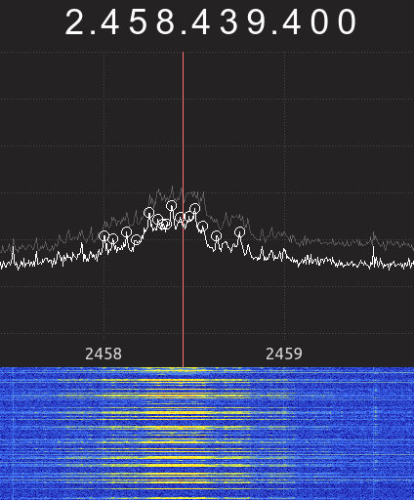

Slide 10
NeuroSky
Service-providing
Server
User
BCI App
Thinkgear.dll/
TGSP Server
1. Register
2. App ID, App Secret
3. App ID, App Secret
4. App ID, App Secret
5. App ID
6. User grants
permission
7. Access Token
8. Access Token
9. Access Token
10. EEG Data

Slide 11
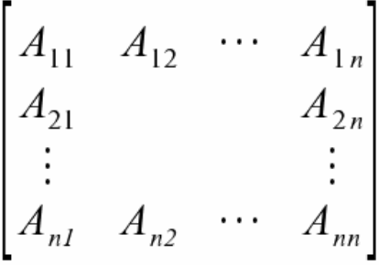
输入数据
循环卷积神经网络结构
循环神经网络
物联网设备固件
控制流图及数据流图
的邻接矩阵
物联网设备固件
漏洞分类
自动编码器
自动解码器
卷积神经网络
针对物联网恶意攻击
控制流图及数据流图
的邻接矩阵
针对物联网的
恶意攻击分类

