Slide 1
More Neural Network

Slide 2
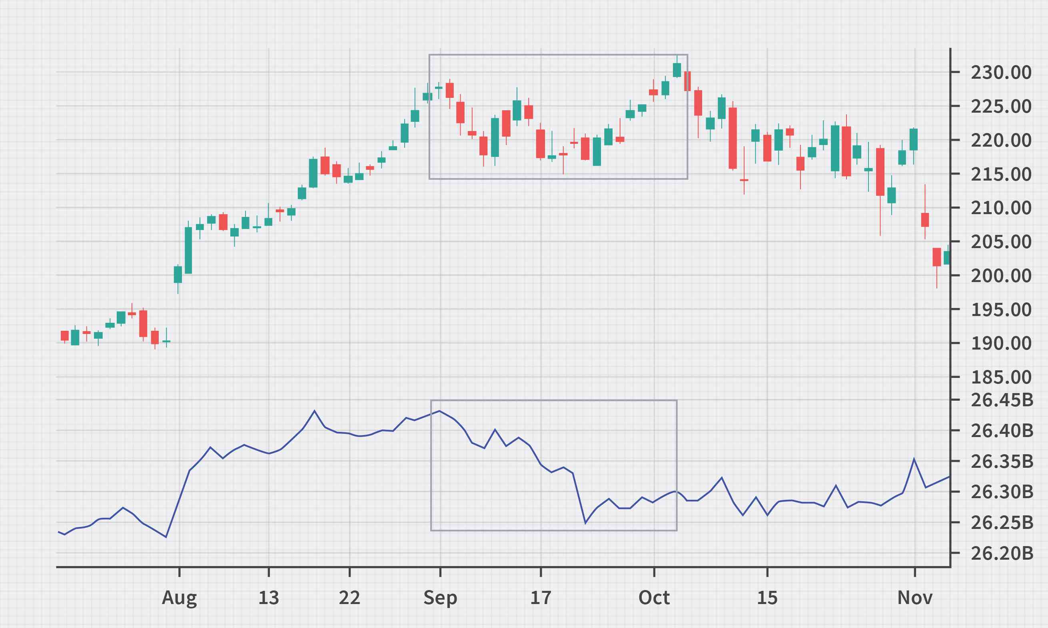
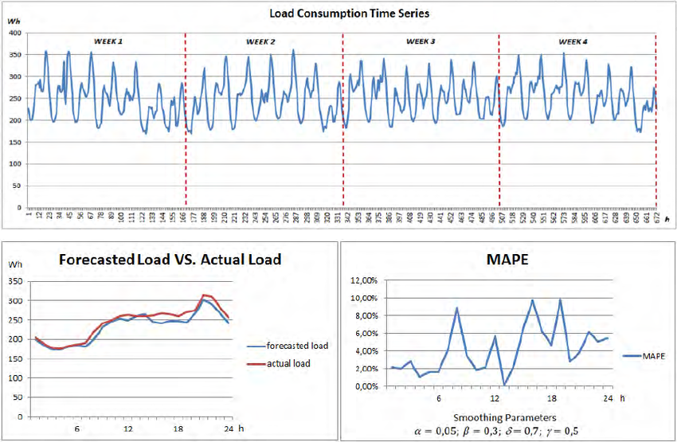
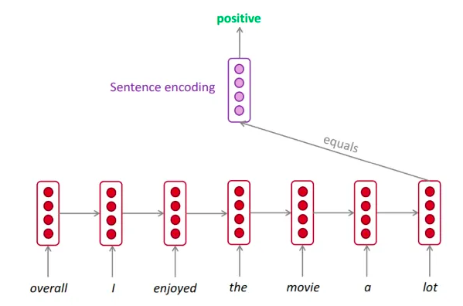
Recurrent Neural Network
时间序列预测、分类
What is a time series
A time series is a sequence of data points that occur in successive order over some period of time.

Slide 3
Neural Network structure
Standard Neural Networks are DAGs (Directed Acyclic Graphs). That means they have a topological ordering.
The topological ordering is used for activation propagation, and for gradient back-propagation.
They process one input instance at a time.
Conv 3x3
ReLU
Conv 3x3
+

Slide 4





Recurrent Neural Networks (RNNs)
Recurrent networks introduce cycles and a notion of time.
They are designed to process sequences of data $x_{1},…,x_{n}$ and can produce sequences of outputs $y_{1},…,y_{m}$.
$$x_{t}$$
$$y_{t}$$
$$h_{t−1}$$
$$h_{t}$$
One-step delay

Slide 5






















Unrolling RNNs
RNNs can be unrolled across multiple time steps.
This produces a DAG which supports backpropagation.
But its size depends on the input sequence length.
$$x_{t}$$
$$y_{t}$$
$$y_{0}$$
Usually drawn as:
$$x_{0}$$
$$h_{t−1}$$
$$h_{t}$$
$$h_{0}$$
$$y_{0}$$
$$y_{1}$$
$$y_{2}$$
$$y_{1}$$
One-step delay
$$x_{1}$$
$$h_{0}$$
$$h_{1}$$
$$h_{2}$$
$$h_{1}$$
$$y_{2}$$
$$x_{0}$$
$$x_{1}$$
$$x_{2}$$
$$x_{2}$$
$$h_{2}$$

Slide 6


















RNN structure
Often layers are stacked vertically (deep RNNs):
$$y_{10}$$
$$y_{11}$$
$$y_{12}$$
$$h_{10}$$
$$h_{11}$$
$$h_{12}$$
Same parameters at this level
$$x_{00}$$
$$x_{01}$$
$$x_{02}$$
≠
Abstraction
Higher level features
$$y_{00}$$
$$y_{01}$$
$$y_{02}$$
$$h_{00}$$
$$h_{01}$$
$$h_{02}$$
Same parameters at this level
$$x_{0}$$
$$x_{1}$$
$$x_{2}$$
Time

Slide 7
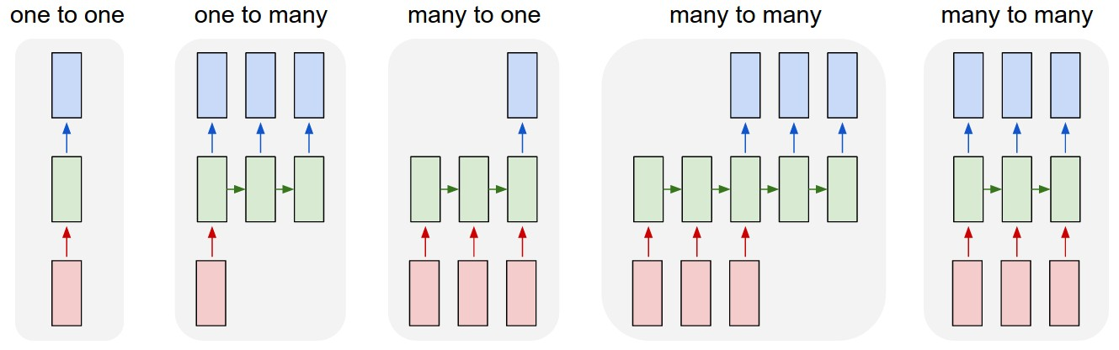
Recurrent Networks offer a lot of flexibility:
e.g. Machine Translation
seq of words -> seq of words
e.g. Image Captioning
image -> sequence of words
Vanilla Neural Networks
e.g. Sentiment Classification
sequence of words -> sentiment
e.g. Video classification on frame level

Slide 8


y
Recurrent Neural Network
We can process a sequence of vectors x by applying a recurrence formula at every time step:
RNN
x
new state
old state
input vector at some time step
some function
with parameters W
Notice: the same function and the same set of parameters are used at every time step.

Slide 9
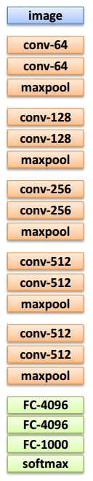

test image
y0
y1
y2
sample
<END> token
=> finish.
Image
Representation
h0
h1
h2
x0
<START>
straw
hat
<START>

Slide 10
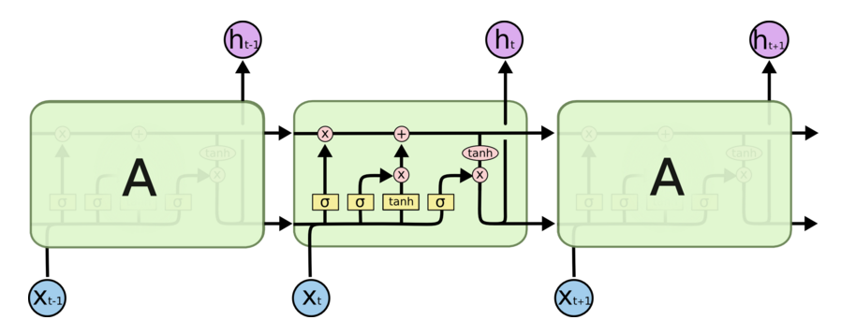
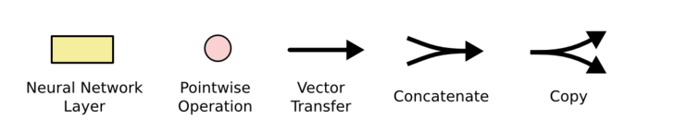
Architecture for an LSTM
“Bits of memory”
Decide what to forget
Decide what to insert
Longterm-short term model
Combine with transformed x_{t}
σ: output in [0,1]
tanh: output in [-1,+1]
http://colah.github.io/posts/2015-08-Understanding-LSTMs/
Notes:
Info is transferred down the chain, not just propagated
Decide when to insert imformation from input into the “backbone”

Slide 11
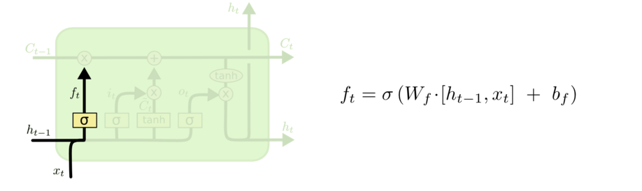
Walkthrough
What part of memory to “forget” – zero means forget this bit

Slide 12
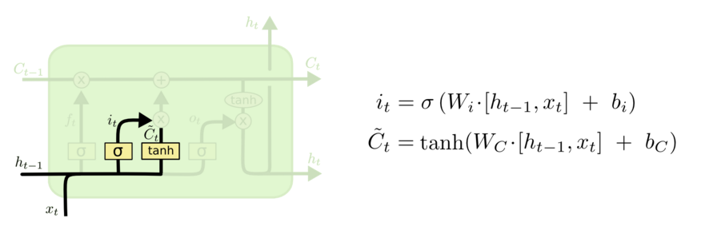
Walkthrough
What bits to insert into the next states
What content to store into the next state
http://colah.github.io/posts/2015-08-Understanding-LSTMs/

Slide 13
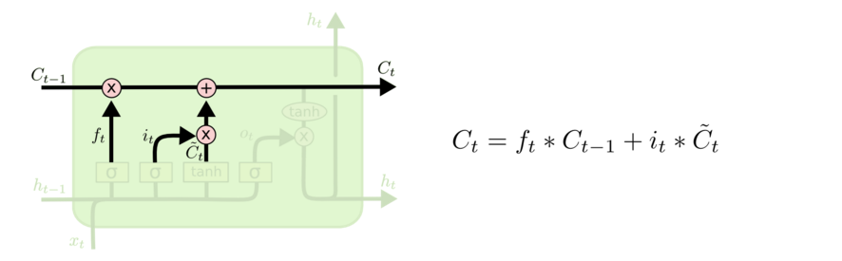
Walkthrough
Next memory cell content – mixture of not-forgotten part of previous cell and insertion
http://colah.github.io/posts/2015-08-Understanding-LSTMs/

Slide 14
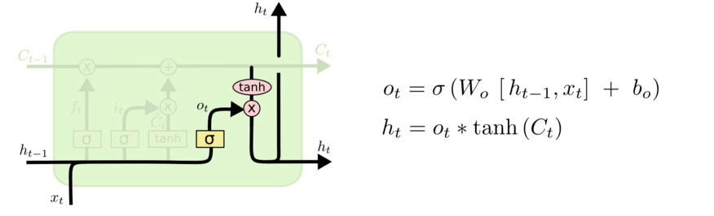
Walkthrough
What part of cell to output
tanh maps bits to [-1,+1] range
http://colah.github.io/posts/2015-08-Understanding-LSTMs/

Slide 15
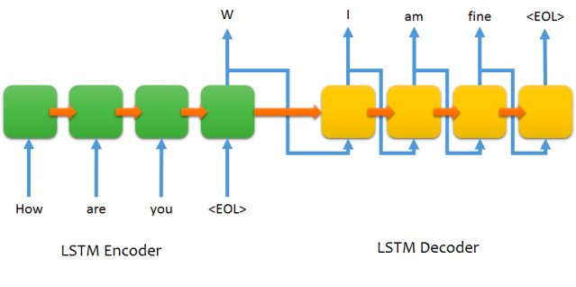
Encoder-Decoder LSTM structure for chatting

Slide 16
Demo Stock price prediction

Slide 17
Homework-Household power consumption prediction

Slide 18
/ Attention/ Transformers /
Motivation:
Slow to train (inefficient / not parallelizable)
Suffer from exploding or vanishing gradients
Cannot handle very long-term dependencies

Slide 19
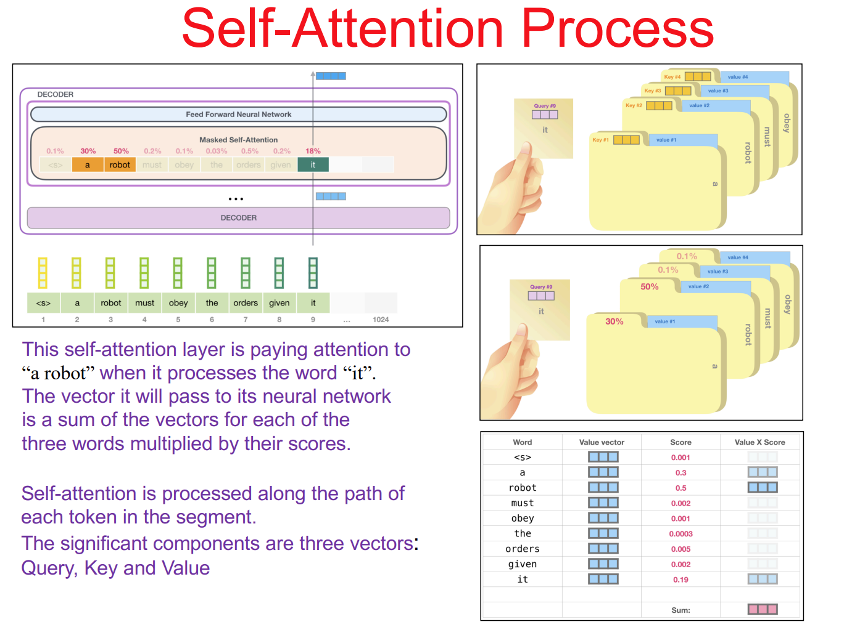
Self-Attention

Slide 20
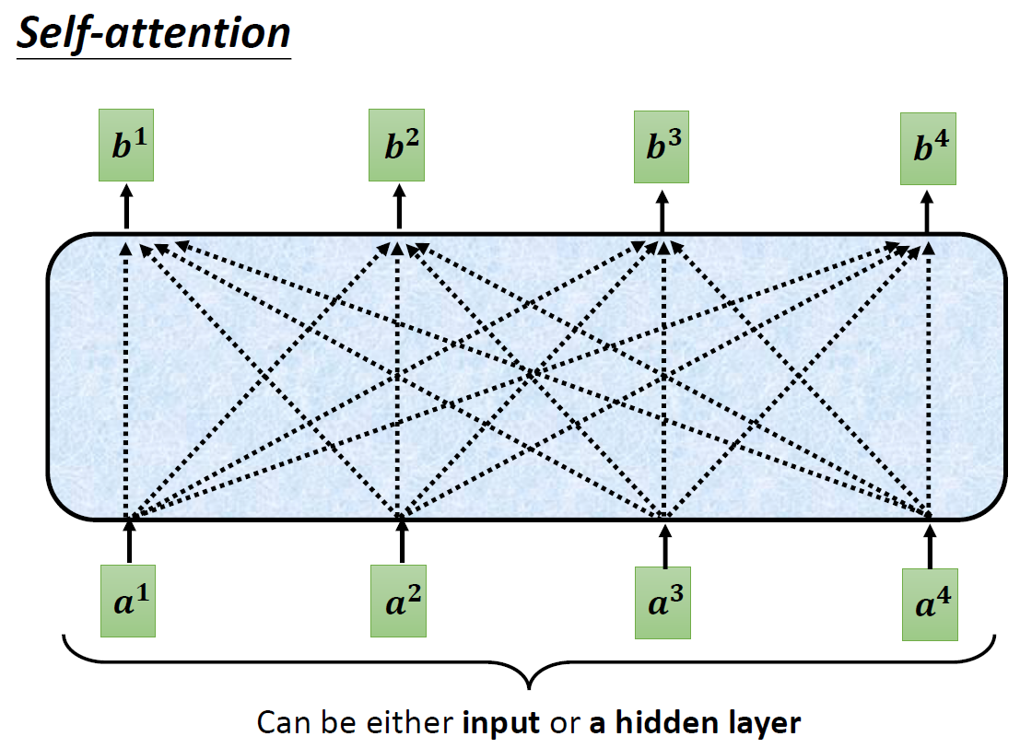

Slide 21
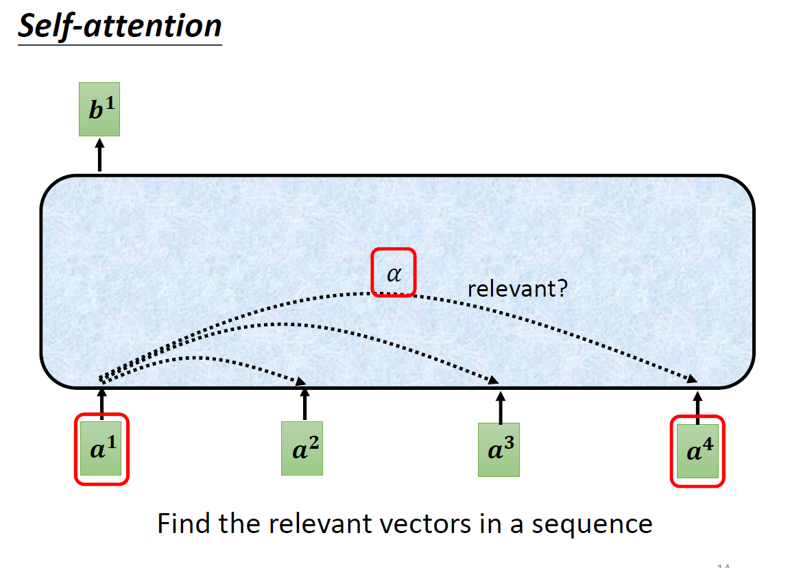

Slide 22
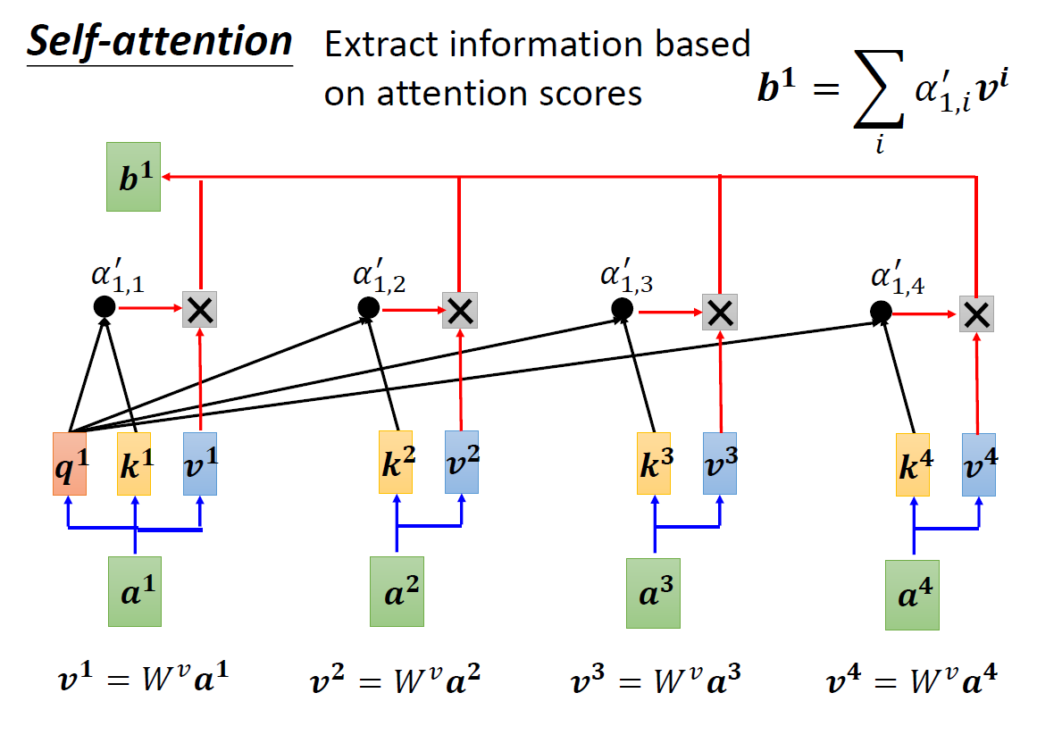

Slide 23
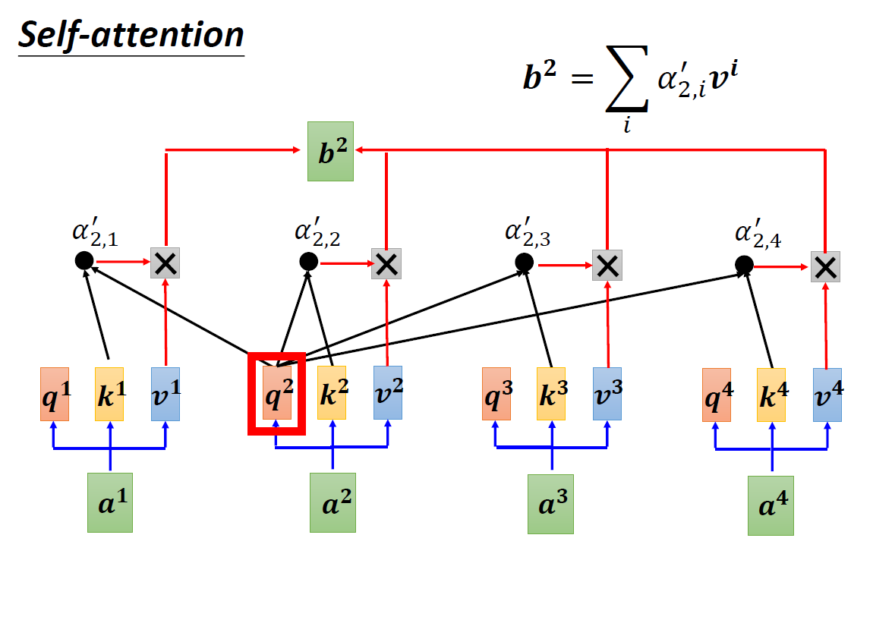

Slide 24
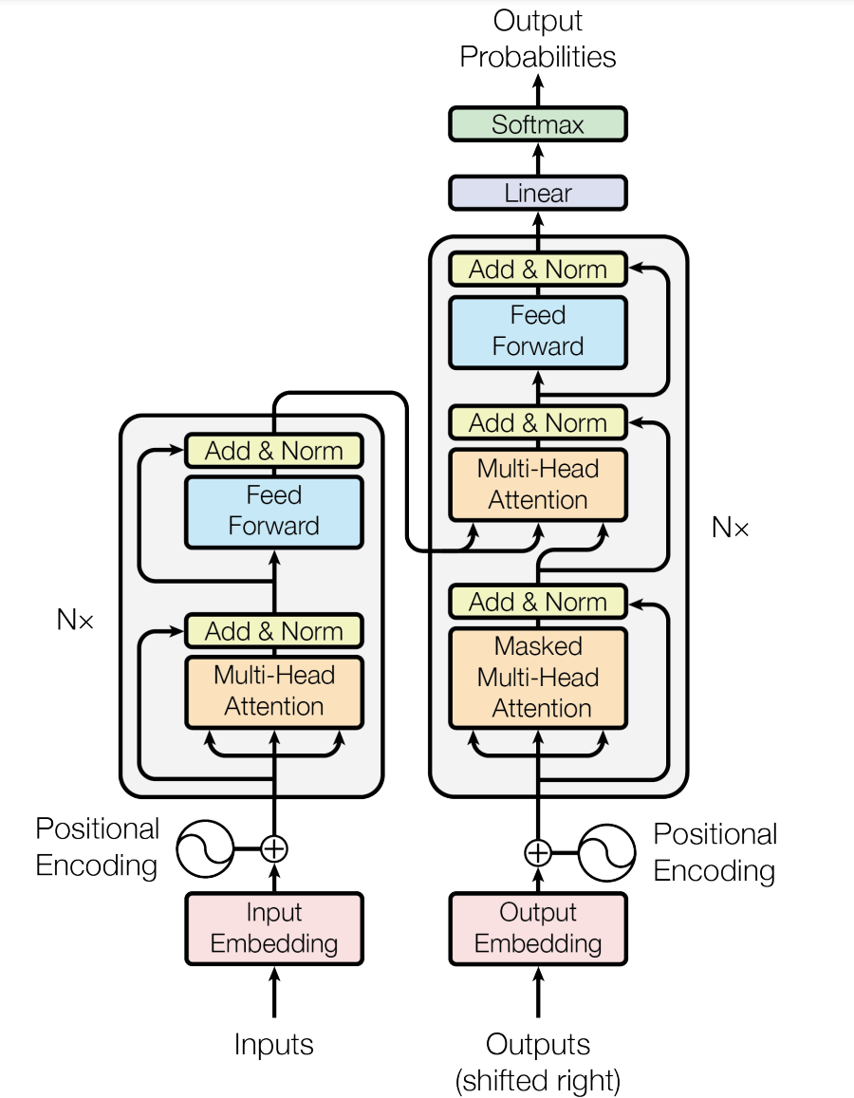
Transformer

Slide 25
