Slide 1
PART 01
LLM for Insurance Sector

Slide 2
Benefits for Agents and Customers
01
Automated Customer Support
Personalized Recommendations
With the help of LLMs, customers can get immediate responses to their queries, be it policy details, claim status, or any other information, leading to increased customer satisfaction.
LLMs can analyze a customer's requirements based on their interactions and provide tailored insurance product recommendations, ensuring a more personalized shopping experience.
02
03
Streamlined Claims Processing
By utilizing LLMs, the process of claim initiation and status checks can be simplified, allowing claims to be processed faster and with less manual intervention.
Continuous Learning and Training
04
Agents can leverage LLMs to keep themselves updated with the latest insurance products, market trends, and best practices, ensuring they always offer the best to their clients.

Slide 3
Detailed Use Cases
Interactive Policy Finder:
Scenario: A customer is unsure about which insurance policy to choose.
Implementation: An LLM-powered chatbot can ask the customer a series of questions about their needs, analyze the answers, and then recommend the most suitable insurance policy.
Outcome: The customer feels valued and understood, leading to higher chances of policy purchase.
Automated Claim Status Checker:
Scenario: A customer wants to know the status of their claim.
Implementation: Instead of navigating through complex IVR systems or waiting for a human agent, the customer can simply ask the LLM-powered system about their claim status.
Outcome: The customer gets an instant and accurate update on their claim status, leading to increased trust in the insurance provider.
01
02

Slide 4
Detailed Use Cases
Knowledge Base for Agents:
Scenario: An insurance agent is confronted with a unique case or a rarely chosen policy and needs information quickly.
Implementation: The agent can ask an LLM-powered system, which instantly provides detailed information, potential pitfalls, and best practices related to that specific case or policy.
Outcome: Agents can handle unique cases with confidence and efficiency, leading to better service delivery and increased sales.
Automated Claim Status Checker:
Scenario: A customer wants to know the status of their claim.
Implementation: Instead of navigating through complex IVR systems or waiting for a human agent, the customer can simply ask the LLM-powered system about their claim status.
Outcome: The customer gets an instant and accurate update on their claim status, leading to increased trust in the insurance provider.
03
04

Slide 5
PART 02
Challenges & Comparisons

Slide 6
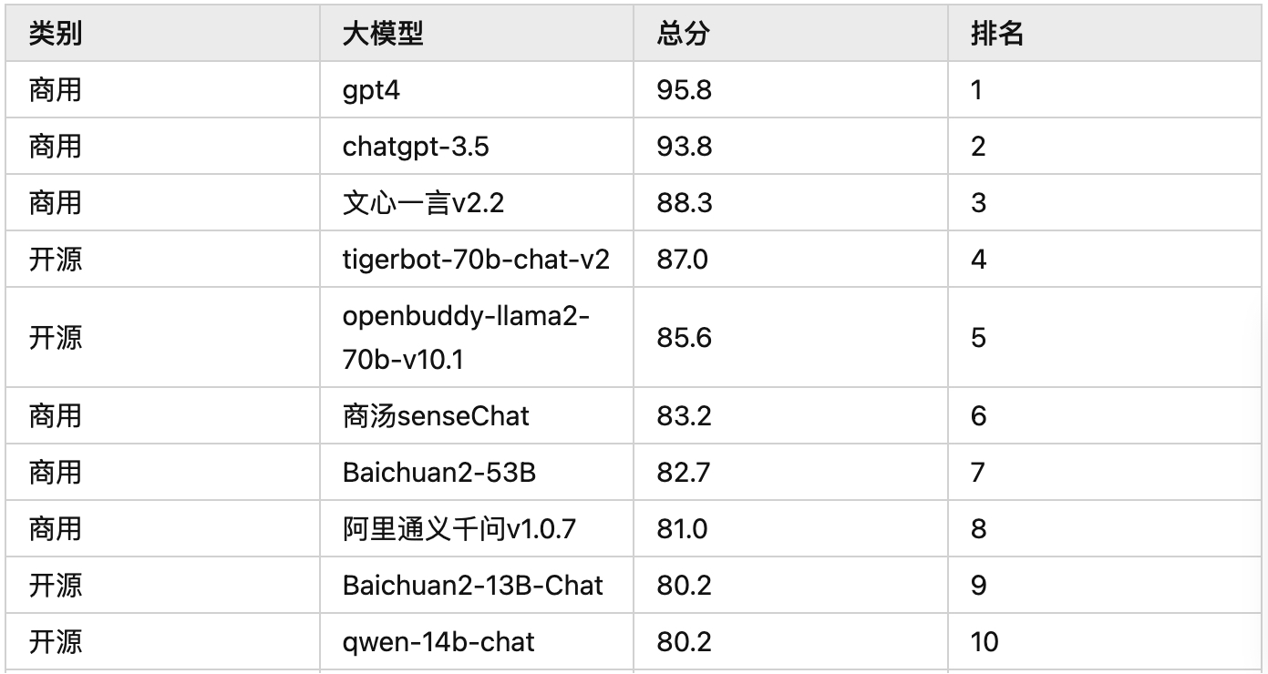
CLiB Chinese Large Model Capability Evaluation
Overall Capability Leaderboard

Slide 7
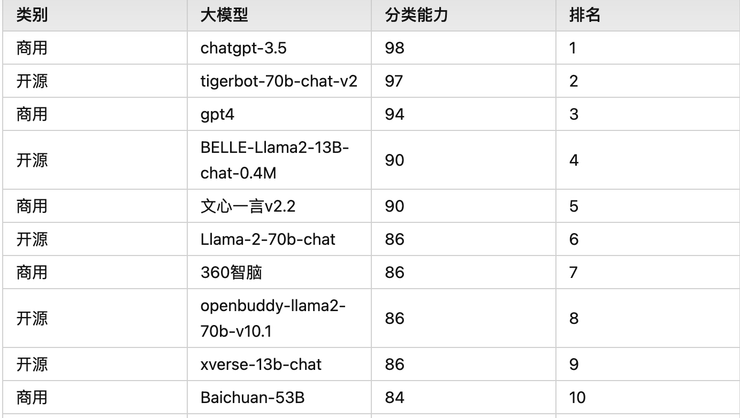
Classification Capability

Slide 8
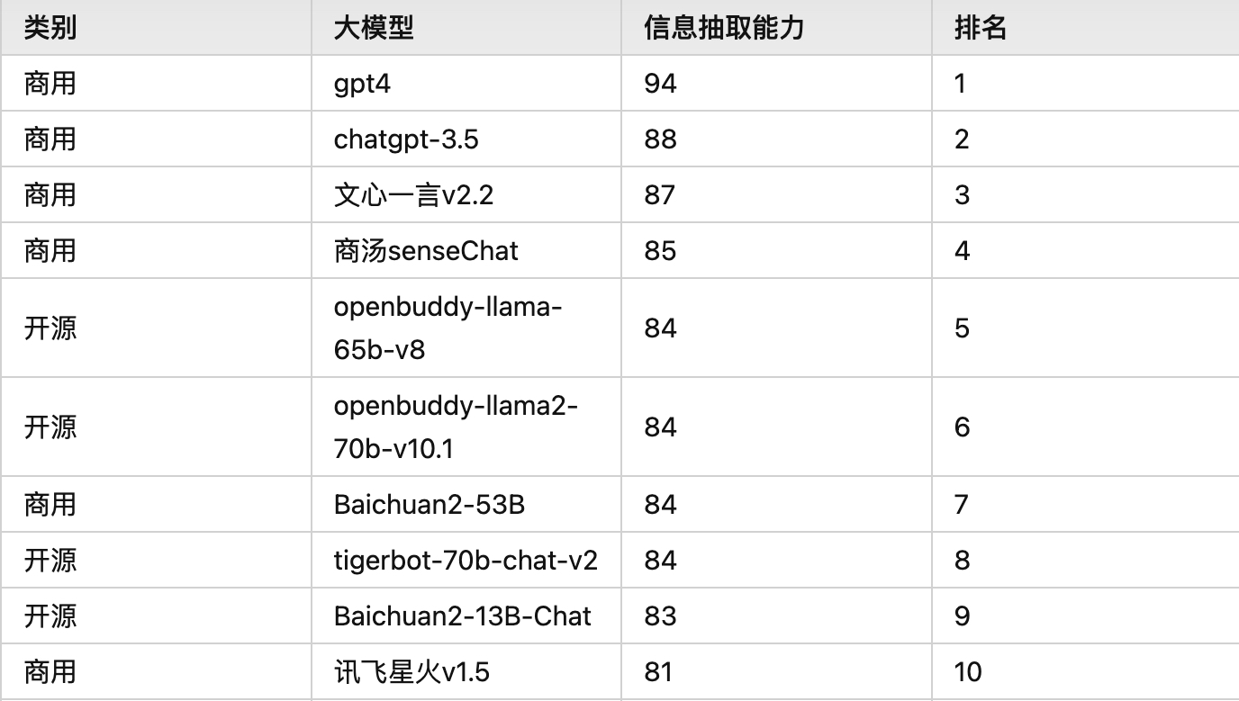
Information Extraction Capability

Slide 9
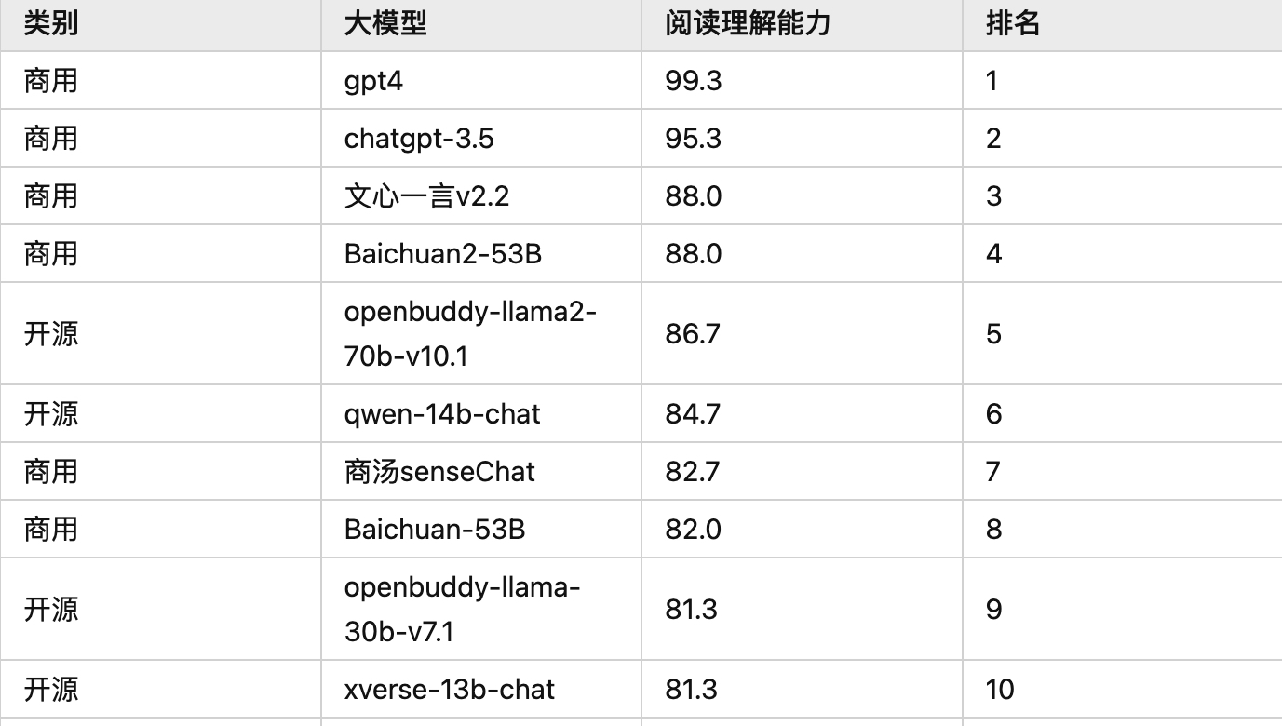
Reading Comprehension Capability

Slide 10
Capability Gap: The Chinese models still lag behind GPT-4 in terms of overall capabilities.
Quality of Generation: Chinese models exhibit deficiencies in terms of content generation quality and performance in specific NLP tasks.
Model Parameters and Data Volume: With the proliferation of large Chinese models, there's an emphasis on model parameters and data volume. Most are focused on the sheer size and scale.
Bridging the Gap with GPT-4: Companies, such as Moon's Dark Side, attempt to narrow the gap with GPT-4 by enhancing model context token limits and improving text parsing capabilities.
Specialized Models: Some enterprises are creating domain-specific models, targeting fields like law and healthcare, aiming to enhance the practical deployment of these large models in commercial sectors.
Training in the Chinese Internet Context: Given that these models are trained on the Chinese internet, they exhibit more localized behaviors, especially when addressing questions related to local policies or when subjected to safety reviews specific to the Chinese online environment.

Slide 11
Reference
https://zhuanlan.zhihu.com/p/634608422
http://www.csia-jpw.com/UserFiles/Article/file/6382890297670230551053527.pdf
https://github.com/wgwang/LLMs-In-China
https://github.com/LaVi-Lab/CLEVA/blob/main/README_zh-CN.md
http://www.lavicleva.com/#/homepage/overview

