Slide 1
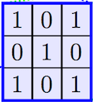
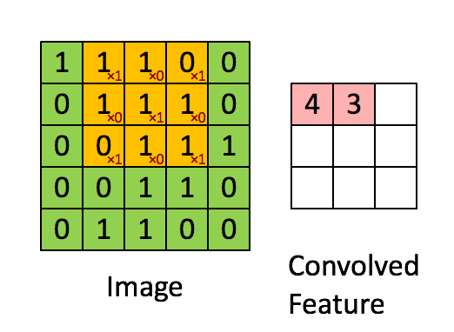
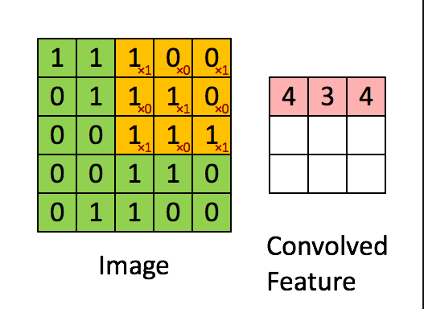
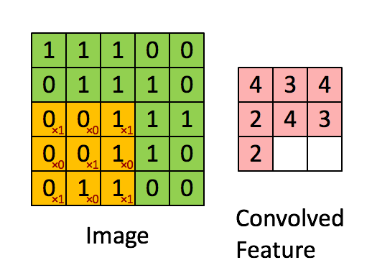
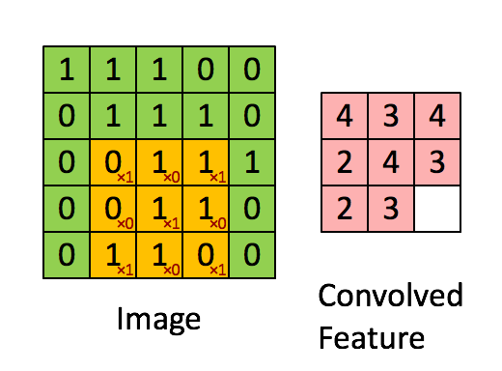
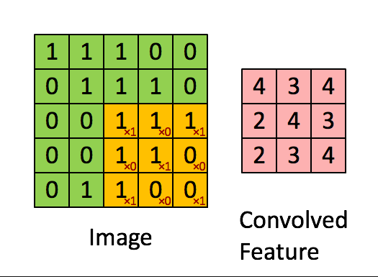

Example: Convolution with Scanning
1x1=1 | 1x0=0 | 0x1=0
1x0=0 | 1x1=1 | 1x0=0
0x1=0 | 1x0=0 | 1x1=1
= 3
The kernel is
Example：

