Slide 1
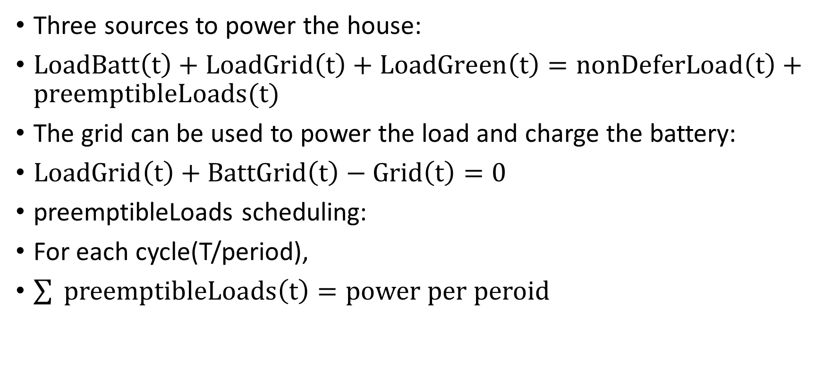
Three sources to power the house:
$LoadBatt\left(t\right)+LoadGrid\left(t\right)+LoadGreen\left(t\right)=nonDeferLoad\left(t\right)+preemptibleLoads(t)$
The grid can be used to power the load and charge the battery:
$LoadGrid\left(t\right)+BattGrid\left(t\right)−Grid\left(t\right)=0$
preemptibleLoads scheduling:
For each cycle(T/period),
$\sum{ preemptibleLoads\left(t\right)=power per peroid }$

Slide 2

The grid can be used to power the load and charge the battery:
$LoadGrid\left(t\right)+BattGrid\left(t\right)−Grid\left(t\right)=0$

Slide 3

preemptibleLoads scheduling:
For each cycle(T/period),
$\sum{ preemptibleLoads\left(t\right)=power per peroid }$

Slide 4

Objective function:
$Total electricity cost m=\sum{(GridCost\left(t\right)∗Grid\left(t\right)−α∗GridCost\left(t\right)∗NetGreen\left(t\right))}$

