Slide 1

Total battery charge rate cannot be higher than BattCapa/4
$BattGreen\left(t\right)+BattGrid(t)≤BattCapa/4$

Slide 2

Power discharged from the battery is never greater than the power charged to the battery
$\sum{LoadBatt\left(t\right)}−BattE$* $\sum{\left(BattGreen\left(t\right)+BattGrid\left(t\right)\right)≤0}$

Slide 3

The energy stored in battery, which is the difference between the energy charged to or discharged from the battery over the previous time intervals, cannot be greater than its capacity:
$\sum{BattGreen\left(t\right)+ \sum{BattGrid\left(t\right)−\left(\frac{1}{BattE}\right)∗ \sum{LoadBatt(t)≤}}}BattCapa$

Slide 4

The renewable power, Green(t), may be used to run the LoadGreen(t), to charge the battery(BattGreen(t)), and/or ner metering (NetGreen(t)):
$LoadGreen\left(t\right)+BattGreen\left(t\right)+NetGreen\left(t\right)≤Green(t)$

Slide 5
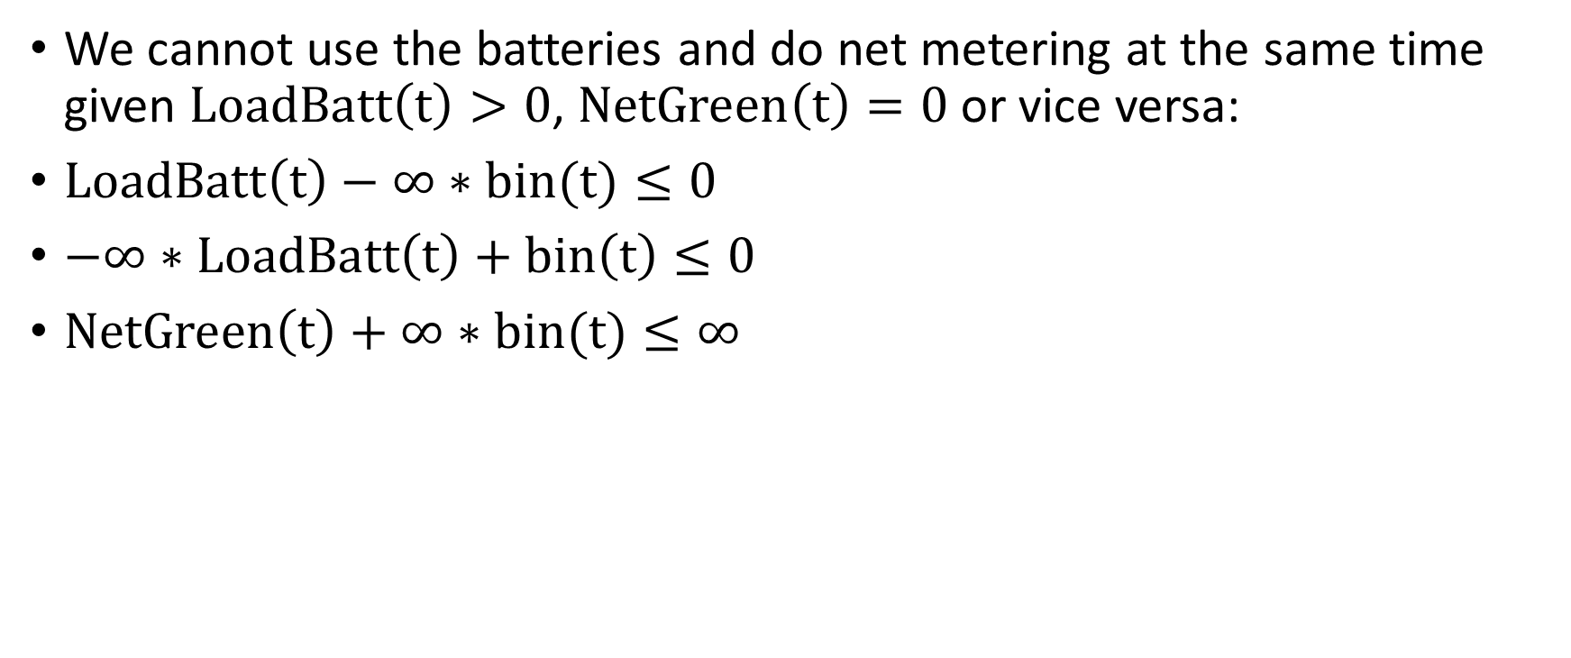
We cannot use the batteries and do net metering at the same time given $LoadBatt\left(t\right)>0$, $NetGreen\left(t\right)=0$or vice versa:
$LoadBatt\left(t\right)−∞∗bin(t)≤0$
$−∞∗LoadBatt\left(t\right)+bin\left(t\right)≤0$
$NetGreen\left(t\right)+∞∗bin(t)≤∞$

Slide 6
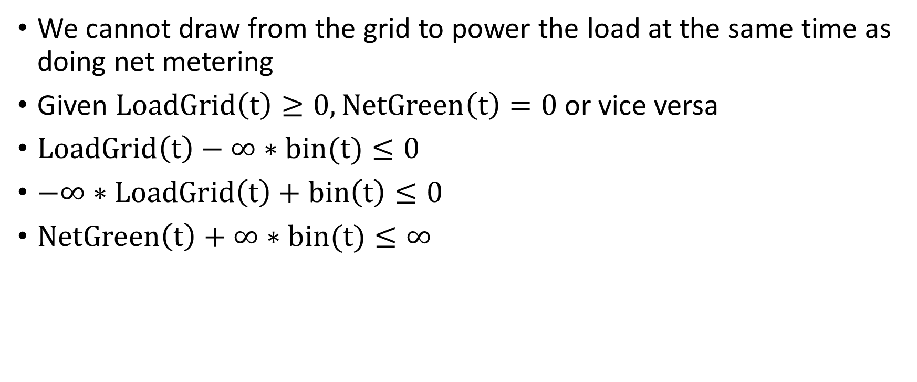
We cannot draw from the grid to power the load at the same time as doing net metering
Given $LoadGrid\left(t\right)≥0,NetGreen\left(t\right)=0$or vice versa
$LoadGrid\left(t\right)−∞∗bin(t)≤0$
$−∞∗LoadGrid\left(t\right)+bin\left(t\right)≤0$
$NetGreen\left(t\right)+∞∗bin(t)≤∞$

Slide 7
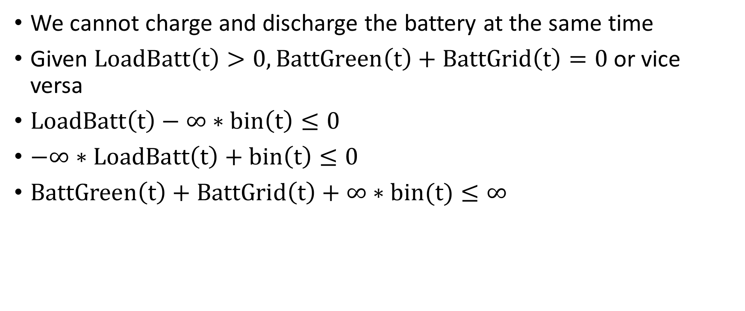
We cannot charge and discharge the battery at the same time
Given $LoadBatt\left(t\right)>0,BattGreen\left(t\right)+BattGrid\left(t\right)=0$or vice versa
$LoadBatt\left(t\right)−∞∗bin\left(t\right)≤0$
$−∞∗LoadBatt\left(t\right)+bin\left(t\right)≤0$
$BattGreen\left(t\right)+BattGrid\left(t\right)+∞∗bin(t)≤∞$

