Slide 1
Shift, Store, or Sell: Analyzing Scheduling Freedom in Smart Homes
Ye Xu
Wei Li
Zhefan Lin
Xi Zhang

Slide 2
Overview: Big Picture
Why: many utilities from fixed rate pricing models to new market-based schemes, e.g., real-time or time-of-use
significant burden on consumers.
need to continuously monitor prices
alter usage manually to reduce costs without disrupting normal daily activities
Main Purposes: by intelligent management of workloads and the sources of energy, for:
Cost reduction in electricity

Slide 3
Outline
Overview
Background
Related Work
Algorithm
Experimental Evaluation
Limitations and Future Work
Conclusion

Slide 4
U.S. Energy Consumption
Energy Consumption Structure
Building Consumption——38.9%
Electrical in Building——74%
Lighting
Computing
HVAC
Residential and Commercial
Increasing Cost of Electricity

Slide 5
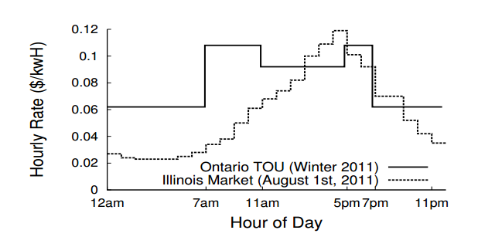
New Market-based Schemes
Example TOU and hourly market-based rate plans in Ontario and Illinois, respectively

Slide 6
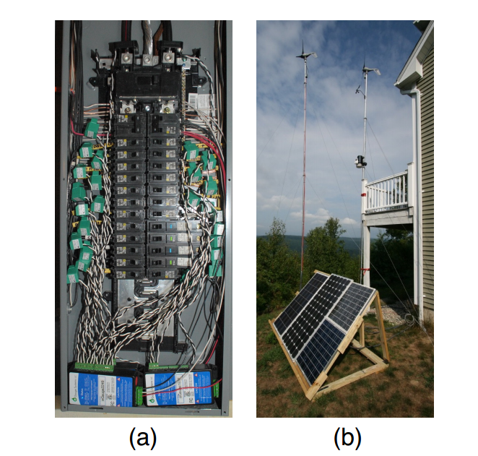
Houses Powered with Renewable Sources and Storage
Current transducers(CT) installation at the mains panel (a);solar panel and micro wind turbines(b).

Slide 7
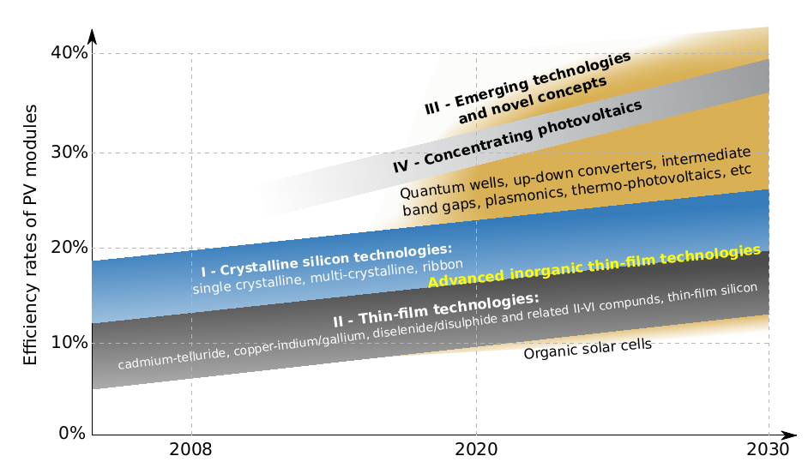
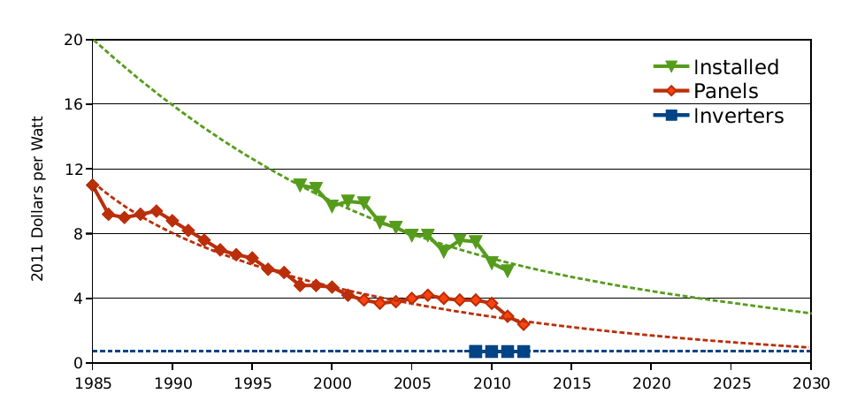
Space and cost of solar energy
Space: solar PV efficiency would represent a 50+% increment in space requirements.
Capital Cost: solar energy has become substantially cheaper over time.

Slide 8
Common Solutions for Home
Simplest Way(with/without renewable sources and/or battery storage)
Use Less Electricity
Quality of Life——Negative
Operate Appliance Based on Electricity Market Price
No Idea about the Specification of Appliances

Slide 9
Our Goals
When and How Much to Store Low-cost Energy
When to Use Solar Energy or Power Energy
When to Turn on or Turn off Appliance

Slide 10
Outline
Overview
Background
Related Work
Algorithm
Experimental Evaluation
Limitations and Future Work
Conclusion

Slide 11
Smart Charge
Smart Charge
An Intelligent Charging and Discharging System
Based on expectations of future demand
Linear Optimization
Power Data
UPS System

Slide 12
Parasol & Green Switch
Parasol & Green Switch
Manage Datacenter——Energy Quantified
Energy sources scheduling
Workloads time scheduling
Based on the Real Data Experimental Evaluations
The Tradeoffs of Building a solar Powered Datacenter

Slide 13
Limitations or Differences
Smart Charge:
Doesn’t take into account the use of renewable source
Also no workload time scheduling
Parasol and Green Switch:
A “kitchen-sink” approach
But for Data Centers
Home appliances completely different power usage pattern
Doesn’t have non pre-emptible loads
All deferrable loads have the same pattern(period, deadline, etc.)

Slide 14
Outline
Overview
Background
Related Work
Algorithm
Experimental Evaluation
Limitations and Future Work
Conclusion

Slide 15
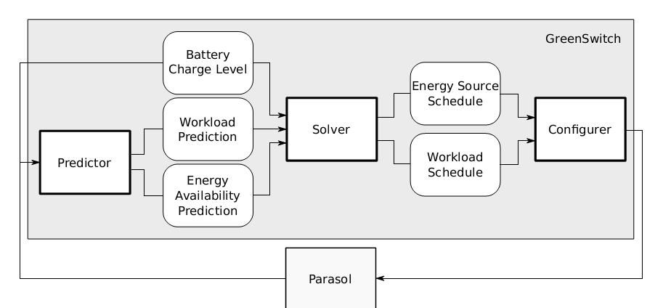
Architecture for Parasol(Reusable)
Predictor
predicts the workload and the renewable energy production.
Solver(controller)
outputs a workload schedule and an energy source schedule.
Configurer(actuator)
effects the changes prescribed by the solver.
only part specific to the system GreenSwitch is supposed to control

Slide 16
Our Solver Design
Handles:
grid electricity cost, on/off peak different charges
Two types of workload
Non-deferrable
Deferrable
Pre-emptible, Non Pre-emptible
Modeling: [deadline, period, execution time, power per cycle]
Three energy sources
Solar
Battery
Grid

Slide 17
Solver Objectives
Under non-deferrable workloads:
Schedule only the use of the energy sources to minimize the grid electricity cost
Under deferrable workloads:
Schedule both workload and use of the energy sources to minimize the grid electricity cost.
Workload schedule
how much energy should be consumed in each cycle.
Energy source schedule
how much energy to draw from each source in each cycle

Slide 18
Linear Programming Modeling
Three sources to power the house:
Solar, Battery, Grid
The grid can be used to power the load and charge the battery
Total battery charge rate cannot be higher than BattCapa/4
Power discharged from the battery is never greater than the power charged to the battery
The energy stored in battery cannot be greater than its capacity
360 constraints, 192 variables

Slide 19
Linear Programming Modeling
The renewable power may be used to run the Loads, to charge the battery, and/or sell back to net metering
We cannot use the batteries and do net metering at the same time
We cannot draw from the grid to power the load at the same time as doing net metering
We cannot charge and discharge the battery at the same time

Slide 20
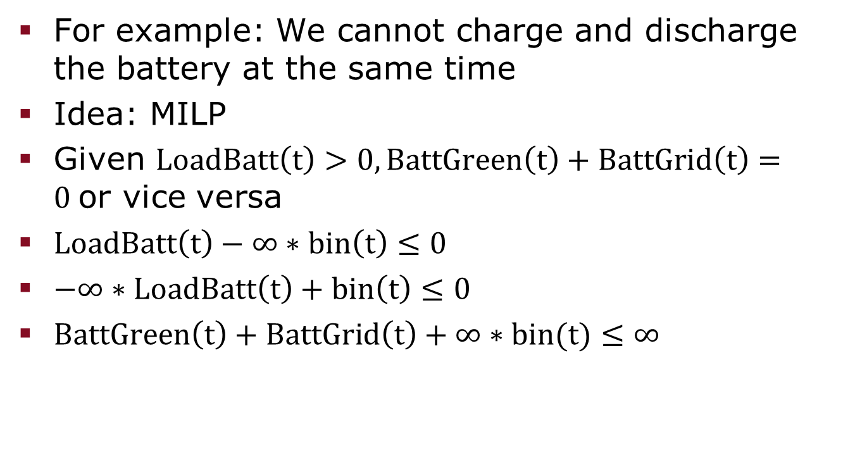
How to Model Mutual Exclusive Problem
For example: We cannot charge and discharge the battery at the same time
Idea: MILP
Given $LoadBatt\left(t\right)>0,BattGreen\left(t\right)+BattGrid\left(t\right)=0$or vice versa
$LoadBatt\left(t\right)−∞∗bin\left(t\right)≤0$
$−∞∗LoadBatt\left(t\right)+bin\left(t\right)≤0$
$BattGreen\left(t\right)+BattGrid\left(t\right)+∞∗bin(t)≤∞$

Slide 21
Non Pre-emptible Loads
if (i == startTime or i == startTime + 1 or...or i == startTime + executionTime)
then Load(i) = TotalPower / executionTime;
else Load(i) = 0;
Non linear, difficult to convert
(T – executionTime) different choices
Run all of them, treat as non deferable
Choose the final optimal solution

Slide 22
Outline
Overview
Background
Related Work
Algorithm
Experimental Evaluation
Limitations and Future Work
Conclusion

Slide 23
Data Sets
Need data sets
Home house electricity consumption data quantify the saving potential
Environmental data predict consumption in the future

Slide 24
Data Resource
Publicly available numerous data sets
researchers from UMASS Amherst computer science department
“Cutting the Electricity Bill in Smart Homes with Energy Storage”
Three homes’ electricity consuming value between April and July in 2012

Slide 25
Example Home A
Around Amherst
Collect the energy consumption for 68 days
For each day, 26 indexed different sources such as grid, HRV, washing machine, bedroom lights
Filter only the real and apparent powers every second from grid

Slide 26
Data Process
Less than 86400 data every day
insert data into lost seconds as same as the last reasonable value
Incorrect timestamps
unix time：how many seconds have passed since 1/1/1970
shift data to the correct starting place for every day
Calculate interval, day, month power consumption
Tool: MATLAB

Slide 27
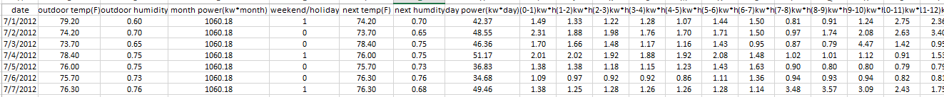
Other Data
Outdoor temperature, humidity
www.wunderground.com
sensor located in computer science building of UMASS Amherst
Weekday - ”0”
Weekend/holiday -”1”

Slide 28
Assumptions
Battery non empty at the beginning of every day
Behave like an oracle(predictor’s work):
Knows next day’s power pattern
Knows next day’s solar availability
Period is integer, and can be divided by T
Deadline is equal to period

Slide 29
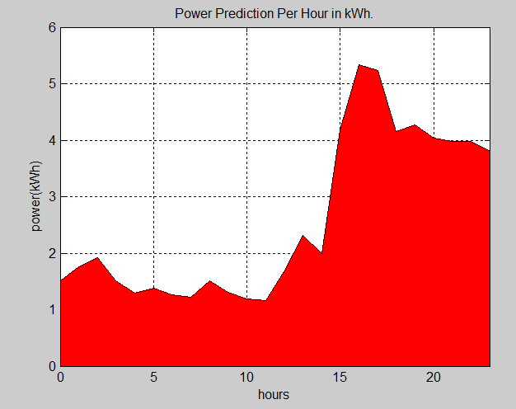
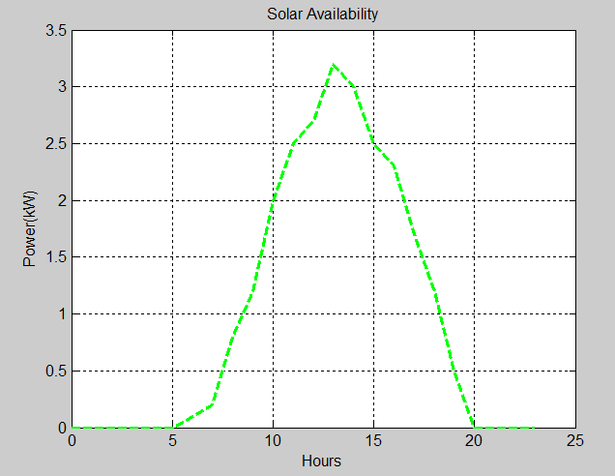
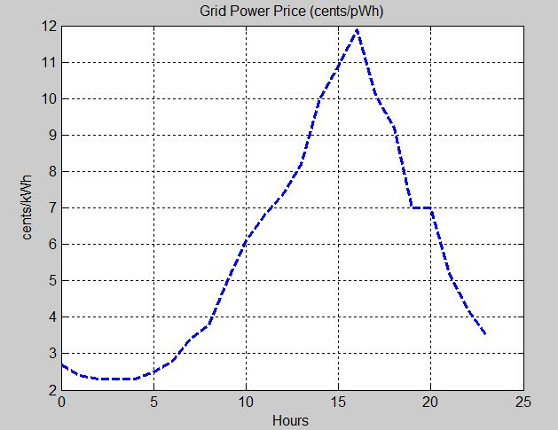
Data for Testing and Simulation
Power pattern per hour, Total Non Deferrable
Available Solar per hour
Grid Price per hour
Deferrable Modeling
ACCentral = [24, 24, 8, 56];
refrigerator = [2, 2, 1, 0.36];
dishwasher = [24, 24, 2, 4]; Non Pre-emptible

Slide 30
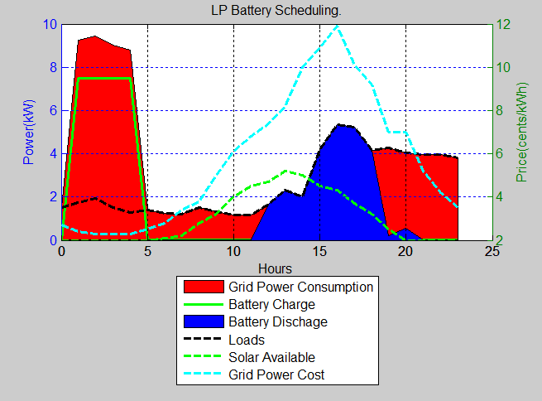
Battery Only Scheduling
The Electricity Bill originally per Day is: $4.17
The Electricity Bill with LP Batterty-Only per day is: $2.30
Total cost reduction is: 44%

Slide 31
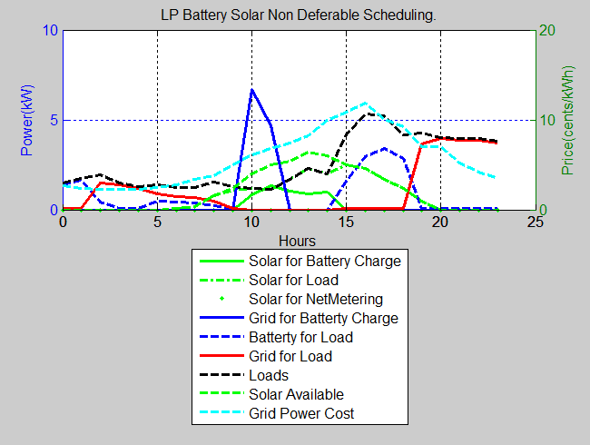
Battery Solar Scheduling
The Electricity Bill orginally per Day is: $4.17
The Electricity Bill with LP Solar-Battery per Day is: $1.98
Total cost reduction is: 52%

Slide 32
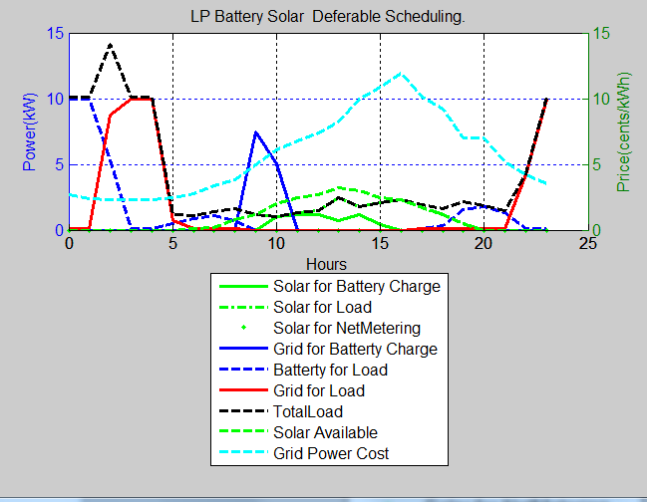
Battery Solar Plus Workload Scheduling
The Electricity Bill originally per Day is: $4.17
The Electricity Bill with Green Switch: the Home Adaption per Day is: $1.94
Total cost reduction is: 54%

Slide 33
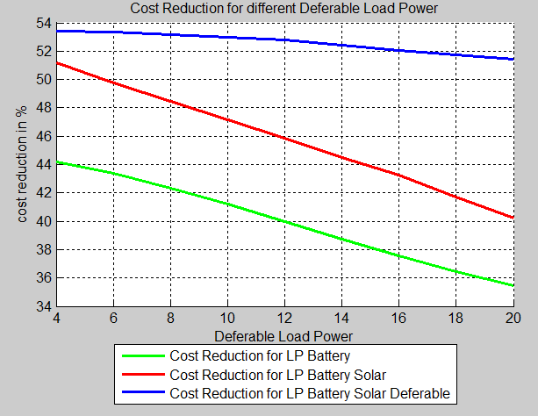
Cost Reduction for Different Deferrable Load Power
Hardware cost considerations tradeoff based on this curve.

Slide 34
Outline
Overview
Background
Related Work
Algorithm
Experimental Evaluation
Limitations and Future Work
Conclusion

Slide 35
Limitations and Future Work
No Predictor and Configurer Design:
Need Predictions rather than know in advance
Need to actuate
No average cost reductions:
Need to run multiple simulations with different data
Get average cost reduction under different configurations
Trade Off analysis
Pre-emptible vs non Pre-emptible
Hardware cost vs Cost reduction by Different Scheduling
Big or Less batteries?
Etc.

Slide 36
Conclusion
A MILP solver to schedule both energy source and workload, both deferrable and non deferrable loads, both pre-emptible and non pre-emptible loads.
Each Deferrable Load has its own pattern
Compared Different cost reduction benefits with different scheduling
Showed when to use which scheduling can yield more benefits

Slide 37
THANK YOU!!

