Slide 1

New MCT Standards Are you ready?

Slide 2
The way Airlines sell has evolved……MCT processing has not
Minimum Connect Times (MCT) are a major factor in how systems validate what connecting flight options are to be displayed; determining what product is offered for sell
An MCT has traditionally been defined as the shortest time interval required in order to transfer passengers and luggage from one flight to a connecting flight
MCTs are used to build connected flight offerings
There has been a shift in focus from using MCT strictly for airport logistics to a marketing perspective
Carriers now often use MCT to flow traffic directionally and optimize operations at hubs and outstations
MCT data analysis can be difficult and imprecise due to the way data is filed and maintained today
Codeshare flights are increasing and Schedules data increasing and changing more frequently
Change presents challenges
MCT processing has not changed to keep pace with the evolution of airline distribution
There has been no IATA standards for filing information or transmitting MCT data between entities
Airlines and other distribution channels may consume MCT from different sources which can produce different schedule offerings
MCT data exchange between entities are not compatible with XML

Slide 3
IATA: MCT Working Group (MCTWG)
Until today, there has been no industry standards supporting the data exchange process between airlines, data aggregators, GDSs and other business partners for the processing presentation, application and transfer of MCTs
The results are inconsistent schedule displays across different platforms
MCT processing issues were raised at the industry level by carriers (with GDSs and data aggregators support) for more efficient processes
A working group (MCTWG) was formed within the IATA Schedules Information Standards Committee (SISC) to review the issues and provide a documented proposal as part of SSIM standards, and an implementation plan designed to introduce additional flexibility, cleaner data and XML capabilities
The MCTWG was tasked with proposing standard formats
For MCT communication; including exchange of full databases and incremental changes
More timely updates with improved automation
Reduction in manual updates providing improved database accuracy

Slide 4
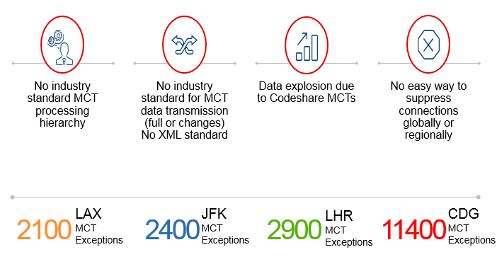
Industry Problems Identified with MCTs

Slide 5
How These Problems Affect Our Industry
Passengers/Bags misconnecting
Front-line agents quoting incorrect information
Data too complex to understand what will be offered in schedules and availability
Undetected errors & typos
Need to keep changing as marketing flight numbers change
Inefficient flight number utilization
MCT database is full of clutter that can be deleted
Focus on what we don’t want to do instead of what we want to do when filing MCT exceptions
Difficult to control connecting flow (Marketing Connect Times)
Connections offered may not be what the carrier commercially planned to sell
We have different versions of the truth
Not easy to identify conflicting data between airline and aggregator databases

Slide 6

Financial Impact
Analysis of schedule displays, completed in conjunction with the MCTWG, identified financial impacts to airlines due to lack of standardized processes and data application.
Data covered the North American market, utilizing schedules of multiple carriers including codeshare flights
Results showed load factors different by approximately 0.11% with revenue deferring by approximately 0.33%
Connectivity:
Limited ability for airlines to manage connectivity efficiently from a network perspective, increases risk and cost associated with passenger issues arising in cities not designed for connecting traffic.
Misconnections:
Cost of rerouting passengers to final destination
Cost of reuniting luggage with passengers
Customer satisfaction

Slide 7
Key Results From SISC & MCTWG
Standardised MCT Hierarchy with new data fields and additional details added to existing fields
Standardised submission and transmission formats
New dedicated SSIM Chapter 8 for MCTs
Detailed list of processing rules for both codeshare flights and operating flights
Development of implementation and user guides for MCT processing
Provide the ability to identify MCT for codeshare flights by using the codeshare operating carrier
Defined timeline for industry implementation

Slide 8

Pathway to Implementation
Industry Commitment & Readiness
Implementation & Alignment
Endorsement of standards from the Passenger Services Conference (October 2017)
SSIM Chapter 8 published and effective from SSIM MARCH 2018 version
Industry wide awareness campaign
Project Test & Implementation guide
User guide & FAQs
End to end testing in parallel with production system
Industry migration to new standards to be completed by 26 October 2019 with cutover from 27 October 2019
XML data modelling developed for Phase II implementation

Slide 9
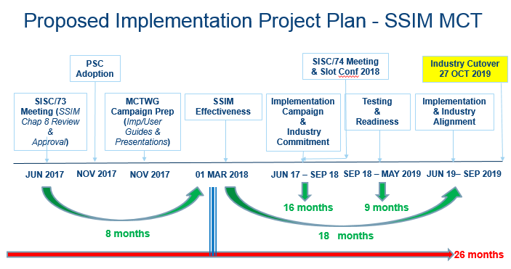

Slide 10

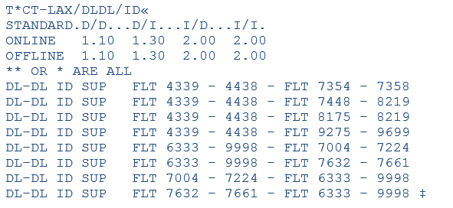
Where are we now
AMADEUS
Databases today can be complex and confusing to read leading to misinterpretation of data
DELTA
SABRE
* Actual displays will vary between systems

Slide 11


Where are we going
Newly introduced fields provide improvements in the way carriers are able to indicate MCT for codeshare relationships by indicating the operating carrier
Enables front lines representatives to more accurately disclose correct MCT
* Actual displays will vary between systems

Slide 12

The Final Answer
Carriers will ultimately have the ability to clean clutter from databases, eliminating confusing flight number ranges
Database size will be reduced as unnecessary data is removed
Agents will have the ability to clearly and correctly provide passengers with MCT information when needed
Clarity
* Actual displays will vary between systems

Slide 13
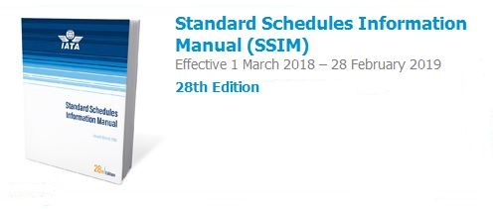
Be a part of the communication campaign within your organization!
Update your SSIM in 2018 to ensure accurate resources.
Questions? SSIM@IATA.ORG
For more information visit www.iata.org/sisc

