Slide 1
Standardisation of Minimum Connecting Times
Industry Awareness
September 2018

Slide 2
What is driving the MCT Industry Initiative
MCTs are used to build connected flight offerings
MCTs are a major factor in how systems validate what connecting flight options are to be displayed; determining what product is offered for sell
There has been a shift in focus from using MCT strictly for airport logistics to a marketing perspective
MCTs can be used to flow traffic directionally and optimize operations at hubs and outstations

Slide 3
The way Airlines sell has evolved…MCT processing has not
MCT processing has not changed to keep pace with the evolution of airline distribution
There are no IATA standards for filing information or transmitting MCT data between entities
Airlines and other distribution channels may consume MCT from different sources which can produce different schedule offerings on different platforms
MCT data analysis can be difficult and imprecise due to the way data is filed and maintained today
Schedules changes are more frequent and the number of codeshare flights have increased significantly
MCT data exchange between entities are not compatible with XML

Slide 4
How These Problems Affect Our Industry
Passengers/Bags misconnecting
Front-line agents quoting incorrect information
Data too complex to understand what will be offered in schedules and availability
Undetected errors & typos
Need to keep changing as marketing flight numbers change
Inefficient flight number utilization
MCT database is full of clutter that is not applicable and can be deleted
Today’s focus is on what we don’t want to do instead of what we want to do when filing MCT exceptions
Difficult to control connecting flow (Marketing Connect Times)
Connections offered may not be what the carrier commercially planned to sell
We have different versions of the truth
Not easy to identify conflicting data between airline and aggregator databases

Slide 5
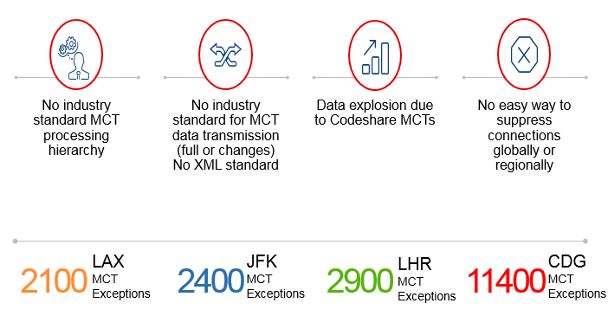
In Summary…..

Slide 6
Background to the MCT Industry Initiative
MCT processing issues were raised at the industry level at the IATA Schedules Information Standards Committee (SISC)
Carriers, GDS and Aggregators were looking for more efficient processes
The SISC formed a Working Group (MCTWG) to explore the issues and make future proposals
The MCTWG aim has been to:
Develop Industry Data Standards for MCTs
Introduce additional flexibility
Deliver greater consistency across selling channels
Reduce manual updates providing improved database accuracy
Introduce XML capability

Slide 7

Pathway to Industry Adoption
October 2017 – The Passenger Service Conference endorsed the proposed MCT standards and agreed a timeline for industry implementation
March 2018 – Effectiveness of new MCT standards within a dedicated SSIM Chapter 8. It includes new MCT standardized transmission format, new data fields, an Application Hierarchy and detailed processing rules
IATA are embarking on an industry wide awareness campaign in 2018 outlining Compliance Testing and providing a User guide & Technical FAQs
End to end testing in parallel with production systems leading to the Industry migration to new standards to be completed by 26 October 2019 with cutover from 27 October 2019
Creation of XML schema by the MCTX Group

Slide 8

How will Airlines Benefit
Airlines will be able to:
Ensure a consistent Product offering across booking channels
Reduce the volume of MCT’s they will need to file and maintain
Improve accuracy in connection building especially between Codeshare Partners
Supply the same MCTs updates to both data Aggregators for distribution
Opportunity to review & clean up their MCT data

Slide 9
The Key Changes
Geographical Suppression capability
New data fields to support codeshare
New processing hierarchy for the application of MCT’s when connection building
A standardise transmission for delivering global MCT data files to GDS, Airline Res System and System Providers – SSIM Chapter 8
A standardise submission format for airlines to submit MCTs including a new User Guide

Slide 10
Geographical Suppressions
Currently a Carrier can only suppress by airport
The new MCT standards will enable a carrier to file suppressions by:
State
Country
Region
When matching flights for connection building, if no MCT exception is found then the Geographical Suppressions should be searched to determine if a connection can be built before applying to the Airport Standard or Status Defaults

Slide 11
Example of a Geographical Suppression
STATION |  | CONNECTION | TIME | ARR CARRIER |  |  | ARR FLIGHT # |  | DEPARTURE CARRIER |  |  | DEPART FLIGHT # |  | SUPPRESSIONS
ARR | DEPT | STATUS | HHMM | Carrier | Codeshare Indicator | Codeshare Operating | Range Start | Range End | Carrier | Codeshare Indicator | Codeshare Operating | Range Start | Range End | Suppression Indicator (Y/N) | Region | Country | State
 |  | II |  | AA |  |  |  |  | VY |  |  |  |  | Y
 |  | ID |  | AA |  |  |  |  | VY |  |  |  |  | Y
BCN | BCN | ID | 0200 | AA |  |  |  |  | VY |  |  |  |  | N
FCO | FCO | II | 0200 | AA |  |  |  |  | VY |  |  |  |  | N
AA suppressing connecting onto VY globally but allowing connections at Barcelona and Rome.

Slide 12

New MCT fields for Codeshare Processing
New MCT Standards enable carriers to file MCTs for codeshare without specifying a Flight Range
New data fields:
Departure Carrier
Departure Codeshare Indicator
Departure Codeshare Operating Carrier
Arrival Carrier
Arrival Codeshare Indicator
Arrival Codeshare Operating Carrier

Slide 13
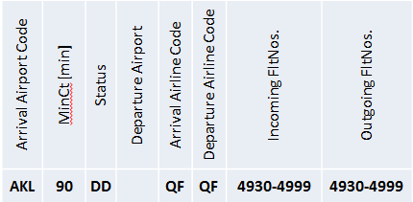
Codeshare Processing
Currently there is no ability to file an MCT where an airline is the Marketing carrier except by specifying by flight number or flight range
Example of a current filing of MCT where QF is the Marketing Carrier and JQ is Operating:

Slide 14
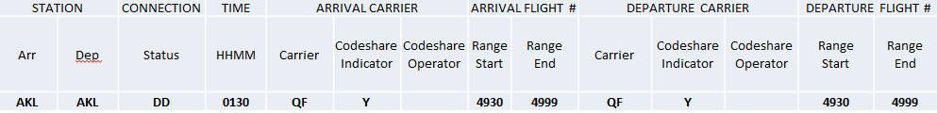
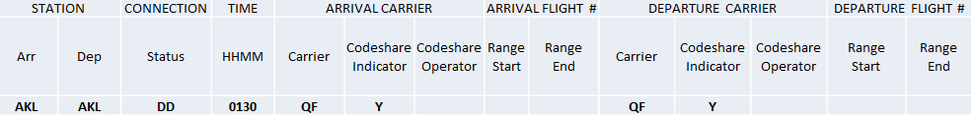
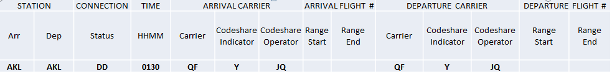
3 Ways to File for Codeshare
Using only the Codeshare Indicator
Specifying the Operating Carrier with a Codeshare Indicator
Using a Flight Range with a Codeshare Indicator

Slide 15
Codeshare Processing when Connection Building
Codeshare is determined by the presence of a DEI 50 on the flight schedule
Processing will look for a DEI 50 for each flight segment it is trying to build a connection with
If there is a DEI 50, it will look to match with a codeshare MCT i.e. where “Y” is specified in the Codeshare Indicator field
If there isn’t a codeshare MCT that fits the flight, it will look for an operating MCT for the flight specified by the DEI50
A marketing MCT will override an operating MCT
If there is not a DEI50 on the flight segment, processing will look for a corresponding operating MCT (without the Codeshare Indicator “Y” ) as the flight will be assumed to be the operating carrier
For an MCT record to “fit” to a flight, it needs to match any other flight attributes e.g. A flight number range matches for codeshare flights where the MCT has Codeshare Indicator “Y” set

Slide 16
Other Key Changes
Times expressed in hhmm
Airports are now referred to as Stations
Both Departure and Arrival Station must always be specified except where using a Geographical Suppression
Departure and Arrival Wide and Narrow body Type field now separate Aircraft Type
The Filing Date will be included in the global distribution file
A Submitting Carrier Identifier field to be populated by data Aggregators for distribution
A new Data Submission Template

Slide 17
New Data Submission Template
ACTION INDICATOR | STATION |  | CONNECTION | TIME | ARR CARRIER |  |  | ARR FLIGHT # |  | DEPARTURE CARRIER |  |  | DEPART FLIGHT #
(A/D) | ARR | DEPT | STATUS | HHMM | Carrier | Codeshare Indicator | Codeshare Operating | Range Start | Range End | Carrier | Codeshare Indicator | Codeshare Operating | Range Start | Range End
TERMINAL |  | STATION |  | STATE |  | COUNTRY |  | REGION |  | AIRCRAFT TYPE |  | AIRCRAFT BODY (W/N) |  | SUPPRESSIONS |  |  |  | DATE
Arrive | Depart | Prev | Next | Prev | Next | Prev | Next | Prev | Next | Arrive | Depart | Arrive | Depart | Suppression Indicator (Y/N) | Region | Country | State | Effective From | Effective To
The Template supports ‘Adds’ and ‘Deletes’
Aggregators will upload directly and validate the data when processing
Concurrence will still be required
The Template is located on the SISC website: www.iata.org/sisc.
The data elements order of template is not the same as the priority order listed on the hierarchy table.

Slide 18
Changes to the Application Hierarchy
Current Data Hierarchy | New Data Priority | New Data Hierarchy
Arrival Airport | # | International/Domestic Status
Status e.g. DD/DI/ID/II | 1 | Departure Codeshare Indicator
Departure Airport | 2 | Departure Carrier
Departure Flight Number | 3 | Departure Codeshare Operating Carrier
Departure Flight Number Range | 4 | Arrival Codeshare Indicator
Departure Carrier | 5 | Arrival Carrier
Next Airport | 6 | Arrival Codeshare Operating Carrier
Next State | 7 | Departure Flight Number Range Start
Next Country | 8 | Departure Flight Number Range End
Next Region | 9 | Arrival Flight Number Range Start
Departure Terminal | 10 | Arrival Flight Number Range End
Departure Aircraft Type or Equipment Type | 11 | Departure Terminal
Arrival Flight Number | 12 | Arrival Terminal
Arrival Flight Number Range | 13 | Next Station
Arrival Carrier | 14 | Previous Station
Previous Airport | 15 | Next State
Previous State | 16 | Previous State
Previous Country | 17 | Next Country
Previous Region | 18 | Previous Country
Arrival Terminal | 19 | Next Region
Arrival Aircraft Type or Equipment Type | 20 | Previous Region
Effective From Date | 21 | Departure Aircraft Type
Effective To Date | 22 | Arrival Aircraft Type
 | 23 | Departure Aircraft Body
# indicates fields that are not part of the Hierarchy but are used for matching | 24 | Arrival Aircraft Body
 | 25 | Effective From date (local)
 | 26 | Effective To date (local)
 | 27 | Departure Station
 | 28 | Arrival Station
Red = new data fields | # | Suppression Indicator
 | 29 | Suppression State
 | 30 | Suppression Country
 | 31 | Suppression Region
 | # | Time
 | # | Filing Date
 | # | Submitting Carrier Identifier
 | # | Action Indicator

Slide 19
Example of change to MCT Application Hierarchy
If the 2 MCT records below were available for selection in connection building using the current Application Hierarchy, MCT 1 of 0130 would be selected because a record with a ‘Departure Terminal’ comes higher in the hierarchy even though MCT 2 has both a Departure and Arrival flight range specified.
 | STATION |  | CONNECTION | TIME | ARRIVAL CARRIER |  |  | ARRIVAL FLIGHT # |  | DEPARTURE CARRIER |  |  | DEPARTURE FLIGHT # |  | Terminal
 | Arr | Dep | Status | HHMM | Carrier | Codeshare Indicator | Codeshare Operator | Range Start | Range End | Carrier | Codeshare Indicator | Codeshare Operator | Range Start | Range End | Arr | Dep
MCT 1 | LHR | LHR | II | 0130 | AA |  |  |  |  | AA |  |  | 4930 | 4999 |  | 3
MCT 2 | LHR | LHR | II | 0120 | AA |  |  | 1 | 2814 | AA |  |  | 6100 | 6779
In the new Application Hierarchy, MCT 2 would be selected over MCT 1 as it has both a Departure and Arrival Flight number ranges specified and these are both in a higher position than Departure Terminal as deemed to be more specific.

Slide 20
Summary of Key Application Rules
MCTs must be applied according to the data hierarchy specified in SSIM Chapter 8
An MCT with a Codeshare Indicator will take precedence over an MCT without a codeshare indicator
When using Flight Ranges, a sub-set of a wider flight range will supersede
A Geographical Suppression will take precedence over an Airport Standard or Status Standard MCT
Further details of Application rules with examples can be found in SSIM Chapter 8, Section 8.9.

Slide 21
As an Airline what you need to know
Aggregators will map your current MCT data to the new MCT format
Airlines should review their new MCT data
Airlines should file updates to the new MCT data using the new template
Continue to file changes in current format up to the ‘Data Freeze’
Data freeze starts 6 October until 3 November 2019
Industry Cutover date to new format 27 October 2019
What will happen if you are not ready:
You won’t be able to process the new MCT data after OCT2019 in the new format
You may not build accurate connections
Cleaning up your existing MCT data now will make the new mapped data easier to review!

Slide 22
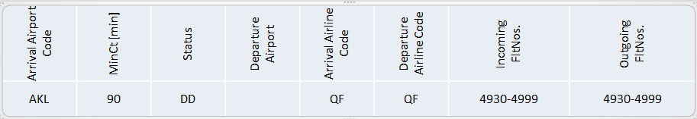
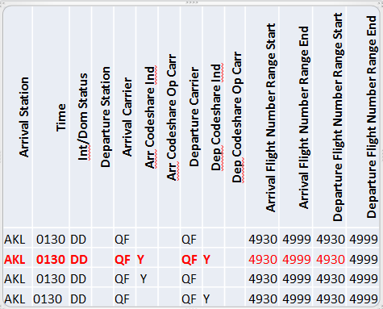
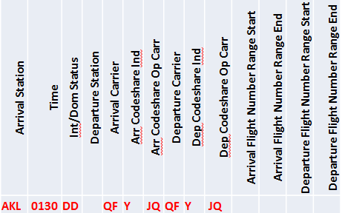
Your mapped data – what to expect
Data will be ‘exploded’ to accommodate possible Codeshare scenarios
Current MCT Record :
This will be mapped to look like this: The airline may then edit to look like this:

Slide 23
Mapping Suppressions
Airport ‘999’ MCT Suppressions will now have a ‘blank’ time field and the Suppression Indicator field set to ‘Y’ in the new data format
Current MCT Record
This will be mapped to look like this : This can be edited to be:
Arrival Airport Code | MinCt [min] | Status | Departure Airport | Arrival Airline Code | Departure Airline Code | Incoming FltNos. | Outgoing FltNos.
CDG | 999 | DD |  | AA | AA | 6100 - 9099 | 6100 - 9099
Arrival Station | Time | Int/Dom Status | Departure Station | Arrival Carrier | Arr Codeshare Ind | Arr Codeshare Op Carr | Departure Carrier | Dep Codeshare Ind | Dep Codeshare Op Carr | Arr. Flight Number Range Start | Arr. Flight Number Range End | Dep. Flight Number Range Start | Dep. Flight Number Range End | Departure Terminal | Arrival Terminal | Suppression Indicator
CDG |  | DD |  | AA |  |  | AA |  |  | 6100 | 9099 | 6100 | 9099 | TN | TN | Y
CDG |  | DD |  | AA | Y |  | AA | Y |  | 6100 | 9099 | 6100 | 9099 | TN | TN | Y
CDG |  | DD |  | AA | Y |  | AA |  |  | 6100 | 9099 | 6100 | 9099 | TN | TN | Y
CDG |  | DD |  | AA |  |  | AA | Y |  | 6100 | 9099 | 6100 | 9099 | TN | TN | Y
Arrival Station | Time | Int/Dom Status | Departure Station | Arrival Carrier | Arr Codeshare Ind | Arr Codeshare Op Carr | Departure Carrier | Dep Codeshare Ind | Dep Codeshare Op Carr | Departure Terminal | Arrival Terminal | Suppression Indicator
CDG |  | DD |  | AA | Y |  | AA | Y |  | TN | TN | Y
23

Slide 24
Mapped MCT Data – What to Expect
Your MCT data could be up to x 4 greater initially
It is important that you review your mapped data and remove the non relevant records
Remember - you no longer need to retain Flight Number Ranges for Codeshare
You can use Geographical Suppressions to support your interline agreements
Use the new MCT submission template to file updates to your new MCT data
Your data Aggregator will support you throughout the process
Your data Aggregator will track your progress and resolve any issues
To reduce the amount of mapped record you may need to review and start removing any unwanted record from the current data
If you do nothing your online MCTs will continue to build connections but the application of those MCTs may change

Slide 25
Timetable for Industry Adoption
Mar 18 New SSIM MCT Standards Chapter 8 available
Apr 18 OAG will provide first Data Sample
Sep 18 OAG will provide a full MCT file for Industry Testing
Oct 18 Pilot testing to validate the new MCT Hierarchy and data fields
31 Jan 19 E2E Test period - up until 06 OCT2019
New MCT data will be available for Airlines to review
Aggregators will start to accept airline updates to new MCT data
Airlines should continue to file updates to current data
24 Mar 19 Participants to self-certify based on successful compliance test
06 Oct 19 MCT distribution Data Freeze up until 03NOV19
26 Oct 19 Final day of MCT distribution in current format
27 Oct 19 Industry Cutover

Slide 26
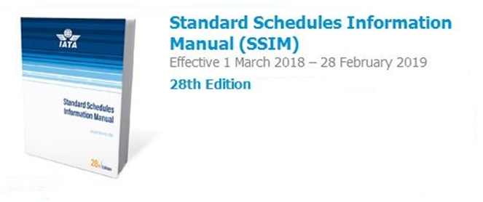
Be a part of the communication campaign within your organization!
Update your SSIM in 2018 to ensure accurate resources
Questions? SSIM@IATA.ORG
For more MCT Implementation information visit www.iata.org/sisc

