Slide 1
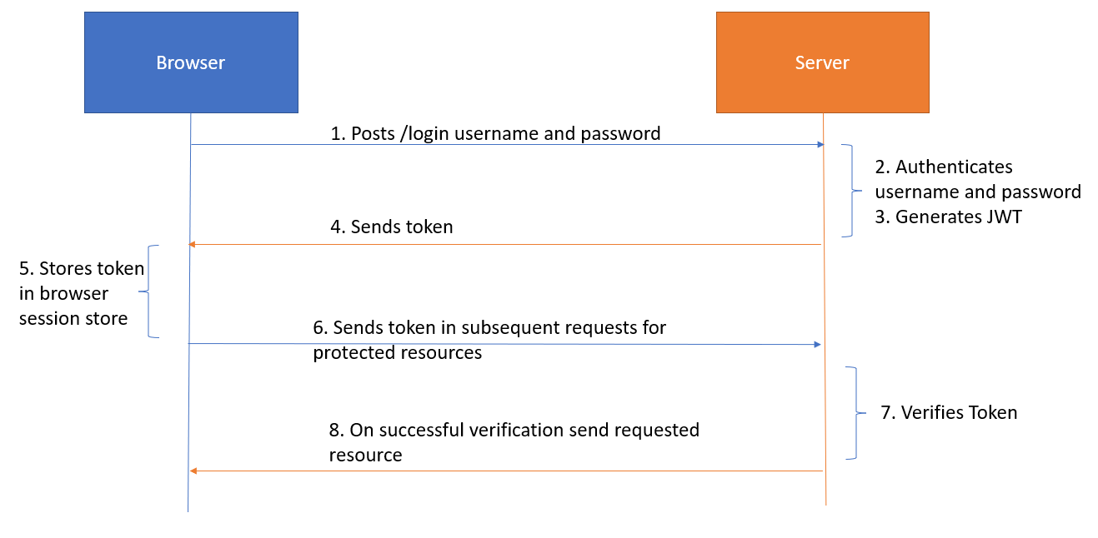
JWT is short for “JSON Web Token,” a type of token used to authenticate and secure communications over the Internet. JWT is used in mobile data mining applications to securely exchange information between client and server. JWT encrypts the information, signs it with its own secret keys, and secures it. In addition, JWT allows additional information such as user permissions and contact information to be provided.

Slide 2
