Slide 1


FooberEats
Food Ordering Platform
Matthew Blanco, Xueying Yang, Xuechi Zhao

Slide 2
Design
Problem Definition:
Develop a food ordering application which allows user to order food and pay through the e-wallet of the application.
Requirement Analysis:
Restaurants
View list of restaurants
Select restaurant from list
Dishes
View list of dishes from chosen restaurant
Select dish from restaurant menu
Modify dish
Cart
Add (modified) dish to cart
Remove (modified) dish from cart
Update (modified) dish from cart
Pay for order using e-wallet balance
e-Wallet
View e-wallet balance
Add money to e-wallet

Slide 3
Assumptions
The customer is already logged into the app.
Restaurants listed are open 24/7.
All dishes listed on the menu are available for order.
Some dishes do not have modifiable options.
The customer can only have one cart at a time for a single restaurant.
The customer already has credit card information saved to add funds to e-wallet.
The restaurant will automatically confirm all non-$0.00 orders.

Slide 4
Use Cases
Actors in our system:
Customer: Can place a food order and pay for it.
Restaurant: Can include menu in database for customers to order from.
System: Handles input from customer through GUI and displays output messages when certain actions are completed (e.g., view balance, add funds).
Top use cases:
Select Restaurant: Choose from restaurants in database.
Select Dish: Choose from menu items for a given restaurant in database.
Modify Dish: Modify dish, if applicable, after selecting it from menu.
Add/Remove/Update Dish in Cart: Additional options while in cart.
Pay Order: Use e-wallet balance to complete payment.
View/Add Funds in e-Wallet: View current balance and top up if insufficient funds.
View Order History: View list of previous orders.

Slide 5
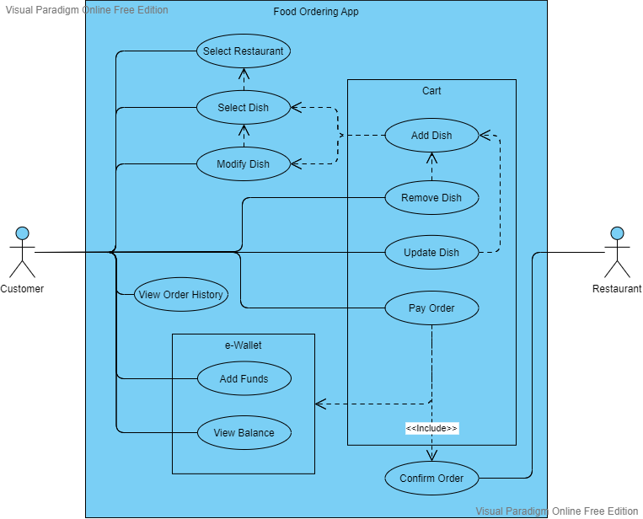
Use Case Diagram

Slide 6
Classes
HomePage: Window to display options for user to place an order, check e-wallet balance, add funds to e-wallet, and view order history.
Restaurant: Window to display the list of restaurants in the database.
DishList: After a restaurant is selected, a new window is opened to display dish menu items from database that can be added to cart (friend of Restaurant).
Dish: When a dish is selected, a new window is opened for dish customization based on options available in database (friend of DishList).
Cart: Window for viewing items in cart. Items can be selected and either updated or deleted before proceeding to payment (friend of Dish, DishList).
CartData: Singleton class used by Cart, Dish, and Payment to keep track of (modified) dishes in cart and calculate order total.
Payment: Window for viewing order total and paying with e-wallet. User can check balance for sufficient funds. If user has insufficient funds, an option is available to top up balance before confirming payment for order.

Slide 7
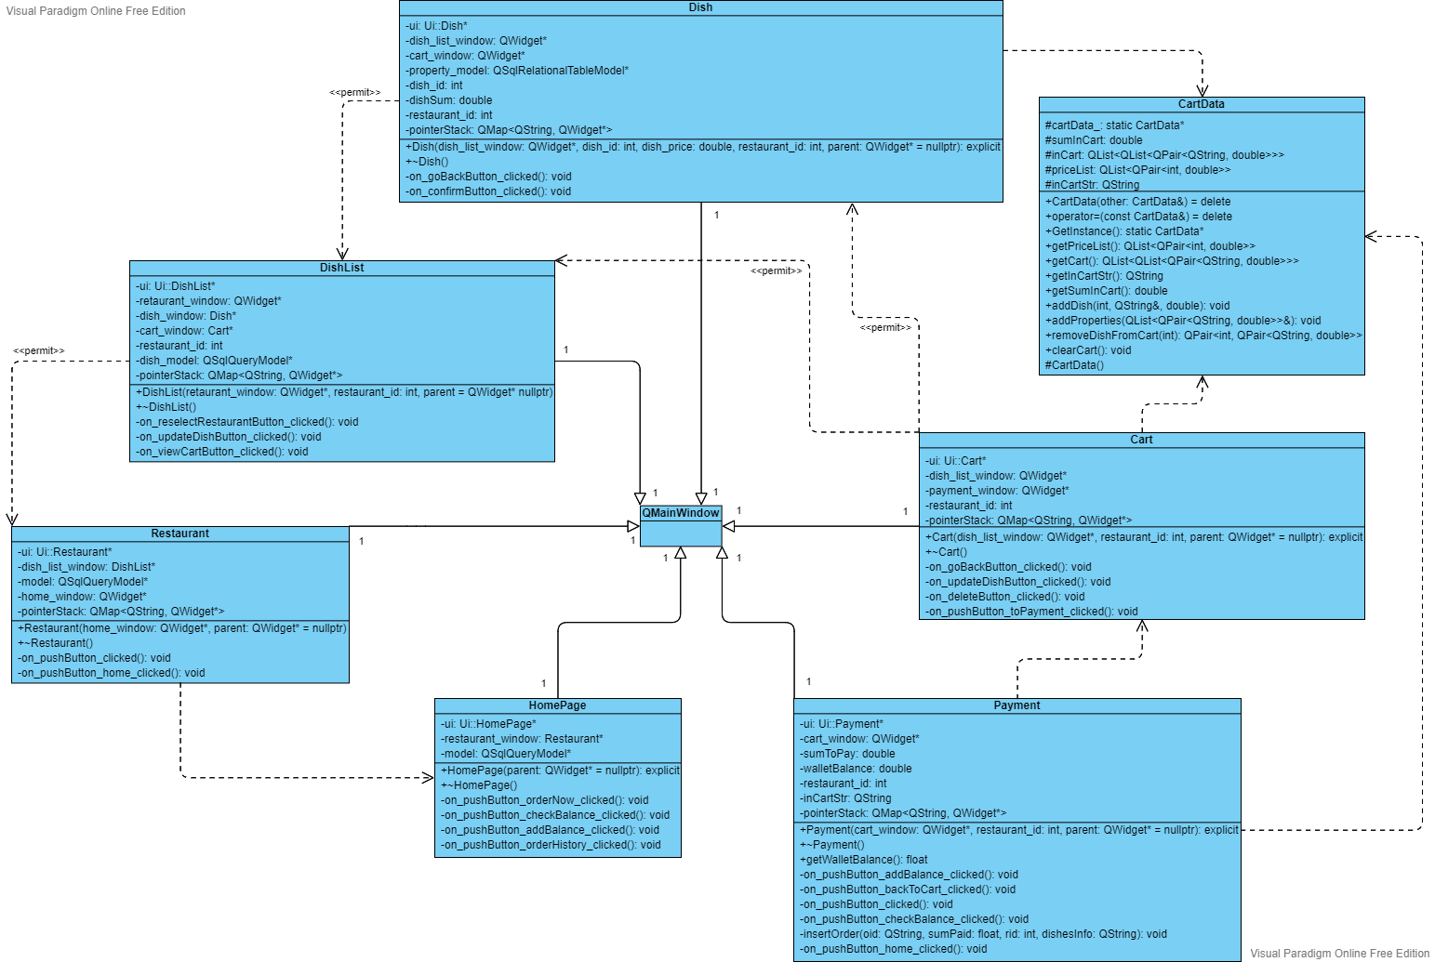
Class Diagram

Slide 8
OO Concepts
Abstraction: Exposing certain methods for other classes to call.
E.g. Cartdata class is called to obtain sum in cart.
Encapsulation: Wrapping up of data and behaviors of an object into a class.
E.g. Cart class, Dish class.
Inheritance: One class inherits the attributes and methods of another class.
E.g. in the ui, sub windows inherit from QMainWindow class.
Design Pattern: Singleton, a class that can only have one object at a time.
E.g. CartData class.

Slide 9
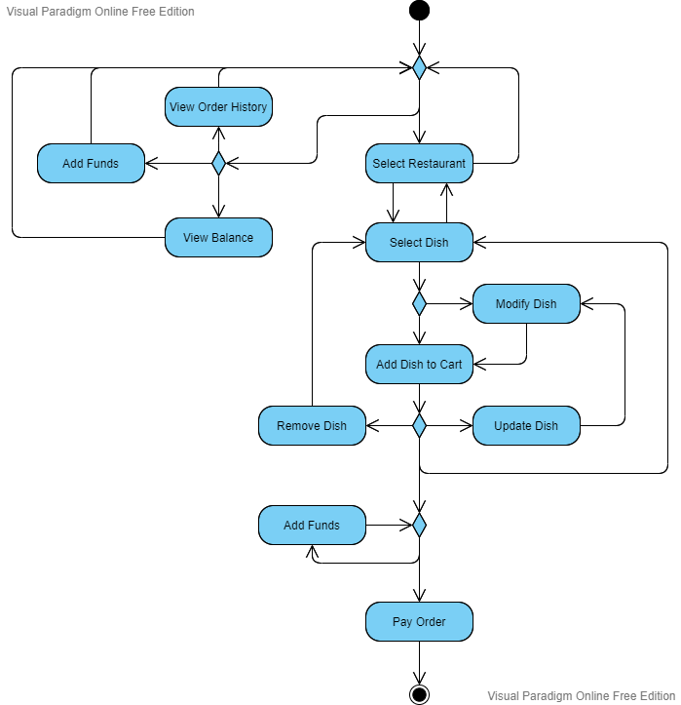
Activity Diagram

Slide 10
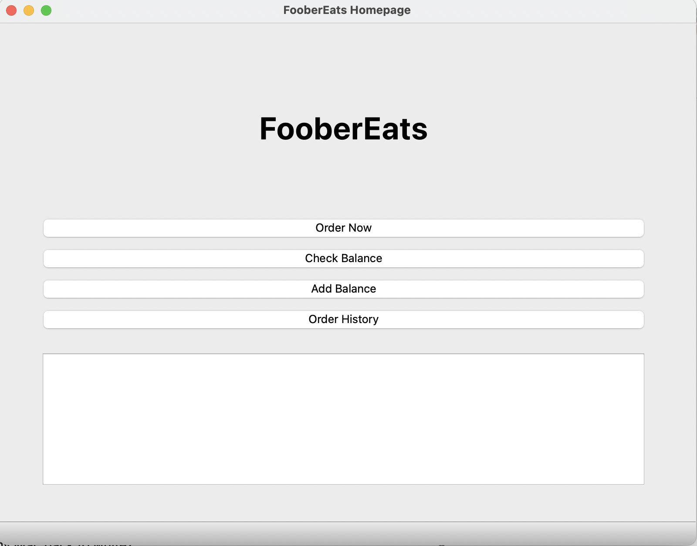
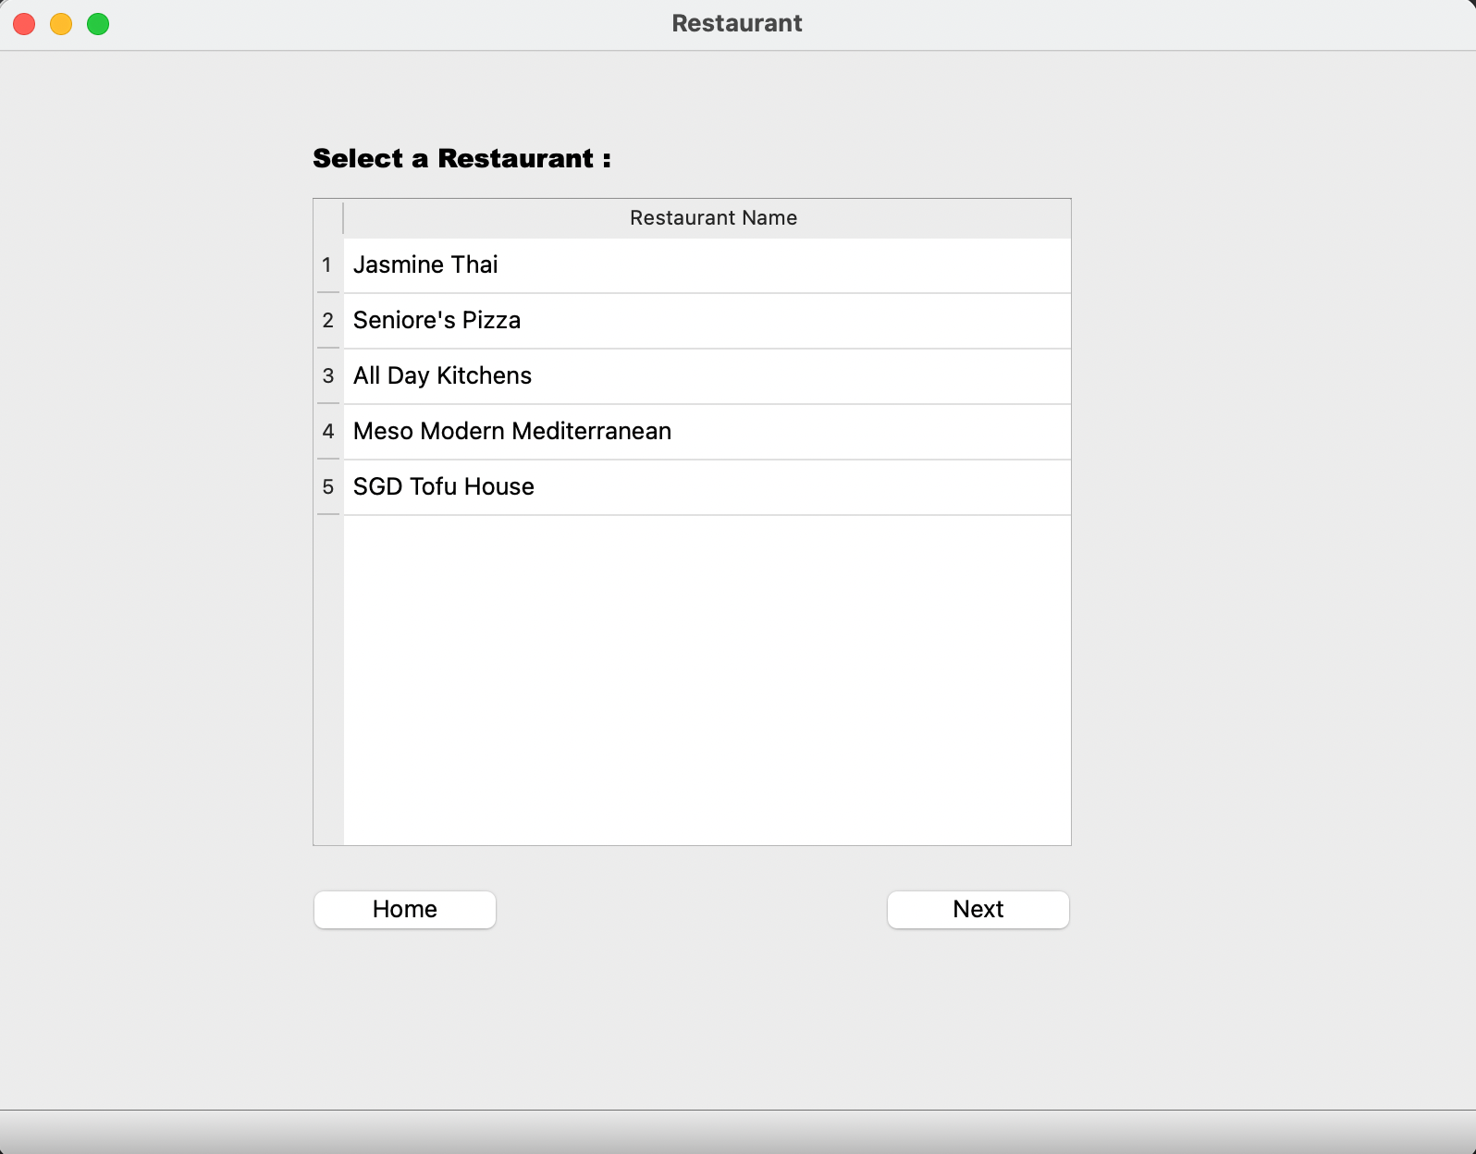
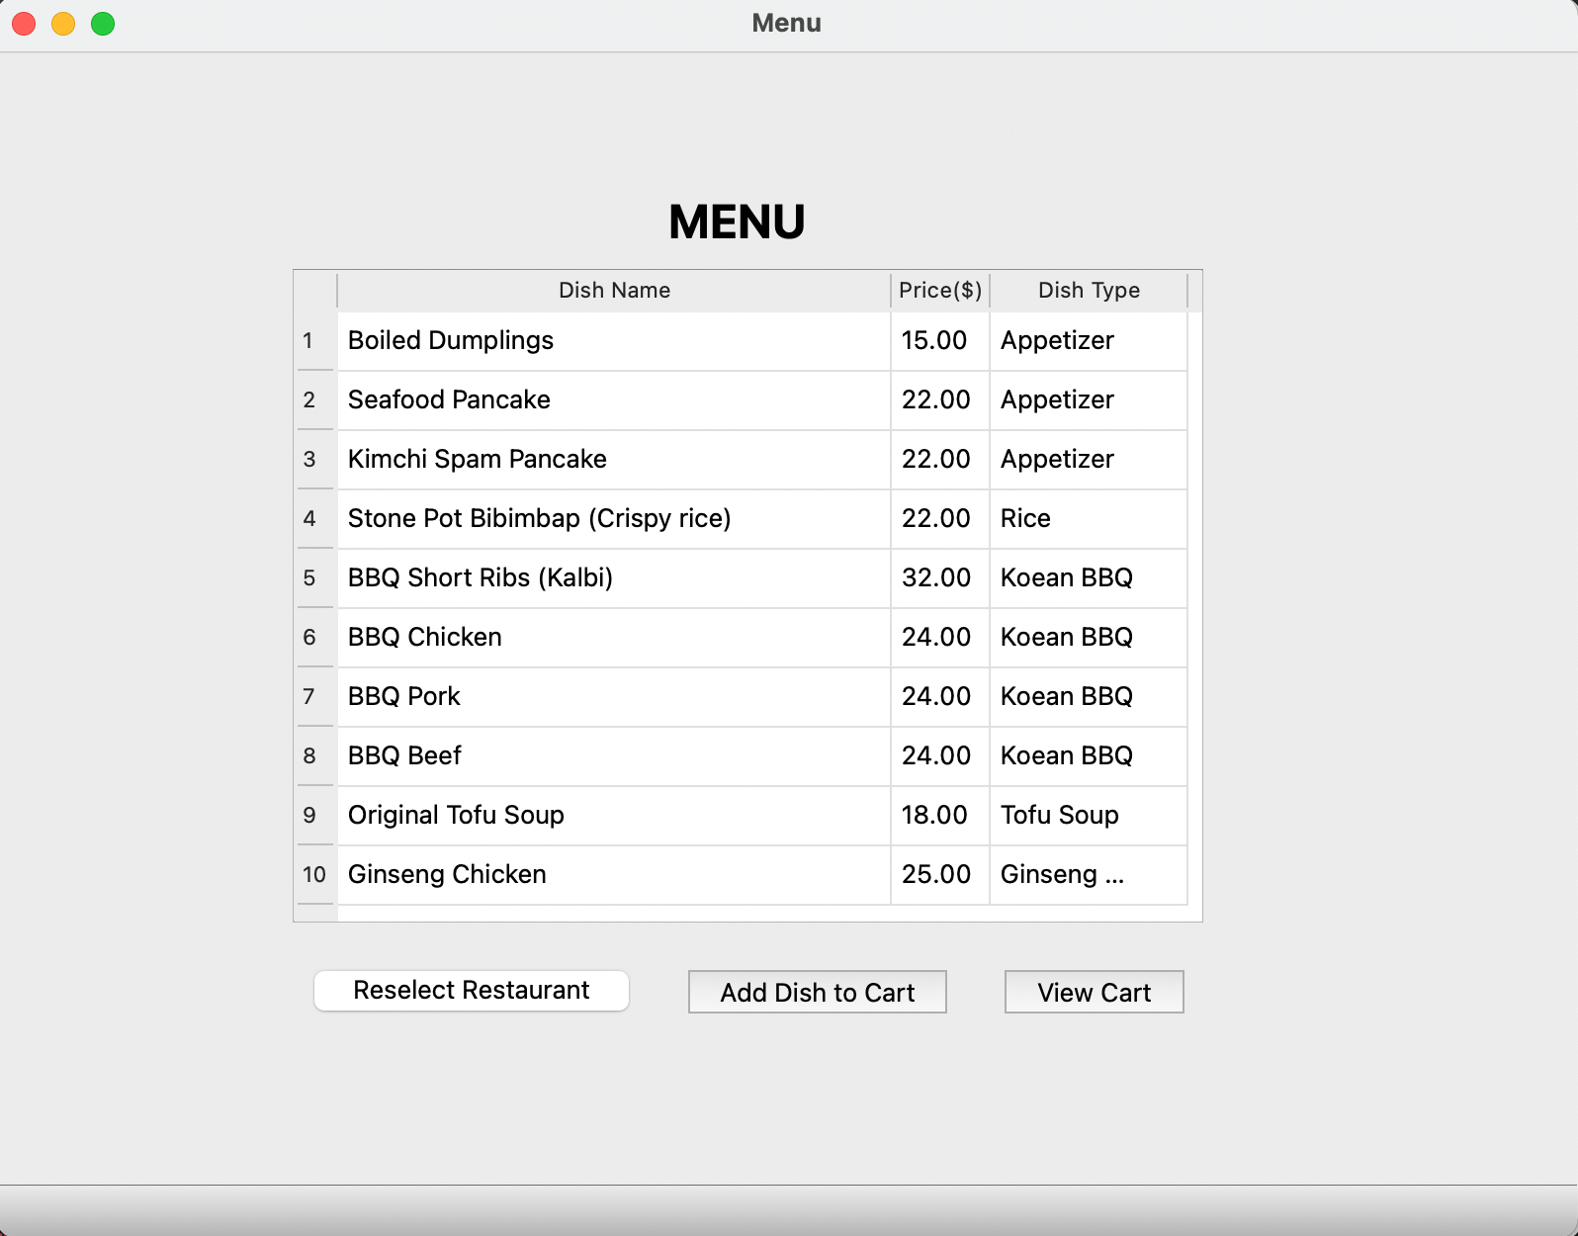
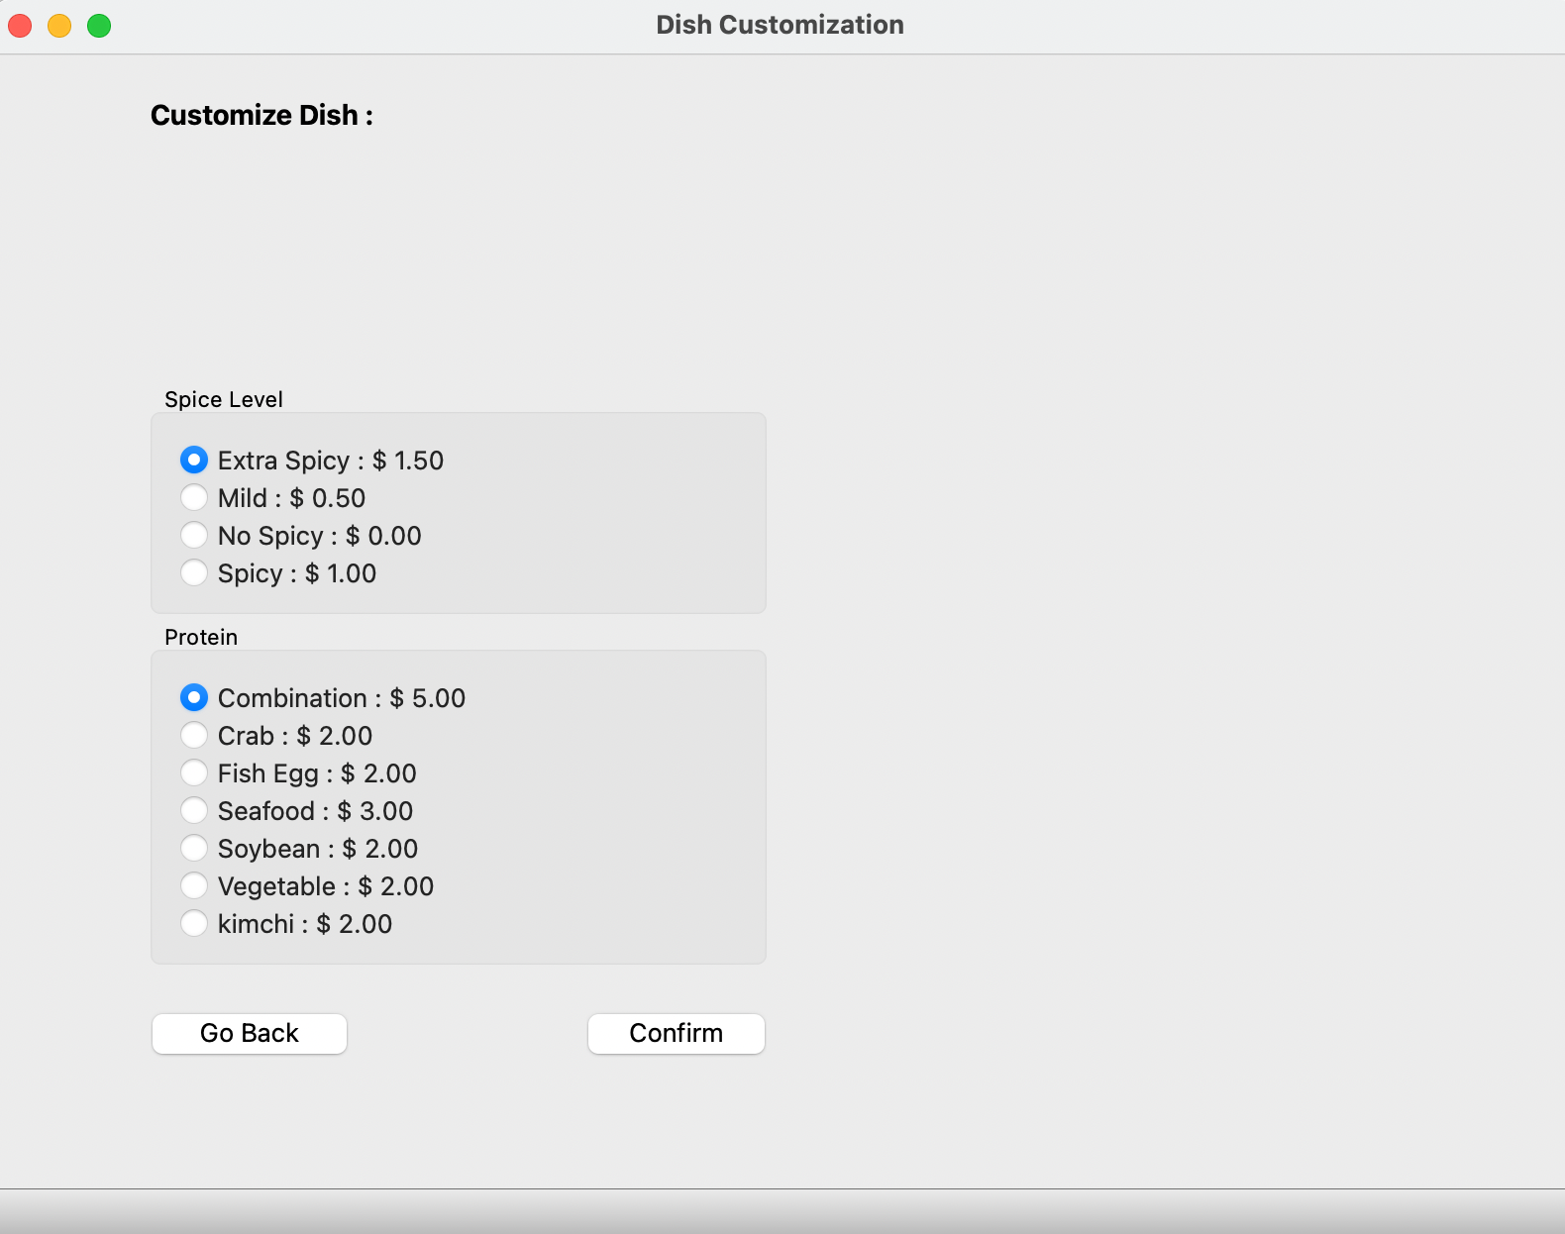
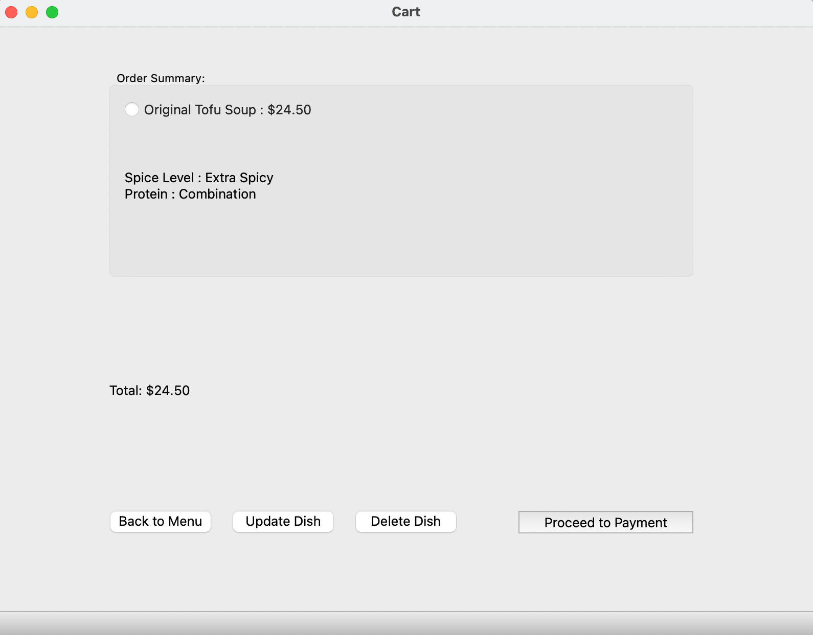
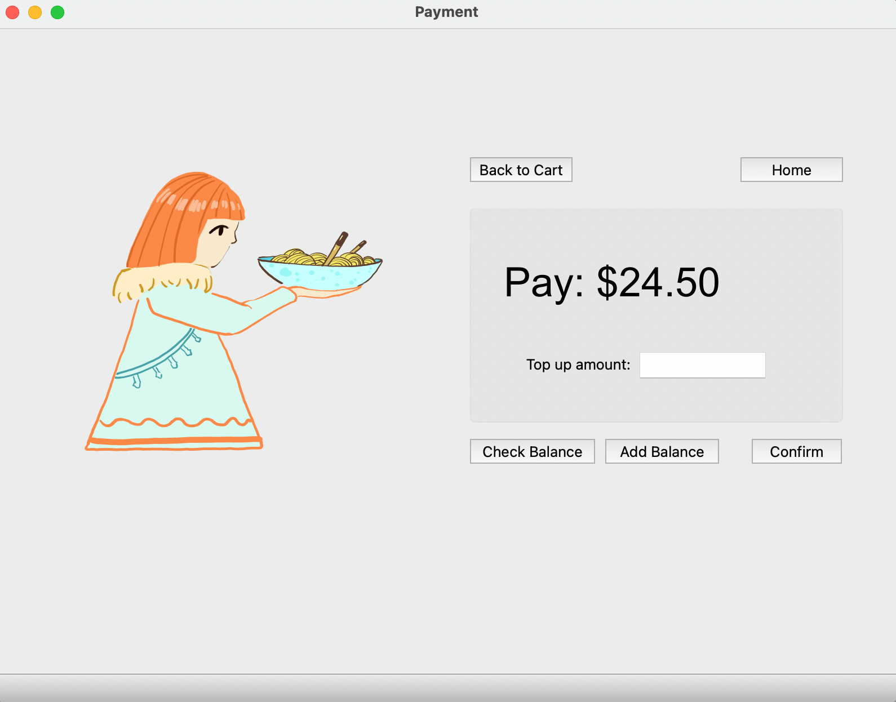

Slide 11
Demo

Slide 12
Questions?

Slide 13
Thank You!

