Slide 1


Construct 2: Platformer Tutorial
Windows 8  Windows Phone 8  Web  Mobile  … and more!
By Shahed Chowdhuri
Sr. Technical Evangelist
WakeUpAndCode.com
@shahedC
Notes:
Title Page: Intro to Indie Game Development Windows  Web  Xbox  Mobile
By Shahed Chowdhuri
Technical Evangelist
Blog: WakeUpAndCode.com
Twitter: @shahedC

Slide 2
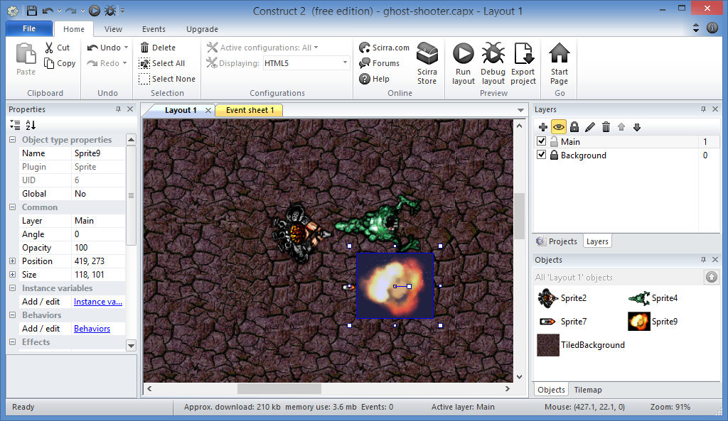
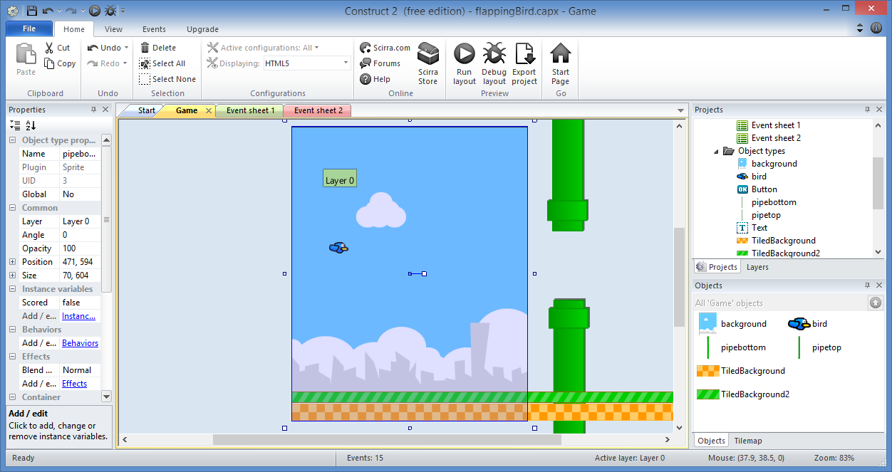
Prerequisites
Ghost Shooter Tutorial
Flapping Bird Tutorial
Both available at:
Construct 2 – Step by Step
http://wakeupandcode.com/construct-2-step-by-step/

Slide 3
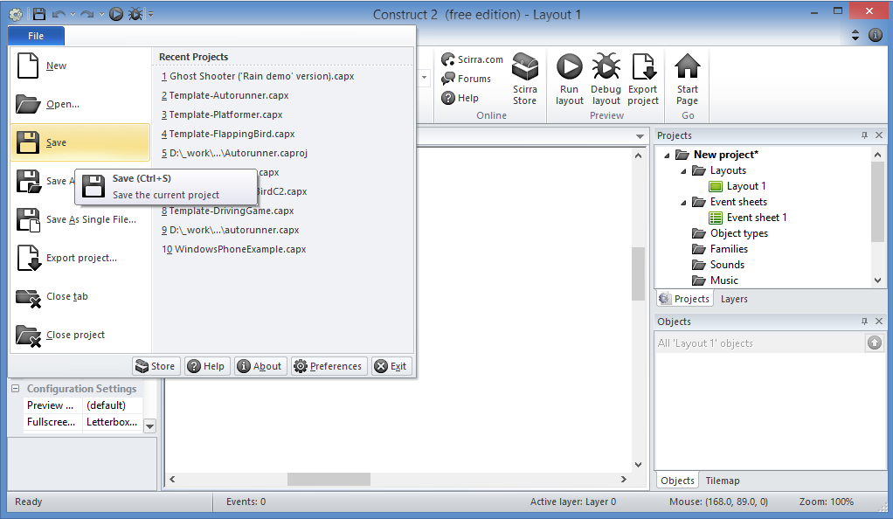
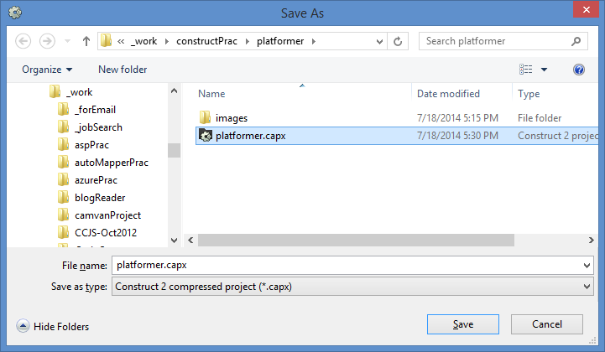
Step 1: Save a New Project, “platformer.capx”
Enter
File name
Save!

Slide 4
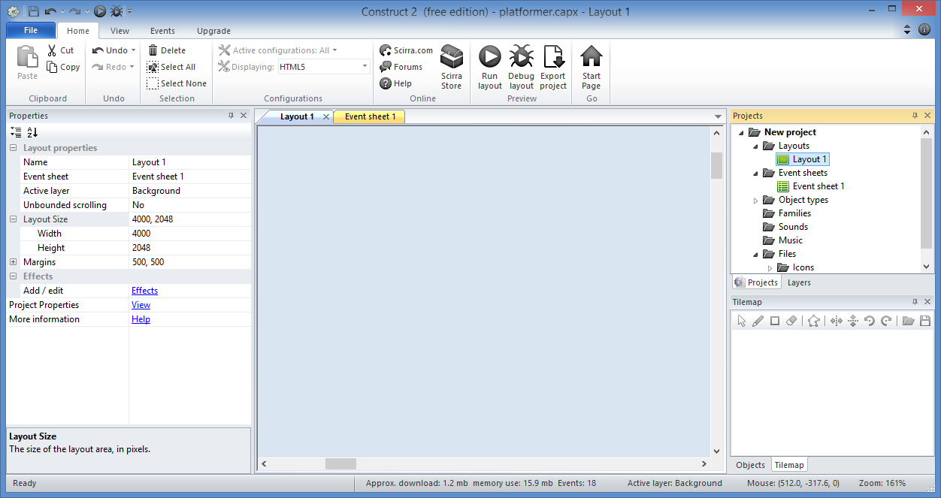
Step 2: Change Layout size
Layout Size
Width = 4000
Height = 2048

Slide 5
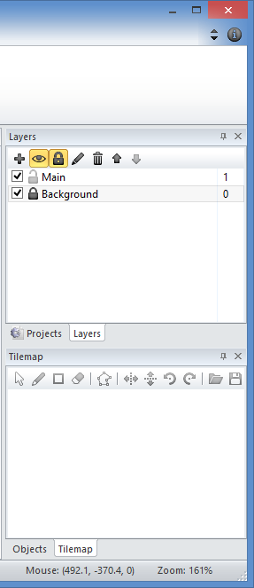
Step 3: Prepare Your Layers
Bottom layer
Rename it “Background”
Remember to Lock it later!
New layer
Add new layer
Rename it “Main”

Slide 6
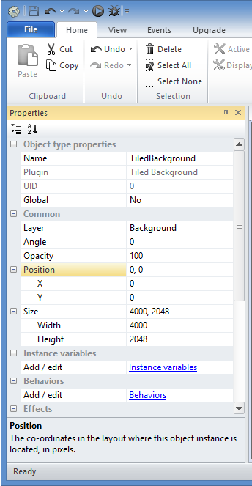
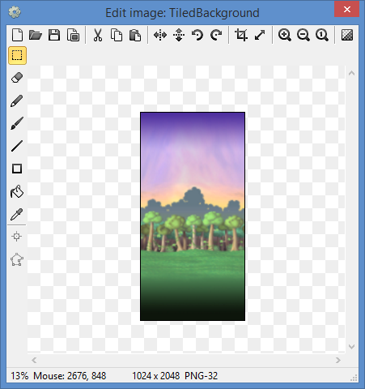
Step 4: Add Background, update properties
Update:
Name
Position
Size

Slide 7
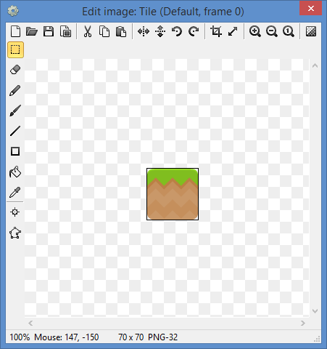
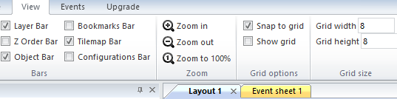
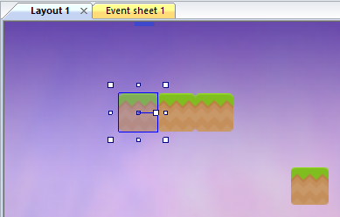
Step 5: Add New Sprite -> Tile
Tips:
Rename sprite object to “Tile”
Check “Snap to Grid”.
Ctrl-Click and Drag to create more.

Slide 8
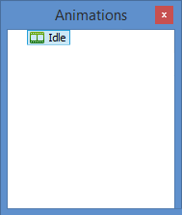
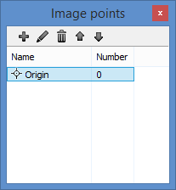
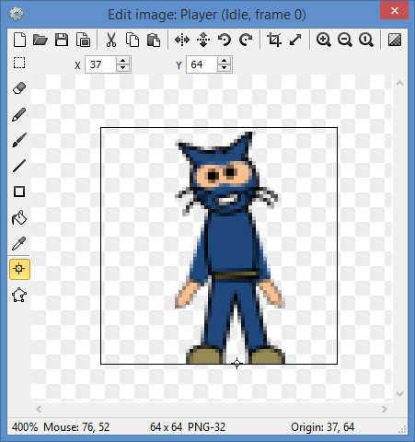
Step 6: Add New Sprite -> Player
Tips:
Rename sprite object to “Player”
Rename Default animation to “Idle”
Set origin to bottom center point

Slide 9
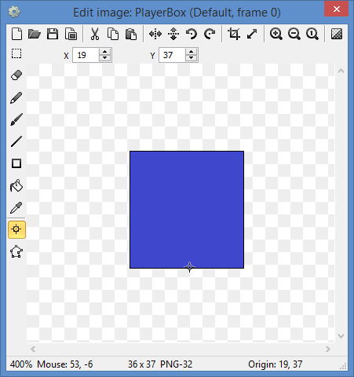
Step 7: Add New Sprite -> PlayerBox
Tips:
Rename sprite object to “PlayerBox”
Set origin to bottom center point

Slide 10
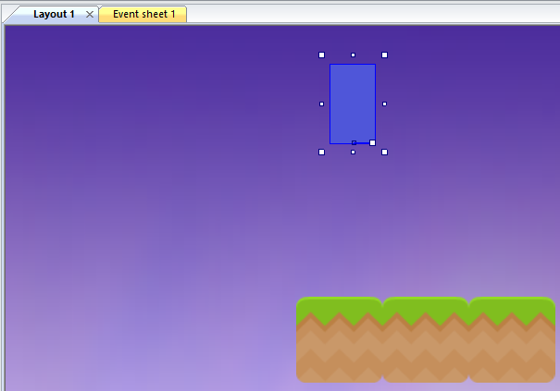
Step 8: Cover Player with PlayerBox
Tips:
Resize PlayerBox to match Player
Position PlayerBox over Player

Slide 11
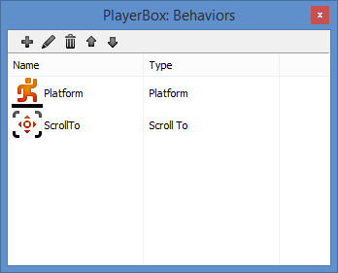
Step 9: Add Behaviors to PlayerBox
Add the following behaviors:
Platform
ScrollTo

Slide 12
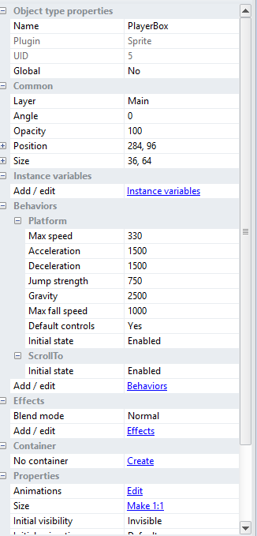
Step 10: Update PlayerBox Properties
Update the following for Platform:
Jump Strength = 750
Gravity = 2500
Also update:
Initial visibility = Invisible

Slide 13
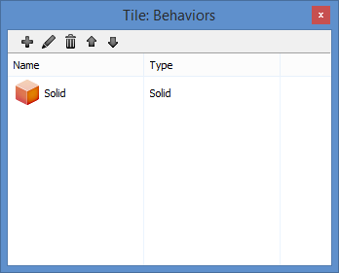
Step 11: Add Behaviors to Tile object
Add the following behaviors:
Solid

Slide 14
Step 12: Add Event for Player to follow Box
Add Event
Object: System
Condition: Every tick
Action:
Object: Player
Event: Set position to PlayerBox (image point 0)

Slide 15
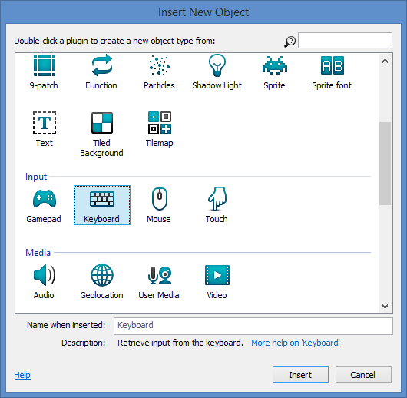
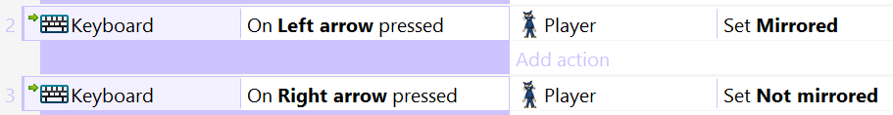
Step 13: Add Keyboard Support
Tips:
Insert New Object → Keyboard
Add 2 events for Left/Right

Slide 16
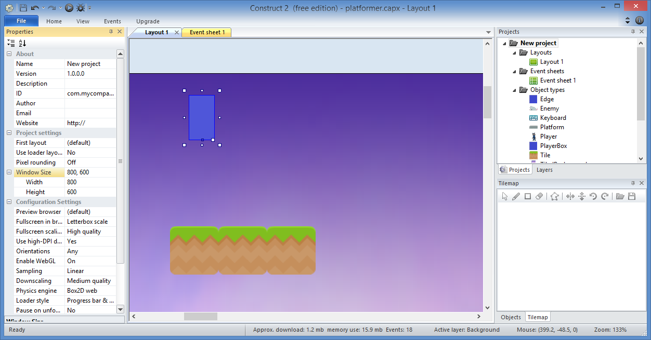
Step 14: Update Project Window Size
Tip: Set Window Size: 800, 600

Slide 17
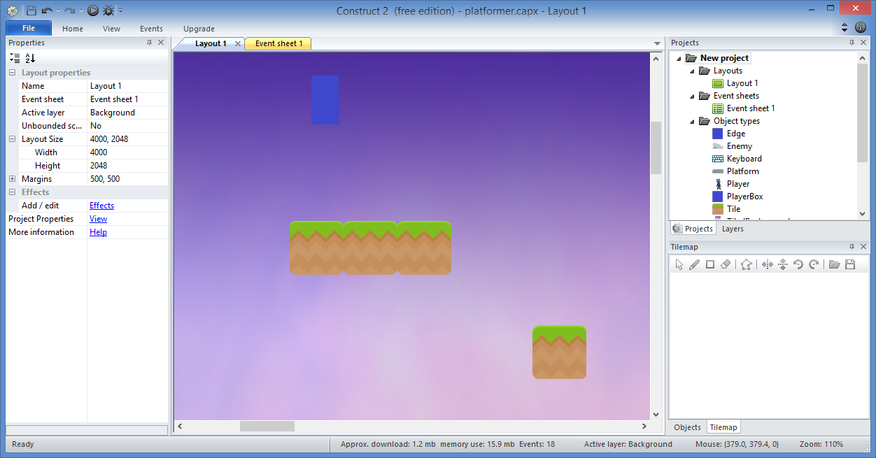
Step 15: Create More Tiles
Tip: Ctrl-Click and Drag to create more tiles

Slide 18
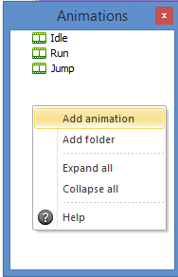
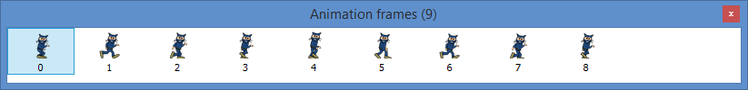
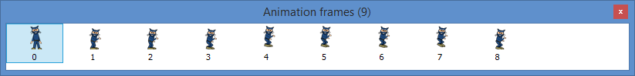
Step 16: Add Run and Jump Animations
Tips:
Right-Click Animations window to Add each animation
Import Sprite Strip as 4x4 for each
Remove empty frames
Clean up any stray pixels
Rename to “Run” and “Jump”, respectively
Set origin to bottom center point for all frames

Slide 19

Step 17: Add Events for Running and Stopping
Add Events
Object: PlayerBox
Condition: (Platform) On moved
Action:
Object: Player
Event: Set animation to “Run”
Add Events
Object: PlayerBox
Condition: (Platform) On stopped
Action:
Object: Player
Event: Set animation to “Idle”

Slide 20
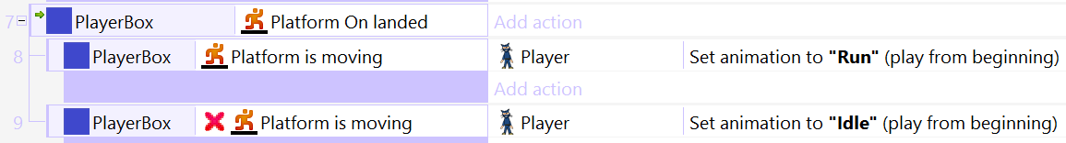
Step 18: Add Event for Jumping and Landing
Add Event
Object: PlayerBox
Condition: (Platform) On jump
Action:
Object: Player
Event: Set animation to “Jump”
Add Event with sub-events
Object: PlayerBox
Condition: (Platform) On landed
Sub-events: (see details below)

Slide 21
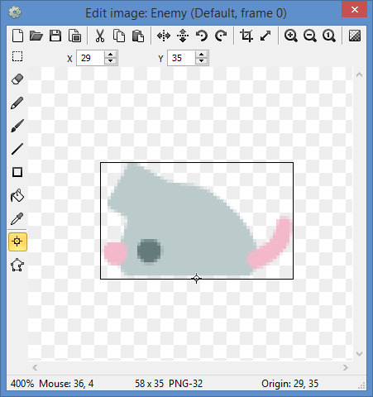
Step 19: Add New Sprite -> Enemy
Tips:
Rename sprite object to “Enemy”
Set origin to bottom center point

Slide 22
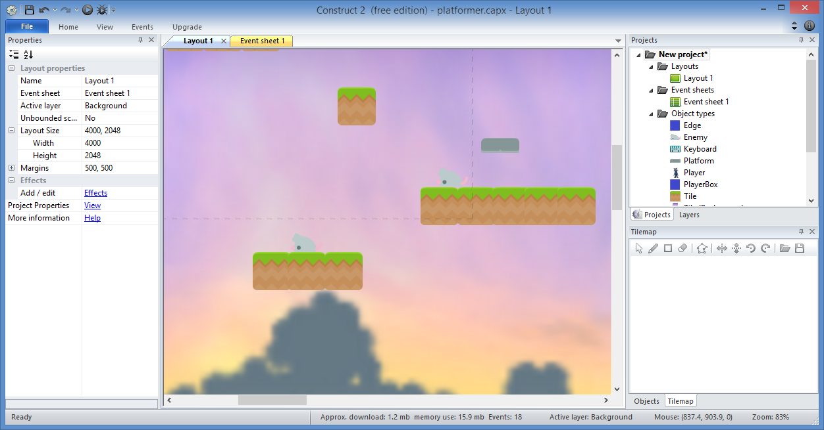
Step 20: Place enemies on blocks
Tip: Ctrl-Click and Drag to copy enemy

Slide 23
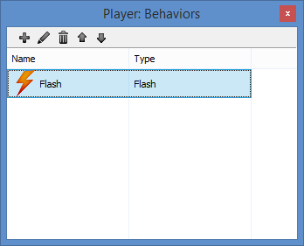
Step 21: Add Behaviors to Player object
Add the following behaviors:
Flash

Slide 24
Step 22: Add New Event for Collision
Add Event
Object: PlayerBox
Condition: On collision with another object → Enemy
Action:

Slide 25

Step 23: Add New Event for Collision
Add Sub-Event:
Object: PlayerBox
Condition: (Platform) is falling
Add another condition:
Object: PlayerBox
Condition: (Compare Y) < Enemy.Y
Add Actions:
Object: Enemy
Event: Destroy
Object: PlayerBox
Event: Set (Platform) vector Y
Value: -700

Slide 26
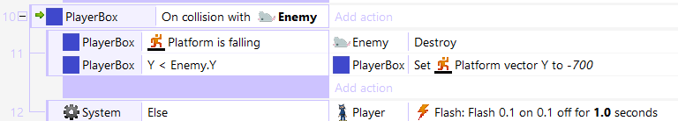
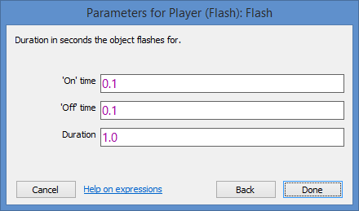
Step 24: Add Else for Collision
Add Else condition:
Object: System
Condition: Else
Action:
Object: Player
Action: Flash 0.1 on 0.1 off after 1.0 seconds

Slide 27
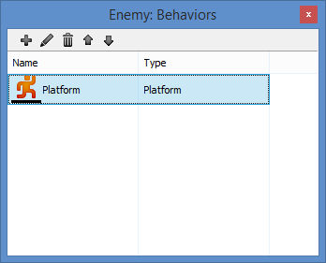
Step 25: Add Behaviors to Enemy
Add the following behaviors:
Platform

Slide 28
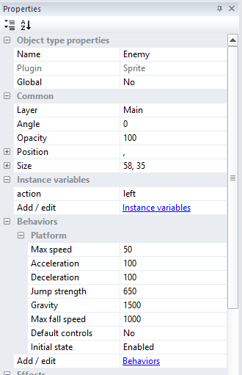
Step 26: Update Enemy Platform Behavior
Update the following:
Max Speed: 50
Acceleration: 100
Deceleration: 100
Default Controls: No

Slide 29
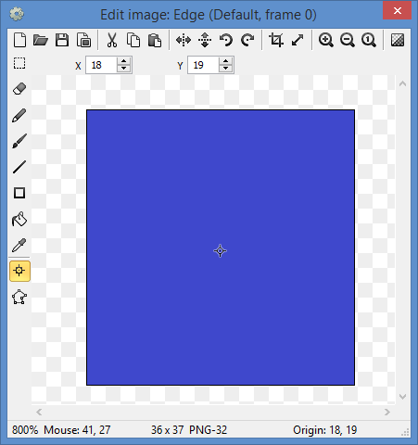
Step 27: Add New Sprite -> Edge
Tips:
Rename sprite object to “Edge”

Slide 30
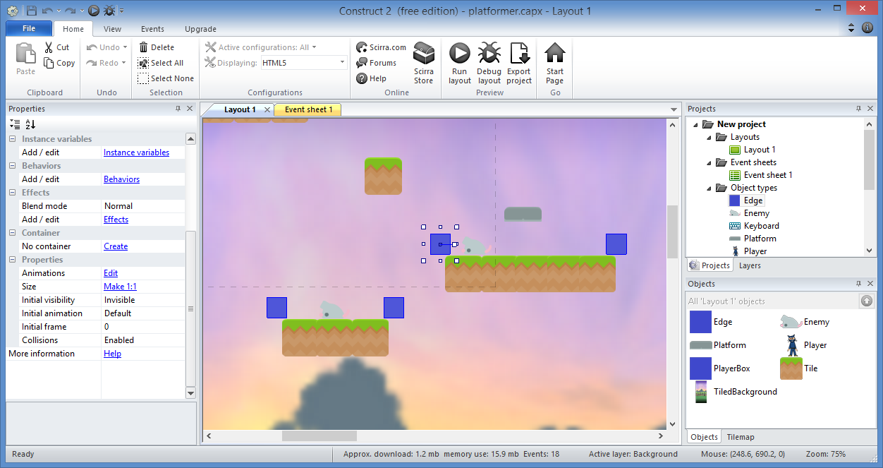
Step 28: Place along edges using Ctrl + Drag
Tip: Make the Edge object Invisible

Slide 31
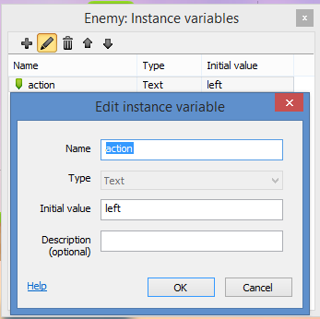
Step 29: Add New instance variable to Enemy
Instance Variable:
Name: action
Type: Text
Initial value: left
Description (optional)

Slide 32
Step 30: Create Event for “right” movement
Add Event:
Object: Enemy
Condition: (compare instance variable), action = “right”
Action:
Object: Enemy
Action: Simulate (platform) pressing Right
Object: Enemy
Action: Set Mirrored

Slide 33
Step 31: Create Event for “left” movement
Add Event:
Object: Enemy
Condition: (compare instance variable), action = “left”
Action:
Object: Enemy
Action: Simulate (platform) pressing Left
Object: Enemy
Action: Set Not mirrored

Slide 34
Step 32: Create Event for Edge collision
Add Event:
Object: Enemy
Condition: On collision with Edge
Action:

Slide 35

Step 33: Create Sub-Event with Actions
Add Sub-Event:
Object: Enemy
Condition: (compare instance variable), action = “right”
Action:
Object: Enemy
Action: (Set value) action to “left”

Slide 36
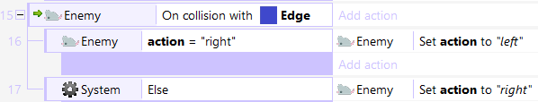
Step 34: Create Else Condition
Add Else Condition:
Object: System
Condition: Else
Action:
Object: Enemy
Action: (Set value) action to “right”

Slide 37
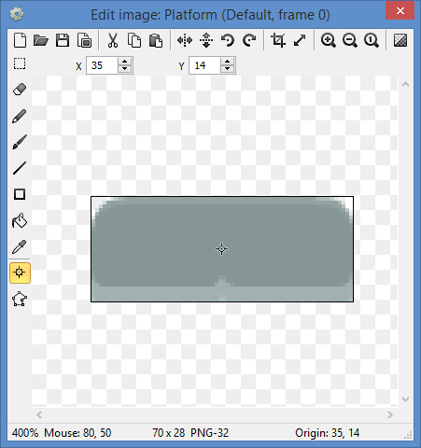
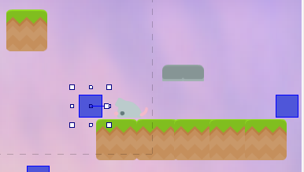
Step 35: Add New Sprite -> Platform
Tips:
Rename sprite object to “Platform”
Place it higher than a Tile.
Ctrl-Click and Drag to create more.

Slide 38
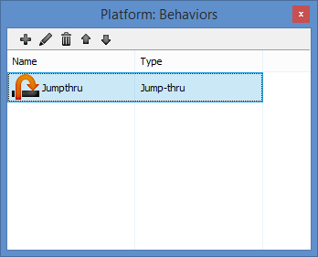
Step 36: Add Behavior to Platform
Add the following behaviors:
Jump-thru

Slide 39
Step 37: Add New Event for Player falling out
New Event
Object: Player
Condition: Is outside layout
Action:
Object: System
Action: Restart layout

Slide 40
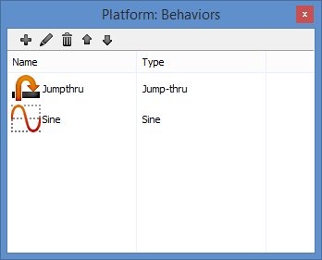
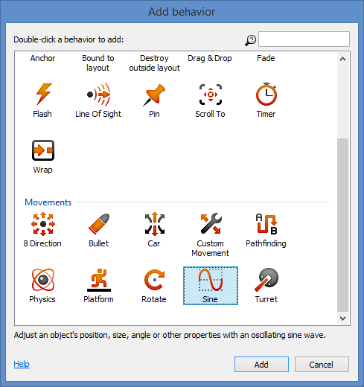
Step 38: Add Moving Platforms
Add Behavior
Sine

Slide 41
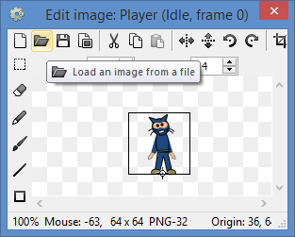
Step 39: Customize Graphics
Download Free Graphics
Free Bundle from Scirra:
http://www.scirra.com/freebundle.zip
Top-down shooter + zombies:
http://gfxpax.blogspot.com/2011/07/top-down-shooter-zombie-pack.html
Tiled Backgrounds, etc:
http://sandbox.yoyogames.com/make/resources

Slide 42
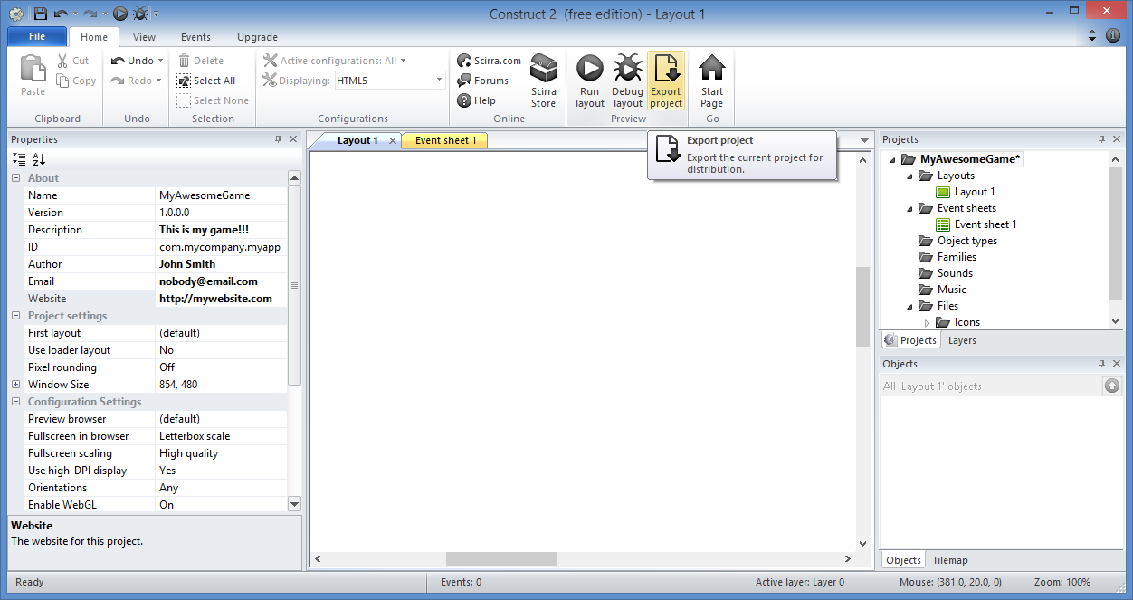
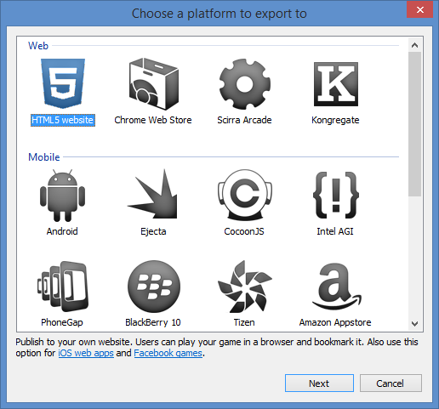
Step 40: Export to HTML5 Website
Export Project

Slide 43
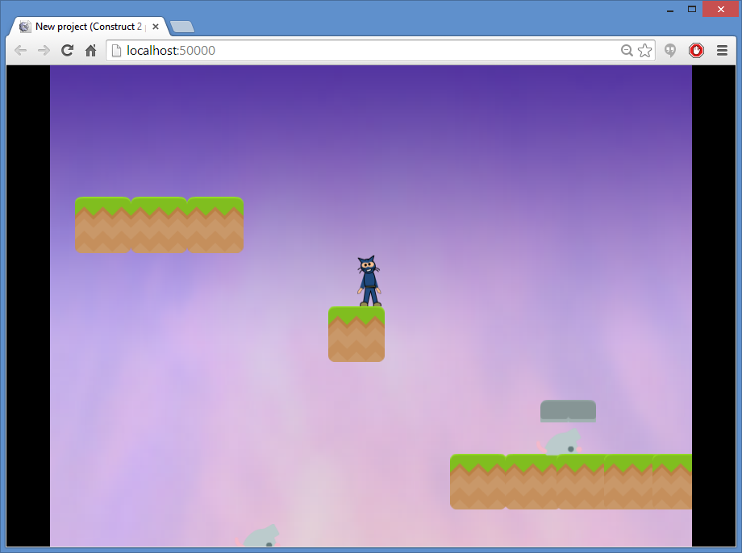
Play Your Game!!!

Slide 44
(END of Platformer tutorial)
Derived from ‘How to make a Platform game’ originally published by Ashley
Updated with different graphics and simplified animations

