Slide 1
STATE PMTCT CASCADE
FY2021
OCTOBER 2022

Slide 2
OUTLINE
Target Population Estimates
FY2021 Maternal Testing & Treatment
Quarterly Testing & Treatment
Testing Disaggregation
Treatment Disaggregation
2021 Population Estimates (CLHIV)
FY2021 Infant Testing & Treatment
Quarterly ARV Prophylaxis < / > 72h Post Partum
Quarterly Infant Testing (DBS) After Birth
HIV Outcome At 18 Months
Maternal Cascade Summary

Slide 3
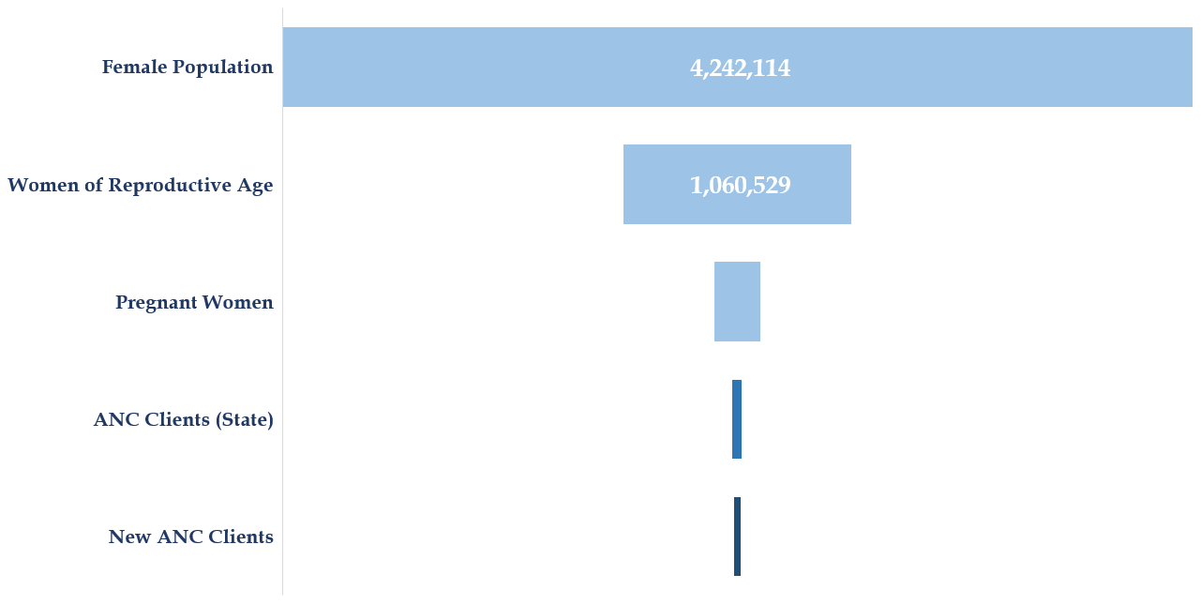
2021 POPULATION ESTIMATES
276,474
38,345
(13.9%)
25,305
(66%)

Slide 4
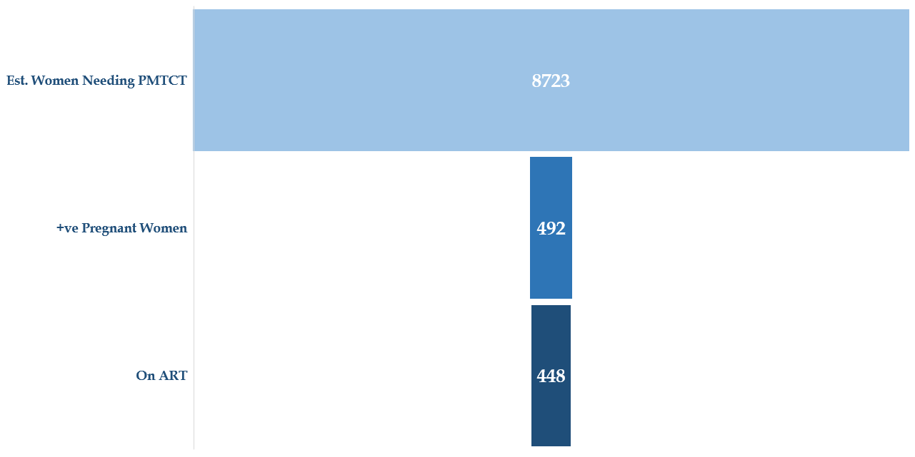
2021 POPULATION ESTIMATES
5.6%
5.1%
91.1%

Slide 5
FY2021 MATERNAL TESTING & TREATMENT

Slide 6
QUARTERLY TESTING & TREATMENT

Slide 7
TESTING -DISAGGREGATED

Slide 8
TREATMENT -DISAGGREGATED
114
125

Slide 9
2021 POPULATION ESTIMATES (CLHIV)
61.2%
53.1%

Slide 10
FY2021 INFANT TESTING & TREATMENT

Slide 11
QUARTERLY ARV PROPHYLAXIS < / > 72H POST PARTUM
1,243
(90) 6.8%
597

Slide 12
QUARTERLY INFANT TESTING (DBS) AFTER BIRTH
27 HIV+
46 HIV+

Slide 13
OUTCOME AT 18 MONTHS
17 HIV+

Slide 14
TESTING TREND

Slide 15
POSITIVITY TREND 2018-2021

Slide 16
INFANT CASCADE TREND

Slide 17
THE END

